Slide 1
AIR BORN PATHOGEN.
FUNGAL
BACTERIAL
VIRAL

Slide 2
Air born fungal disease.
Airborne fungi cause more crop diseases and damage to major crops – such Rising temperatures, they add, might increase the prevalence of fungal diseases, which are likely to extend to the Himalayan regions and the Western Ghats, where rare and important medicinal plants grow.
Microorganisms, spread as suspended particles in the air, are called bioaerosols. Airborne crop pathogens such as bacteria and viruses have been widely studied. The roles of fungi in crop diseases, however, remain largely unexplored. as rice, potato, tomato and ginger – than bacteria and viruses

Slide 3
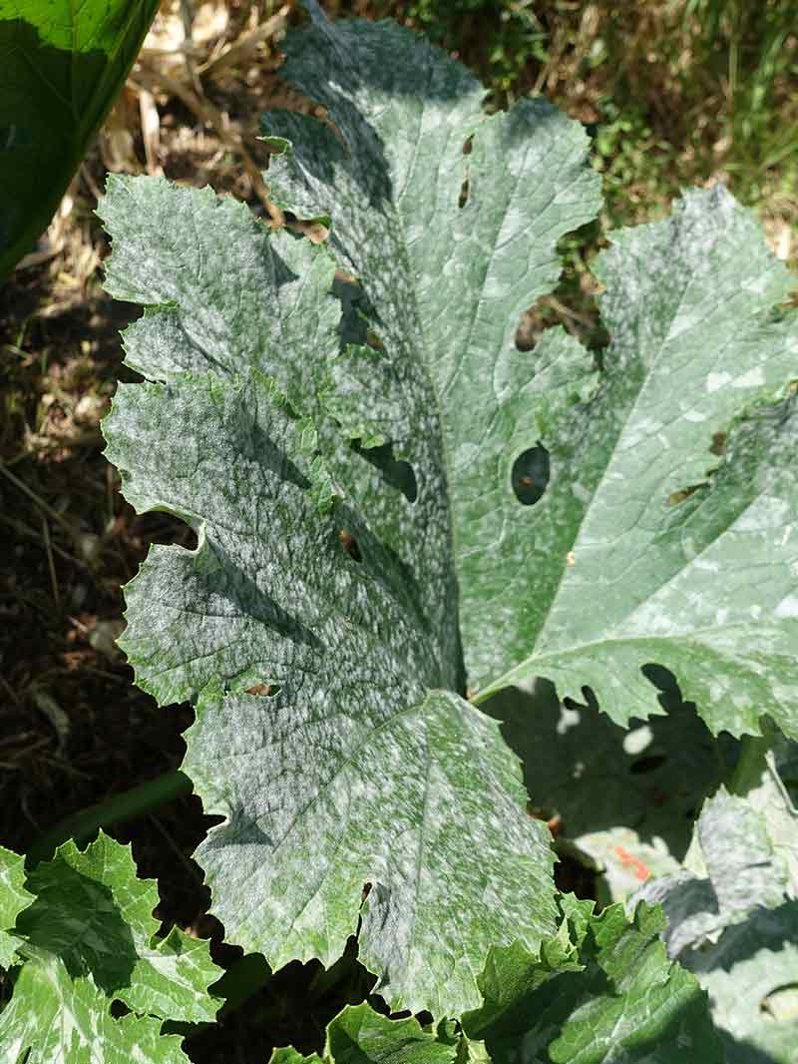
Powdery mildew: White, powdery growth on leaves, new shoots and other plant parts often signal powdery mildew has arrived.
Unlike many fungal diseases, powdery mildew does not need free water to develop and spread; it stays active even in dry, warm weather.
High humidity and poor air circulation encourage this wind-borne disease, which targets succulent new growth.

Slide 4
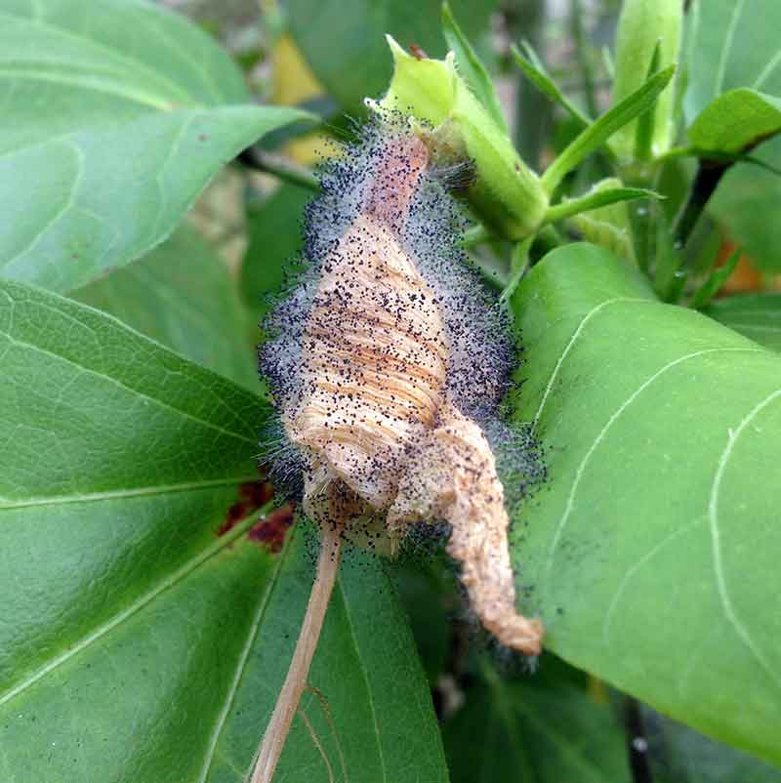
Botrytis blight: Once beautiful and vigorous flower petals and buds decay and rot, and show signs of fuzzy, gray mold with botrytis blight.
Pathogens behind this airborne disease attack during cool, damp spring and fall days.
High humidity, poor air circulation and overcrowding create prime botrytis blight conditions.

Slide 5
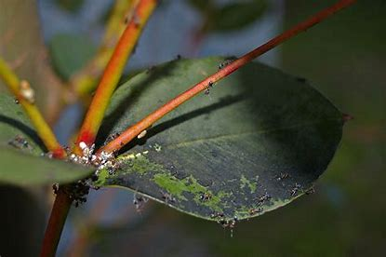
Sooty mold
is a collective term for different Ascomycete fungi, which includes many genera, commonly Cladosporium and Alternaria.
It grows on plants and their fruit, but also environmental objects, like fences, garden furniture, stones, even cars.
The mold benefits from either a sugary exudate produced by the plant or fruit, or if the plant is infested by honeydew-secreting insects or sap suckers. Sooty mold itself does little if any harm to the plant.
Treatment is indicated when the mold is combined with insect infestation.

Slide 6
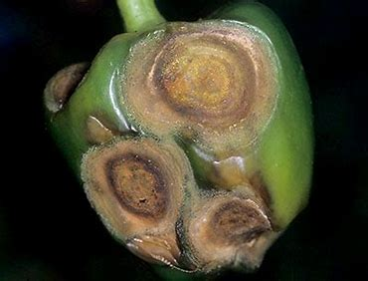
Anthracnose,
a group of fungal diseases that affect a variety of plants in warm, humid areas. Shade trees such as sycamore, ash, oak, and maple are especially susceptible, though the disease is found in a number of plants, including grasses and annuals.
Anthracnose causes the wilting, withering, and dying of tissues. It commonly infects the developing shoots and leaves. The causative fungi (usually Colletotrichum or Gloeosporium) characteristically produce spores in tiny, sunken, saucer-shaped fruiting bodies known as acervuli.
Symptoms include sunken spots or lesions (blight) of various colours in leaves, stems, fruits, or flowers, and some infections form cankers on twigs and branches.
The severity of the infection depends on both the causative agent and the infected species and can range from mere unsightliness to death.

Slide 7
Methods for sampling for airborn fungal spores
1.Tilak air sampler.
2.Culturable method.
3.Air sampling .
4.Culture media and growth condition.
5.Sarface samples.
6.Culturable fungi on surface samples.

Slide 8
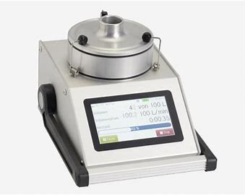
Tilak Air Sampler
Last Updated on Wed, 23 May 2018 | Pollen Grains It is a modified version of the Burkard sampler fabricated for Indian weather conditions by the outstanding Indian aerobiologist Professor S. T. Tilak.
Instead of a vacuum pump, an exhaust fan is provided on the top position of the sampler. The apparatus runs on electric power supply (AC - 220 V) and provides a continuous sampling of air for eight days.
The electric clock fitted in the instrument is synchronized with the drum. Air is sucked through the orifice of the projecting tube at the rate of 5 litres per minute and it impinges on the transparent cellotape, which is 1.5 cm in breadth and stuck on the slowly rotating drum.
The drum completes one circle in eight days, thus giving the trace of catches for eight days.

Slide 9
The tape should be coated with glycerine mixed with vaseline or petroleum jelly. The mounting of cellotape is done in glycerine jelly. Scanning is done by dividing the tape into eight sections, which are mounted on eight separate slides. The tape can be further divided into hourly intervals for microscopic examination
Fungi Culturable Method
The fungi culturable method normally involves preparation of culture, incubation, observation,and identification. For species identification, it is often necessary to use subculture or slide culture technique.
Culture preparation method varies among sample types Mature fungal colony was observed macroscopically and then prepared for microscopic
observation using either direct examination of a portion of the colony or adhesive tape technique.
Microscope examination was performed using a Phase Contrast Microscope with 150X – 1500Xmagnifications.

Slide 10
The microscope is regularly aligned and calibrated. Lacto-cotton blue, distilled and sterilewater, or sometimes, stain was used to prepare the microscopic slides.
Taxonomic references, especiallymonographs and peer-reviewed publications, were used to guide fungal identifications.
Fungi wereidentified to the taxonomic level (e.g., genus or species) requested by the client or to a characteristicgroup (e.g., yeasts, sterile mycelium), as allowed by the morphological characteristics present in the culture.
Fungal identification to species level is highly complicated and requires education, experienceand use of taxonomic references. Identification characteristics vary greatly according to genus.
Isolation,culture and identification methods in selected reliable references are followed, including those included in Klich (2002) for Aspergillus; Pitt (2000) for Penicillium

Slide 11
Air samples
Air sampling, for example, using Anderson N6 sampler, has the advantage of providingvolumetric data.
A Petri dish containing culture medium was used to capture aerosols, biological or nonbiological, as a measured volume of air is pulled in.
The Petri dish with the sample was then incubated after received by the laboratory. Fungal spores and hyphal fragments (together called propagules) that germinated and grew on the culture medium were identified and counted as CFU (=Colony FormingUnits).
By factoring in the air volume sample, this sampling analysis generated quantitative data onviable and culturable fungi. Laboratory Limit of Detection (LOD) is determined to be one CFU.

Slide 12
Culture media and growth condition
Two media, MEA and DG18, were used routinely, and if necessary, a third media such as
cellulose agar was also used to bring out certain fungi. Malt extract agar (MEA) is a wide spectrummedium for recovering many fungi, Dichloran glycerol agar (DG18) is for xerophilic saprotrophic fungi,and cellulose agar is for cellulotic fungi, such as Stachybotrys. Another medium, CYA, may be used for
identification of Aspergillus and Penicillium species as specified in standard reference methods.
Fungal cultures were normally incubated at 25°C and for 7 days before identification wereattempted.
Higher incubation temperature (35°C) may be adapted to aid identification of thermophilic fungi, such as Aspergillus fumigatus. Longer incubation time is needed to induce fungal sporulation or if subculturing was performed.

Slide 13
Surface Samples –
Bulk, Culture (e.g., contact plate), Dust, Swab (Method ID: Aemtek SOP AF104)Surface sampling is primarily used to detect mold growth or confirm the existence of mold colonies at the sampling site. Surface sampling is also occasionally used to obtain spore distribution datato determine if mold is growing indoors, but in a different site.
An initial check was performed to evaluate the condition of the sample and to determine the recovery strategies. Direct plating was performed for samples with low count in addition to serial dilution plating.
Serial dilution method was used to obtain propagule suspension series after the samplewas washed thoroughly with sterile and distilled water.
A measured volume from each propagulesuspension was poured and spread onto a pre-selected culture medium and subsequently incubated to obtain fungal colonies suitable for identification.
Plates with optimal number of countable colonies were selected for further analysis. Sample weight or area sampled, concentration of propagule suspension, and number of CFU were used to calculate final concentration of CFU.

Slide 14
Culturable fungi on surface samples
The primary purpose of surface sampling is to detect mold growth at the sampling site or a nearby area.
When interpreting report, one should pay attention the presence of unusually large number,or presence of moisture indicator fungi, such as Alternaria, Chaetomium, Memnoniella, Stachybotrys,Ulocladium, etc.
As in air samples, fungi culturable method only detects fungi that grow on the specified culture media and growth conditions, such it is highly possible that underestimation occurs.

Slide 15
Viable, culturable, and total fungi
Viable and culturable refer to different groups, i.e., viable organisms may not be culturable on the
culture medium or growth condition specified. In contrast to air sampling of total fungal spores, air
sampler impacting aerosols on culture medium provide information on culturable propagules only,
which are a portion of viable fungi and an even smaller portion of total fungi. Sampling of culturable
fungi can greatly underestimate the total propagule numbers due to several factors: 1) viable but nonculturable microorganisms, such as obligate parasites that cannot grow on media, 2) decline in fungal
spore viability, 3) culture medium selection, 4) competition among microorganisms, 5) difference in
growth rate of fungi, 6) damage to the propagules during sampling, 7) growth conditions, and 8) samplerperformance.

Slide 16
Application
Forecasting of plant diseases.
Knowledge of epidemiology
Host,parasite ,weather interaction study
Give information to farmers.
To check disease incidence
Study of aeospora
Seasonal variation of pathogens.

Slide 17
Thank you

