Slide 1
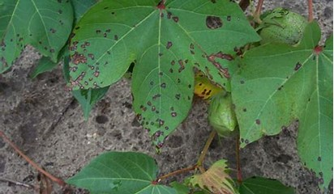
Angular leaf spot of cotton

Slide 2
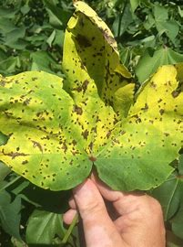
The angular appearance of lesions is due to restriction of the lesion by fine veins of the cotton leaf, and bacteria may spread along the leaf veins causing blackened lesions along major veins.
Leaf petioles and stems may also become infected (cotton black leg) which can lead to premature defoliation of the plant.
➢Angular leaf spot of cotton (bacterial blight) is found in all the major cotton-producing areas of the world.
➢ However, it remains a potentially important disease because of the variability of the pathogen and the appearance of new races.
➢The main cause of yield loss is the blackarm symptom, which results from the loss of the fruiting branches.

Slide 3
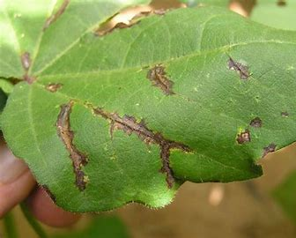
Symptoms
➢The most common and conspicuous symptom is angular leaf spot which begins with dark-green, water-soaked spots, initially more clearly visible on the underside of the leaf lamina; the spots are angular in shape, being delimited by the smaller veins.
➢ Older spots become dark-brown or black and are visible on the upper surface of the leaves.
The angular spots may be few in number in more resistant host material but, on susceptible cultivars, they can cover much of the leaf, causing chlorosis, followed by necrosis and distortion of the lamina.
➢Similar spots may be found on the cotyledons of young seedlings where infection occurs from the soil or seed during germination and emergence.

Slide 4
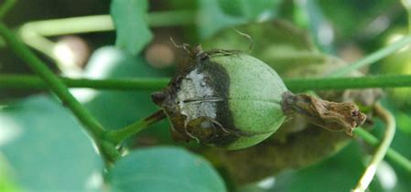
Under favorable conditions, infection may spread from the seedling cotyledon or the leaf onto the petiole and then to the main stem, leading to seedling mortality in susceptible cultivars.
➢In older plants, the lesions can girdle the main branches causing them to break, with the loss of leaves and fruiting branches.
This phase of the bacterial blight syndrome is known as black arm because of the blackened appearance of the affected petioles and branches.
➢Sometimes infection on the leaf occurs as water-soaked tissue, which later turns black, on either side of the main veins.
This is referred to as vein blight and can occur together with, or occasionally in the absence of, angular leaf spot.

Slide 5
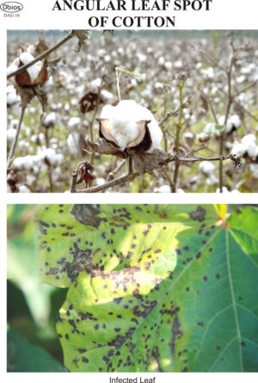
Symptoms:
The disease appears on different parts of cotton plant, both in seedling and mature plant stage.
The disease first appears on leaves, which appear water soaked, turn black and dry up often leaving the young seedling green with a black tip. Most of such plants die.
In less severely affected plants, points on leaves and stem become water soaked and enlarge into angular reddish spots about 1 mm in diameter.
The spots often coalesce and the leaf gradually yellows and drops. Lesions on young stems sometimes cause girdling and referred to as black arm.
In older stems the spots may be callused off and leave open cankers.
Yellowish bacterial exudate is common on lesions, in moist weather.
On bolls, water soaked lesions appear,
which coalesce to form irregular, large, brown, sunken areas.
Bolls infected when young, may drop prematurely.
Older bolls when infected may become
distorted and the lint may be discolored.

Slide 6
In older plants, water-soaked lesions can occur on the bracts of the epicalyx and more commonly on the developing boll.
➢ Bacterial boll rot begins as roughly spherical water-soaked spots on the boll surface which can expand to >1 cm in diameter on susceptible cultivars, becoming black as they age and penetrating the boll cortex to cause internal boll rot.
➢The blight bacterium can also be introduced into the young boll during feeding on the seed by the cotton stainer (Dysdercus spp.).
This causes the lint to become stained yellow or brown and sometimes leads to internal boll rot.
List of symptoms/signs 1. Fruit - lesions: black or brown 2. Fruit - lesions: scab or pitting 3. Leaves - abnormal colors 4. Leaves - abnormal forms 5. Leaves - abnormal patterns 6. Leaves - necrotic areas 7. Stems - discoloration of bark
Epidimiology: High humidity and moderate temperature (28 °C) favours the development of the disease. Primary infection is favoured by 30 °C and secondary infection is better at 35 °C. presence of moisture is very important for the first 48 hours. Dry and hot weather retards disease development

Slide 7
Causal organism Xanthomonas axonopodis pv. malvacearum  A Gram negative, motile
rod-shaped, non spore-forming bacterium with a single polar flagellum.
Scientific classification Kingdom: Bacteria
Phylum: Proteobacteria
Class: Gammaproteobacteria
Order: Xanthomonadales
Family: Xanthomonadaceae
Genus: Xanthomonas
Species: axonopodis

Slide 10
Control:
Cultural and Sanitary Methods Crop rotation Deep ploughing Soil sanitization Seed treatment with 2gms of carbendizam per kg of seed. Use infection free and certified seeds.
late sowing, early thinning, good tillage, early irrigation and addition of potash to the soil minimize the disease.
Destroy the infected-plant debris.
. Chemical and Antibiotic control ➢As it occurs in months of September and November, 100 mg of tetracycline, streptomycin sulphate, plantamycin, poshamycin; should be sprayed for 3 or 4 times in every 15 days gap.
➢Chemicals linked with copper should be sprayed at their recommendation of 3gm per litre of water to reduce the disese.
➢Acid delinting followed by seed dressing with carbendazim @3-4g/kg of seed eliminates seed borne inoculum.
➢Foliar spray of combination of Poshamycin/Plantomycin 100 mg + 3 gms of Copper Oxychloride per lit of water for 3 or 4 rounds at 15 days interval from the time of disease appearance.

Slide 11
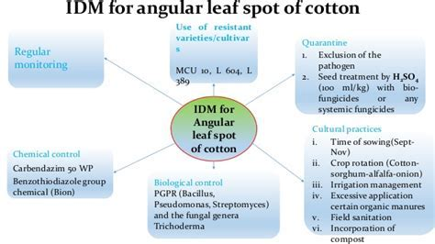
Control:
Use of healthy seed from healthy plants.
Delinting seeds with concentrated sulphuric acid then floating the delinted seeds in water and removal of the floating seeds.
Disinfections of seeds with 1000 ppm streptomycin sulphate solution overnight.
Destruction of diseased plant debris, and
Killing of volunteer seedlings.

Slide 12
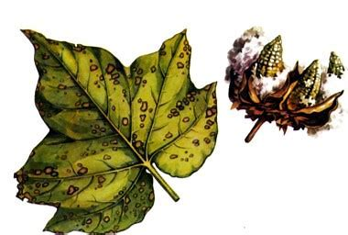
Thank you…

