Slide 1
Bryophyta: Features, Classification
The division Bryophyta (Gr. bryon=moss) includes over 25000 species of non-vascular embryophytes such as mosses, liverworts and hornworts.
Bryophytes are small plants (2cm to 60cm) that grow in moist shady places. They don’t attain great heights because of absence of roots, vascular tissues, mechanical tissues and cuticle. They are terrestrial but require external water to complete their life cycle.
Hence, they are called “Amphibians of plant kingdom”.
The fossil record indicates that bryophytes evolved on earth about 395 – 430 million years ago (i.e. during Silurian period of Paleozoic era). The study of bryophytes is called bryology. Hedwig is called ‘Father of Bryology’. Shiv Ram Kashyap is the ‘Father of Indian Bryology’.

Slide 2
General characteristics of Bryophytes:
1. Bryophytes grow in damp and shady places.
2. They follow heterologous haplodiplobiontic type of life cycle.
3. The dominant plant body is gametophyte on which sporophyte is semiparasitic for its nutrition.
4. The thalloid gametophyte differentiated in to rhizoids, axis (stem) and leaves.
5. Vascular tissues (xylem and phloem) absent.
6. The gametophyte bears multi-cellular and jacketed sex organs (antheridia and archegonia).
7. Sexual reproduction is oogamous type.
8. Multi-cellular embryo develops inside archegonium.
9. Sporophyte differentiated into foot, seta and capsule.
10. Capsule produces haploid meiospores of similar types (homosporous).

Slide 3
11. Spore germinates into juvenile gametophyte called protonema.
12. Progressive sterilization of sporogenous tissue noticed from lower to higher bryophytes.
13. Bryophytes are classified under three classes: Hepaticae (Liverworts), Anthocerotae (Hornworts) and Musci (Mosses)

Slide 4
Classification of Bryophytes:
According to the latest recommendations of ICBN (International Code of Botanical Nomenclature), bryophytes have been divided into three classes.
1. Hepaticae ( Hepaticopsida = Liverworts)
2. Anthocerotae (Anthocertopsida= Hornworts)
3. Musci (Bryopsida= Mosses)

Slide 5
Class 1. Hepaticae or Hepaticopsida:
1. Gametophytic plant body is either thalloid or foliose. If foliose, the lateral appendages (leaves) are without mid-rib. Always dorsiventral.
2. Rhizoids without septa.
3. Each cell in the thallus contains many chloroplasts; the chloroplasts are without pyrenoi.
4. Sex organs are embedded in the dorsal surface.
5. Sporophyte may be simple (e.g., Riccia) having only a capsule, or differentiated into root, seta and capsule (e.g., Marchantia, Pallia and Porella etc.)
6. Capsule lacks columella.
7. It has 4 orders:
(i) Calobryales
(ii) Jungermanniales
(iii) Spherocarpales
(iv) Marchantiales.

Slide 6
Class 2. Anthocerotae or Anthocerotopsid:
1. Gametophytic plant body is simple, thalloid; thallus dorsiventra without air cambers, shows no internal differentiation of tissues.
2. Scales are absent in the thallus.
3. Each cell of the thallus possesses a single large chloroplast with a pyrenoid.
4. Sporophyte is cylindrical only partly dependent upon gametophyte for its nourishment. It is differentiated into bulbous foot and cylindrical capsule. Seta is meristematic.
Endothecium forms the sterile central column (i.e., columella) in the capsule (i.e. columella is present).
6. It has only one order-Anthocerotales.

Slide 7
Class 3. Musci or Bryopsida:
1. Gametophyte is differentiated into prostrate protonema and an erect gametophores
2. Gametophore is foliose, differentiated into an axis (=stem) and lateral appendages like leaves but without midrib.
3. Rhizoids multi-cellular with oblique septa.
4. Elaters are absent in the capsule of sporangium.
5. The sex organs are produced in separate branches immersed in a group of leaves.
6. It has only three orders:
(i) Bryales,
(ii) Andriales and
(iii) Sphagnales.

Slide 8
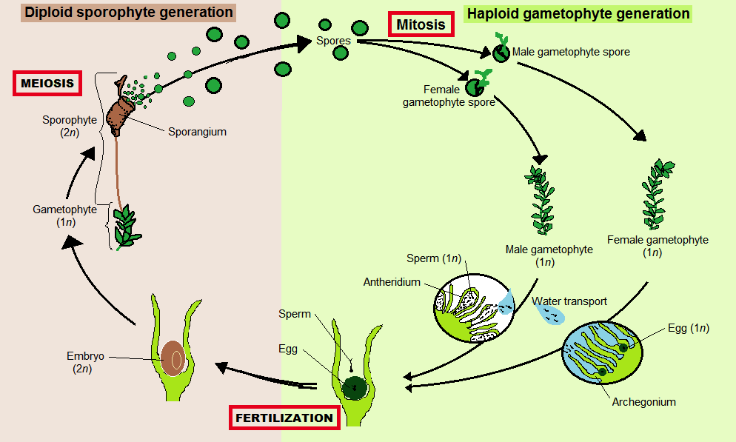

Slide 9
Hepaticopsida
▪ About 280 genera and approximately 9,500 spp.
▪ Popularly called liverworts.
▪ Gametophyte either a thallose or foliose.
▪ Internal differentiation into photosynthetic and
storage regions.
▪ Photosynthetic cells with numerous chloroplasts
but without pyrenoids.
▪ Rhizoids both smooth walled and tuberculated.
▪ Sex organs develop from single initial cell.
▪ Sporogonium simple/with a foot and
capsule/with a foot, seta and capsule.
▪ Archesporium develops from endothecium of the
embryo.
▪ Sporogenous tissue differentiates into spore mother cells
and elaters (absent in Riccia).
▪ Elaters single celled with spirally thickened walls.
▪ Capsule lacks columella.
▪ Capsule splits along preformed lines of weakness.
▪ Gametophyte a prostrate, dorsiventral dichotomously
branched thallus.
▪ Well marked specialization of tissues with ventral
storage and dorsal photosynthetic regions having air
chambers and air pores.
▪ Scales and rhizoids (smooth walled and tuberculated)
present on ventral surface of thallus.
▪ Sex organs either scattered along the midrib or grouped
in receptacles on vertical stalks antheridiophores and
archegoniophores.
▪ Capsule wall 1-layered.
▪ Capsule never opens by 4-regular valves.
▪ Consists of about 35 genera and about 420 spp.

Slide 10
Divided into four orders (Cavers, 1910, Campbell, 1936).
i. Sphaerocarpales
Marchantiales
Jaungermanniales
iv. Calobryales.

Slide 11
Marchantia
Kingdom Plantae – Plants
Division Hepaticophyta – Liverworts
Subdivision Hepaticae
Class Hepaticopsida
Subclass Marchantiae
Order Marchantiales
Family Marchantiaceae
Genus Marchantia L. P
Marchantiales is an order of thallose liverworts that includes species like Marchantia polymorpha, a widespread plant often found beside rivers, and Lunularia cruciata, a common and often troublesome weed in moist, temperate gardens and greenhouses.

Slide 12
Five families :
▪ Family 1. Ricciaceae :
• Sporophyte consist solely of a capsule.
• There are 03 genera and some 140 .
• Oxymitra (Tesselina), Ricciocarpus and Riccia.
▪ Family 2. Corsiniaceae:
• Sporophyte with a capsule and foot.
• Of 03 genera, Corsinia is the best known.
▪ Family 3. Targionaceae:
• Female receptacle enclosed by a sheath (involucre)
developed from tissues lateral to it.
• 03 genera : Targionia, Cyathodium and Aitchinsoniella
▪ Family4. Marchantiaceae :
• Sporophyte with a foot, seta and capsule having typical
sterile cells , the elaters, inside the capsules.
• There are 23 genera and some 250 spp .
• Marchantia, plagiochasma, Conocephalum, Dumortiera.
▪ Family 5. Monocleaceae:
• Presence of unique hood-like sheath posterior to the
female receptacle.
• Elongate capsule also of different shape from other
families of Marchantiales.
• Single Genus Monoclea.

Slide 13
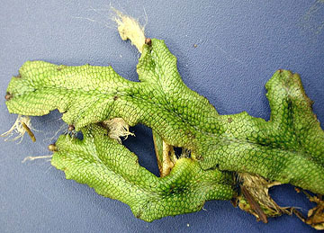
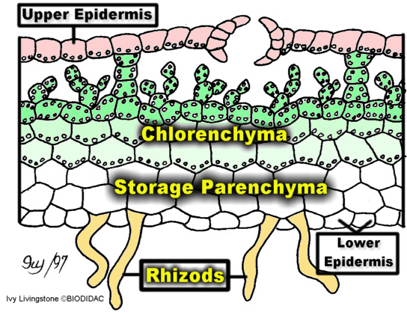
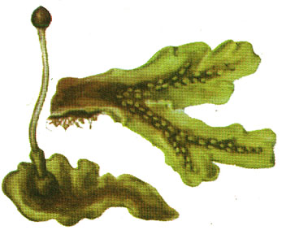
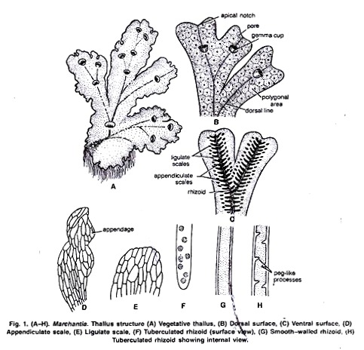

Slide 14
Distribution and Habitat of Marchantia:
Marchantia, the most important genus of family Marchantiaceae is represented by about 65 species. The name Marchantia was given in honour of Nicolas Merchant, director of botanical garden of Gaston d’ Orleans in Blois, France.
All species are terrestrial and cosmopolitan in distribution. The species prefer to grow in moist and shady places like wet open woodlands, banks of streams, wood rocks or on shaded stub rocks. These grow best after the forest fire in the burnt soil. It is perhaps because of nitrification of soil due to fire

Slide 15
These species are commonly found growing’ in the Himalayan region at an altitude of 4000-8000 feet. Eastern Himalayan region particularly supports the growth of these species.
Some species are also found growing in plains of Haryana, Punjab, Uttar Pradesh and hilly regions of South India.
Some of the common Indian species are M. palmata, M. polymorpha, M. simlana etc. M. polymorpha is most widely distributed species. M. polymorpha var aquatic grows submerged in swampy meadows. The thalli with gemma cups are found throughout the year whereas the thalli with sex organs occur abundantly during February to March in Himalayas and October to November in hills of South India.

Slide 16
Gametophytic Phase of Marchantia:
External Features of Gametophyte:
The plant body is gametophytic, thalloid, flat, prostrate, plagiotropic, 2-10 cm. long and dichotomously branched Dorsal surface:
Dorsal surface is dark green. It has a conspicuous midrib and a number of polygonal areas called areolae. The midrib is marked on the dorsal surface by a shallow groove and on the ventral surface by a low ridge. Each polygonal area re-presents the underlying air chamber.
The boundaries of these areas represent the walls that separate each air chamber from the next. Each air chamber has a central pore. The midrib ends in a depression at the apical region forming an apical notch in which growing point is situated
Dorsal surface also bears the vegetative and sexual reproductive structures. The vegetative reproductive structures are gemma cup and develop along the midrib. These are crescent shaped with spiny or fimbriate margins and are about one eighth of a inch in diameter

Slide 17
Sexual reproductive structures are borne on special Stalked structures called gametophores or gamatangiophores. The gametophores bearing archegonia are called archegoniophores and that bearing antheridia are called antheridiophores
Ventral surface:
The ventral surface of the thallus bears scales and rhizoids along the midrib. Scales are violet coloured, multicellular, one cell thick and arranged in 2-4 rows (Fig. 1 C). Scales are of two types:
(i) Simple or ligulate
(ii) Appendiculate.
Appendiculate (Fig- 1 C, D) scales form the inner row of the scales close with midrib. Ligulate scales form the outer or marginal row and are smaller than the appendiculate scales
Rhizoids are unicellular, branched and develop as prolongation of the lower epidermal cells. They are of two types:
(i) Smooth-walled rhizoids,
(ii) Tuberculate rhizoids.
In smooth-walled rhizoids both the inner and outer wall layers are fully stretched while in tuber-culate rhizoids appear like circular dots in surface view (Fig. 1 F). The inner wall layer modifies into peg like in growth which projects into the cell lumen (Fig. 1 H). The main functions of the rhizoids are to anchor the thallus on the substratum and to absorb water and mineral nutrients from the soil.

Slide 18
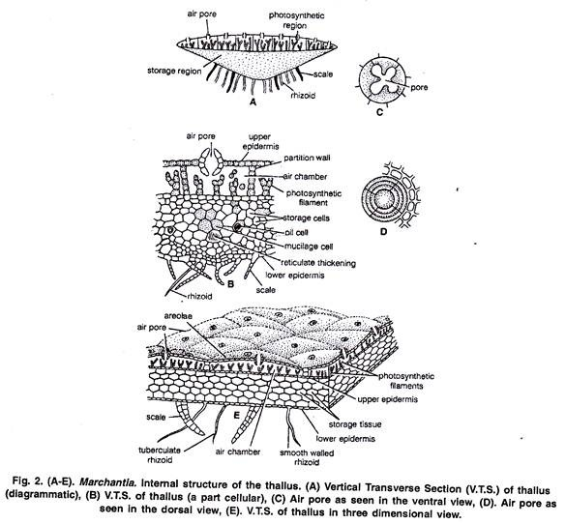
Anatomy of the Gametophyte:
A vertical cross section of the thallus can be differentiated photosynthetic zone and lower storage zone

Slide 19
Upper Photosynthetic zone:
The outermost layer is upper epidermis. Its cells are thin walled square, compactly arranged and contain few chloroplasts. Its continuity is broken by the presence of many barrel shaped air pores. Each pore is surrounded by four to eight superimposed tiers of concentric rings. with three to four cells in each tier
Air pores are compound in nature. The lower tier consists of four cells which project in the pore and the opening of the pore looks star like in the surface view The walls of the air pore lie half below and half above the upper epidermis
Just below the upper epidermis photosynthetic chambers are present in a horizontal layer Each air pore opens inside the air chamber and helps in exchange of gases during photosynthesis.
These are chambers develop schizogenously (Vocalized separation of cells to form a cavity) and are separated from each other by single layered partition walls. The partition walls are two to four cells in height. Cells contain chloroplast. Many simple or branched photosynthetic filaments arise from the base of the air chambers
Storage zone:
It lies below the air chambers. It is more thickened in the centre and gradually tapers towards the margins. It consists of several lasers of compactly arranged, thin walled parenchymatous isodiametric cells. Intercellular spaces are absent.
The cells of this zone contain starch. Some cells contain a single large oil body or filled with mucilage. The cells of the midrib region possess reticulate thickenings. The lower most cell layer of the zone forms the lower epidermis. Some cells of the middle layer of lower epidermis extend to form both types of scales and rhizoids

Slide 20
Reproduction in Marchantia:
Marchantia reproduces by vegetative and sexual methods.
Vegetative Reproduction:
In Marchantia it is quite common and takes place by the following methods:
1. By Gemmae:
Gemmae are produced in the gemma cups which are found on the dorsal surface of the thallus (Fig. 3 A). Gemma cups are crescent shaped, 3 m.m. in diameter with smooth, spiny or fimbriate margins (Fig. 3 B).
V. S. passing through the gemma cup shows that it is well differentiated into two regions:
Upper photosynthetic region and inner storage region (Fig. 3 D).
The structure of both the zones is similar to that of the thallus. Mature gemmae are found to be attached at the base of the gemma cup by a single celled stalk.
Intermingled with gemmae are many mucilage hairs. Each gemma is autotrophic, multicellular, bilaterally symmetrical, thick in the centre and thin at the apex. It consists parenchymatous cells, oil cells and rhizoidal cells. It is notched on two sides in which lies the growing point

Slide 21
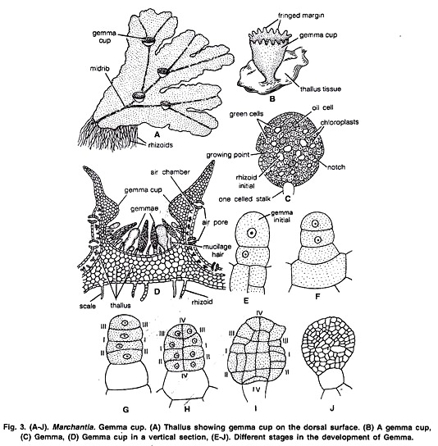
All cells of the gemma contain chloroplast except rhizoidal cells and oil cells. Rhizoidal cells are colourless and large in size. Oil cells are present just within the margins and contain oil bodies instead of chloroplast.

Slide 22
Dissemination of Gemmae:
Mucilage hairs secrete mucilage on absorption of water. It swells up and presses the gemmae to get detached from the stalk in the gemma cup. They may also be detached from the stalk due to the pressure exerted by the growth of the young gemmae. The gemmae are dispersed over long distances by water currents.
Germination of Gemmae:
After falling on a suitable substratum gemmae germinate. The surface which comes in contact with the soil becomes ventral surface.
The rhizoidai cells develop into rhizoids. Meanwhile, the growing points in which lies the two lateral notches form thalli in opposite directions. Thus, from a single gemmae two thalli are formed. Gemmae which develop on the male thalli form the male plants and those on the female thalli form the female plant.
Development of Gemma:
The gemma develops from a single superficial cell. It develops on the floor of a gemma cup. It is papillate and called gemma initial (Fig. 3 E). It divides by a transverse division to form lower stalk cell and upper cell (Fig. 3 F). The lower cell forms the single celled stalk.
The upper cell further divides by transverse division to form two cells. Both cells undergo by similar divisions to form four cells (Fig. 3 G). These cells divide by vertical and horizontal division to form a plate like structure with two marginal notches. It is called gemma

Slide 23
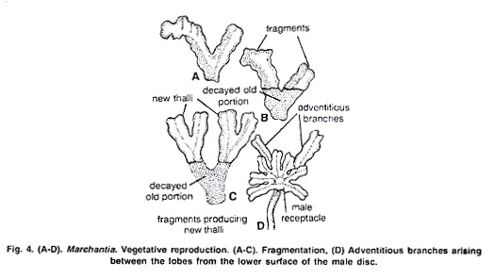
2. Death and decay of the older portion of the thallus or fragmentation:
The thallus is dichotomously branched. The basal part of the thallus rots and disintegrates due to ageing. When this process reaches up to the place of dichotomy, the lobes of the thallus get separated. The detached lobes or fragments develop into independent thalli by apical growth (Fig. 4 A-C).
3. By adventitious branches:
The adventitious branches develop from any part of the thallus or the ventral surface of the thallus or rarely from the stalk and disc of the archegoniophore in species like M. palmata (Kashyap, 1919). On being detached, these branches develop into new thalli

Slide 24
SEXUAL REPRODUCTION
Sexual reproduction in Marchantia is oogamous. All species are dioecious. Male reproductive bodies are known as antheridia and female as archegonia. Antheridia and archegonia are produced an special, erect modified lateral branches of thallus called antheridiophore and archegoniophore arpocephalum)
Further growth of the thallus is checked because growing point of the thallus is utilised in the formation of these branches. In some thalli of M. palmatci and M. polymorpha abnormal receptacle bearing both anheridia and archegonia have also been reported, such bisexual receptacles are called as androgynous receptacles.
Internal structure of Antheridiophore or Archcgoniophore:
Its transverse section shows that can be differentiated into two sides: ventral side and dorsal side. Ventral side has two longitudinal tows with scales and rhizoids. These grooves, run longitudinally through the entire length of the stalk. Dorsal side shows an internal differentiation of air chambers.

Slide 25
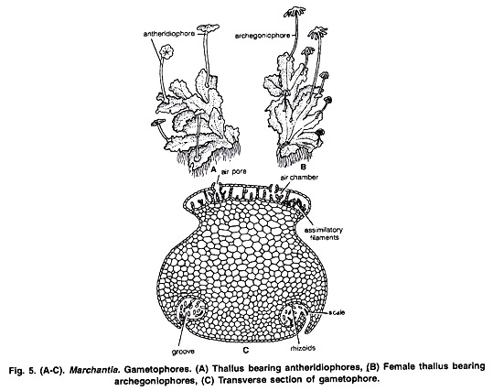

Slide 26
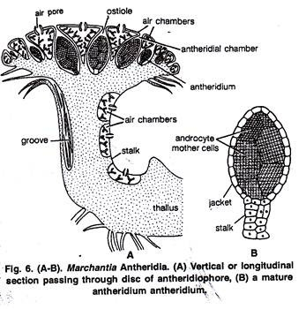
Antheridiophore:
It consists of 1-3 centimetre long stalk and a lobed disc at the apex (Fig. 32). The disc is usually eight lobed but in M. geminata it is four lobed. The lobed disc is a result of created dichotomies.
L.S. through disc of Antheridiophore:
The disc consists of air chambers alternating with heridial cavities. Air chambers are more or less triangular and open on upper surface by n pore Called ostiole. Antheridia arise in acropetal succession i.e., the older near the center and youngest at the margins.

Slide 27
Mature Antheridium:
A mature antheridium is globular in shape and can be differentiated into two parts stalk and body. Stalk is short multicellular and attaches the body to the base of the antheridial chamber. A single layered sterile jacket encloses the mass of androcyte mother cells which metamorphosis into antherozoids (Fig. 6 B, 7 G). The antherozoid is a minute rod like biflagellate structure (Fig. 8 H).
Development of Antheridium:
The development of the antheridium starts by a single superficial cell which is situated on the dorsal surface of the disc, 2-3 cells behind the growing point. This cell is called antheridial initial (Fig. 7 A). The antheridial initial increases in size and divides by a transverse division to form an outer upper cell and a lower basal cell (Fig. 7 B).
Basal cell remains embedded in the tissue of the thallus, undergoes a little further development and forms the embedded portion Of the antheridial stalk. Outer cell divides to form a filament of four cells. Upper two cells of the four celled filament are known as primary antheridial cells and lower two cells are known as primary stalk cells (Fig. 7 C).
Primary stalk cells from the stalk of the antheridium. Primary antheridial cells divide by two successive vertical divisions at right angle to each other to form two tiers of four cells each (Fig. 7 D). A periclinal division is laid down in both the tiers of four cells and there is formation of eight outer sterile jacket initials and eight inner primary androgonial cells (Fig. 7 E).

Slide 28
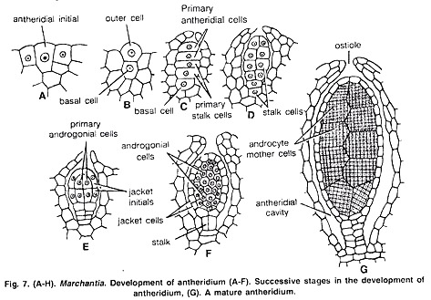
Jacket initials divide by several anticlinal divisions to form a single layer of sterile antheridial jacket. Primary androgonial cells divide by several repeated transverse and vertical divisions resulting in the formation of large number of small androgonial cells (Fig. 7 F).
The last generation of the androgonial cells is known as androcyte mother cells (Fig. 7 G). Each androcyte mother cells divides by a diagonal mitotic division to form two triangular cells called androcytes. Each androcyte cell metamorphosis into an antheozoid (Fig. 8 A-G).

Slide 29
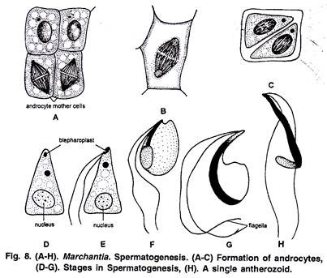
Spermatogenesis:
The process of metamorphosis of androcyte mother cells into antherozoids is called spermatogenesis.

Slide 30
It is completed in two phases:
(1) Development of blepharoplast.
(2) Elongation of androcyte nucleus.
1. Development of Blepharoplasty:
In the young triangular androcyte (Fig. 8 D) blepharoplast appears as a dense granule in one of the acute angles. It elongates to some extent and puts its whole body in close contact with the inner contour of androcyte. From the elongated blepharoplast emerge the flagella.
2 Elongation of Androcyte nucleus:
With the elongation of blepharoplast, the nucleus also elongates. The spline apparatus acts as a cytoskeleton for the elongation of nucleus. Spline apparatus is a multilayered structure which comprises tubules (Fig. 8 E-H).
Archegoniophore or Carpocephalum:
It arises at the apical notch and consists of a stalk and terminal disc. It is slightly longer than the antheridiophore. It may be five to seven cm. long. The young apex of the archegoniophore divides by three successive dichotomies to form eight lobed rosette like disc.
Each lobe of the disc contains a growing point. The archegonia begin to develop in each lobe in acropetal succession, i.e., the oldest archegonium near the centre and the young archegonium near the apex of the disc. (Fig. 10 A). Thus, eight groups of archegonia develop on the upper surface of the disc. There are twelve to fourteen archegonia in a single row in each lobe of the disc.

Slide 31
Development:
The development of the archegonium starts on the dorsal surface of the young receptacle in acropetal succession. A single superficial cell which acts as archegonial initial enlarges and divides by transverse division to form a basal cell or primary stalk cell and an outer cell or primary archegonial cell (Fig. 9 A, B).
The primary stalk cell undergoes irregular divisions and forms the stalk of the archegonium. The primary archegonial cell divides by three successive intercalary walls or periclinal vertical walls resulting in the formation of three peripheral initials and a fourth median cells, the primary axial cell (Fig. 9 C, D). Each of the three peripheral initials divide by an anticlinal vertical division forming two cells (Fig. 9 G, H) In this way primary axial cell gets surrounded by six cells. These are called jacket initials (Fig. 9 H, I). Six jacket initials divide transversely into upper neck initials and lower venter initials (Fig. 9 F). Neck initial tier divides by repeated transverse divisions, to form a tube like neck.

Slide 32
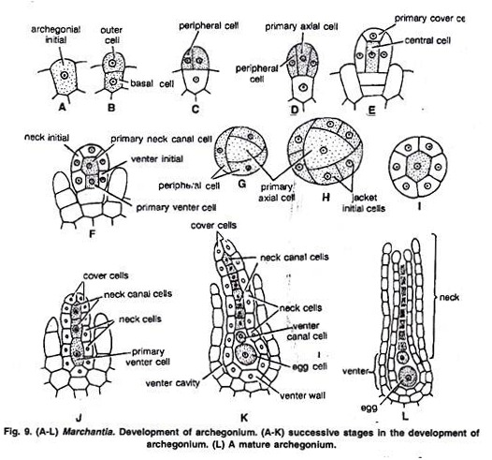
Mature Archegonium:
A mature archegonium is a flask shaped structure. It remains attached to the archegonial disc by a short stalk. It consists upper elongated slender neck and basal globular portion called venter. The neck consists of six vertical rows enclosing eight neck canal cells and large egg. Four cover cells are present at the top of the neck.

Slide 33
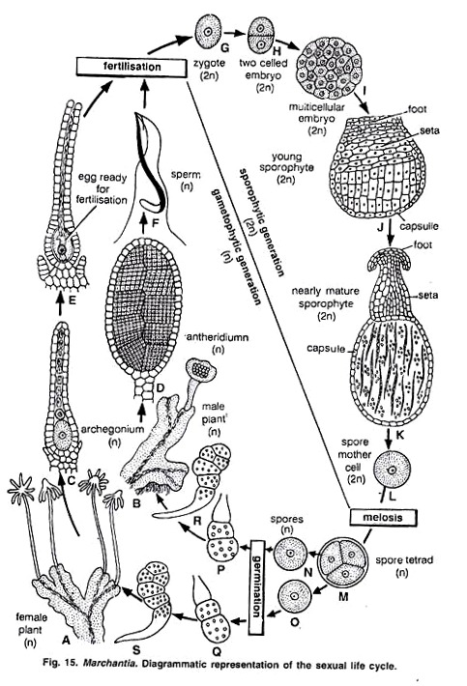
Alternation of Generation in Marchantia:
The life cycle of Marchantia shows regular alternation of two morphologically distinct phases. One of the generations is Haplophase and the other is diplophase.
Haplophase or Gametophytic Phase:
In Marchantia this phase is dominant and produces the sex organs. Sex organs produce gametes to form a diploid zygote.
Diploid Phase or Sporophytic Phase:
Zygote develops into sporophyte. In Marchantia sporophyte is represented by foot, seta and capsule. The sporophyte produces the spores in the capsule. The spores on germination produce the gametophyte.
So, in Marchantia two morphologically distinct phases (Haplophase and Diplophase) constitute the life cycle. The life cycle of this type which is characterised by alternation of generations and sporogenic meiosis is known as heteromorphic and diplohaplontic (Fig. 16).

Slide 34
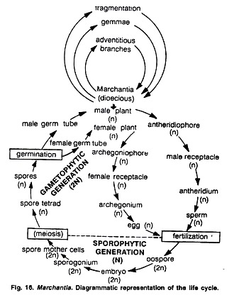

Slide 35
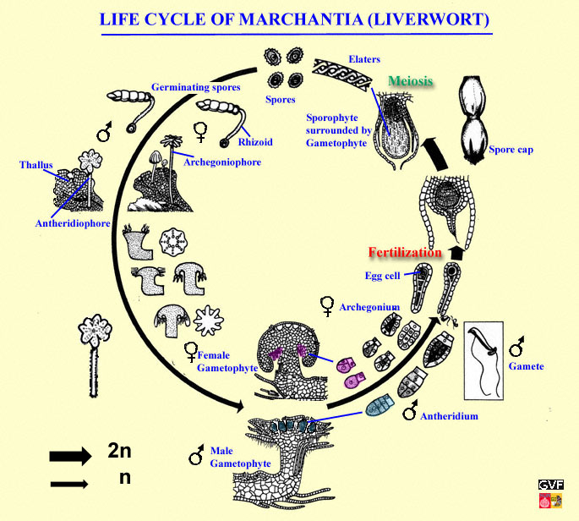

Slide 36
Bryopsida
The Bryopsida constitute the largest class of mosses, containing 95% of all moss species. It consists of approximately 11,500 species, common throughout the whole world.
Kingdom: | Plantae
Division: | Bryophyta
Class: | Bryopsida
Characteristics
All of the features of the gametophyte (protonema, gametophore, gametangia) and sporophyte (seta, sporangium and peristome) described for the Bryophyta are applicable to the Bryopsida
The group is distinguished by having spore capsules with teeth that are arthrodontous; the teeth are separate from each other and jointed at the base where they attach to the opening of the capsule.^{[2]} These teeth are exposed when the covering operculum falls off. In other groups of mosses, the capsule is either nematodontous with an attached operculum, or else splits open without operculum or teeth.

Slide 37
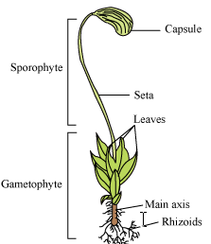
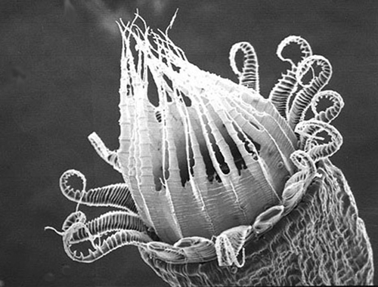
Funaria
Kingdom: | Plantae
Division: | Bryophyta
Class: | Bryopsida
Subclass: | Funariidae
Order: | Funariales
Family: | Funariaceae
Genus: | Funaria
Characteristics
Funaria grows on moist humid soil, trunks of trees during the rainy season. External structure The plant body is foliose. It is differentiated into rhizoids, stem and leaves. 1. Rhizoids: rhizoids are multicellular, branched and slender structure. They fix the plant as well as absorb water and minerals. 2. Axis (stem): the axis is slender, erect and branched. It is green in colour. 3. Leaves: leaves are arranged on the axis in spiral fashion. The leaves are sessile, simple, green and distinct mid rib.

Slide 38
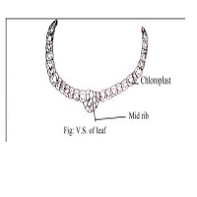
Habit and Habitat:
The genus Funaria includes about 117 species which are cosmopolitan in nature. They are the common moss, also known as cord moss or green moss. It forms velvety tufts on moist ground, rocks, tree trunks, under shade etc. About 15 species of Funaria have been reported from India. Funaria hygrometrica is a common moss on Indian hills.
b. Leaf The leaf is single layered thick except for the mid- rib. The central part is similar to the central cylinder of the axis.

Slide 39
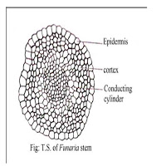
Internal structure a. Stem i. Epidermis: it is outer most single layered. It is made up of thick walled cells. ii. Cortex: it is multilayered zone situated just below the epidermis and consists of parenchymatous cells. iii. Central cylinder: it forms the central core of the axis and consists of vertically elongated, thin walled cell. The central cylinder provides mechanical strength to plant and help in conduction of water and mineral.
External structures
Plant is small about 1-3 cm long, stem is erect and branched. It is differentiated into rhizoids, axis, and leaves. The rhizoids are multicellular and branched. The axis is aerial, erect, and branched. The leaves are simple, small, and spirally arranged. The upper leaves are large and lower leaves are crowded.

Slide 40
Life cycle of Funaria:
In Funaria, two types of life cycle seen: Sexual and vegetative.
A. Sexual life cycle:
The life cycle of Funaria is haplo-diplontic type. In the life cycle free living haploid gametophyte alternates with a semiparastitic diploid sporogonium (Sporophyte). In this type alternation of generations is called heteromorphic or heterologous. In Funaria the main plant body is free-living gametophyte (n) which exist in 2 forms i.e. protonema (juvenile gametophyte) and leafy gametophore (adult gametophyte).
1. Spore germination and Protonema:
Spore is the first cell of gametophytic generation. On a suitable damp habitat, a meiospore of Funaria germinates into a filamentous green alga-like structure called protonema. Protonema has green epiterranean chloronemal branches (chlornema) and non-green subterranean rhizoidal branches (caulonema). Chloronemal branches produce several buds, each of which develop into a leafy gametophore.

Slide 41
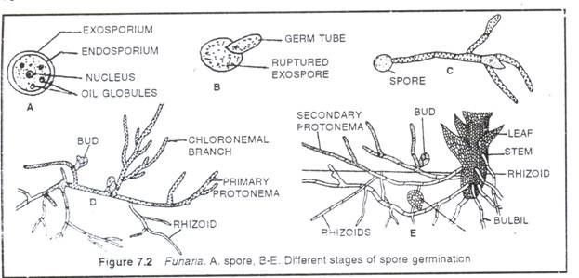
2. Adult Gametophore:
It is a long 1-3 cm in height and differentiated into rhizoids, axis (stem) and leaves.
i. Rhizoids:
Multicellular, colourless root-like structures with oblique septa. They help in anchorage and absorption.
ii. Axis:
It is 1-3 cm in height and branched. The axis and its branches covered with spirally arranged leaves. While the tip of axis contain crowded young leases forming a bud like structure. The growth of the axis is due to the activity of a pyramidal apical cell.
iii. Leaves:
Leaves are sessile, ovate and green. Each leaf has a mid rib, on both side of which single layered wing present.

Slide 42
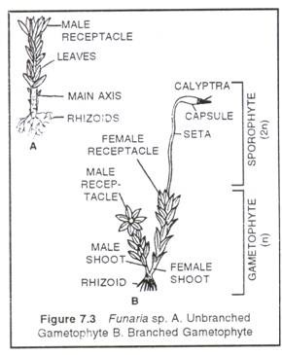
3. Sex organs:
Adult gametophore is monoecious and autoecious i.e. male and female sex organs develop at the tips of separate shoots of the same gametophore.Antheridia (Male sex organs)-The main axis is called male shoot or antheridiophore. The tip of male shoot has a convex disc or receptacle on which a cluster of club-shaped antheridia intermingled with like capitates paraphysis arises.
The receptacle is surrounded by rosette of perigonial leaves. Each mature antheridium has a short talk and a dub-shaped jacketed body. Inside the jacket, a mass of androcyte mother cells present, each of which diagonally divides into two androcytes. Each androcyte develops into a biflagellate antherozoid.

Slide 43
Archegonia (Female sex organs):
The female shoot arise from the base of the male shoot and called as archegonial branch or archegoniophore. The apex of fem ale shoot is called female receptacle from which cluster of archegonia arise intermixed with non- capitate paraphysis. Further, the female receptacle is surrounded by perichaetial leaves (perichaetium). Each archegonium has a stalk, flask-shaped venter and a neck. Venter encloses a basal egg cell (oosphere) and upper smaller venter canal cell. Neck consists of 6 or more neck canal cells (6-11).
4. Dehiscence of sex organs:
When the surface of moss plant is wet, the mature antheridia absorb water and burst releasing the male gametes (antherozoids). The male gametes swim towards archegonia. In each mature archegonium, neck canal cell and venter canal cells degenerate to form mucilage. The mucilage swells up and opens the tip to create a passage up to egg. The mucilage contains sucrose which attracts the male gametes (chemotactic).

Slide 44
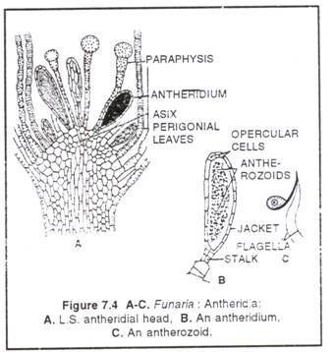
5. Fertilization:
Funaria is protandrous i.e. male sex organs mature first. Hence, Cross-fertilization takes place. Water is essential for fertilization. During heavy rains, the antherozoids reach the vicinity of archegonial neck and swim down to venter. Any one antherozoid fuses with egg to form zygote (2n). Soon, the zygote secretes a cell wall and becomes the oospore. The oospore divides and redivides to form embryo. Later the embryo grows into a sporophyte or sporogonium. Thus, zygote or oospore is the first cell of sporophyte generation.

Slide 45
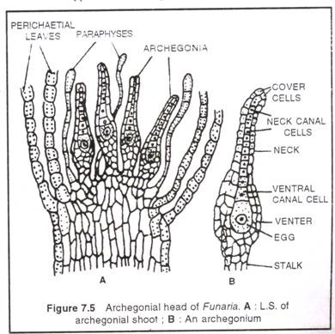
6. Sporogonium (sporophyte):
The sporogonium of Funaria is photosynthetic, hence semi-parasitic on gametophore. It differentiates into foot, seta and capsule. The foot embedded in the female receptacle and absorbs inorganic nutrients. Seta is a long stalk with a pear-shaped capsule by its tip. Capsule has 3 parts-basal apophysis, central theca and terminal operculum.
Annulus is ring like cell separates operculum and Theca. The middle fertile theca, from centre to outside, consists of a sterile columella, surrounded by a barrel-shaped spore sac, a cylindrical air space with trabeculae, hypodermis and epidermis. As the sporogonium grows, the venter grows along with it in the form of a protective covering called calytra. Later the calyptra ruptures and remains like a cap on the capsule. Calyptrais haploid because it develop from venter wall.

Slide 46
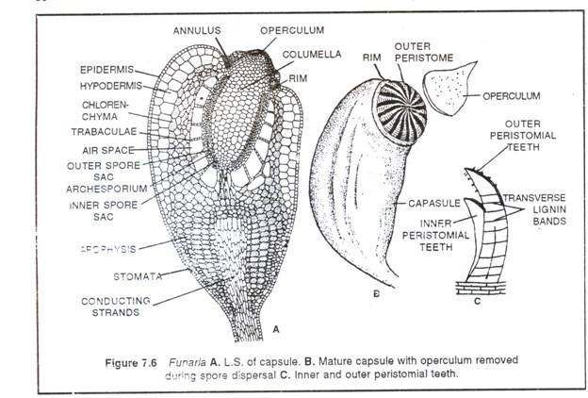
7. Dehiscence of capsule and dispersal of spores:
When the capsule dries up, Operculum thrown off to expose the peristome consisting of two overlapping rings of periostomial teeth. Each ring of peristome possesses 16 teeth. The teeth of outer ring (exostome) are conspicuous, red with thick transverse bands whereas the inner rings (endostome) are comparatively small, colourless and soft. The dispersal of spores is due to hygroscopic movements (viz. movement due to moisture contents of atmosphere) of exostome of peristomial teeth. The inner ring of peristomial teeth do not show hygroscopic movement.

Slide 47
B. Vegetative cycle:
In Funaria, the alternation of generations is not always obligatory. Frequently, the gametophyte undergoes vegetative propagation to form a succession of the gametophyte generations before the sporophyte generation develops.
Vegetative propagation is a method by which a part of the gametophyte separate or specialized to form a new individual.
The various methods of vegetative propagation in Funaria are:
(a) By fragmentation of Primary protonema:
Accidentally, or death of intercalary, segment sometime causes fragmentation of primary protonema, each fragment can give rise to leafy gametophore.
(b) By secondary protonema:
Secondary protonema develops from any cell of injured part of gametophore. This develops lateral bud which grows into leafy gametophore.
(c) By Bulbils (tubers):
These are perinnating structures developed on rhizoids. On return of suitable condition, each of them produces a protonema.
(d) By Gemmae:
The apices of protonemal branches, leaves an axis develop gemmae. Detached gammae give rise to gametophore under favourable condition.
(e) Apospory:
This is the vegetative propagation of sporogonia in which any somatic cell produce leafy gametophore without spore formation. The aposporously produced gametophores are exceptionally diploid (2n).

Slide 48
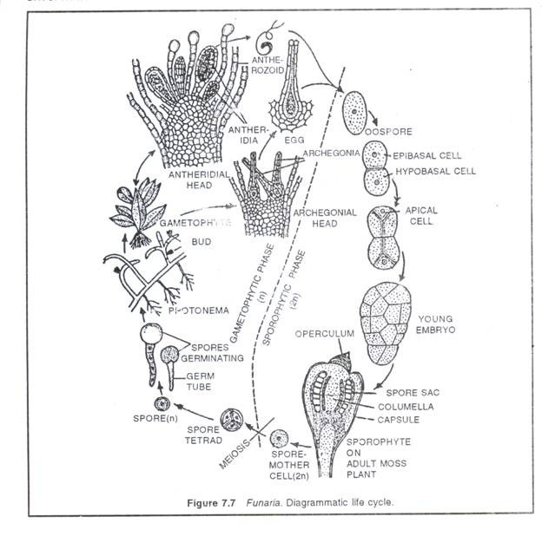

Slide 49
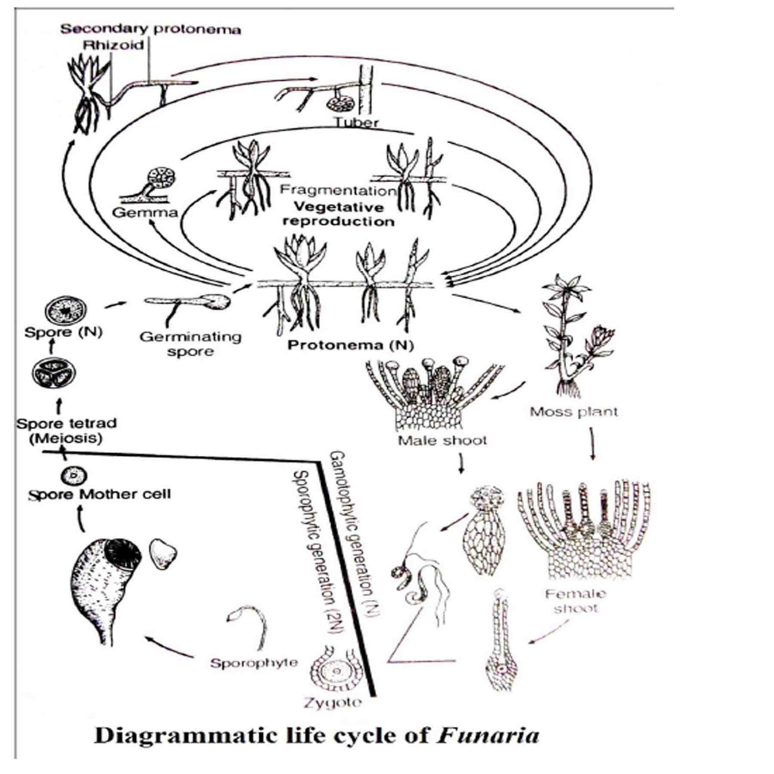

Slide 50
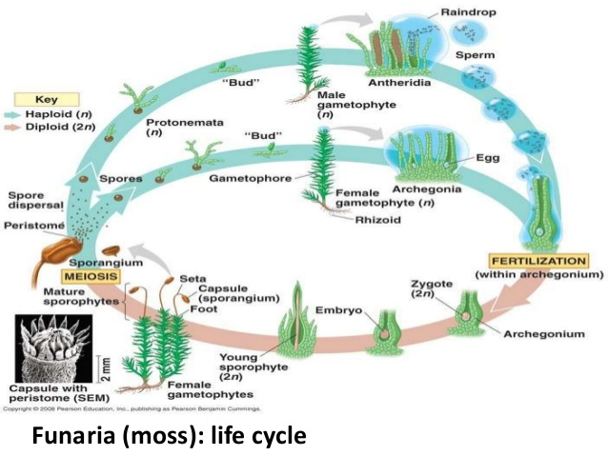

Slide 52
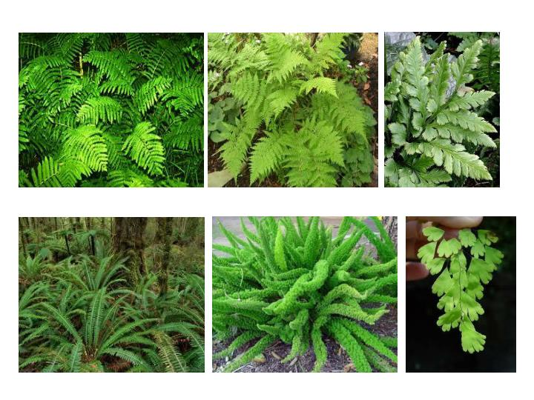

Slide 56
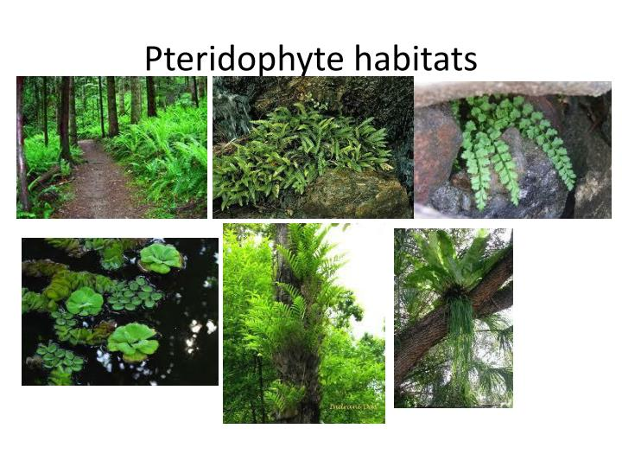

Slide 60
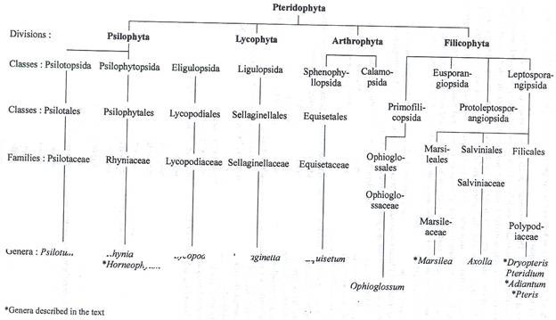

Slide 62
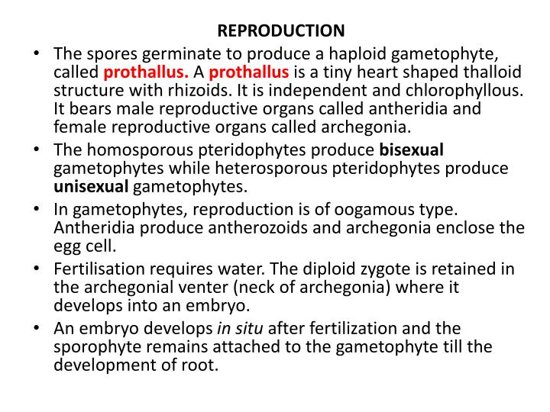

Slide 63
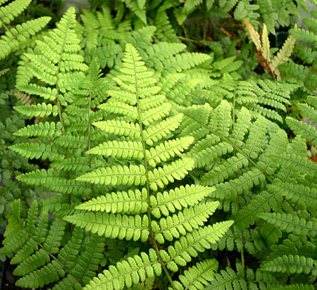
Fern Life Cycle

Slide 64
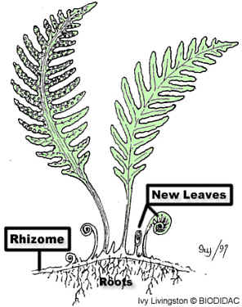
1) Sporophyte creates and releases haploid spores
Adult
Sporophyte
.
.
.
.
ground

Slide 65
2) Haploid spores land in the soil
.
.
.
.
ground

Slide 66
3) From the haploid spores, gametophyte grows in the soil
Let’s zoom in
Fern gametophytes are called a prothallus
ground

Slide 67
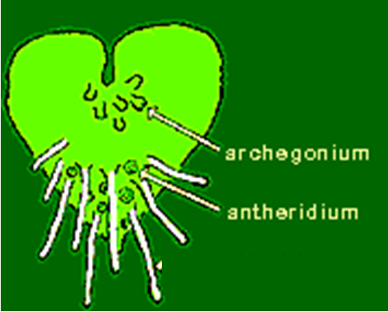
4) Sperm swim through water from the male parts (antheridium) to the female parts (archegonia)…zygote created
Let’s zoom back out
egg
zygote
egg
zygote
egg
zygote

Slide 68
5) Diploid sporophyte grows from the zygote
sporophyte
Fern gametophytes are called a prothallus
ground

Slide 69
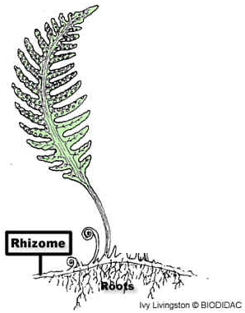
6) Fiddle head uncurls….fronds open up
7) Cycle repeats
-- Haploid spores created and released
.
.
.
fiddlehead
frond
.
ground

Slide 70
2) Haploid spores land in the soil
.
.
.
.
ground

Slide 71
3) From the haploid spores, gametophyte (called the prothallus) grows in the soil
Let’s zoom in
ground

Slide 72
4) Sperm swim through water from the male antheridium to the female archegonia
Let’s zoom back out
egg
zygote
egg
zygote
egg
zygote

Slide 73
5) Diploid sporophyte grows from the zygote
fiddlehead
sporophyte
ground

Slide 74
6) Fiddlehead uncurls….fronds open up.
7) Cycle repeats
.
.
.
.
ground

Slide 76
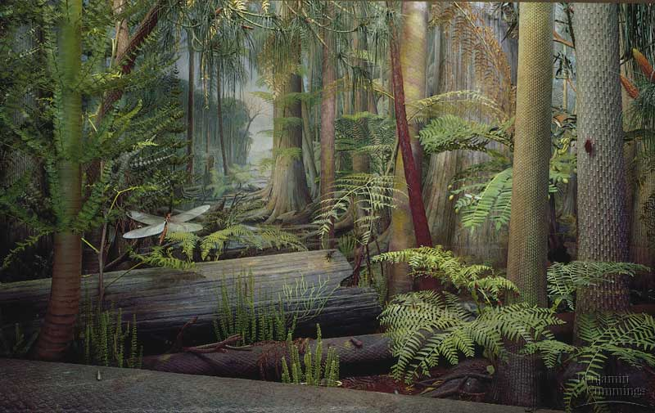

Slide 77
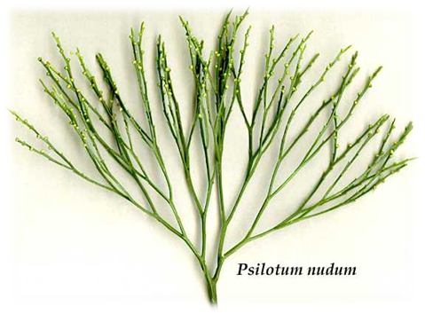
Psilotum
Kingdom: | Plantae
Division: | Pteridophyta
Class: | Psilotopsida
Order: | Psilotales
Family: | Psilotaceae
Genus: | Psilotum
Psilotum (whisk fern) is a genus of fern-like vascular plants, one of two genera in the family Psilotaceae, order Psilotales, and class Psilotopsida (the other being Tmesipteris). The name of the genus is from Greek psilos = bare, referring to the lack of the usual plant organs, such as leaves.

Slide 78
General characteristics of Psilotum:
i. The sporophytes are dichotomously bran­ched with an underground rhizome and upright branches.
ii. The upright branches are leafless.
iii. Rhizoids present instead of roots.
iv. Stem have a relatively simple vascular cylin­der.
v. The sporangia are borne in groups (trilo­cular) and form synangia.
vi. Spores produced are all alike (homosporous).
vii. The development of gametophyte is exosporic and form monoecious subterranian gametophyte.
viii. The development of embryo is exoscopic.

Slide 79
Sporophyte:
The plant body of Psilotum is sporophytic branched rhizome system and dichotomously branched, slender, upright, green aerial systems that bears small appendages and synangia (singular: synangium).
Aerial Stem: Any one of the rhizome tips may turn upward and undergo several dichotomies to give rise to a green aerial shoot. The aerial shoots are slender, generally erect but may be pendent in epiphytes (P. flaccidum). They are perennial and become shrubby by repeated dichotomies and sometimes attain a height up to one meter.
The aerial axis may be cylindrical at base, furrowed in the upper parts (wavy in C.S.), but somewhat flattened with three longitudinal ridges (triangular in C.S.) at the top. The basal part of the aerial axes is smooth but the distal part bears small, scaly appendages and synangia

Slide 80
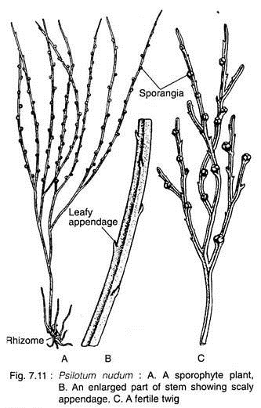
The aerial stems are photosynthetic and the general appearance is xerophytic although the plants grow in very moist environment. In T.S., the aerial system is covered by an epidermis, followed by extensive cortical areas, single-layered endodermis and stele. The stele is siphonostelic in the basal part which becomes actinostelic in the younger branches

Slide 81
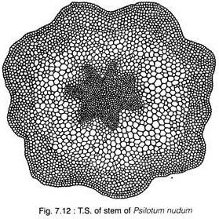
The epidermis is single-layered, in which the outer tangential cell walls are heavily cutinised and covered by a layer of cuticle. The epidermis is broken regularly by stomata .The stomata of Psilotum do not have subsidiary cells.

Slide 82
The cortex is extensive and is divisible into three regions. The outer portion (chlorenchymatous) directly beneath the epider­mis consists of elongated, lobed chlorophyllous cells with intercellular spaces. This region is two- to five-layered thick and the cells are full of chloroplastids and starch grains.
Internal to this zone, there is a middle cortex of 4 to 5 layers of vertically elongated thick-walled sclerenchymatous cells without intercellular spaces. The walls of these cells apparently become lignified in the lower portion of the aerial stem.
These tissues provide mechanical support to the plant. Further inwards, there is a broader zone of parenchyma­tous cells (the inner cortex), the cell walls of which become thinner and thinner towards the centre. These cells are without intercellular space but contain more starch grains.
The cortical tissue is bounded inwardly by a single-layered endodermis whose vertically elon­gated cells have a conspicuous casparian bands on the radial and end walls.
The centre of the stem is occupied by a ridged or flattened cylinder of primary xylem with protoxylem elements at the tip of each ridge. This cylinder may have as many as ten ridges near the transition region from rhizome to aerial stem. Fewer ridges are present in the more distal parts of the aerial stem.
A single-layered parenchymatous pericycle is present just below the endodermal layer. The phloem is internal to the pericycle and located between the ridges of the xylem.

Slide 83
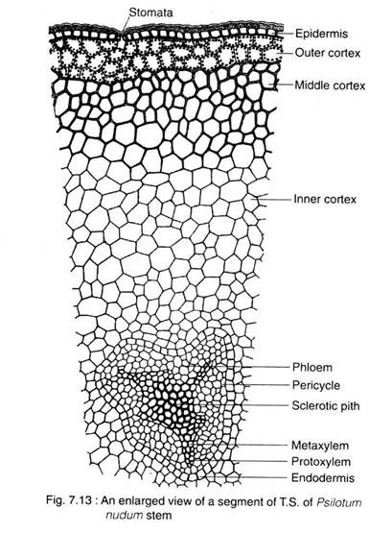
At the extreme base, the stem is protostelic (actinostelic). In the middle portion the stele is siphonostelic as the centre of the xylem is occu­pied by a patch of elongated sclerenchymatous cells (sclerotic pith).

Slide 84
Rhizome:
The basal subterranean branched rhizome is generally hidden beneath the soil or humus. It bears numerous rhizoids, instead of roots, which perform the functions of absorption and ancho- rage.
In T. S., the rhizome reveals an outermost epidermis, cortex, endodermis, pericycle and stele. The epidermis is indistinct and gives rise to 2-celled rhizoid. The cortex is exten­sive, parenchymatous and differentiated into outer, middle and inner layers.
The outer cortical layer is characterised by the presence of intracel­lular endophytic mycorrhiza. The cells of middle cortex are large with starch grains, while the cells of the inner cortex are often dark brown in colour because of the presence of phlobaphene (an oxidative product of tannins).

Slide 85
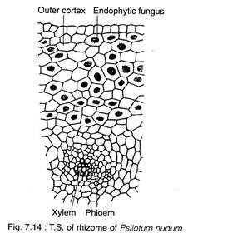
Appendages:
These are small scale-like structures helically arranged on the upper part of the aerialsystem. Internally, the appendage is composed of parenchymatous photosynthetic cells, bounded by a single-layered cutinised epidermis. There is no stomata in the appendages. There is no vas­cular trace in the appendages of P. nudum, although minute leaf traces originate from stele in P. flaccidum which fade out in cortex.

Slide 86
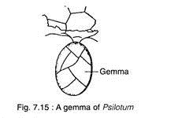
Reproduction in Psilotum:
The Psilotum reproduces vegetatively as well as by spores.
i. Vegetative Reproduction:
The sporophyte as well as gametophyte of Psilotum (e.g., P. nudum) propagate vegetatively through the production of Gemmae (Fig. 7.15). They are small, multicellular and ovoid structures developing on surface of rhizome (in sporophytic plant body) or prothallus (in the gametophyte).
After detachment from the parent body, gemmae of sporophyte may germinate to form a subterra­nean shoot, while the gemmae of prothallus, on germination, form a new prothallus.

Slide 87
ii. Reproduction by Spores:
Spore-Producing Structure:
At maturity, many of the dichotomously branched aerial shoots become fertile and pro­duce trilocular sporangia known as synangia (Fig. 7.11C & 7.16A, B). The mature synangium is generally a three-lobed structure (Fig. 7.17A) and each lobe of the synangium corresponds to a sporangium.
The synangia located at the tip of very short axis, measuring 1-2 mm in diameter and closely associated with a forked, foliar appendage (Fig. 7.1 7B). At maturity, the synan­gium exhibits loculicidal dehiscence.
Development of Sporangium:
The mode of development of each sporan­gium of the synangium of Psilotum nudum is of eusporangiate type. Each sporangium develops from a group of superficial initial cells which divide periclinally to produce primary wall ini­tials and primary sporogenous cells.
A sporangial wall of four or five layers is produced through repeated periclinal and anticlinal divi­sions of the primary wall initials. The sporoge­nous tissue is produced from repeated divisions of primary sporogenous cells in various planes.

Slide 88
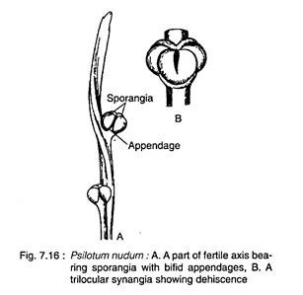
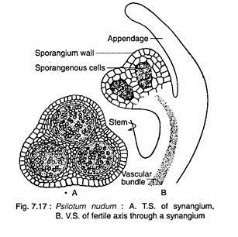
Further development of sporangenous tissue gives rise to spore mother cells and numerous spores are produced as a result of meiosis of the spore mother cells. The spores are of equal size and shape (i.e., homosporous), bilaterally sym­metrical, colourless and kidney-shaped with monolete aperture.

Slide 89
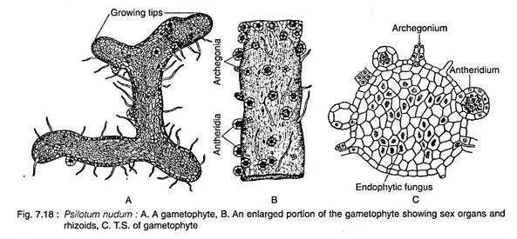
Gametophyte:
The mature gametophyte shows a striking similarity with a piece of sporophytic rhizome. It grows as saprophyte with an asso­ciated fungus.
Spores germinate exosporically to form the gametophyte. The mature gametophytes are brown, cylindrical, subterranean, radially sym­metrical and usually dichotomously branched, but may sometimes become irregular. The surface of the gametophyte is covered by long unicellular, brownish rhizoids. The gameto­phyte grows by means of apical meristem

Slide 90
In T.S., the gametophyte reveals cutinised peripheral cells which encloses many-layered thin-walled parenchymatous cells. Many of the internal parenchyma cells are filled with the hyphi of a symbiotic fungus. It has been observed that in the gametophyte of tetraploid P. nudum, the centre is occupied by xylem with annular, scalariform and reticulate tracheids, surrounded by phloem and an endo- dermis.
Thus, Psilotum is the only plant in the plant kingdom where the vascular tissues deve­lop in the gametophytic generation. The exter­nal resemblance of the sporophytic rhizome and gametophyte, coupled with the presence of vascular tissue in the gametophyte, supported the homologous theory on the origin of alter­nation of generations.

Slide 91
Sex Organs:
The gametophytes of Psilotum are monoe­cious (i.e., homothallic). Sex organs i.e., antheridia and archegania, are superficial and scattered over the surface of the gametophyte. Generally, antheridia are more in number than archegonia.
Antheridium:
The antheridium develops from a single superficial cell (antheridial initial) of the pro­thallus. The periclinal division of the superficial cell produces an outer jacket initial and an inner primary androgonial cell.
The outer jacket initial undergoes repeated anticlinal divisions and forms a single-layered jacket. The inner primary androgonial cell divides in various planes and produces a mass of developing androgonial cells, the last gene­ration of which are the androcytes.
At this stage, the antheridium projects above surface of the prothallus as a minute protube­rance. Each androcyte eventually becomes a spirally-coiled, multiflagellate antherozoid. and escapes by the disintegration of the opercular cell.

Slide 92
Archegonium:
The archegonium is also developed from a single superficial cell (archegonial initial) of the prothallus. The initial cell undergoes peri­clinal division to form an outer primary cover cell and an inner central cell (Fig. 7.20A, B). The anticlinal divisions followed by periclinal divisions of the outer cover cell produces a long projecting neck arranged in four vertical rows of cells with four to six cells in each row.
The central cell divides transversely to form an upper primary neck canal cell and a lower primary venter cell. The nucleus of the primary neck canal cell divides to form two neck canal nuclei and generally this division is not accom­panied by wall formation resulting into a binucleate neck canal cell. The primary venter cell divides transversely to produce a large egg and a small ventral canal cell

Slide 93
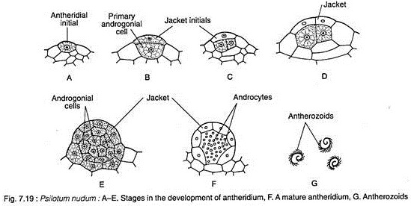

Slide 94
Fertilisation:
At maturity, the cell wall of the lower tier of neck cells becomes thick walled and cutinized. The apical tier, however, breaks away in pre­sence of water and the mucilagenous contents of the neck cells are released. Thus, a free passage is formed for the entry of the antherozoids.
Fertilisation is accomplished by the union of a multiflagellate sperm and egg, resulting in the formation of a diploid zygoie.

Slide 95
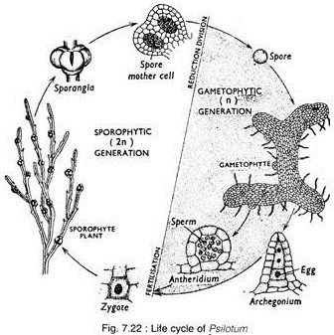

Slide 96
Embryo (New Sporophyte):
The diploid zygote is the mother cell of the sporophytic generation. The first division of the zygote is transverse, forming an outer epibasai cell (directed towards the neck of the archegoni­um) and an inner hypobasal cell (directed towards the base of the archegonium)
The apical epibasai cell ultimately gives rise to the sporophytic branch system (aeri­al and underground), while the lower hypobasal cell produces the foot. This type of embryogeny where the shoot forming apical cell is directed outward (towards the neck of the archegonium) is called exoscopic mode of embryo develop­ment.
The foot anchors the young sporophyte securely to the gametophyte and absorbs nutri­ents until the sporophyte becomes pysiologi­cally independent.

Slide 97
Phylogeny of Psilotum:
Affinity with Ferns:
Bierhorst (1971) placed Psilotum along with Tmesipteris within Filicopsida primarily on the basis of similarities with some ferns like Gleichenia, Stromatopteris, etc., by the following characteristics:
1. Axial nature of gametophytes.
2. Superficial position of antheridia on the pro­thallus.
3. Exoscopic type of embryogeny.
4. Development of sporangial structure.
5. Mutiflagellated spermatozoids

Slide 99
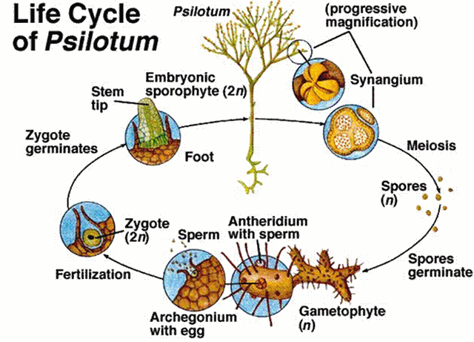

Slide 100
Lycopodium
Kingdom: | Plantae
Division: | Pteridophyta
Class: | Lycopodiopsida
Order: | Lycopodiales
Family: | Lycopodiaceae
Genus: | Lycopodium
Characteristic Features:
The living Lycopodiales are the representatives of a group which, during the Carboniferous period, formed the chief vegetation. Many of the types then growing, e.g., Lepidodendron, were large trees. The modern representatives are small and herbaceous sporophytes. The leaves are small and simple. Each leaf possesses an unbranched midrib. The leaves have no ligules. There are no leaf gaps in the stele of the stem. The sporophylls may or may not be restricted to the terminal portion of branches and organized into definite strobili.
The sporophylls and simple vegetative leaves may be similar or dissimilar. They possess homosporous sporangia, i.e., all the spores of one kind only. The gametophytes are wholly or partly subterranean. The antheridia remain embedded in the tissue of the prothallus. The antherozoids are biflagellate.

Slide 101
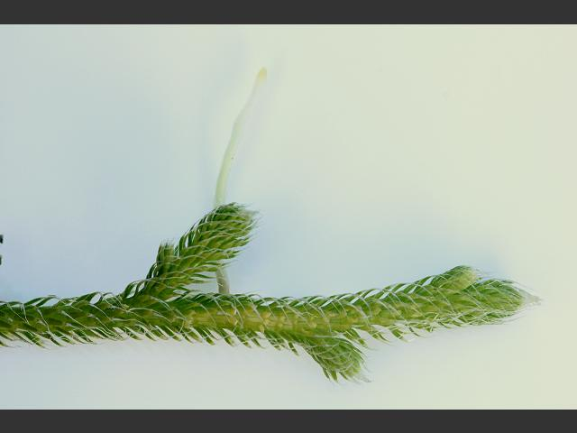

Slide 102
Habit and Habitat of Lycopodium:
Lycopodium is commonly known as ‘club moss’ due to their moss like appearance and club shaped strobili. It has about 400 species, which are cosmopolitan in distribution. They are found in colder arctic region as well as in temperate, tropical and sub-tropical regions but they are abundantly found in tropical zones.
Thirty three species of Lycopodium have been reported from India. Mostly it is found growing in moist and shady places which are rich in humus and other organic matters. Some of the common species are L. clavatum, L. phlegmaria, L. cernuum, etc.
It has got 2 sub-genuses:
(i) Urostachya—branching dichotomous and roots originate from the base of the stem.
(ii) Rhopalostachya—stem prostrate with erect branching and roots arise adventitiously from all along the stem.
Mostly the tropical species are epiphytic (e.g., L. phlegmaria) and grow hanging from the tree trunks. The temperate species may be erect and shruby (e.g., L. reflexum), creeping (e.g., L clavatum) or erect form (e.g., L. cernuum) etc.

Slide 103
External Morphology of Lycopodium:
The herbaceous plant body is sporophytic. Usually they may have either prostrate
stem with erect leafy branches or weak pendent stem (epiphytes).
The plant body is distinctly differentiated into following three regions
(i) Stem, (ii) Roots, and (iii) Leaves.
(i) Stem:
In the sub-genus Urostachya stem is erect (terrestrial) or pendent (epiphytic) and may be branched (dichotomously) or unbranched. In the sub-genus Rhopalostachya the stem is prostrate with erect branches. First the branching is dichotomous and later on becomes monopodial.
(ii) Root:
Usually small, adventitious roots are present. In the sub-genus Urostachya roots originate only from the base of the stem (not arising from the whole length of the stem). In some species e.g., L. selago etc. the roots arise endogenously from pericycle of the stem, do not penetrate the cortex of the stem but turn downward through the cortex and finally emerge only at the base of the stem.
Due to this reason a T. S. of stem usually shows roots within the cortex and are known as cortical roots (inner roots). In sub-genus Rhopalostachya also roots are adventitious and arise all along the underside of the prostrate portion of the stem.

Slide 104
(iii) Leaves:
Leaves are simple, sessile, small in size, eligulate and possess a single unbranched midrib and are known as microphylls. Usually the leaves are spirally arranged (e.g., L. clavatum) but may be arranged in whorls (e.g., L. cernuum) or pairs (e.g., L. alpinum).
In all the cases they condensely cover the surface of the stem. Leaves are usually homophyllous (isophyllous) i.e., of same size and shape but in some cases e.g., in L. complanatum the leaves are heterophyllous (anisophyllous) i.e., of different size.
Usually the leaves near the apical portion of the branches bear sporangia and are called sporophylls. Depending upon the species the sporophylls may or may not be differentiated from the ordinary leaves.
These sporophylls usually form a condense structure at the apex of the branches which are known as strobili. The numbers of strobili at the tip of branches differ in different species.

Slide 106
Internal Structure of Lycopodium:
(a) Stem:
A transverse section (T.S.) of the stem of Lycopodium is somewhat circular in outline and can be differentiated into following three regions:
1. Epidermis:
It is the outermost covering layer comprising of single cell in thickness. The epidermis is cutinised on the outer side and interrupted at places by the presence of stomata.
2. Cortex:
Inner to the epidermis is present a wide zone of cortex which shows a great variation in its structure in different species.
Usually four types of cortex are recognized:
(i) The whole of the cortex is made up of parenchymatous cells with small or large intercellular spaces (e.g., L. selago). Such cortex is called homogeneous.
(ii) The whole of the cortex is made up of sclerenchymatous cells, without intercellular spaces.
(iii) The cortex is differentiated into outer and inner sclerenchymatous cells and middle parenchymatous cells (e.g., L. clavatum,).
(iv) The cortex is differentiated into outer and inner parenchymatous cells and middle sclerenchymatous cells (e.g., L. cernuum).

Slide 107
Next to the cortex is present a single layer of well-defined cells known as endodermis with conspicuous casparian strips but at maturity the endodermis may or may not be a distinct structure. Endodermis is followed by pericycle which is composed of one or more layers of compactly arranged parenchymatous cells.

Slide 108
3. Stele:
It is made up of only primary xylem and primary phloem. It is a protostele i.e., pith is absent and the stele is situated in the centre. The arrangement of xylem and phloem tissues is different in different species and the stele is also named differently.
In case of L. serratum, L. phlegmaria etc. the xylem is star shaped with a protoxylem situated at the periphery (protoxylem exarch). In L. annotinum in actinostele the furrows in the xylem are much more and show stellate arrangement.
The phloem lays in the space between the xylem rays. This type of stele is known as actinostele. In case of L. clavatum. L. volubile etc. xylem appears to be in the form of separate plates arranged somewhat parallel, with phloem in between them.
This type of stele is known as plectostele. In case of L. cernuum, L. drummondii etc. xylem and phloem are uniformly distributed i.e. it appears as if strands of xylem are embedded in the phloem. This type of stele is known as mixed protostele

Slide 109
The protoxylem is usually exarch in all the cases. Xylem is usually composed of tracheids and phloem of sieve tubes and phloem parenchyma. Cambium is absent hence there is no secondary growth i.e., no formation of secondary xylem and secondary phloem.
(b) Root:
The roots are adventitious:A transverse section (T.S.) of the aerial root of Lycopodium is somewhat circular in outline and shows the following internal structure:
(i) Epidermis: It is the outermost covering layer and is only one cell thick. The cells are thin walled. Epidermis is provided with numerous root hairs present in pairs (characteristic of Lycopodium).

Slide 110
(ii) Cortex:
Just below the epidermis is present a wide zone of cortex. It is differentiated into outer sclerenchyma and inner parenchyma. The outer one gives the mechanical strength to the root.

Slide 111
(iii) Stele:
It may be di-, tetra-, or polyarch. In prostrate species it is polyarch i.e., having 6-10 plates of xylem arranged radially (star shaped). The xylem is exarch. The phloem is present between the radiating arms of xylem. In erect or pendent species stele is diarch or tetrarch. In L.selago, L. serratum it is diarch and xylem is C, U or crescent shaped. The phloem is present between the 2 ends of xylem, only in one group.
The cortical roots are exactly similar in their internal structure to that of aerial roots, except that the epidermis and root hairs are absent.
The xylem is composed of tracheid and phloem of sieve tubes and phloem parenchyma. The endodermis and pericycle are indistinct structure at maturity. Pith and cambium are absent.
(c) Leaf:
T. S. of the leaf shows epidermis, mesophyll tissue and a single median vascular bundle:
1. Epidermis:
It is the outermost surrounding layer and is only one cell in thickness. The cells of epidermis are parenchymatous and cutinised on their outer side. The epidermis is also interrupted by the presence of stomata. In homophyllous (isophyllous) species the stomata are present on outer as well as inner epidermis (amphistomatic) but in heterophyllous (anisophyllous) species the stomata are mostly restricted on the lower epidermis (hypostomatic).

Slide 112
2. Mesophyll:
It occupies a wide zone between the epidermis and the vascular bundle. It is usually made up of thin walled chlorenchymatous cells which may be with or without intercellular spaces.
3. Vascular bundle:
In the centre of the leaf is situated only a single concentric vascular bundle made up of only xylem and phloem. The vascular bundle is surrounded on all sides by a sclerenchymatous sheath.

Slide 113
Reproduction in Lycopodium:
Lycopodium reproduces by two methods vegetatively and by spores.
1. Vegetative reproduction:
It takes place by the following methods:
(i) Gemmae or bulbils:
In a few species like L. selago, L. lucidulum etc. certain buds like structures known as gemmae or bulbils are usually produced in large number on new stem tips annually. The morphological nature of gemmae is still not fully known. The gemmae when fall on ground, develop root primodia and soon form the root.

Slide 114
(ii) Death and decay:
Species with creeping stem reproduces vegetatively by the death and decay of older parts of the stem up to the point of branching. This separates the branches which later on grow independently.
(iii) Resting buds:
In L. inundatum the whole of the plant body except the growing tip of rhizome is dead during winter. This tip portion of the rhizome acts as resting bud which in the coming spring resumes growth and develops into a new plant.
(iv) Fragmentation:
In several epiphytic species fragments of the plant body are capable of giving rise to new plants.

Slide 115
2. Sexual Reproduction:
Spore Producing Organs:
Lycopodium is a sporophytic plant and reproduces sexually. The plants are homosporous i.e., produces only one type of spores (without differentiation of mega- and microspores). These spores are produced in sporangia which, in turn, are produced on fertile leaves known as sporophylls. Usually the sporophylls are grouped together to form a compact structure known as strobili (Sing. strobilus) which are terminal structures.
Strobilus (Reproductive organ):
In the primitive species of the sub-genus Urostachya every leaf on the plant is a sporophyll or at least potentially so and the fertile and sterile zones alternate. The sporophylls are loosely arranged. In species of Rhopalostachya and in some species of Urostachya the leaves of the apical portion of the branches only bear sporangia and are called sporophylls. The rest behave as vegetative leaves. The sporophylls may be of the same size or of different size from the foliage leaves in different species. The arrangement of sporophylls is same on the central axis as that of the vegetative leaves on the stem i.e., spiral, whorled or decussate etc.
The position of the sporangium is also different in different species. The sporangia may be axillary and protected with the help of sporophylls (e.g., L. inundatum) or foliar and protected (e.g., L. cernuum) or subfoliar and exposed or axillary and exposed

Slide 116
Longitudinal section (L.S.) of strobilus shows the presence of a strobilus axis in the centre. On both sides of the strobilus axis are present sporophylls. Each sporophyll bears only one sporangium.All the sporangia are similar in structure and are arranged acropetally in a strobilus i.e., the youngest are at the top

Slide 118
Structure of Sporangium:
Sporangia are sac-like structures but usually kidney shaped in appearance. Sometimes they are sub-spherical in appearance. Their colour varies from orange to yellow. Each sporangium consists of a basal short massive stalk i.e., sub-sessile, with an upper globular unilocular body containing numerous spores.
The body of the sporangium consists of 3 or more layers of wall surrounding a cavity. The inner most layer of the wall of sporangium is called as tapetum which is nutritive in nature and persists till maturity.
In the young sporangium inside the wall is present a mass of sporogenous cells which in due course of development form spore mother cells which by meiotic divisions, produce haploid tetrad of spores. The spores at maturity separate from each other. The wall of the sporangium is provided with a transverse strip of cells known as stomium from where the sporangium at maturity splits into 2 valves and the spores are dispersed away in the air.
The spores produced by a sporangium are all alike (homosporous). They are small, rounded or even spherical structures. The surface of the spores is usually rough due to the presence of reticulate ridges or knob like protrusions. Each spore is provided with a triradiate ridge) and is somewhat yellow in colour. A small amount of chlorophyll may or may not be present in spores. Reserve food is in the form of oil in the spores.
Development of sporangium and formation of spores. Bower (1894) had studied the development of sporangium in Lycopodium. The sporangium develops from a small group of superficial cells arranged in a transverse row on the adaxial side of the sporophyll near the base.

Slide 120
Gametophytic Generation:
The development of the gametophyte (prothallus) takes place from the haploid spores which are the unit of gametophytic generation. Each spore is unicellular, uninucleate haploid structure, 0.03 mm in diameter and surrounded by 2 layers, with a triradiate ridge at the surface
Chlorophyll may or may not be present in different species. In few species spores may germinate within a few days after liberation but in some species the spores germinate when they are 3-8 years old and the development of gametophyte upto formation of mature sex organs may take a time of 8 months to 6 or even 15 years.
The rate of the formation of photosynthetic tissue is usually proportional to the rate of growth of gametophyte. Both the male and female reproductive organs are produced on the same gametophyte. The male sex organs are produced earlier than female sex organs. The upper cell further divides by two successive divisions in such a way as to form an apical cell with two cutting faces . At this stage the gametophyte is 5 celled structures and the symbiotic phycomycetous fungus (mycorrhizal fungus) attacks it.
If this fungus fails to attack at this stage, further development of gametophyte stops. This infection takes place through the basal cell. During further course of development of gametophyte the apical cell further divides to form six or morecells which later on develop into meristematic cells. These cells, by further divisions form a multicellular structure, the gametophyte

Slide 122
Development of sex organs:
Both the sex organs i.e., antheridia (male) and archegonia (female) develop on the same prothallus, usually in distinct patches on the upper surface. The gametophytes are protandrous i.e., antheridia develop before archegonia. Sex organs develop just on the back of the apical meristem.
Development of antheridium:
A single superficial cell situated just away from the meristematic cells gives rise to an antheridium. This superficial cell is known as antheridial initial .This cell divides periclinally to form an outer cell known as jacket initial (primary wall cell) and an inner cell known as primary androgonial initial or cell .
The jacket initial divides only anticlinally by several divisions resulting in the formation of single layered covering known as jacket layer. In the middle of the jacket layer a triangular cell is differentiated, which is known as opercular cell.
Simultaneously, the primary androgonial divides by various divisions, forming a mass of cells embedded in the prothallus, known as androgonial cells which finally give rise to androcytes (antherozoid mother cells,). The number of androcytes per antheridium varies in different species.
Each androcyte later on metamorphosis into a biflagellated antherozoid. Each antherozoid is a haploid, uninucleate, fusiform structure with broad rounded posterior end and an upper pointed biflagellated anterior end The triangular opercular cell becomes mucilaginous as a result of which an opening is formed at the apex of antheridium through which water enters into it. The antherozoids absorb water and swell up as a result of which a pressure is created on the wall of antheridium which finally ruptures and the antherozoids are liberated.

Slide 124
Development of archegonium:
Just like antheridium, the archegonium also arises from a single superficial cell called archegonial initial, situated just away from the meristematic cells at the apex. The archegonial initial divides by periclinal division into an upper primary cover cell and lower basal central cell.
The primary cover cell later on divides vertically by two successive divisions at right angle to each other forming four neck initials which later on by transverse divisions form a 3-4 cells high neck. Each tier of the neck consists of 4 cells.
The central cell divides transversely forming an, upper primary canal cell and a lower primary ventral cell. The primary canal cell by successive transverse divisions produces a variable number of neck canal cells (usually one in L. cernuum, seven in, L. selago and 14-16 in L. complanatum).
The primary ventral cell may directly behave as an egg or may divide transversely to form an upper ventral canal cell and a lower egg. The egg is somewhat broader then the rest part of archegonium. The archegonial jacket is absent. The archegonium is a sunken flask shaped structure with neck projecting out of the prothallus.

Slide 125
Fertilization:
At the time of fertilization the neck canal cells and the ventral canal cell disorganise and the cells of the upper-most tier of neck slightly separate apart forming a passage upto the egg. Fertilization is brought about in the presence of water.
The biflagellate antherozoids reach the archegonium by swimming in water on the surface of prothallus. The antherozoids are perhaps attracted towards the neck of archegonium by a chemotactic movement. They enter the archegonium through neck and reach the egg.
Only the nucleus of one antherozoid fuses with the egg nucleus thus forming a diploid structure-known as oospore (2x). The act of fertilization ends the gametophytic generation and the initial stage of sporophytic generation is formed.

Slide 127
Economic Importance of Lycopodium:
Different species of Lycopodium are differently important as for example, some species of Lycopodium (L. obscurum) are used in making Christmas wreaths. L. volubile is used for table decoration.
Extract from the plant of Lycopodium was used as kidney stimulant in the old times. The spores of Lycopodium are highly inflammable and have been used to produce stage lighting, for the theatres. The spores of L. clavatum etc. are used in pharmacy as water repellent protective dusting powder for tender skin etc.
Life Cycle Patterns in Lycopodium:
Lycopodium is a sporophyte (2x) with distinct sporophytic (2x) and gametophytic (x) generations which alternate with each other. The plant is homosporous i.e., reproduces by producing only one type of spores. The spore on germination produces gametophyte (x) which, in turn, produces both antherozoids and eggs in antheridia and archegonia respectively.
These reproductive structures later on after fertilization produce zygote (2x) which again on germination gives rise to a sporophytic plant (2x). In this way sporophytic and gametophytic generations alternate with each other and it shows a distinct alternation of generation although the sporophytic phase is dominant over gametophytic phase

Slide 130
Selaginella
Kingdom: | Plantae
Division: | Lycopodiophyta
Class: | Isoetopsida
Order: | Selaginellales
Family: | Selaginellaceae
Genus: | Selaginella
Selaginella is the sole genus of vascular plants in the family Selaginellaceae, the spikemosses or lesser clubmosses.

Slide 131
Selaginella
Single living genus, Selaginella (spike moss)
Mainly tropical
Several commercially grown as ornamental plants
Selaginella lepidophylla (resurrection plant, rose of Jericho)
Selaginella willdenovii (peacock fern)
Selaginella braunii (treelet spike moss)
Single living genus, Selaginella (spike moss)
Mainly tropical Several commercially grown as ornamental plants
Selaginella lepidophylla (resurrection plant, rose of Jericho)
Selaginella willdenovii (peacock fern)
Selaginella braunii (treelet spike moss)
Habit and Habitat of Selaginella:
Selaginella shows considerable variation in size, symmetry and morphology. Mostly they are herbaceous perennials, however, a few are annu­als (Selaginella pygmaea).
Majority are dorsiventral, prostrate and creeping on the sur­face (e.g., Selaginella kraussiana; S. pellidissima; S. chrysocaulis), some are radial and grow erect (e.g., S. rupestris; S. viridangula; S. selaginoides) and few are scandent (e.g., 5. willdenovii; 5. adunca) and climbers (5. alligans).

Slide 132
Most of the species of Selaginella grow on the ground in humid, shady habitats. A few species are xerophytic and grow in arid condi­tions on exposed rock surfaces (5. pilifera; S. lepidophylla). They have the ability to survive desiccation.
Resurrection Plant:
Some xerophytic species (e.g., S. lepidophylla, S. pilifera, 5. bryopteris) rolls up into a compact ball of seeming­ly dead leaves and stems during dry seasons, but unrolls to carry on normal activities when put in water. Such plants are commonly known as the “resurrection plants” and are often sold as curiosities.
Salient Features of Selaginella:
i. The sporophyte is herbaceous and the shoot is dorsiventral and radial and creeping or erect.
ii. The leaves are small (microphyllous) and a ligule is present at the base of each leaf and sporophyll.
iii. Rhizophore is (a leafless structure where from roots arises) present in some species.
iv. Sporophylls are usually aggregated into strobili at the apices of the branch, hetero- sporous.
v. Heterothallic (dioecious) gametophytic pro­thalli.
vi. Antherozoids are biciliate.

Slide 133
Structure of Selaginella:
The Sporophyte:
The plant body of Selaginella is differentia­ted into well developed roots, stem and leaves.
Besides, some species also have rhizophore

Slide 134
Hieronymus (1902) divided the genus Selaginella into two sub-genera viz., Homoeophyllum and Heterophyllum on the basis of general structure of the plant body

Slide 135
Stem
The stem is generally erect and radially con­structed in the subgenus Homoeophyllum. The species belonging to the subgenus Heterophy­llum are prostrate and dorsiventral. The bran­ching is dichotomous in the member of Homoeophyllum and somewhat lateral in Heterophyllum.
The anatomy of the mature stem is very dis­tinct and is differentiated into an outer epider­mis, middle cortex and centrally located stele. The outer cell walls of the epidermis are cutinised. It is devoid of stomata and hairs. In many species there are several layers of thick- walled cells (hypodermis) beneath the epider­mis, which merge gradually with thin-walled chlorophyllous cells of the cortex.
The cortex is usually made up of compactly arranged angular parenchymatous cells without intercellular spaces. The most part of the cortex of xerophytic species viz., S. lepidophylla and 5. rupestris, is comprised of thick-walled sclerenchymatous cells.
There is much variation in the vascular cylinder among the different species of Selaginella. The number of stele varies from species to species and sometimes even in the same species. This is due to the dissection of the main stele. Young plants invariably show monostelic configuration.

Slide 137
In most species the creeping stem or pros­trate rhizome is protostelic. Species with radial symmetry may have a single, cylindrical proto- stele in the stem (monostelic e.g., S. spinulosa, S. flabellata), whereas dorsiventral species may have two (e.g., distelic e.g., S. kraussiana) or more vascular strands (12-16 steles) (polystelic e.g., S. laevigata) that are either circular or ribbon-shaped.
The number of steles may vary in different parts of the same plant. In S. braunii, the creep­ing prostrate axis is bistelic, while the erect branches are monostelic. In S. lyalli prostrate branches are bistelic, whereas erect branches are polystelic.
Each stele is surrounded by a single-layered pericycle. The stele is set off from the cortex by a few radially elongated endodermal cells desig­nated as trabeculae. They have the characteristic casparian bands on their radial walls. Thus, the central stele is separated from the cortex by large air spaces.
Regardless of the stelar organisation, the primary xylem is exarch in development and the metaxylem consists primarily of tracheids with scalariform pittings.
The phloem of Selaginella consists of sieve cells and parenchyma. In some species (S. densa, S. rupestris, S. oregana) the xylem possesses true vessels with transverse per­foration plates.

Slide 139
Rhizophores:
(Greek rhiza = root; phora = bearer).
In many species of Selaginella, peculiar leaf­less, prop-like cylindrical, structures, originate from the stem at the point of branching. These grow downwards into the surface and form many adventitious roots at their free ends. They are known as rhizophores.
A T.S. of the rhizophore shows features very much similar to the root, however, with some mild variations. The epidermis is single-layered and highly cutinised. The cortex is extensive and may be differentiated into an inner thin-walled parenchymatous and outer thick-walled sclerenchymatous zone (hypo- dermis).
The stele is protostelic and surrounded by a layer of endodermis. It shows variations in its form and arrangement of protoxylem in different species of Selaginella. In S. martensii, the xylem is monarch and exarch.
In S. atroviridis the metaxylem is crescent-shaped and the protoxylem occurs in the form of a few groups on the concave adaxial side. In S. kraus­siana, the stele is centroxylic where a single concentric stele with one protoxylem lying in the centre.

Slide 140
Morphological Nature of Rhizophore:
The morphological nature of rhizophore is controversial because of its unusual position and structure. It has been interpretated by vari­ous plant scientists as root, stem or an organ sui generis (i.e., an organ, neither a stem nor a root).
Similarities with Root:
i. Rhizophores are positively geotropic in nature.
ii. It does not bear leaves.
iii. Monarch xylem like that of root.
iv. Presence of root cap in some species, e.g., S. densa, S. kraussiana, S. martansii, S. wallacei (Webster and Steeves, 1967).
v. Transport of auxin in rhizophore is acropetal which is similar to root (Wochok and Sensex, 1974).

Slide 141
II. Similarities with Stem:
i. Exogenous in origin like stem.
ii. Absence of root caps and root hairs.
iii. Originate due to the activities of meristems which are present between the two branches of the stem. This meristem has been termed as angle meristem which is basically an embryonic shoot (Curick, 1959).
iv. Production of roots endogenously from the tip.
v. Under experimental conditions the rhi­zophore can be transformed into a leafy short (Foster and Cifford, 1959).
Hence Bower (1908, 1935) and Goebel (1905) suggested that rhizophore is neither a root nor a stem, but an organ sui generis. According to Schoute (1938) it is a specialised stem behaves like root.
However, recent biochemical studies of pro­tein from stem, leaf, root and rhizophore revealed that the polypeptides of the rhizophore more closely resemble those of the stem rather than subterranean roots. The above-mentioned features are not for a typical root, moreover, they produce roots endo­genously. Therefore, these outgrowths are called rhizophores (Gr. rhiza = root; phora = bearer).

Slide 142
Root:
The roots of the young sporophyte are ephemeral, but the roots of the mature sporo­phyte are adventitious in nature and dichoto­mously branched. Generally they arise at points of branching of the stem from a meristem, termed as angle meristem.
A T.S. of a root shows a very simple arrange­ment with a centrally located protostele covered by parenchymatous cortex and bounded exter­nally by cuticularised epidermis. In some species, the outer layers of cortex become scle­renchymatous and form hypodermis. The stele consists of a small, exarch and monarch xylem.
Leaf:
The leaves of all species are microphyllous, sessile and simple, attaining a length of a few millimeters. The leaves may be ovate, lanceolate or orbicular in shape with one vein running near­ly the entire length of the leaf. All the leaves are of same type and the arrangement is spiral in sub­genus Homoeophyllum.
In the sub-genus Heterophyllum, the leaves are of two types; small leaves and large leaves, that are arranged in four rows along the stem. There are two rows of small leaves on the dorsal side of the stem and two rows of larger leaves on the ventral side or in a lateral position
A small, membra­nous, tongue-like structure, ligule (latin ligula = a small tongue), is located at the base of each vege­tative, leaf and sporophyll. The ligule is found on the ventral (upper) surface of the leaf.

Slide 143
A T.S. of a leaf shows two epidermal layers, mesophyll tissue, stele and stomata. The cells of upper and lower epidermal layers may be similar in most of the species (e.g., 5. rupestris). However, they may be somewhat dif­ferent in some species (e.g., 5. martensii) where the upper epidermis consists of conical cells, but the cells of the lower epidermis are smaller.

Slide 144
Ligule:
The ligule has a basal cup-shaped sheath with often casparian strips (e.g., S. kraussiana) and an adjacent hemispherical glossopodium (Greek glossa ‘tongue’ and podiun ‘foot’) made up of a group of large, vacuolated cells. The remaining cells are more or less cubi­cal in shape. The terminal end of ligule is thin and single-layered. The basal portion of the ligule is somewhat sunken into the tissues of the leaf.
The ligule acts as a water-absorbing struc­ture which keeps the young leaf primordium and sporangium of sporophyll moist during their early development. The ligule in some species, during early development, secretes a mucilagenous substance composed of carbohydrates and proteins that keep the apical meristem moist and prevent them from desiccation

Slide 145
Reproduction in Selaginella:
The sporophyte of Selaginalla reproduces by vegetative and sexual methods.
i. Vegetative Reproduction:
The vegetative reproduction in Selaginella takes place by tubers (e.g., S. chrysocaulis), bulbils (S. chrysorhizos), dormant buds (S. chrysocaulis) and fragmentation (S. rupestris).
Bulbils and dormant buds are produced in aerial branches, while tubers may be aerial or underground. In favourable condition they germinate to produce new sporophytic plants. In S. rupestris, the trailing branches of the stem develop adventitious branches, that separate from the parent plant and grow into new sporo­phyte.

Slide 146
ii. Reproduction by Spores:
Numerous haploid spores are produced in the sporangium. The sporangium are located in the sporophylls and the sporophylls are com­pactly arranged to form cones or strobili.
Strobilus:
All the species of Selaginella forms strobili or cones. Generally strobili occur terminally on side branches, but in some species (e.g., S. patula and S. cuspidata), the apical meristem of the cone may continue meristematic activity produc­ing foliage (vegetative) leaves and, therefore, produces a shoot with sporophylls (sporangium bearing leaves) and foliage leaves in alternate segments along the axis.
Selaginella is heterosporous and, therefore, sporangia are of two types viz., microsporangia and megasporangia. The sporophylls associated with these two types of sporangia are designated as microsporophylls and megasporophylls respectively.

Slide 147
There is variation in distribution of sporangia within the strobili of different species. Strobili either consists entirely of microsporangia or of megasporangia (S. gracilis, S. atroviridis). However, the mixed condition is more common
The lower portion of a strobilus con­sists of megasporangia and the upper portion of microsporangia (S. helvetica, S. rupestris, S. selaginoides) or the two types of sporangia may be mixed indiscriminately.
In some species one side of strobilus bears microsporophylls and other side megasporophylls (e.g., S. inaequalifolia, S. oregana). In some species, only one megaspo­rangium is present at the base of each strobilus, while the rest are microsporangia

Slide 148
Sporangium:
The mature sporangia are stalked with two- layered jacket. The microsporan­gia are slightly elongated and reddish to bright orange in colour. Megasporangia are larger than microsporangia and are frequently lobed. The megasporangia are whitish-yellow or light orange in colour.

Slide 149
Development of Sporangium:
Initially the development of micro- and megasporangia are similar. The sporangial deve­lopment is of eusporangiate type i.e., the spo­rangium develops from a group of initial cells

Slide 150
Gametophyte:
The haploid spores germinate to form the endosporic gametophytes. The development of microspores and megaspores generally starts while they are still inside their respective sporan­gia. Therefore, the spores are shed at multicellu­lar stage.
Male Gametophyte:
The microspore germinates to form the male gametophyte. The first unequal division (1-1) in a microspore results in the formation of a small lenticular prothallial cell (vegetative cell) and a large antheridial initial. The prothallial cell does not divide further. The antheridial initial divides (2-2) vertically forming two primary antheridial cells.
The upper two cells divide anticlinally (3-3) by means of a curved transverse wall forming four antheridial cells and the lower two cells do not divide con­stituting the first jacket cells of the antheridium. The antheridial cells nearer to the prothallial cell divide (4-4) periclinally by means of a curving vertical wall to form two small distal cells (2nd jacket cells) and two large inner cells (androgo­nial cells).

Slide 151
The other two antheridial cells divide (5-5) anticlinally to form two distal cells (3rd jacket cells and two proximal cells which again divide periclinally (6-6) by means of a curving vertical wall to form two outer (4th jacket) cells and two inner antrogonial cells.
Thus, at this stage, the male gametophyte has 13 cells (1 pro­thallial cell, 8 jacket cells and 4 androgonial cells) and male gametophyte is shed at this 13- celled stage.
After shedding, the four primary androgonial cells undergo several divisions forming 128 or 256 androcytes. Each androcyte gets metamor­phosed into a biflagellate sperm (antherozoid) which on disintegration of the jacket cells and rupture of the spore wall along the triradiate ridge are liberated (as free-swimming sperm/antherozoid).
The antherozoids (sperms) are free-swimming type, very narrow and about 15-50 pm in diameter at about the middle of the sperm/antherozoid. Each flagellum is about 30 pm in length. The sperms of Selaginella are the smallest among vascular plants.
Since the whole process of development of male gametophyte takes place inside the microspore wall, the development is endosporic (where gametophyte develops inside the spore wall) and the gametophyte is an extremely reduced structure.

Slide 152
Female Gametophyte:
Like the male gametophyte, the megagametophyte (female gametophyte) development of Selaginella begins while the megaspores are still inside the megasporangium

Slide 154
Development of Archegonium:
Archegonia originate in the apical region of the female gametophyte. Each archegonium develops from a single superficial cell (archegonial initial) which divides periclinally to form a primary cover cell and a central cell.
The primary cover cell follows two vertical divisions at right angle to each other to form four neck initials which again divide trans­versely to form eight neck cells, arranged in two tiers. The central cell divides periclinally to form an outer primary neck canal cell and an inner primary venter cell.
The primary neck cell does not divide further so that a neck canal cell is formed, while the primary venter cell divides transversely into a ventral canal cell and an egg. Thus, a single archegonium con­sists of eight neck cells arranged in two rows of four cells each, one neck canal cell, one ventral canal cell and an egg.
The venter, along with the inner tier of neck, lies embedded in the gameto­phytic tissue, while the terminal neck cells extend above the surface of the gametophytic tissue.

Slide 156
Fertilisation:
In majority of the species, fertilisation takes place after the megasporangium gets settled on the substratum, but in some cases fertilisation occurs while the female gametophyte is still within the sporangium. Biflagellate sperms (haploid) are liberated, then they swim to the archegonia through a thin film of water and fertilise the egg (haploid) to form diploid zygote
The Embryo (The New Sporophyte):
After fertilisation, the diploid sporophytic generation (i.e. zygote) is established. The first division of the zygote is generally transverse. The upper cell (epibasal) develops into one- or several-celled suspensor (that are toward the archegonial neck) and the lower cell (hypobasal) to the embryonic cell. The embryo is endoscopic (embryonic cell directed toward the base of the archegonium) in nature.

Slide 157
The embryonic cell divides by two vertical walls at right angles to each other resulting into a four-celled embryo. A short apical cell with three cutting faces is formed because of oblique divisions in one of the embryonic cells. At this stage, the embryo proper undergoes a 90-degree turn to its left.
The first pair of leaves are developed laterally on two sides of the shoot apex. Eventually a foot is formed on the lower side of the embryo­nic tissue and the primary root is developed between the suspensor and foot. The young sporophyte emerges from the gametophytic tissue through continued growth of the shoot and root.

Slide 160
Equisetum
Equisetum (horsetail, snake grass, puzzlegrass) is the only living genus in Equisetaceae, a family of vascular plants that reproduce by spores rather than seeds.
Kingdom: | Plantae
Division: | Pteridophyta
Class: | Equisetopsida
Order: | Equisetales
Family: | Equisetaceae
Genus: | Equisetum
Equisetum is a "living fossil" as it is the only living genus of the entire class Equisetopsida, which for over one hundred million years was much more diverse and dominated the understory of late Paleozoic forests. Some Equisetopsida were large trees reaching to 30 meters tall.^{[3]} The genus Calamites of the family Calamitaceae, for example, is abundant in coal deposits from the Carboniferous period

Slide 161
Habit and Habitat of Equisetum:
The plant body of Equisetum has an aerial part and an underground rhizome part. The rhizome is perennial, horizontal, branched and creeping in nature. The aerial part is herbaceous and usually annual. Majority of the species are small with a size range in between 15 and 60 cm in height and 2.0 cm in diameter.
However some species grow up in higher heights [e.g., E. giganteum (13 m), E. telmateia (2 m); E. ramosissimum (4 m), though their stem are relatively thin (0.5-2.0 cm in diam.)] showing vine-like habit and climb over adjacent forest trees.

Slide 162
Equisetums generally grow in wet or damp habitats and are particularly common along the banks of streams or irrigation canals (E. debile, E. palustre). However, some species are adapted to xeric condition (e.g., Equisetum arvense). Some common Indian species are : E. arvense, E. debile, E. diffusum, E. ramosissimum. Some species of Equisetum are indicators of the mineral content of the soil in which they grow. Some species accumulate gold (about 4.5 ounce per ton of dry wt.), thus they are consi­dered as ‘gold indicator plants.
Hence these plants help in prospection/exploration for new ore deposits. In Equisetum, silica is deposited on the outer wall of the epidermal cells giving the characteristic rough feeling, thus it provides a protective covering against predators and pathogens.

Slide 163
Structure of Equisetum:
The Sporophyte:
The sporophytic plant body of Equisetum is differentiated into stem, roots and leaves
Stem:
The stem of Equisetum has two parts: peren­nial, underground, much-branched rhizome and an erect, usually annual aerial shoot. The branching is monopodial, shoots are differentia­ted into nodes and internodes.
In majority of the species, all the shoots are alike and chlorophyllous and some of them bear strobili at their apices (e.g., E. ramosissimum, E. debile). Sometimes shoot shows dimorphism (two types of shoots i.e., vegetative and fertile) e.g., E. arvense.
Some shoots are profusely branched, green (chlorophyllous) and purely vegetative. The others are fertile, unbranched, brownish in colour (achlorophyllous) and have terminal strobili.
The underground rhizome and the aerial axis appear to be articulated or jointed due to the presence of distinct nodes and internodes. Externally, the internodes have longitudinal ridges and furrows and, internally, they are hollow, tube-like structures. The ridges of the successive internodes alternate with each other and the leaves are normally of the same number as the ridges on the stem.

Slide 164
Internal Features of Stem:
In T.S., the stem of Equisetum appears wavy in outline with ridges and furrows. The epidermal cell walls are thick, cuticularised and have a deposition of siliceous material.

Slide 165
Stomata are distributed only in the furrows between the ridges. A hypodermal sclerenchymatous zone is present below each ridge which may extend up to stele in E. giganteum. The cortex is differentiated into outer and inner regions.
The outer cortex is chlorenchymatous, while the inner cortex is made up of thin-walled parenchymatous cells. There is a large air cavity in the inner cortex corresponding to each furrow and alternating with the ridges, known as vallecular canal. These are schizolysigenous canals extending the entire length of internodes and form a distinct aerating system.
New leaves and branches of Equisetum are produced by the apical meristem, however, most of the length of the stem are due to the activity of intercalary meristem located just above each node. The activity of intercalary meristem causes rapid elongation of the inter- nodal region.

Slide 166
The stele is ectophloic siphonestele which is surrounded by an outer endodermal layer. An inner endodermis is also present in some species of Equisetum (e.g., E. sylvaticum). The endoder­mis is followed by a single-layered pericycle.
The vascular bundles are arranged in a ring which lies opposite to the ridges in position and alternate with the vallecular canals of the cortex. Vascular bundles are conjoint, collateral and closed. In the mature vascular bundle, protoxylum is disorganised to form a carinal cavity which lies opposite to the ridges.
The metaxylem tracheids (scalariform or reticulate) are present on both sides of the phloem. In some species vessels with reticulate perforations are reported. The central part of the internode of aerial shoot is occupied by a large pith cavity which is formed due to rapid elongation of the internodal region.
The vascular bundles remain unbranched until they reach the level of node. At the nodal region, each vascular bandle trifurcates (divided into three parts).
The middle branch of the trifurcation enters the leaf. Each lateral branch of the trifurcate bundle joins a lateral strand of an adja­cent trifurcate bundle to form a vascuiar bundle of internode. Thus the vascular bun­dles of internode alternate with those of inter­nodes above and below.

Slide 167
In the nodal region, the xylem is extensively developed as a conspicuous circular ring. There are no vallecular or carinal canals at this level. In addition, a plate of pith tissue occurs at the node which separates one internode from another.
The internal structures of the shoot of Equisetum is peculiar because it shows xerophytic as well as hydrophytic features.

Slide 168
The xerophytic features are:
(i) Ridges and furrows in the stem,
(ii) Deposition of silica in the epidermal cells,
(iii) Sunken stomata,
(iv) sclerenchymatous hypodermis,
(v) Reduced and scaly leaves, and
(vi) photosynthetic tissue in the stem.
The hydrophytic characteristics on the other hand are (i) we 11-developed aerating system like carinal canal, vallecular canal and central pith cavity, and (ii) reduced vascular elements.

Slide 169
Root:
The primary root is ephemeral. The slender adventitious roots arise endogenously at the nodes of the stems. In T.S., the root shows epidermis, cortex and stele from periphery to the centre. The epidermis consists of elongated cells, with or without root hairs.
The cortex is extensive; cells of the outer cortex often have thick walls (sclerenchymatous) and those of the inner cortex are thinner parenchymatous. The stele is protostelic where the xylem is triarch or tetrarch, or, in smaller roots, may be diarch.
A large metaxylem element is present in the centre of the stele and the protoxylem strands lie around it. The space between the proto­xylem groups is filled with phloem. There is no pith.

Slide 170
Leaves:
The leaves of Equisetum are small, simple, scale-like and isophyllous; they are attached at each node, united at least for a part of the length and thus form a sheath around the stem. The sheath has free and pointed teeth-like tips.
The number of leaves per node varies according to the species. The species with narrow stems have few leaves (e.g., 2-3 leaves in E. scirpoides) and those with thick stem have many leaves (e.g., up to 40 leaves in E. schaffneri).
The number of leaves at a node corresponds to the number of ridges on the internode below. The leaves do not perform any photosynthetic function and their main function is to provide protection to young buds at the node.

Slide 171
Reproduction by Spores:
Spores are produced within the sporangia. The sporangia are borne on the sporangiophores which are aggregated into a compact structure termed strobilus or cone or sporangiferous spike.
Strobilus:
The strobilus are terminal in position and generally are borne terminally on the chloro­phyllous vegetative shoot. However, they may be borne terminally on a strictly non- chlorophyllous axis (e.g., E. arvense).
The stro­bilus is composed of an axis with whorls of spo­rangiophores. Each sporangio­phore is a stalked structure bearing a hexagonal peltate disc at its distal end On the under surface of the sporangiophore disc 5-10 elongate, cylindrical hanging sporangia are borne near the periphery in a ring.
The flattened tips of the sporangiophores fit closely together which provide protection to the developing spo­rangia. The axis bears a ring-like outgrowth, the so-called annulus immediately below the whorls of sporangiophores which provide additional protection during early development.
The annu­lus has been interpreted as a rudimentary leaf sheath by some botanists, whereas others con­sider it to be sporangiophoric in nature as occa­sionally it bears small sporangia.

Slide 172
Development of Sporangium:
The mode of development of sporangium is eusporangiate, as it is not entirely formed from a single initial. Superficial cells adjacent to the original initial may also take part in the develop­ment of sporangium.
Sporangia are initiated in single superficial cell around the rim of the young sporangiophore. The periclvnal division of the sporangium initial forms an inner and an outer cell. The inner cell, by further divisions in various planes, gives rise to sporogenous tissue.
The outer cell, by periclinal and anticlinal divi­sions, gives rise to irregular tiers of cells, the inner tiers of which may transform into sporoge­nous tissue and the outer tiers become the future sporangial wall cells.
The innermost layer of the sporangial wall differentiates as the tapetum. The sporogenous cells separate from each other, round off and eventually transform into spore mother cell. All but the two outermost wall layers disorganise to form periplasmodial fluid.
However, not all of the sporogenous cells func­tion as spore mother cells. Many of them degene­rates to form a multinucleate nourishing sub­stance for the spore mother cells. Each spore mother cell undergoes meiotic division (reductional division) and produces spore tetrad. All spores in a sporangium are of same size and shape i.e., homosporous.

Slide 173
Structure of Mature Sporangium:
The mature sporangium is an elongated sac­like structure, attached to the inner side of the peltate disc of the sporangiophore. It is surrounded by a jacket layer which is com­posed of two layers of cells. The inner layer is generally compressed and the cells of the outer layer have helical thickenings which are involved in sporangial dehiscence.
Dehiscence of Sporangium:
At maturity, the strobilar axis elongates, as a result the sporangiophores become separated and exposed. Then the sporangium splits open by a longitudinal line due to the differential hygroscopic response of the wall cells.

Slide 174
Spores:
The spores are spherical and filled with densely packed chloroplasts. The spore wall is laminated and shows four concentrate layers. The innermost is the delicate intine, followed by thick exine, the middle cuticular layer and the outermost epispore or perispore. The intine (endospore) and exine (exospore) are the true walls of the spore.
The outer two layers i.e., cuti­cular layer and epispore are derived due to the disintegration of the nonfunctional spore mother cells and tapetal cells. At maturity, the epispore (the outermost layer) splits to produce four ribbon like bands or strips with flat spoon-like tips.
These bands are free from the spore wall except for a common point of attachment and remain tightly coiled around the spore wall until the sporangium is fully matured.
These are called elaters. The elaters are hygroscopic in nature. The spores remain moist at early stages of develop­ment, thus the elaters are spirally coiled round the spore. The spores dry out at maturity and conse­quently the elaters become uncoiled.
These uncoiled elaters become entangled with the elaters of other spores. Through these actions the elaters help in the dehiscence process and also the dispersal of spores in large groups from the spo­rangium.
The elaters of Equisetum are different from those of the bryophytes

Slide 175
Gametophyte Generation:
Equisetum is a homosporous pteridophyte. The haploid spores germinate to form gameto­phyte. The germination takes place immediately if the spores land on a suitable substratum. If the spores do not germinate immediately, their via­bility decrease significantly.

Slide 176
The spores swell up by absorbing water and shed their exine. The first division of the spore results in two unequal cells: a small and a large cell.. The smaller cell elongates and forms the first rhizoid. The larger cell divides irregularly to produce the prothallus. The prevailing environmental conditions deter­mine the size and shape of the prothallus.
If a large number of spores are developed together within a limited space, then the prothalli formed are of thin filamentous type. But a relatively thick and cushion-shaped prothalli are formed from sparsely germinating spores. Mature gametophy­tic plants may range in size from a few milli­meters up to 3 centimeters e.g., E. debile) in diameter.
They are dorsiventral and consist of a basal non-chlorophyllous cushion-like portion from which a number of erect chlorophyllous muticellular lobes develop upwards. Unicellular rhizoids are formed from the basal cells of cushion

Slide 177
The prothallus bears sex organs and repro­duces by means of sexual method.

Slide 178
Sexuality in Equisetum:
The gametophytic plant body bears sex organs i.e., antheridium (male) and archegonium (female). The gametophyte are basically bisexual (homothallic) i.e., they bear both male and female sex organs. Although, some unisexual (dioecious) members are also reported Some are initially unisexual and then become bisexual.
This early sex determination appears to be related to the environmental conditions viz., temperature, light, humidity and the supply of nutrients as well. Ducket (1977), in order to explore the sexuality in Equisetum, observed that some of the fragments of male gametophyte remained male throughout the successive subcultures under laboratory conditions.
Some other fragments produced archegonia, which subsequently bore antheridia in increasing numbers. This pheno­menon supports the contention that Equisetum gametophytes are potentially bisexual. However, Hanke (1969) observed that gametophyte of Equisetum bogotense were unisexual (bearing antheridia) and never change to bisexual type.
However, the initial male gametophyte of E. ramo­sissimum, E. variegatum and E. bogotense never became bisexual.
Schratz (1928) observed that 50% spores germinate to produce male gametophytes, while the remaining 50% spores produce female gametophytes though they do not loose their male potentiality (i.e., antheridia develop later if fertilisation fails). He termed this as ‘incipient heterospory’.
A study of sexuality based on enzymatic analysis revealed the intragametophytic self- fertilisation in E. arvense.
Equisetum is homosporous and, therefore, definite sex-determining mechanism is absent. But, the sexuality demonstrated by some of the members appears to be related to environmental factors. Therefore, it is termed as environmental sex determination.

Slide 179
Sex Organs of Equisetum:
i. Antheridium:
In monoecious species, antheridia develop later than archegonia. They are of two types — projecting type and embedded type. Antheridia first appear on the lobes of the gametophyte. The periclinal division of the superficial antheridial initial gives rise to jacket initial and an androgonial cell.
The jacket initial divides anticlinally to form a single-layered jacket. The repeated divisions of androgonial cells form numerous cells which, on metamor­phosis, produce spermatids/antherozoids. The antherozoids escape through a pore created by the separation of the apical jacket cell.
The apical part of the antherozoid is spirally coiled, whereas the lower part is, to some extent, expanded. Each antherozoid has about 120 flagella attached to the anterior end.

Slide 180
ii. Archegonium:
Any superficial cell in the marginal meristem acts as an archegonial initial which undergoes periclinal division to form a primary cover cell and an inner central cell. The cover cell, by two vertical divisions at right angle to each other, forms a neck. The cen­tral cell divides transversely to form a primary neck canal cell and a venter cell.
Two neck canal cells are produced from the pri­mary neck canal cell. While, the venter cell, by a transverse division, forms the ventral canal cell and an egg.
At maturity, an archego­nium has a projecting neck comprising of three to four tiers of neck cells arranged in four rows, two neck canal cells of unequal size, a ventral canal cell, and an egg at the base of the embed­ded venter. The archegonia are confined to cushion region in- between the aerial lobes

Slide 183
Fertilisation:
Water is essential for fertilisation. The game­tophyte must be covered with a thin layer of water in which the motile antherozoides swim to the archegonia. The neck canal cells and ventral canal cell of the archegonia disintegrate to form a passage for the entry of antherozoids.
Many antherozoids pass through the canal of the archegonium but only one of them fuses with the egg. Thus diploid zygote is formed. Generally more than one archegonia are fertilised in a pro­thallus.

Slide 184
Embryo (The New Sporophyte):
The embryo is the mother cell of the next sporophytic generation. Unlike most pterido­phytes, several sporophytes develop on the same prothallus. The first division of the zygote is transverse. This results in an upper epibasal cell and lower hypobasal cell. The embryo is there­fore exoscopic (where the apical cell is duacted outward i.e., towards the neck of the archegoni­um) in polarity.
No suspensor is formed in Equisetum. The epibasal and hypobasal cells then divide at right angles to the oogonial wall, and as a result a tour-celled quadrant stage is established. All the four cells of the quadrant are of different size and shape.
The four-celled embryo undergoes subsequent divi­sions and the future shoot apex originate from the largest cell and leaf initials from the remai­ning cells of one quadrant of the epibasal hemi­sphere.
One cell of the epibasal quadrant and a portion of the adjacent quadrant of the hypobasal region contribute to the development of root. The first root develops from one of the epibasal quadrants and a portion of the adjacent hypobasal quadrant. The shoot grows rapidly.

Slide 185
Later the root grows directly downward and penetrate the gametophytic tissue to reach the soil or substratum. A number of such sporophytes may develop from a large mature gametophyte if more than one egg is fertilised

Slide 188
Marsilea
Kingdom: | Plantae
Division: | Pteridophyta
Class: | Polypodiopsida / Pteridopsida (disputed)
Order: | Salviniales
Family: | Marsileaceae
Genus: | Marsilea
Marsilea is a genus of approximately 65 species of aquatic ferns of the family Marsileaceae. The name honours Italian naturalist Luigi Ferdinando Marsigli (1656–1730)

Slide 189
There are about 65 species of Marsilea distributed all over the world. They are more commonly found in tropical regions, such as, Africa and Australia. Gupta and Bhardwaja (1957) have recorded about ten species of Marsilea from our country. About six species of Marsilea are known to occur in the United States.
They are hydrophytic or amphibious plants. They grow rooted in the mud of marshes and shallow pools. Marsilea vestita and some other species grow in shallow ponds. A single plant of M. vestita may grow in all directions until it covers an area twenty-five metres or more in diameter.
In M. vestita and most of other species the sporocarps develop to maturity only on the plants that are not submerged. M. minuta and some other species produce sporocarps in the aquatic habitat; on the other hand M. aegyptiaca never produces the sporocarps in the aquatic habitat. An Australian species M. hirsuta can survive in dry conditions throughout the year.

Slide 190
External Morphology:
Stem:
The species of Marsilea possess a rhizome which creeps on or just beneath the surface of the soil. The rhizome is slender, branched and possesses nodes and internodes. The leaves are borne alternately along the upper side of the rhizome usually at the nodes. One or more adventitious roots come out from each node on the underside of the rhizome. The rhizome is dichotomously branched and is capable of indefinite growth in all directions and covers an area more than twenty-five metres in diameter.

Slide 191
Leaves:
The leaves arise from the nodes and are arranged alternately in two rows on the upper side of the creeping rhizome. The leaves are long petiolate and palmately compound, each having four leaflets in many species, but sometimes the number of leaflets varies from 3-8. A young leaf shows circinate vernation. At maturity the pinnae are extended perpendicular to the peti­ole. The venation is of closed reticulate type.
In T.S., the petiole differentiates into epider­mis, cortex and stele The epidermis is cutinised and composed of a single-layered rectangular cells.
The cortex is differentiated into outer and inner cortex. The outer cortex consists of aerenchyma having many air-cavities separated by one-celled thick septa.
The stele is protostelic with diarch and exarch xylem. The xylem has two large metaxylem elements at the centre and proto­xylem elements at each end towards the peri­phery. Phloem bands are present on either side of Marsilea minuta. T.S. of petiole the xylem.

Slide 192
The stele is protostelic, generally triangular in outline and is externally bounded by endoder­mis. A single-layered pericycle is present just inside the endodermis.
The xylem is mesarch, consists of two out­wardly curved strands. Protoxylem patches are present at both the ends with one or more metaxylem in the centre. The xylem is surroun­ded by phloem. Pith is absent.
The vertical section of the leaflet shows epi­dermis, stomata, mesophyll and vascular bun­dles. Stomata are present in the upper epidermis (in submerged species) or on both the upper and lower epidermis (in terrestrial and amphibious species).
Mesophyll tissue is differentiated into palisade and spongy parenchyma and generally associated with vertical airspaces. The vascular bundles are concentric with a central core of xylem surrounded by phloem. Each vascular bundle is separated from the mesophyll tissue by a layer of endodermis.

Slide 193
Root:
In the transverse section of the root, the epidermis, cortex and stele may be seen. The epidermis is single layered and composed of thin-walled parenchymatous cells. The cortex of the root is differentiated into two regions. The outer region consists of large air spaces or lacunae separated by septa from each other the inner zone of the cortex consists of a few layers of sclerotic cells.
Inner to the cortex there is single layered endodermis. Just beneath the endodermis there is single-layered pericycle. In the centre of the stele there is typical diarch and exarch structure with a diametric plate like strand of xylem. The phloem bands are found on either side of the xylem plate.

Slide 194
Reproduction:
The reproduction in Marsilea takes place by vegetative and sexual methods.
Vegetative propagation:
The vegetative reproduction takes place by means of specially developed structures known as tubers. In the dry conditions certain branches develop from the rhizome, which swell because of the storage of food material, and are termed as tubers. These tubers survive in the unfavourable and drought conditions, and on the return of favourable conditions they germinate into new plants, e.g., M. hirsuta.
Sexual reproduction:
The plant is a sporophyte. It bears the special structures known as sporocarps which contain micro and megasporangia in them. It is heterosporous. The sporocarps are borne on short peduncles above the base of the petiole. In most cases the peduncle is unbranched and bears a single sporocarp at its apex. In M. quadrifolia the peduncle is dichotomously branched and bears 2 to 5 sporocarps. The sporocarps may be oval or bean-shaped. In the earlier stages of its development it is soft and green but later on it becomes sufficiently hard and brown in colour. In majority of the species of Marsilea near the point of attachment of the stalk or peduncle at the base, there are usually one and sometimes more protuberances in the median plane. Such protuberan­ces consist of one or two teeth and raphe.

Slide 196
Reproduction by Spores:
Marsilea is a heterosporous fern. It produces two types of spores i.e., the microspores and the megaspores. The microspores and megaspores are produced in microsporangia and mega­sporangia, respectively, and the sporangia are enclosed in special bean-shaped structures called sporocarps.
When young, the sporocarps are soft and green, but turns dark brown and hard at maturity. Sporocarps withstand desiccation and are repor­ted to be viable even after twenty to twenty five years.
The sporocarp develops at the short branch of petiole called pedicel or stalk. In most species they occur singly, but in some species the num­ber varies from two to twenty

Slide 197
The mode of attachment of sporocarps with the peti­ole is of following types:
(a) Sporocarps are attached to one side of the petiole in a single row e.g., M. polycarpa, M. caribaca, M. subangulata, M. detlexa.
(b) Pedicels of the sporocarps are fused in groups and then attached to the petiole by a common stalk e.g., M. quadrifolia.
(c) Pedicels of all the sporocarps remain free and are attached to the petiole at a single point (e.g., M. minuta).
(d) A single sporocarp attached to the base of the petiole by the pedicel (e.g., M. coro- mandelica, M. uncinata).
The place of attachment of the pedicel with the body of the sporocarp is known as raphe The distal end of the raphe in some species is marked by the presence of one or two protuberances or teeth-like projections known as horns or tubercles.
The sporocarp wall is hard, thick, thus resis­tant against mechanical injury. Anatomically, the wall is differentiated into three layers. The outer layer is epidermis made up of single-layered cuboidal cell with sunken stomata.
The middle layer is made up of radially elongated compact­ly arranged thick-walled palisade cells. This is followed by second palisade layer which is com­prised of more elongated thin-walled palisade cells.

Slide 198
nother bundle called placental bundle deve­lops from the point of forking of lateral bundle which enters into the receptacle bearing spo­rangia and dichotomises. Thus a closed net­work of vascular system is formed within the sporocarp.
A vertical longitudinal section (VLS) of sporocarp away from the plane of the stalk reveals many sori arranged in vertical rows. In this plane of section either megaspo­rangia or microsporangia are visible. Each sorus is surrounded by an indusium. The development of sori is of gradate type. The gelatinous mucilage ring is more prominent in dorsal side. A horizontal longitudinal section (HLS) cuts each sorus transversely and it is seen that each sorus is an elongated structure, covered by a delicate indusium.
The sori are gradate, basipetal in arrangement with a row of largest sporangia (megasporangia) at top and two rows of smaller sporangia (microsporangia) on two sides (Fig. 7.123). The mucilage ring is present in the form of two masses, one in the dorsal and the other in the ventral sides.

Slide 199
A vertical transverse section (VTS) of the sporocarp shows only the sori on two sides Both the sori contain megasporangia if the section is taken through the megasporangia or the sori contain only microsporangia if it is taken through the microsporangia. The sporophore is seen in the form of two masses on either side. The mucilage ring is present only on the dorsal side.

Slide 200
Development of Sporangium:
Sporangial development is of the leptosporangiate type. The development of both the micro- and megasporangia is almost alike. The sporangial initials for megasporangium and microsporangium are formed at top and at the sides of the receptacle, respectively.
The initial cell divides periclinally (transversely) into an outer and an inner cell. The inner cell doe not take part in further development. The outer cell undergoes three successive diagonal divisions and forms a tetrahedral apical cell with three cutting faces.
This apical cell cuts off two seg­ments along each of its three cutting faces which forms the stalk of the sporangium. Now the api­cal cell divides with the help of an arched peri­clinal wall towards its outer face and forms an outer jacket initial and an inner tetrahedral archesporial cell. The outer jacket initial divides anticlinally to form a single-layered jacket.
The archesporial cell divides periclinally to forms an outer tapetal initial and an inner primary sporogenous cell. Anticlinal and periclinal divi­sions of the tapetal initial forms a two-layered thick tapetum.
The primary sporogenous cell divides to form a mass of either 8 or 16 spore mother cells. Spore mother cells (2n) undergo meiotic division to form 32 or 64 haploid spores (n). The developments of both the sporangia are similar up to this stage.

Slide 201
Opening of the Sporocarp:
The sporangium wall of Marsilea shows no sign of cellular specialisation (e.g., formation of annulus) required for dehiscence of sporangium. A sporocarp is a hard structure and it does not open until two or three years after their formation. This delay is probably due to the imperviousness of the hard sporocarp wall.
Hence the sporocarp may remain viable for even 50 years. The tissues slowly swell up by absorbing water in natural conditions. Thus the swelling puts pressure on the wall of the sporocarp and eventually it splits open along its ventral side into two halves.
Splitting is followed by the emergence of a long, worm-like gelatinous structure to which the sori are attached. The mucilaginous cord may became ten or fifteen times larger than the sporocarp. Following the release of the sori from the sporo­carp, the indusia and the sporangial wall disinte­grate and the spores are liberated.

Slide 202
Gametophyte:
Marsilea is heterosporous i.e., they produce microspores and megaspores which eventually germinate to form the male and female gameto­phytes, respectively.
Male Gametophyte:
The microspores are small, globose struc­tures with a thick outer ornamented exine and inner thin intine. The outer exine is covered by a thin layer called perispore. The microspore con­tains a distinct haploid nucleus and its cytoplasm is rich in starch grains.
The microspores germinate inside the spore wall (endosporic type) almost immediately after its release. It divides asymmetri­cally to form a small prothallial cell and a large apical cell (1-1). A division (2-2) of apical cell diagonal to prothallial cell forms two antheridial cells.
Then both the antheridial cells divide diag­onally (3-3) with curving wall forming the first jacket cell and large wedge-shaped cell. The jacket cells do not divide, but the wedge-shaped cell divides periclinally (4-4) to form smaller inner cell (2nd jacket) and a large outer cell. Further, the periclinal division (5-5) of outer cell forms 3rd jacket and primary androgonial cell.
At this stage the male gametophyte consists of one prothallial cell, 6 jacket cells and 2 androgonial cells. After several divisions of the primary androgonial cells, sixteen androcytes are formed surrounded by jacket cells.

Slide 204
Female Gametophyte:
The megaspore is an oval or elliptic structure, the wall of which imbibes water and expands to form a gelatinous mass around the megaspore. The spore wall expands to form a small papilla (protuberance) at the apical end where the nucle­us is located in a dense part of cytoplasm. The remaining portion of the spore is filled with a frothy cytoplasm full of starch grains

Slide 205
The first division in the apical nucleus of the large megaspore is transverse, forming a small nipple-shaped apical cell and a very large basal nutritive or prothallial cell. The prothallial cell provides the nutrition to the grow­ing female gametophyte.
The apical cell further divides by three intersecting vertical walls to establish an axial cell surrounded by three late­ral cells. Now the axial cell func­tions as archegonial initial which divides pericli­nally to form an outer primary cover cell and an inner central cell.
A small neck (2 tiers of 4 cells each) is derived from the primary cover cell. The central cell divides transversely to form an upper primary canal cell (behaves as neck canal cell) and lower primary venter cell
The primary ventral cell again divides transverse­ly to form a ventral canal cell and an egg. The growth of the archegonial complex ruptures the megaspore wall at the apical end and forms a conspicuous gelatinous mass with funnel-shaped papilla or protuberance. Now, the megaspore splits through the triradiate fissure and archego­nium becomes exposed.
Fertilisation disintegration of the neck canal cell and ventral canal cell create a passage for the antherozoids to fertilise the egg. The antherozoids, after libe­ration from ruptured male gametophyte, enter through the gelatinous protuberances and moves downwards to the archegonium. One of the antherozoids eventually fuses with the egg to form a diploid zygote.

Slide 206
The Embryo
The zygote is the mother cell of the next sporophytic generation. The first division of the zygote is vertical (in relation to the neck of the archegonium) followed by a transverse division resulting in the quadrant stage (four-celled stage) of the embryo. Subsequent deve­lopment of the upper two cells forms the root and leaf, whereas the lower two cells give rise to the foot and shoot apex.
With the development of the embryo the vegetative cells of the surrounding gametophyte divides periclinally and form a two- to three-layered sheath (calyptra) around the embryo. The primary root grows vertically and establishes the sporeling in the soil. The young sporophyte has a well-developed primary root and leaf.

