Slide 1
Biotechnology and Recombinant DNA
The use of living organisms for practical purposes.
How long has biotechnology been around?
Since man began planting crops, breeding livestock and brewing beer – about 10,000 years! It is even mentioned in the Bible.
Today we can alter an animal or plant one gene at a time, more rapidly and precisely producing altered organisms.
Even the boundaries between species are becoming blurred as we move genes from bacteria into plants and animals.
  Cotton-polyester blends grown in cotton plants
  Alter biochemical pathways :
    Damage genes for ethylene production
    Damage genes for polygalacturonase
Recombinant DNA
A DNA molecule consisting of two or more DNA segments that are not found together in nature.
We can insert a gene into a plasmid, and infect a cell with the plasmid.
“designer genes”

Slide 2
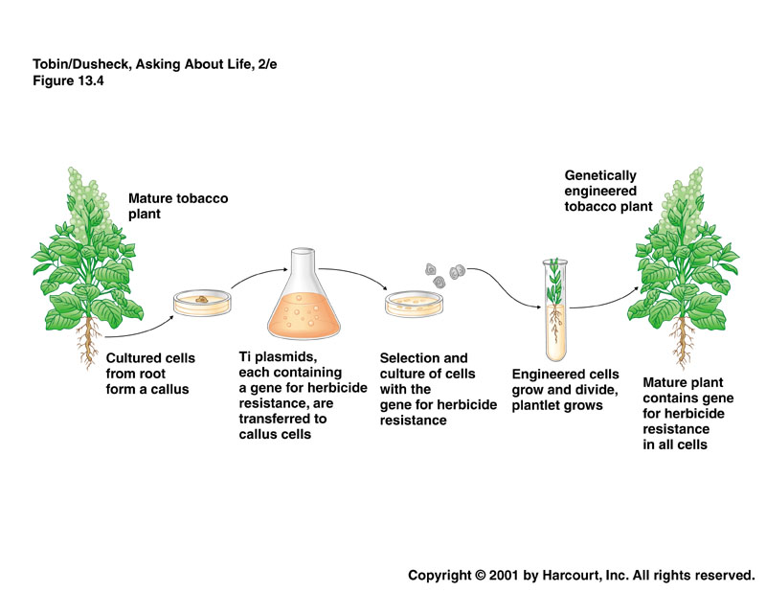

Slide 3
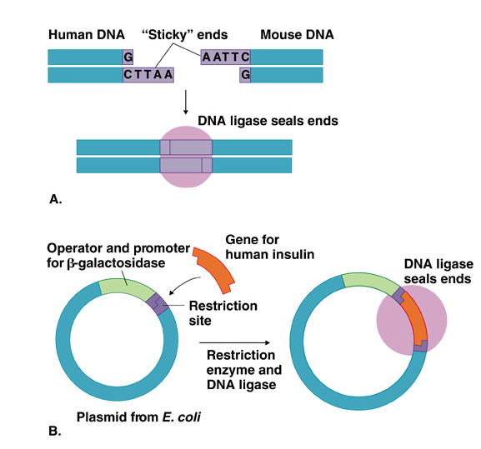
Restriction Enzymes
Bacteria produce many different restriction enzymes that cut genetic material at different sites.
Some make “blunt” ends: ATTC GGATC
TAAG CCTAG
Some make “sticky” ends: ATTCGG ATC
TAA GCCTAG
These pieces are restriction fragments.

Slide 4
For recombinant DNA to be useful, we needed to be able to produce large quantities of a gene.
One way is to use plasmids.
A plasmid can be cut down to an origin of replication and one or more genes for antibiotic resistance.
Now any other gene can be inserted into the plasmid and the bacterium will copy it.
PCR – polymerase chain reaction
Now we can easily copy or amplify DNA in the lab.
Produce two oligonucleotides that match up with the DNA before and after the DNA you want to copy.
Heat DNA to break the hydrogen bonds and open the DNA.
3. Add oligonucleotides (primers)
4. Cool, allowing primers to bind to DNA
5. Add nucleotides and DNA polymerase.
6. Repeat
Can now do the whole thing at higher temperatures using the more stable enzymes from Thermos aquaticus

Slide 5
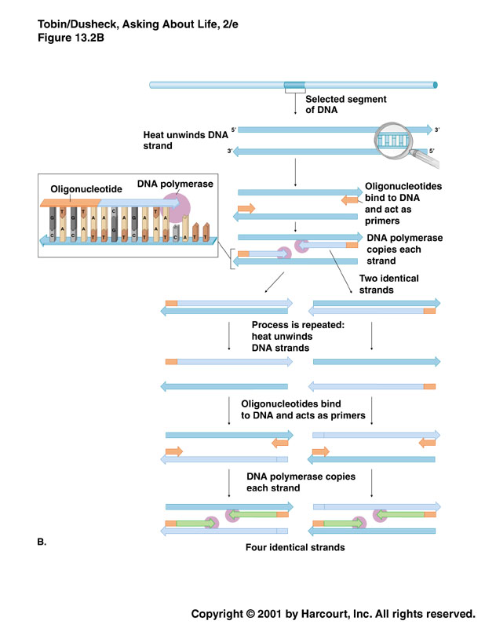

Slide 6
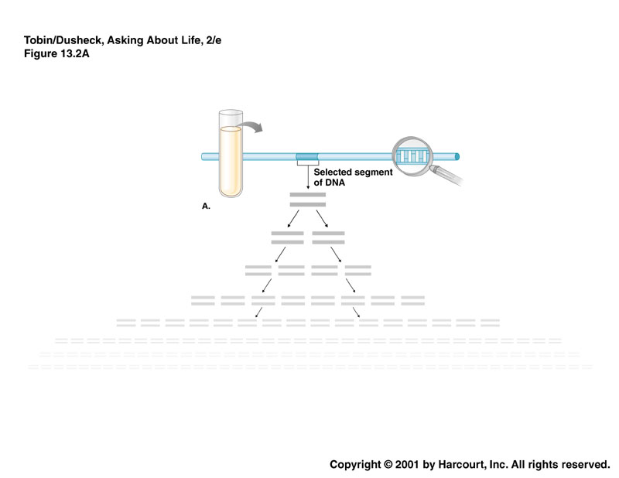
PCR can be applied to :
  Amplifying DNA in a drop of blood
  Find DNA from the HIV virus
  Find early signs of cancer
  Find genetic defects in human embryos
  Examine the DNA of ancient organisms
If we want to put eukaryotic DNA into prokaryotic DNA we have one more problem:
Introns! Bacteria do not have a means for dealing with introns, so we must give them a copy of a gene without introns in it.

Slide 7
Start with mature mRNA.
Use reverse transcriptase to copy it into DNA.
This DNA is called complimentary or cDNA.
Unfortunately, some proteins need to be modified after they are translated, which can only be done in eukaryotic cells.
To get our gene into another cell we need a vector – a means to carry it there.
This vector can be a plasmid or virus or another means of carrying the DNA into cells.
Now we can have bacterial or eukaryotic cells making useful proteins – purer vaccines, enzymes, drugs and human proteins.

Slide 8

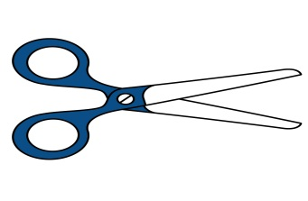

Tools for Genetic engineering
1. Restriction Enzymes
Naturally produced by bacteria – restriction endonucleases
  Natural function - destroy bacteriophage DNA in bacterial cells
  Cannot digest host DNA with methylated C (cytosine)
A restriction enzyme
  Substrate –DNA -recognizes one particular nucleotide sequence in DNA and cuts the DNA molecule (breaks down the bond between two nucleotides)
Prepackaged kits are available for rDNA techniques
sticky ends
blunt ends

Slide 9
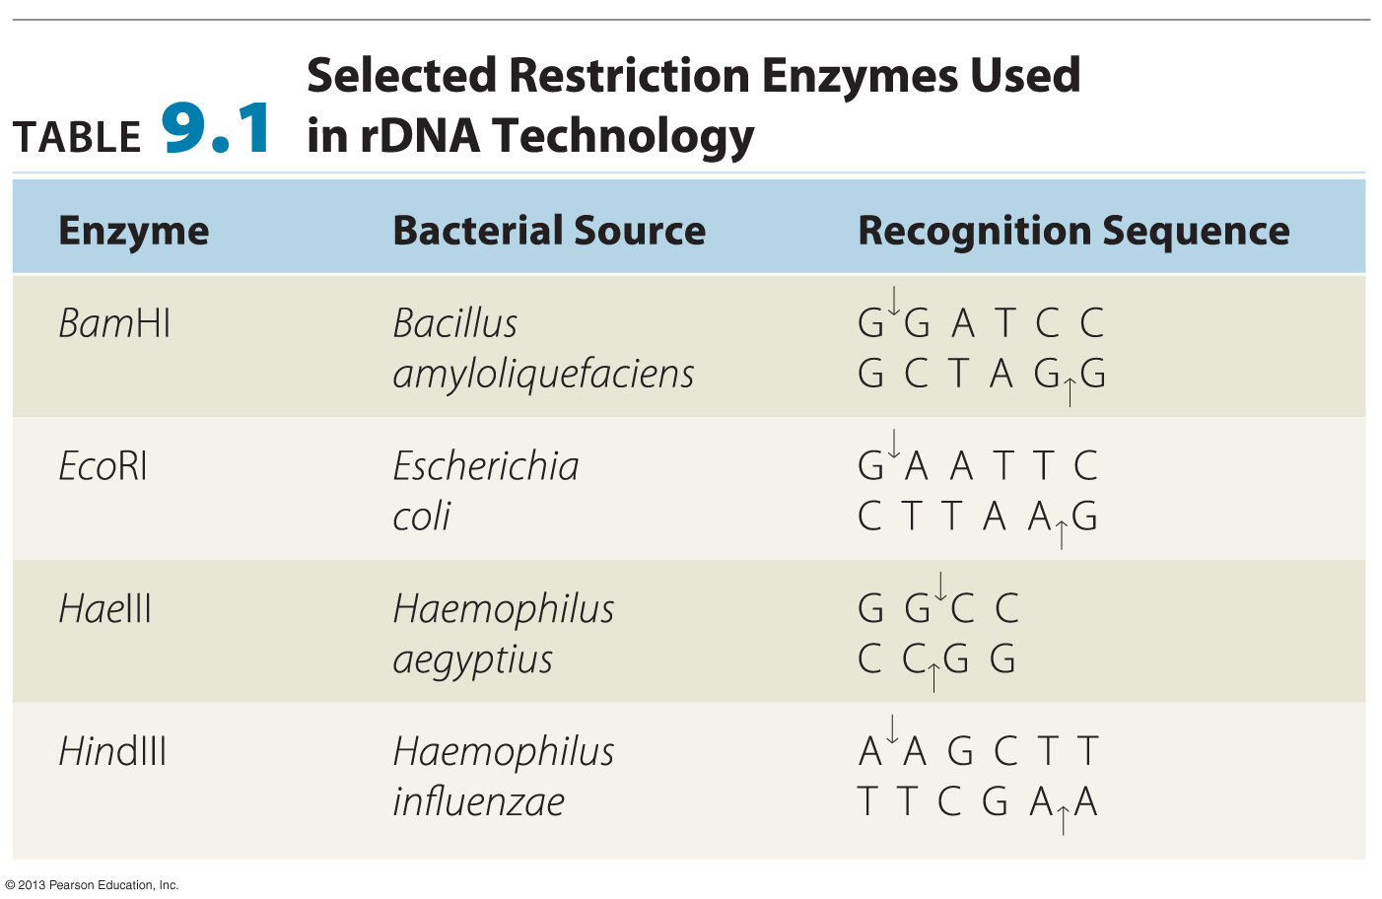

Slide 10
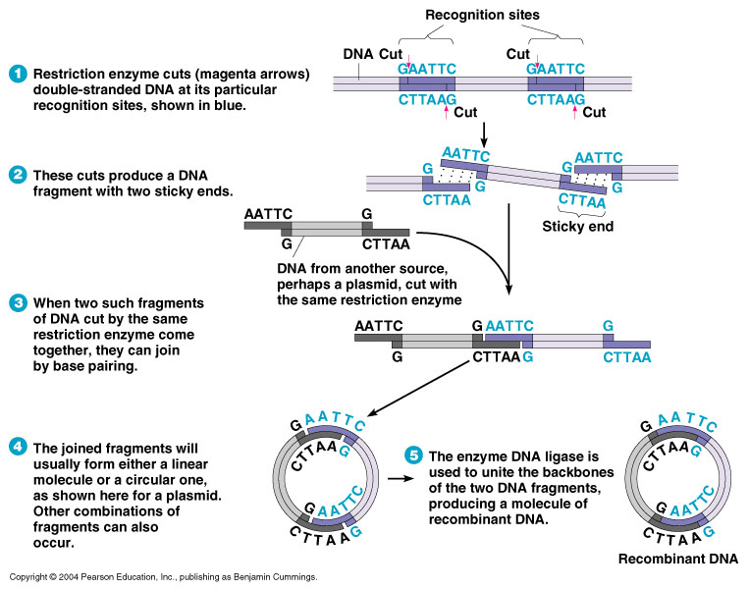
Restriction Enzymes
Fragments of DNA produced by the same restriction enzyme will spontaneously join by base pairing.
Each of the DNA strands will have a break

Slide 11
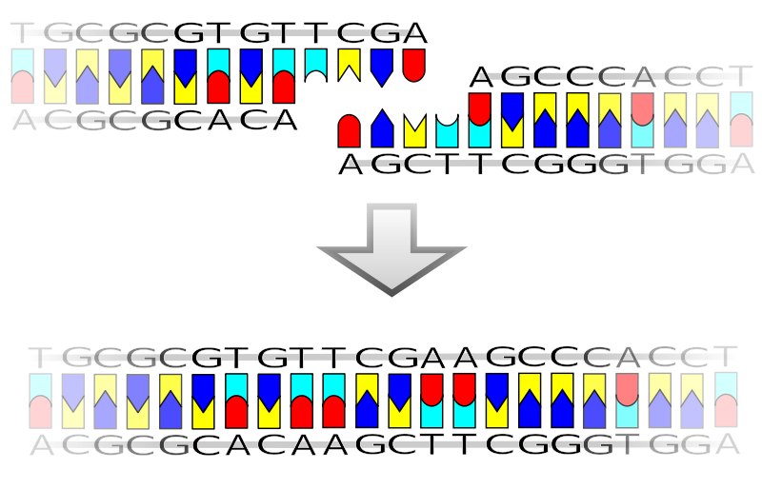
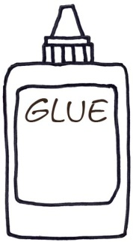
Tools for Genetic engineering
2. Ligase
DNA ligase is a enzyme that can link together DNA strands that have double-strand breaks (a break in both complementary strands of DNA).
  Naturally DNA ligase has applications in both DNA replication and DNA repair .
  Needs ATP
DNA ligase has extensive use in molecular biology laboratories for genetic recombination experiments
ATP

Slide 12
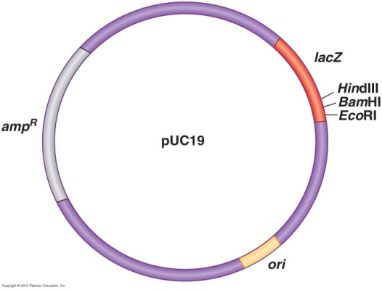
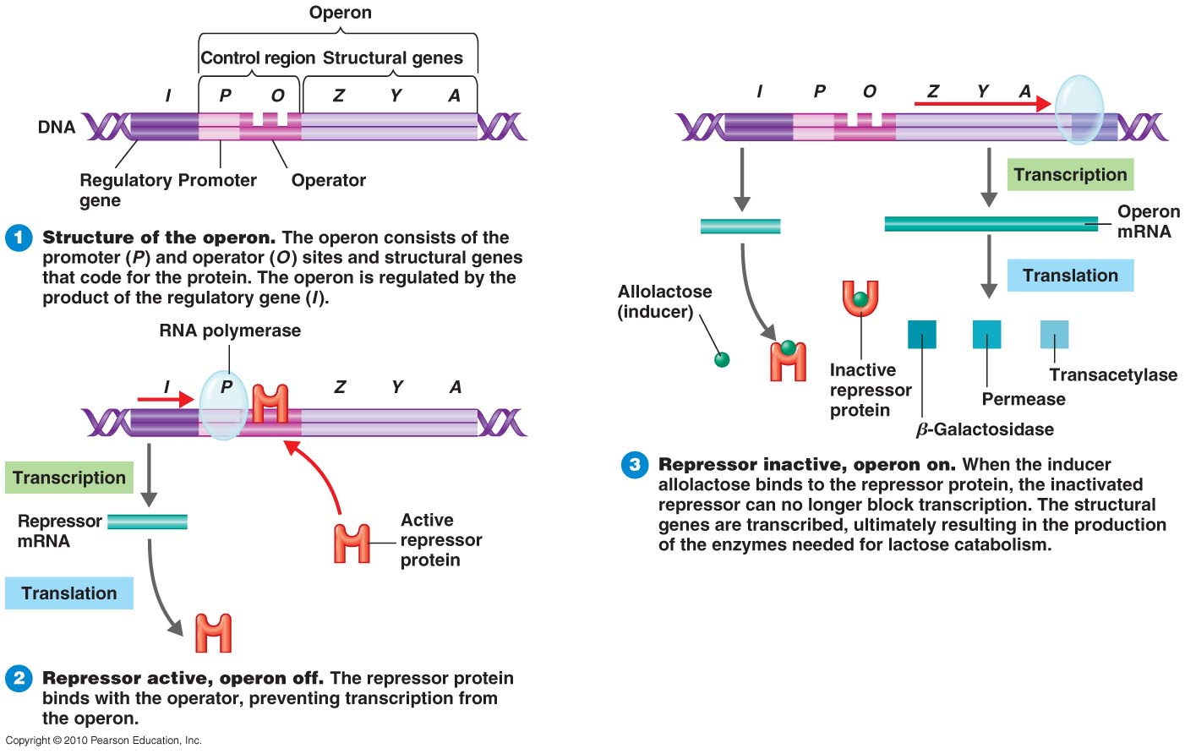
Tools for Genetic engineering
3. Vectors
Vectors - small pieces of DNA used for cloning (the gene to be inserted into the genetically modified organism must be combined with other genetic elements in order for it to work properly)
Requirements of the Vector
  1. Self-replication - able to replicate in the host (origin of
  repliction)
  2. Cloning site (site for recognition of restriction nucleases)
  3. Promoter (and operator) - to support the gene (new DNA) expression in the host
  4. Selectable marker – antibiotic resistance
  5. Proper size

Slide 13

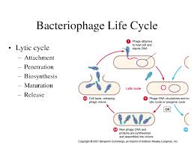
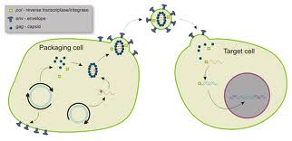
Vectors
1. Plasmid vectors
  Plasmids are self-replicating circular molecules of DNA
  Encode antibiotic resistance ( selection marker)
2. Viral vectors - retroviruses, adenoviruses and herpes viruses
      Accept much larger pieces of DNA
      Mammalian hosts

Slide 14
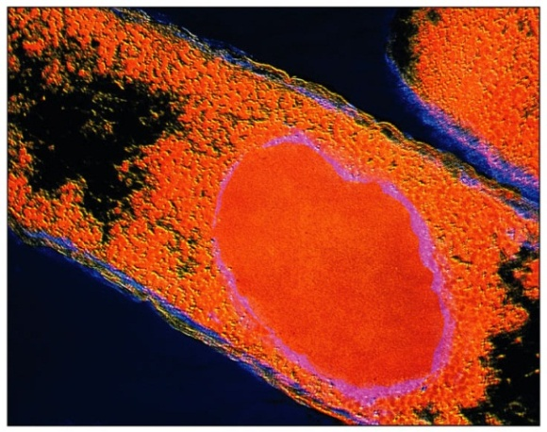
Hosts for DNA recombinant technology
Bacteria
  E. coli - used because is easily grown and its
  genomics are well understood.
  Gene product is purified from host cells
2. Yeasts - Saccharomyces cerevisiae
  Used because it is easily grown and its genomics are known
  May express eukaryotic genes easily
  Continuously secrete the gene product.
  Easily collected and purified
3. Plant cells and whole plants
  May express eukaryotic genes easily
  Plants are easily grown - produce plants with new properties.
4. Mammalian cells
  May express eukaryotic genes easily
  Harder to grow
  Medical use.

Slide 15
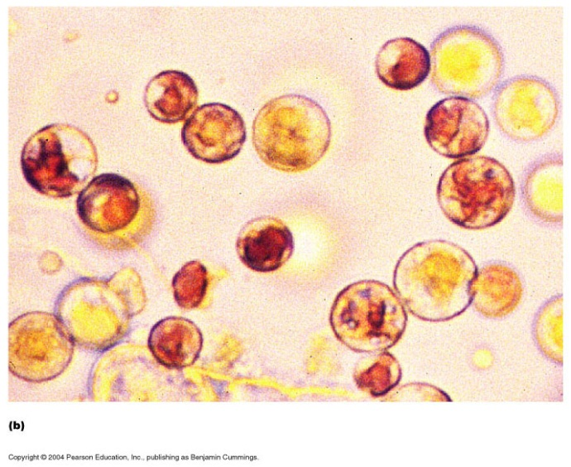
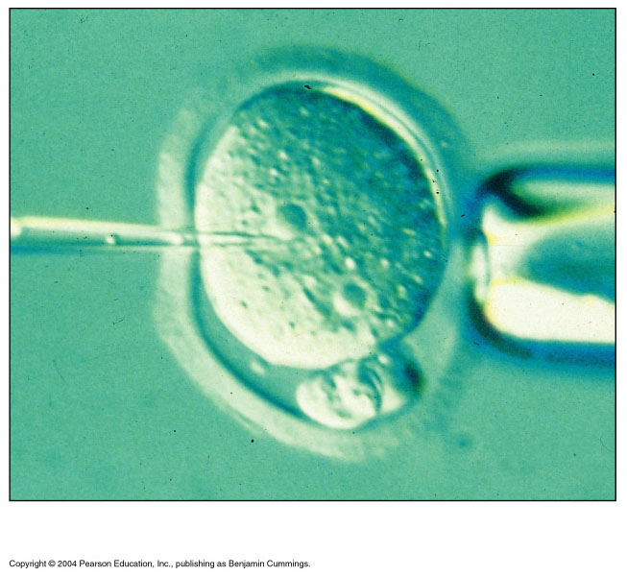
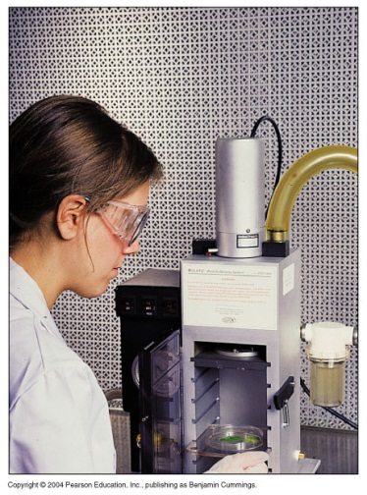
Insert the naked DNA into a host cell
1.Transformation
* treatment make cells competent to accept foreign DNA (CaCl₂ make pores in cell membrane)
2. Electroporation
*use electrical current to form microscopic pores in the membranes of cell
3. Protoplast fusion
– yeast, plants and algal cells
4. Microinjection
5. Gene gun

Slide 16
Recombinant DNA technology - Cloning
A process of producing genetically modified organisms
  A multi-step process.
Isolating and copying the genetic material of interest (DNA fragment ).
2. Building a construct (recombinant DNA - vector and desired gene) containing all the genetic elements for correct expression.
3. Inserting the vector into the host organism, directly through injection or transformation.
4. Selecting the cells expressing that gene by growing under positive selection (of an antibiotic or chemical) – clone .
5. Growing successfully the clone (transformed organisms).

Slide 17

Blue-white screening system
  1. Plasmid vector contains the genes for:
  amp^{R} (ampicillin resistance)
  The cloning site (restriction enzymes site) is inserted into the β-galactosidase gene.
  Cloning the desired gene at that site destroys β-galactosidase gene.
Lac Z (β-galactosidase) gene
P O LacZ
cloning site
Cloning restriction site
P O Desired gene ~ Lac Z

Slide 18
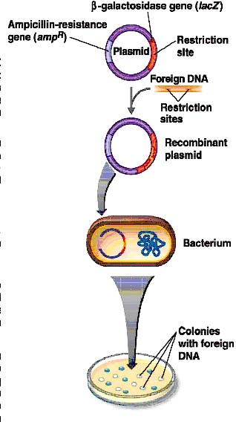
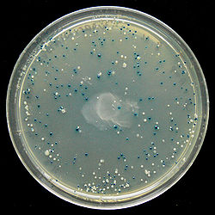
Blue-white screening system
2. The vector is then transformed into host competent cell (bacteria).
    Host is sensitive to ampicillin
    Host is β-galactosidase negative (do not carry LacZ gene)
3. The transformed cells are grown in the presence of:
    ampicillin.
    X-gal – substrate for β-galactosidase
      a colourless modified galactose sugar
      When metabolized by β-galactosidase form an insoluble product (5-bromo-4 chloroindole) which is bright blue, and thus functions as an indicator
4. Results
  Clones lacking the vector will not grow.
  Clones containing the vector without the new gene will be resistant to ampicillin, able to metabolized X-gal and will be blue.
  Clones containing the recombinant vector will be resistant to ampicillin and unable to hydrolyze X-gal (white colonies).
If the ligation was successful, the bacterial colony will be white; if not, the colony will be blue.

Slide 19
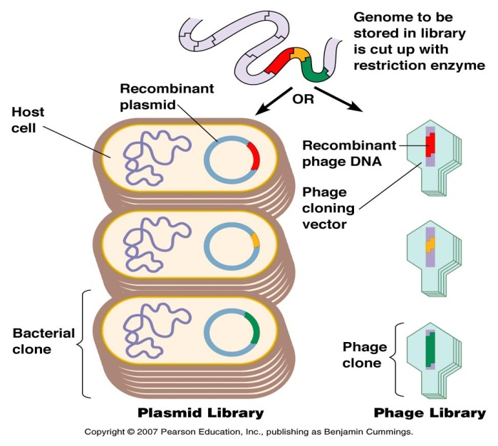
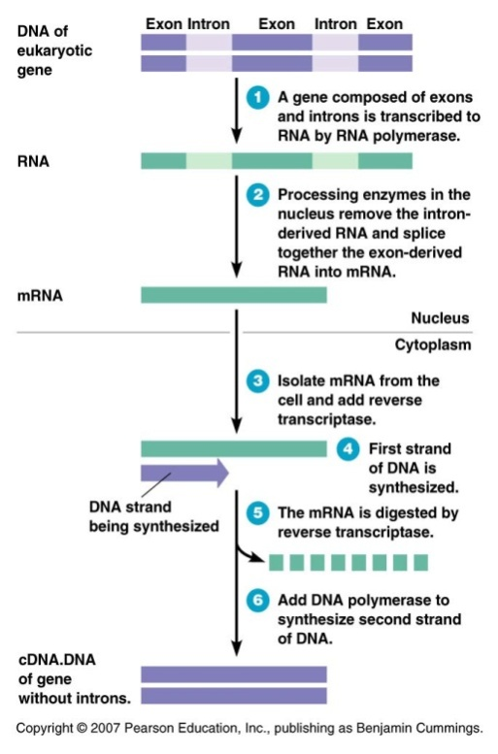
Obtaining DNA – gene of interest
1.Gene libraries are made of pieces of
an entire genome stored in plasmids
or phages
2. cDNA (complementary DNA) is made
from mRNA by reverse transcriptase
(enzyme found in retroviruses)
- Intron free DNA
3. Synthetic DNA is made by a DNA synthesis machine

Slide 20
Screening for the desired Gene
Identify the particular cell that contains the specific gene of interest (Presence of the vector with correct gene of interest)
A short piece of labeled
DNA called a DNA probe
can be used to identify clones
carrying the desired gene.
    Radioactive labeled
    Fluorescent labeled
Labeled DNA probe ( ³²P or fluorescence)
5’ *AGGCTTGTACTTTGGCGG 3’

Slide 21
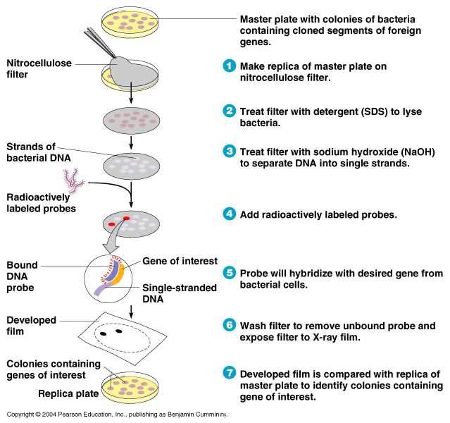

Slide 22
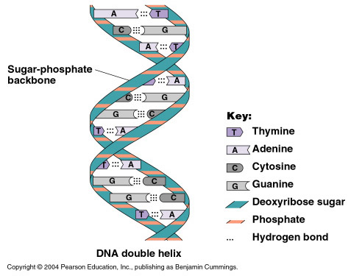
Copying the genetic material of interest - PCR
Polymerase Chain Reaction (PCR)
  A reaction to make multiple copies of a piece of DNA enzymatically
Polymerase – enzyme is DNA polymerase from Thermus aquaticus – Taq polymerase
  Taq's optimum temperature for activity is 75-80°C
  Can replicate a 1000 base pair strand of DNA in less than 10 seconds at 72°C
Chain – chain of cycles of multiplication
DNA-
Dissociation temperature
Hybridization temperature

Slide 23
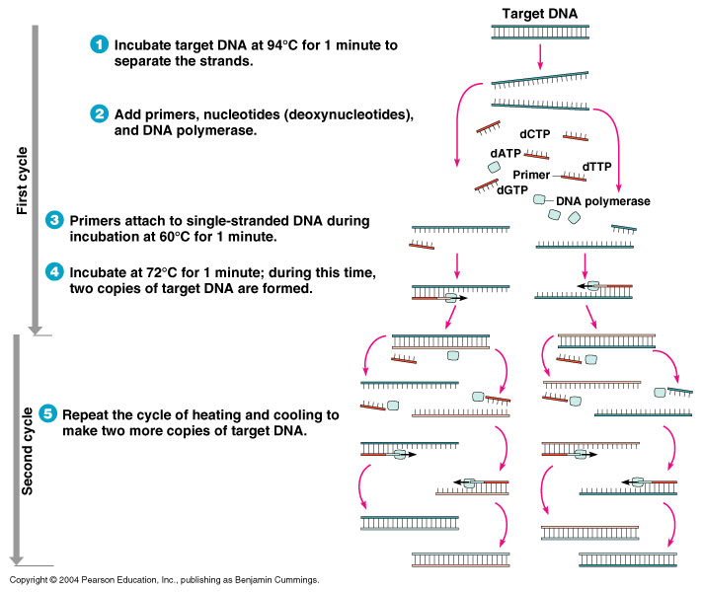
PCR amplify DNA to detectable levels
PCR reaction mixture :
1. Target DNA (template)
2. Short primers- to hybridize to the 5’ end
of each DNA strand
3. four NTP – ATP, GTP, TTP, and CTP
4. Buffer
5. DNA Taq Polymerase (enzyme)
Cycle program in PCR machine:
1. Denaturation -95ºC
2. Annealing (hybridization)- 60-65 ºC
3. Polymerase reaction -72 ºC
Product
      Start with 1 molecule
      First cycle – 2 molecules
      Second cycle – 4 molecules
      …
      ….
      Finished after 30 cycles – 1,073,741,842 molecules
30 cycles

Slide 24
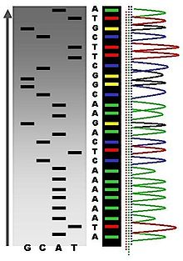
DNA sequencing
DNA sequencing - is the process of
  determining the precise order of nucleotides
  within a DNA molecule
  ( A, G, C and T in a molecule of DNA)

Slide 25
Applications of recombinant DNA technology
1. Scientific applications
  Many copies of DNA can be produced
  Increase understanding of DNA
  Identify mutations in DNA
  Alter the phenotype of an organism
  Bioinformatics is the use of computer applications to study genetic data;
  Proteomics – proteomics is the study of a cell’s proteins.
    determination of all the proteins expressing in the cell

Slide 26
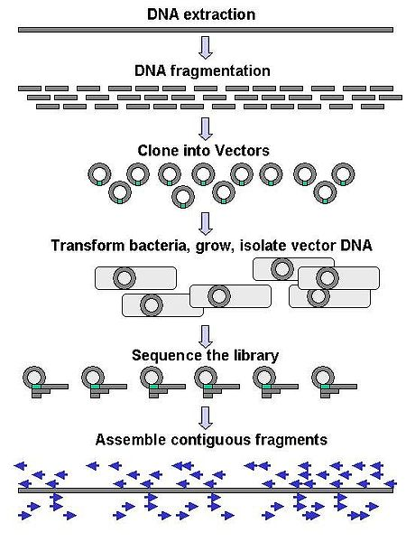
Applications of recombinant DNA technology
Shotgun sequencing - Recombinant DNA techniques were used to map the human genome through the Human Genome Project
  has 24 distinct chromosomes (22 autosomal + X + Y)
  with a total of approximately 3 billion DNA base pairs
  containing an estimated 20,000–25,000 genes
  with only about 1.5-2% coding for proteins
  the rest comprised by RNA genes, regulatory
  sequences, introns and controversially so-called
  junk DNA
  This provides tools for diagnosis and
  possibly the repair of genetic diseases

Slide 27
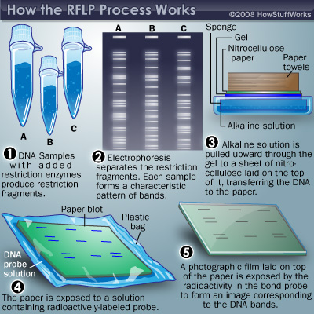
Applications of recombinant DNA technology
2. Diagnose genetic disease
  RFLP analysis (Restriction fragment length polymorphism)
    DNA profiling involved restriction enzyme digestion, followed by Southern blot analysis
  Southern blotting is used for detection of a specific DNA sequence in DNA sample
    DNA probes can be used to quickly identify a pathogen in body tissue or food.
  PCR analysis with specific primers

Slide 28
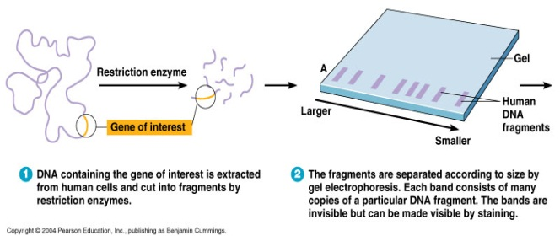
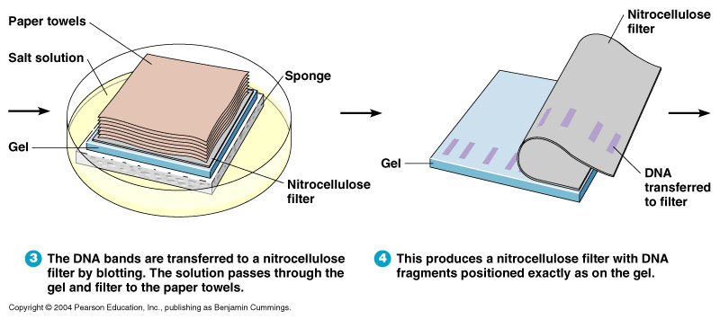
Southern blotting

Slide 29
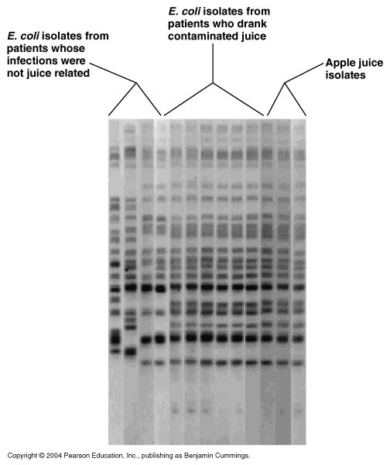
Applications of recombinant DNA technology
3. Recombinant DNA techniques can be used to for genetic fingerprinting identification
Forensic microbiology - use
DNA fingerprinting to identify
the source of bacterial or viral
pathogens.
  bioterrorism attacks (Anthrax in U.S. Mail)
  medical negligence (Tracing HIV to
  a physician who injected it)
  outbreaks of foodborne diseases

Slide 30
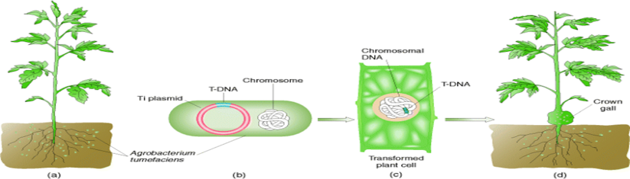
Applications of recombinant DNA technology
4. Agricultural Applications
  Cells from plants with desirable characteristics can be cloned to produce many identical cells, then can be used to produce whole plants from which seeds can be harvested.
  Some bacteria can transfer genes to unrelated species
    Agrobacterium tumefaciens - a plant pathogen
    Cause tumors in plants
    Natural genetic engineer

Slide 31
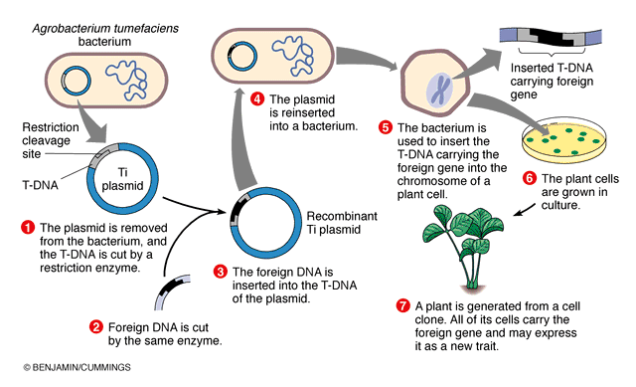
Genetic engineering manipulation
Site of insertion foreign DNA
Selection
GMO
  Genes for resistance to herbicide glyphosate, Bt toxin, and pectinase suppression have been engineered into crop plants.
  Genetically modified Rhizobium has enhanced nitrogen fixation.
  Genetically modified Pseudomonas is a biological insecticide that produces Bacillus thuringiensis toxin.

Slide 32
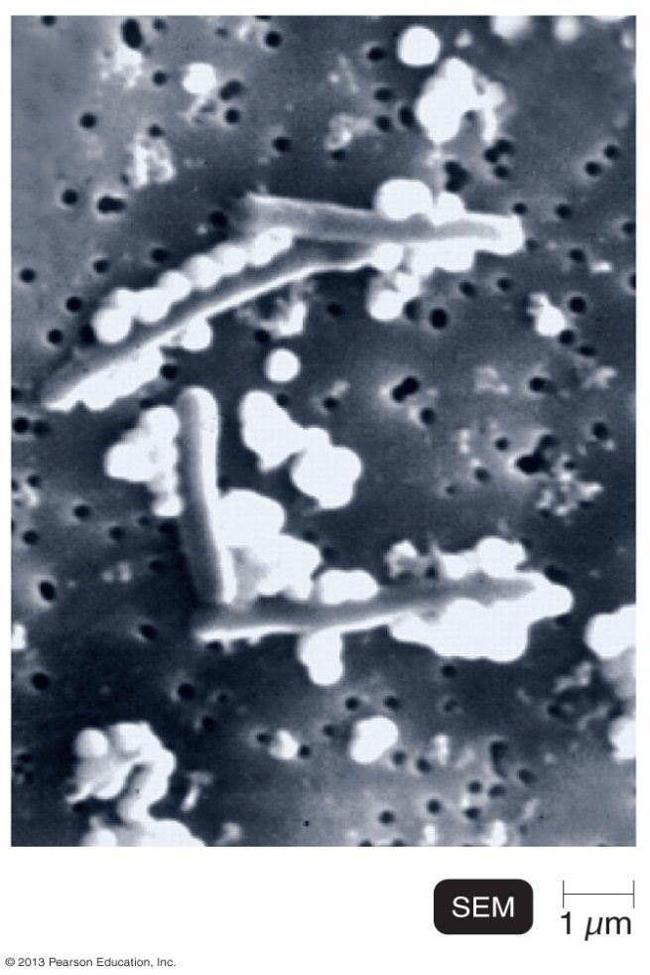
Applications of recombinant DNA technology
5. Nanotechnology
Bacteria can make molecule-sized particles
  Bacillus cells growing on selenium form chains of elemental selenium

Slide 33
Applications of recombinant DNA technology
6. Therapeutic Applications
  Produce human proteins – hormones and enzymes
    Insulin
    hGH
    INFα, INFβ and INFγ
  Vaccines
    Cells and viruses can be modified to produce a pathogen’s surface protein
      Influenza
      Hepatitis B
      Cervical cancer vaccine
    Nonpathogenic viruses carrying genes for pathogen’s antigens as DNA vaccines
    DNA vaccines consist of circular rDNA
  Gene therapy can be used to cure genetic diseases by replacing the defective or missing gene.
  Gene silencing – RNA interference - siRNA or microRNA

Slide 34
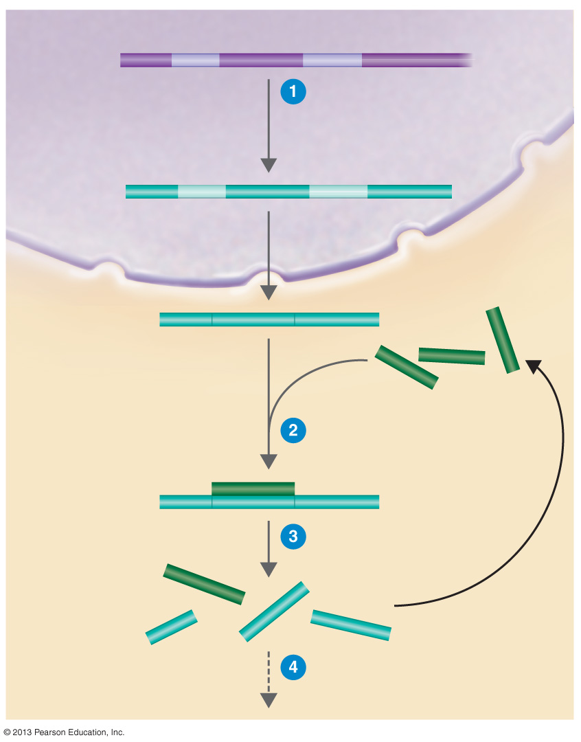
Nucleus
DNA
An abnormal gene, cancer gene, or virus gene is transcribed in a host cell.
RNA
transcript
mRNA
siRNA
siRNA binds
mRNA.
Cytoplasm
RISC breaks down the RNA complex.
No protein expression occurs.

Slide 35
Safety Issues and Ethics
Accidental release - strict safety standards are used to avoid it
  Some microbes used in recombinant DNA cloning have been altered so that they cannot survive outside the laboratory.
  Microorganisms intended for use in the environment may be modified to contain suicide genes so that the organisms do not persist in the environment.
Ethical questions
  Should employers and insurance companies have access to a person’s genetic records?
  Will some people be targeted for either breeding or sterilization?
  Will genetic counseling be available to everyone?
GMO - Genetically modified crops must be safe for consumption and for release in the environment.

Slide 36
Definitions of the gene
The gene is to genetics what the atom is to chemistry.
The gene is the unit of genetic information that controls a specific aspect of the phenotype.
The gene is the unit of genetic information that specifies the synthesis of one polypeptide.

Slide 37
How has the concept of a gene developed in the minds of geneticists?

Slide 38
Mendel (1866)
Inheritance is governed by “characters” or “constant factors” that each controls a phenotypic trait such as flower colour.

Slide 39
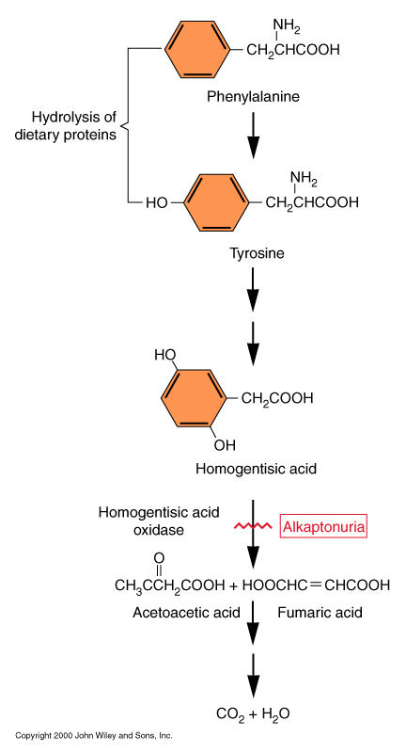
Garrod (1909) Inborn errors of Metabolism
Inherited human metabolic disorders such as alkaptonuria result from alternative metabolism.
Individual genes can mutate to cause a specific metabolic block. Concept later elaborated as “one gene-one enzyme”.
Over 4,000 inherited genetic disorders have now been described.

Slide 40
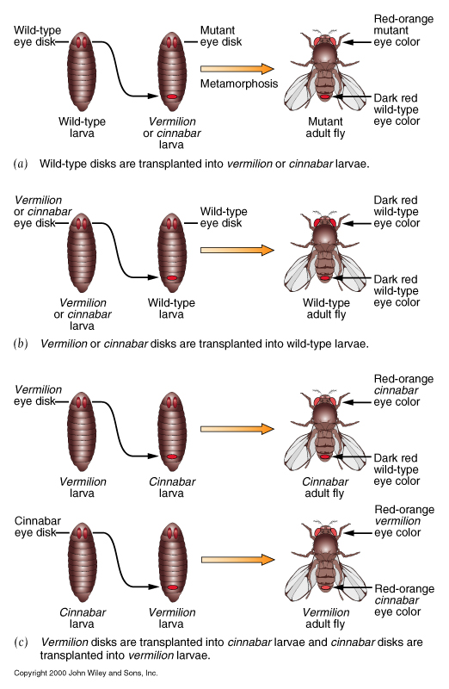
Metabolic mutations in Drosophila (Beadle and Ephrussi)
Fly eyes are normally dark red because of two pigments, one bright red and one brown.
Mutants in v or cn have bright red eyes because they lack brown pigment.
Disk transplantation experiments showed that wild-type hosts produce a diffusible substance than can allow v or cn disks to form dark red eyes.
v disks transplanted into cn hosts also develop normally, but cn disks transplanted into v hosts still develop bright red eyes!

Slide 41
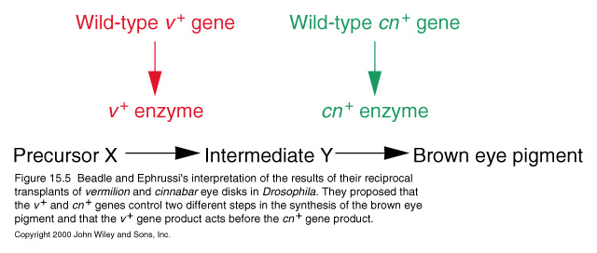
Explanation: v and cn affect different steps of the same metabolic pathway

Slide 42
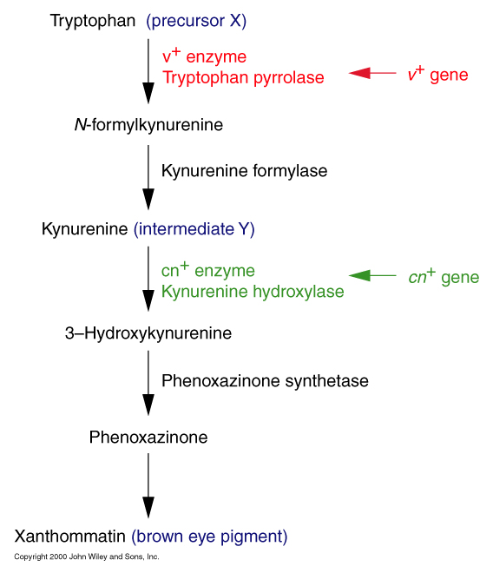
We now know the precise pathway.

Slide 43
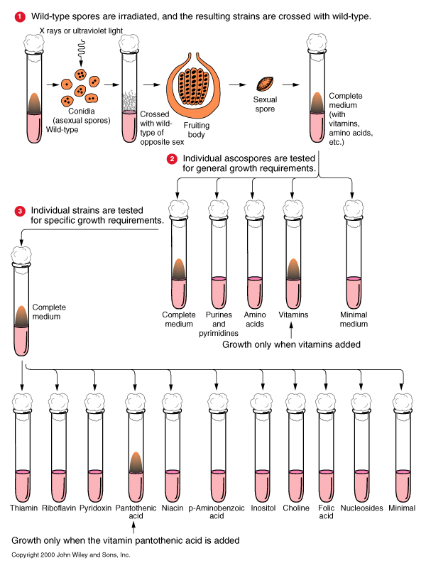
Beadle and Tatum (1942)--One Gene, One Enzyme
Bread mold Neurospora can normally grow on minimal media, because it can synthesize most essential metabolites.
If this biosynthesis is under genetic control, then mutants in those genes would require additional metabolites in their media.
This was tested by irradiating Neurospora spores and screening the cells they produced for additional nutritional requirements (auxotrophs).

Slide 44
Are genes both the basic functional unit and the smallest genetic structural unit?
Until 1940, the gene was considered as the basic unit of genetic information as defined by three criteria.
  The unit of function, controlling the inheritance of one “character” or phenotypic attribute.
  The unit of structure, operationally defined by recombination and by mutation.

Slide 45
Oliver (1940) - intergenic recombination at lozenge
Mutations in lozenge affect eye shape in Drosophila.
Two mutations, lz^{s} and lz^{g}, were considered alleles of the same gene because lz^{s}/lz^{g} heterozygotes have lozenge, not wild-type, eyes.
But when lz^{s}/lz^{g} females are crossed to lz^{s} or lz^{g} males, about 0.2% of the progeny are wild-type!
These must result from recombination between lz^{s} and lz^{g} , because the wild-type progeny always had recombinant flanking markers. Also, the frequency of 0.2% is much higher than the reversion rate of the mutations.

Slide 46
Further studies of intergenic recombination in bacteriophage and bacteria (where billions, instead of thousands, of progeny can be analyzed) showed that recombination occurs between adjacent nucleotide pairs.

Slide 47
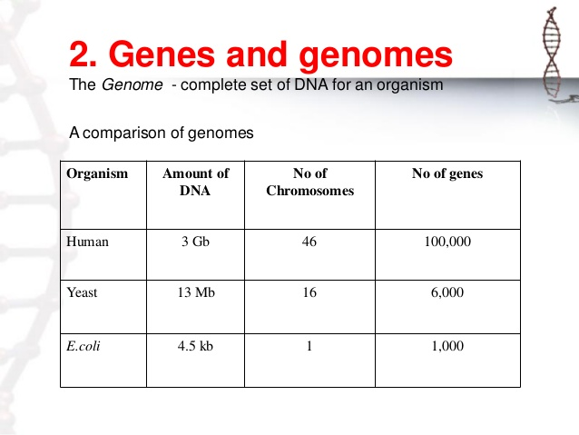
So the nucleotide, not the gene, is the basic unit of genetic structure.

Slide 48
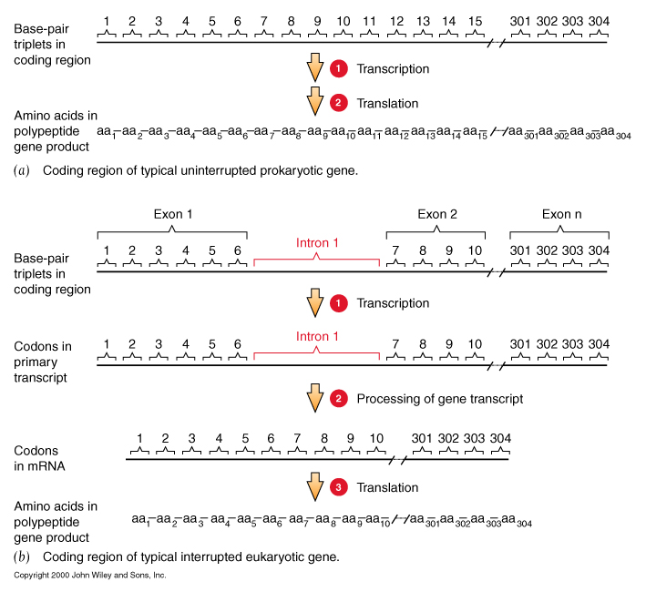
The coding sequence of a gene and its polypeptide product are colinear

Slide 49
Summary
Mendel’s work established the concept of the gene.
This concept has evolved from:
  the unit that can mutate to cause a specific block in metabolism…
  to the unit specifying one enzyme…
  to the sequence of nucleotide pairs in DNA encoding one polypeptide chain.

Slide 50
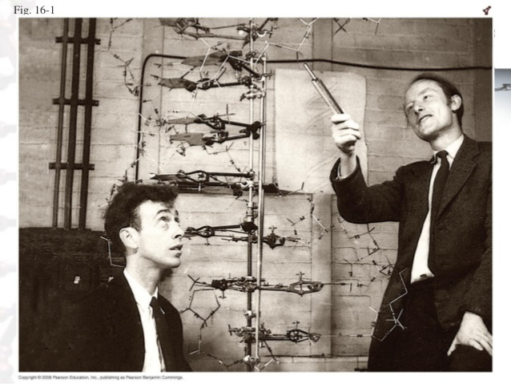

Slide 51
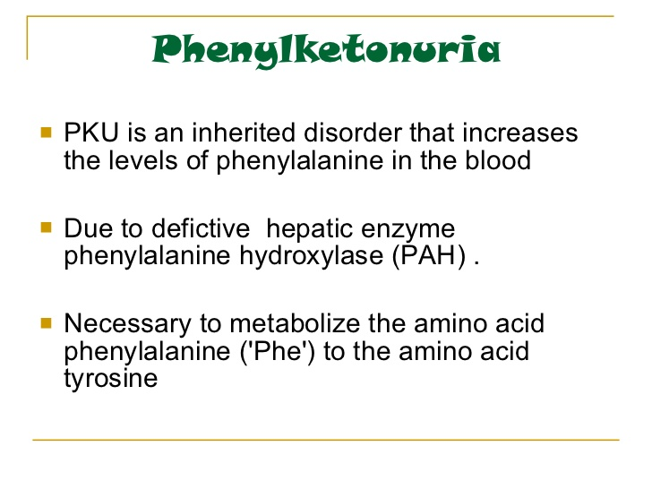

Slide 52
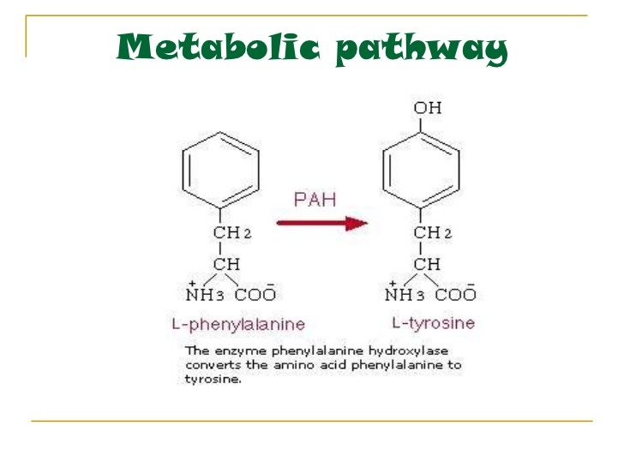

Slide 53
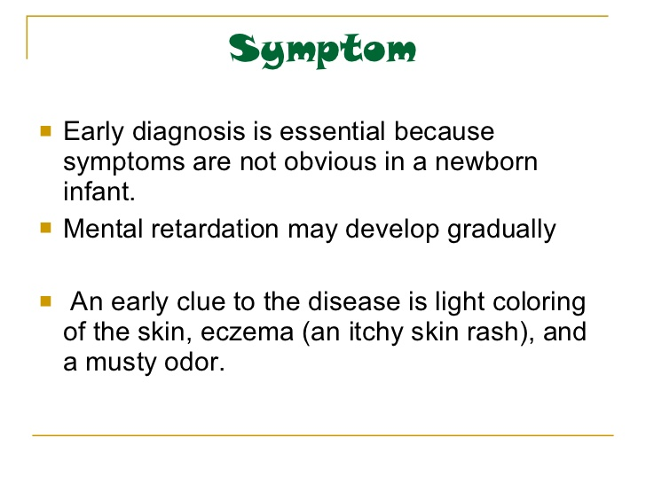

Slide 54
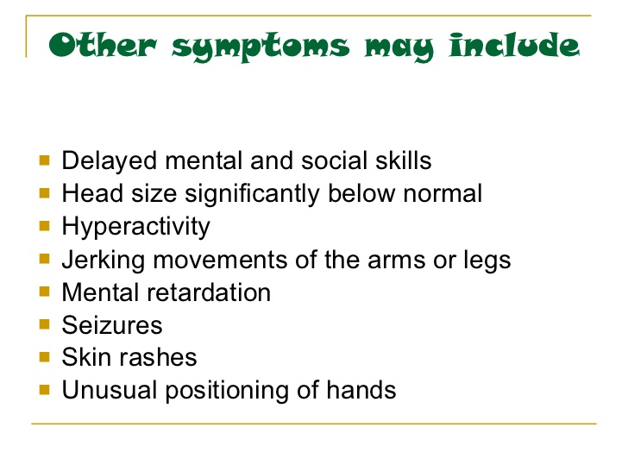

Slide 55
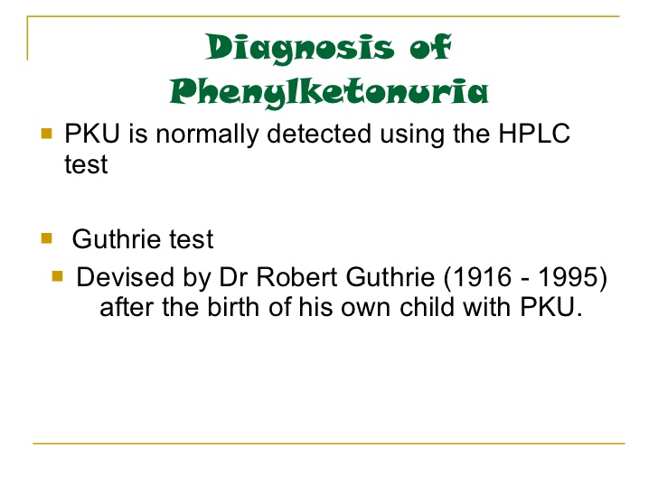

Slide 56
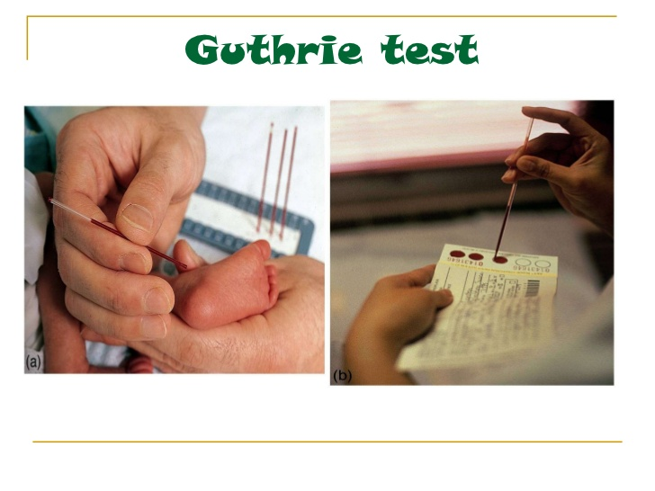

Slide 57
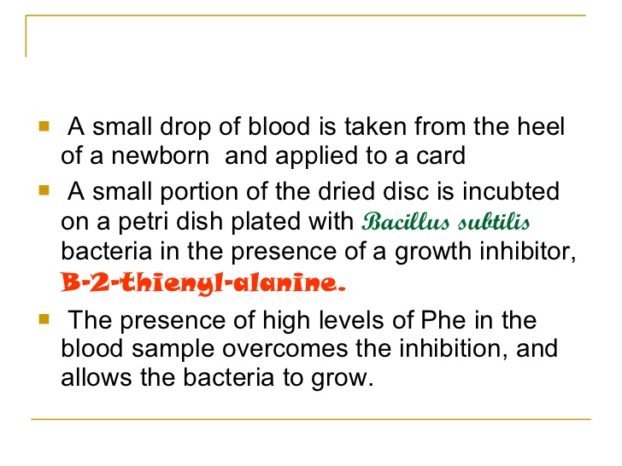

Slide 58
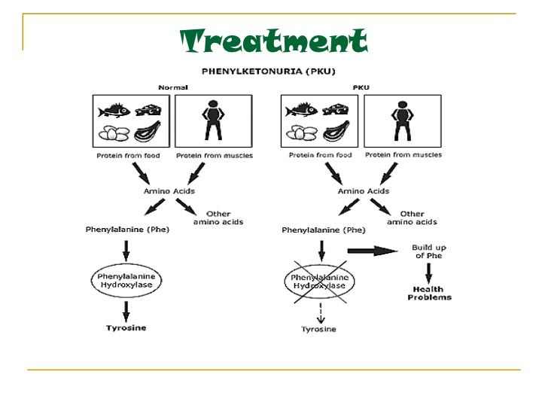

Slide 59


Slide 60


Slide 61


Slide 62


Slide 63


Slide 64


Slide 65


Slide 66


Slide 67



Slide 68


Slide 69


Slide 70


Slide 71


Slide 72


Slide 73


Slide 74


Slide 75


Slide 76


Slide 77



Slide 78
Genetic Counseling
Genetic counseling is a process, involving an individual or family, with the goal of evaluating, confirming, diagnosing or excluding a genetic condition.
A genetic counselor can help by providing information about the pros and cons of the test and discussing the social and emotional aspects of testing.
Genetic counseling may involve:
discussion of natural history and the role of heredity;
identification of medical management issues;
calculation and communication of genetic risks;
provision of or referral for mental and social support

Slide 79

SEX DETERMINATION
The sex of an individual is determined by the sex chromosomes contributed to the zygote by the sperm and the egg

Slide 80
SEX DETERMINATION
An egg can donate an X
A sperm can donate an X or Y
Therefore the sperm determines the sex of a child

Slide 81

SEX-LINKED INHERITANCE
Using fruit flies as test subjects, Thomas Morgan studied eye colour using simple monohybrid crosses.
Red eyes (R) are dominant over white eyes (r).

Slide 82

SEX-LINKED INHERITANCE
When he crossed purebred white-eyed males with red-eyed females, he was unable to produce a female with white eyes.
He concluded that the gene must be located on the X chromosome.

Slide 83

SEX-LINKED INHERITANCE
Some traits are located on the sex chromosomes, so the inheritance of these traits depends on the sex of the parent carrying the trait.

Slide 84

SEX-LINKED INHERITANCE
Most known sex-linked traits are X-linked (carried on the X chromosome). This is probably because the X chromosome is much larger than the Y chromosome.

Slide 85
SEX-LINKED DISORDERS
Some sex-linked traits are associated with disorders.
Most are found on the X chromosome, Y-linked disorders are rare.
Males are at a much greater risk for inheriting sex-disorders because they only inherit one X, so if the X has the allele for the disorder, they will suffer from the disorder.
Recessive lethal X-linked traits result in death.

Slide 86

EXAMPLES OF SEX-LINKED TRAITS and DISORDERS
Male pattern baldness, red-green colour blindness, myopia, night blindness, hemophilia

Slide 87

SEX-LINKED INHERITANCE
Punnett squares are used to predict the outcome of sex-linked inheritance.
Assume the trait is X-linked unless told otherwise!
Most disorders are recessive, some are dominant, the question will tell you.
A “carrier” is a female who is heterozygous for the trait.

Slide 88
EXAMPLE
Hemophilia is a recessive X-linked trait. What is the probability of a couple having a hemophiliac child if the man does not have hemophilia and the woman is a carrier?

Slide 89
Sex determination
TED Ed - Sex Determination

Slide 90

Patterns of Inheritance

Slide 91

What is the only way for a female to show a recessive sex-linked trait?
  She must inherit a recessive trait from both her mother and father. (her father must have the disorder)
How does a male show a recessive sex-linked trait?
  He must inherit the recessive trait from his mother. He gets the Y from his father so it has no bearing on a sex-linked disorder.

Slide 92


Slide 93

Sex Chromosomes
Females have two complementary sex chromosomes: XX
Males have 2 non-complementary sex chromosomes: XY
  Blood clotting

Slide 94


The Y chromosome
The Y chromosome is much smaller than the X.
It carries a small number of genes, most of which are for “male characteristics”

Slide 95


Slide 96

X chromosome
All human eggs contain the X chromosome.
The X chromosome contains genes that code for all aspects of femaleness and genes unrelated to gender.
Including genes for:
  Vision
  Immunity

Slide 97

Sex-Linked Genes
Genes unrelated to gender on the X chromosome.
Females have two X chromosomes (so they can be heterozygous or homozygous for each of these genes)
Males have one copy of the sex-linked genes.
Thus, the male is referred to as hemizygous.

Slide 98
Hemophilia
A blood disorder where the blood does not clot properly.
A minor cut can cause serious injury and demand medical attention.
Bleeding into the joints, internal bleeding and deep cuts can be fatal for hemophiliacs.
Genetic lack of one of the clotting factors produced by the liver.
There is no cure for hemophilia but treatment options with clotting factor transfusions are available.

Slide 99




Slide 100

Complications from hemophilia include: bruising and bleeding into the muscles, bleeding into the joints, infection, adverse reaction to transfusions and serious bleeding.

Slide 101
Genetics of Hemophilia
The gene for hemophilia is found on the X chromosome
It is a recessive disorder.
It is referred to as a sex-linked recessive disorder.
Males are more likely to get hemophilia.
Females have the possibility of being heterozygous for hemophilia. (This makes them a carrier)

Slide 102

PEDIGREE OF QUEEN VICTORIA

Slide 103

Czar Nicholas II & Family

Slide 104

Grigori Rasputin

Slide 105

In this example: The father has hemophilia. He cannot give his son hemophilia because he gives his son the Y chromosome.
He can give his daughter the recessive gene, but if her mother does not give her the recessive gene, she will not have hemophilia. She will be a carrier.

Slide 106

In this example:
The mother is a carrier of hemophilia.
She does not have hemophilia but she is heterozygous for the trait.
There is a 50% chance her son will have hemophilia.

Slide 107
Color Blindness
Males are more likely to be color blind due to the fact they only have one X chromosome.
Color Blindness is a sex-linked trait found on the X chromosome.

Slide 108


Slide 109

In this example: the mother is a carrier of the colorblind gene.
There is a 50% chance her son will be colorblind but unless the father is colorblind the daughter cannot end up colorblind.

Slide 110

Sex-Linked Inheritance
Punnett Square
In the punnett square the mother is a carrier and the father is normal.
Male offspring: 50% normal & 50%
Color Blindness
Female offspring: 50% normal 50% carrier

Slide 111
Complete the following punnett square:
Cross a normal mother with a hemophiliac father.
Results:
Genotypes: 50% 50%
Phenotypes: 50% 50%

Slide 112
What is the only way for a female to show a recessive sex-linked trait?
  She must inherit a recessive trait from both her mother and father. (her father must have the disorder)
How does a male show a recessive sex-linked trait?
  He must inherit the recessive trait from his mother. He gets the Y from his father so it has no bearing on a sex-linked disorder.

Slide 114
What is a holandric gene?
Give an example of a trait. Holandric genes are Y linked genes that are found on the Y chromosome. Therefore this gene is only found in males (Free dictionary). An example of a trait for this gene is facial hair growth

Slide 115
Y-linked (Holandric)
4
4
Only males are affected
Affected males pass the disease gene to all their sons and to
none of their daughters
Adapted from The Pedigree: A Basic Guide, by Jorgenson, Yoder & Shapiro

Slide 116



Y-linked Genes –caused by gene found on Y chromosome that is not homologous with X chromosome (called holandric gene) Not many holandric genes
    Is it possible for a female to inherit a holandric trait?
    “Hairy Ears”- (hypertrichosis)

Slide 117
Characteristics of Drosophila melanogaster
1. Easy to maintain and breed
2. About 0.1 inch long- so tiny that hundreds can be kept in a jar
3. Have a reproductive cycle of 10-15 days, therefore they can produce many generations of offspring in a matter of weeks

Slide 118


Slide 119


Slide 120


Slide 121
Morgan’s Experiment
In fruit flies- alleles for red eyes (R) are dominant over alleles for white eyes (r).
Morgan hypothesized that the allele for eye color is carried on the X chromosome
P1 generation – Cross a white-eyed male and a homozygous red-eyed female

Slide 122
Sex-linked Traits
Example: red eye color is a dominant trait carried on the X chromosomes in fruit flies; white is recessive
Cross red eyed female with a white eyed male
Get: 2 heterozygous red eyed females and 2 red eyed males

Slide 123
Sex-linked Traits
Now cross the F1: red eyed male with heterozygous red eyed female
You get:
  1 homozygous red eyed female
  1 heterozygous red eyed female
  1 red eyed male
  1 white eyed male

Slide 124

Parental Generation (P₁)
F₁ generation
F₂ generation

Slide 125
Conclusion
The gene for eye color in Drosophila must be carried on the X chromosome
Females have two X chromosomes
Males have only one X chromosome so whatever allele in on the X chromosome for eye color is expressed

Slide 126
Morgan concluded that genes for certain traits are carried on the X chromosomes and that chromosomes and their genes segregate during meiosis
The discovery of sex-linked traits explained why some characteristics caused by recessive genes are appear far more often in males since males have only one X chromosome and females have two X chromosomes

Slide 127
Gynandromorphism
A gynandromorph is an organism that contains both male and female characteristics. The term gynandromorph, from Greek "gyne" female and "andro" male, is mainly used in the field of entomology. These characteristics can be seen in butterflies, where both male and female characteristics can be seen physically because of sexual dimorphism.

Slide 128


Tiger Swallowtail
Pterourus glaucus
female
male

Slide 129


What is up with this Tiger Swallowtail?
female
male

Slide 130

An actual specimen: no photoshop!

Slide 131
It’s a gynandromorph!
“gyn” means “female”
“andro” means “male”
“morph” means “form”
“Gynandromorph” literally means part female and part male.

Slide 132
Vocabulary review
Zygote: fertilized egg cell
Cell differentiation: at some point in cell division, a cell becomes determinate
Sex chromosomes: X and Y
Humans: XX=female XY= male
Lepidoptera: XX=male XY or X=female
Non-disjunction: Chromosomes do not detach from each other

Slide 133
How does this happen?
Normally, in moths & butterflies:
XX = Male
XY = Female
If the butterfly has two or more “X” chromosomes, it will develop as a male. With only one “X” chromosome, it will be a female.
In arthropods, the first cell division differentiates left from right.
Bilateral gynandromorphs arise by mitotic nondisjunction in the sex chromosomes at this one-two cell stage.

Slide 134

XX
XX
duplicated
XXX
X
male
female

Slide 135



Example #2

Slide 136

Another Example: Blue Crab
female
male

Slide 137


Slide 138


Slide 139


Slide 140


Slide 141


Slide 142


Slide 143


Slide 144


Slide 145


Slide 146


Slide 147
Blood Genetics
The human ABO gene is on chromosome 9.
Everyone has two copies of chromosome 9 so you have two ABO genes.
One copy is inherited from our mother, the other from our father.

Slide 148
Alleles
There are three versions (called “alleles”) of this blood type gene: A, B, and O.
A person’s blood type is determined by which allele he/she inherits from each parent.

Slide 149
Pheno vs. Geno
The genetic makeup of an organism is called the “genotype”.
The “phenotype” is the visible properties of an organism.
In this case, the A, B, and O allele combination a person has is their genotype
Their blood type is their phenotype.

Slide 150
Dominant vs. Recessive Genes
The “A” allele is dominant and so is the “B” allele.
Together though, the “A” and “B” alleles are co-dominant.
The “O” allele is recessive.

Slide 151



Slide 152


Slide 153
Blood Genetics
The human ABO gene is on chromosome 9.
Everyone has two copies of chromosome 9 so you have two ABO genes.
One copy is inherited from our mother, the other from our father.

Slide 154
Alleles
There are three versions (called “alleles”) of this blood type gene: A, B, and O.
A person’s blood type is determined by which allele he/she inherits from each parent.

Slide 155
Pheno vs. Geno
The genetic makeup of an organism is called the “genotype”.
The “phenotype” is the visible properties of an organism.
In this case, the A, B, and O allele combination a person has is their genotype
Their blood type is their phenotype.

Slide 156
Dominant vs. Recessive Genes
The “A” allele is dominant and so is the “B” allele.
Together though, the “A” and “B” alleles are co-dominant.
The “O” allele is recessive.

Slide 157
Inheritance
Blood group antigens are “codominant”, if the gene is inherited, it will be expressed.
Some aberrant genotypes do occur but due to the rarity will not be discussed.
Understanding of basic inheritance important.

Slide 158
Genetics
Two genes inherited, one from each parent.
Individual who is A or B may be homozygous or heterozygous for the antigen.
Heterozygous: AO or BO
Homozygous: AA or BB
Phenotype is the actual expression of the genotype, ie, group A
Genotype are the actual inherited genes which can only be determined by family studies, ie, AO.

Slide 159
Example of Determining Genotype
Mom’s phenotype is group A, genotype AO
Dad’s phenotype is group B, genotype BO
 | B | O
A | AB 25% | AO 25% (Group A)
O | BO 25% (Group B) | OO 25% (Group O)

Slide 160
Other Examples
Mom | Dad | Offspring Blood Group
AA | BB | 100% AB
BO | OO | 50% each of B or O
OO | OO | 100% O
OO | AO | 50% each of A or O

Slide 161
Group O
Approximately 45% of the population is group O.
No A or B antigens present, think of as “0” antigens present.
These individuals form potent anti-A and anti-B antibodies which circulate in the blood plasma at all times.

Slide 162
Group A
Approximately 40% of the population is group A.
No B antigens present.
These individuals form potent anti-B antibodies which circulate in the blood plasma at all times.

Slide 163
Group B
Approximately 11% of the population is group B.
No A antigens present.
These individuals form potent anti-A antibodies which circulate in the blood plasma at all times.

Slide 164
Group AB
Approximately 4% of the population is group AB.
Both A and B antigens present.
These individuals possess no ABO antibodies.
NOTE: This slide is in error as it only illustrates presence of one antigen not 2.

Slide 165
Summary
Blood Group | Antigens on cell | Antibodies in plasma | Transfuse with group
A | A | Anti-B | A or O
B | B | Anti-A | B or O
AB | A and B | none | AB, A, B or O
O | None | Anti-A & B | O

Slide 166
Rh (D) Antigen (continued)
Unlike the ABO blood group system, individuals who lack the D antigen do not naturally make it.
Production of antibody to D requires exposure to the antigen.
The D antigen is very immunogenic, ie, individuals exposed to it will very likely make an antibody to it.
For this reason all individuals are typed for D, if negative must receive Rh (D) negative blood.

Slide 167
Rh (D) Antigen (continued)
The most important patient population to consider is females of child-bearing age.
If immunized to Rh (D) antigen the antibody can cross the placenta and destroy Rh (D) positive fetal cells resulting in death.
This is why Rh negative women are given Rhogam after birth of Rh positive baby.

Slide 168


Slide 169
Non allelic and non epistatic - comb shapes in fowls
The genes of an individual do not operate isolated from one another, but obviously are functioning in a common cellular environment. Thus, it is expected interactions between genes would occur. Bateson and Punnett performed a classical experiment that demonstrated genetic interactions. They analyzed the three comb types of chicken known to exist at that time:
Chicken Varieties | Phenotype
Wyandotte | Rose Comb
Brahmas | Pea Comb
Leghorns | Single Comb

Slide 170


Slide 171

Dominant epistasis (9: 3: 3: 1):
Result:
The F₁ differed from both parents and two new phenotypes not seen in the parents appeared in the F₂. How can this result be explained? The first clue is the F₂ ratio. We have seen this ratio before when the F₁ from a dihybrid cross is selfed (or intermated). This observation suggests that two genes may control the phenotype of the comb. The gene interactions and genotypes were determined by performing the appropriate testcrosses.

Slide 172
A series of experiments demonstrated that the genotypes controlling the various comb phenotypes are as follows
Phenotypes | Genotypes | Frequency
Walnut | R_P_ | 9/16
Rose | R_pp | 3/16
Pea | rrP_ | 3/16
Single | rrpp | 1/16
It was later shown that the genotypes of the initial parents were:
Rose = RRpp
Pea = rrPP

Slide 173


Slide 174

Therefore, genotypically the cross was:
The development of any individual is obviously the expression of all the genes that are a part of its genetic makeup. Therefore, it is not an unexpected conclusion that more than one gene could be responsible for the expression of a single phenotype. We will now discuss this situation. First let's give a definition.

Slide 175


Duplicate gene or Dulpicate dominant epistasis 15:1 Ratio
Epistasis - the interaction between two or more genes to control a single phenotype
The interactions of the two genes which control comb type was revealed because we could identify and recognize the 9:3:3:1. Other genetic interactions were identified because the results of crossing two dihybrids produced a modified Mendelian ratio. All of the results are modifications of the 9:3:3:1 ratio.
Example 1:
15:1 Ratio
Phenotypes: Kernel Color in Wheat

Slide 176
Genotype | Kernel Phenotype | Enzymatic Activities
9 A_B_ | colored kernels | functional enzymes from both genes
3 A_bb | colored kernels | functional enzyme from the A gene pair
3 aaB_ | colored kernels | functional enzyme from the B gene pair
1 aabb | colorless kernels | non-functional enzymes produced at both genes
If we sum the three different genotypes that will produce a colored kernel we can see that we can achieve a 15:1 ratio. Because either of the genes can provide the wild type phenotype, this interaction is called duplicate gene action.

Slide 177

Complimentary factor ratio
9:7 Ratio
Example: Flower color in sweet pea
If two genes are involved in a specific pathway and functional products from both are required for expression, then one recessive allelic pair at either allelic pair would result in the mutant phenotype. This is graphically shown in the following diagram.
If a pure line pea plant with colored flowers (genotype = CCPP) is crossed to pure line, homozygous recessive plant with white flowers, the F₁ plant will have colored flowers and a CcPp genotype. The normal ratio from selfing dihybrid is 9:3:3:1, but epistatic interactions of the C and P genes will give a modified 9:7 ratio. The following table describes the interactions for each genotype and how the ratio occurs.

Slide 178
Genotype | Flower Color | Enzyme Activities/TH>
9 C_P_ | Flowers colored; anthocyanin produced | Functional enzymes from both genes
3 C_pp | Flowers white; no anthocyanin produced | p enzyme non-functional
3 ccP_ | Flowers white; no anthocyanin produced | c enzyme non-functional
1 ccpp | Flowers white; no anthocyanin produced | c and p enzymes non-functional
Because both genes are required for the correct phenotype, this epistatic interaction is called complementary gene action.

Slide 179


Slide 180

Dominant epistasis
12:3:1 Ratio
Phenotype: Fruit Color in Squash
With this interaction, color is recessive to no color at one allelic pair. This recessive allele must be expressed before the specific color allele at a second locus is expressed. At the first gene white colored squash is dominant to colored squash, and the gene symbols are W=white and w=colored. At the second gene yellow is dominant to green, and the symbols used are G=yellow, g=green. If the dihybrid is selfed, three phenotypes are produced in a 12:3:1 ratio. The following table explains how this ratio is obtained.
Shapes of Squash Fruit

Slide 181
Genotype | Fruit Color | Gene Actions
9 W_G_ | White | Dominant white allele negates effect of G allele
3 W_gg | White | Dominant white allele negates effect of G allele
3 wwG_ | Yellow | Recessive color allele allows yellow allele expression
1 wwgg | Green | Recessive color allele allows green allele expression
Because the presence of the dominant W allele masks the effects of either the G or g allele, this type of interaction is called dominant epistasis.

Slide 182
Dominant and recessive interaction
13:3 ratio
Phenotype: Malvidin production in Primula
Certain genes have the ability to suppress the expression of a gene at a second locus. The production of the chemical malvidin in the plant Primula is an example. Both the synthesis of the chemical (controlled by the K gene) and the suppression of synthesis at the K gene (controlled by the D gene) are dominant traits. The F₁ plant with the genotype KkDd will not produce malvidin because of the presence of the dominant D allele. What will be the distribution of the F₂ phenotypes after the F₁ was crossed?
Genotype | Phenotype and genetic explanation
9 K_D_ | no malvidin because dominant D allele is present
3 K_dd | malvidin productions because dominant K allele present
3 kkD_ | no malvidin because recessive k and dominant D alleles present
1 kkdd | no malvidin because recessive k allele present

Slide 183
The ratio from the above table is 13 no malvidin production to 3 malvidin production. Because the action of the dominant D allele masks the genes at the K locus, this interaction is termed dominant suppression epistasis.
Suppressor - a genetic factor that prevents the expression of alleles at a second locus; this is an example of epistatic interaction
Remember that epistasis is the interaction between different genes. If one allele or allelic pair masks the expression of an allele at the second gene, that allele or allelic pair is epistatic to the second gene. Therefore, the following table summarizes the four epistatic interactions discussed above.
Example | Allelic Interactions | Type of Epistasis
Wheat kernel color | A epistatic to B, b B epistatic to A, a | Duplicate genes
Sweet pea flower color | cc epistatic to P, p pp epistatic to C, c | Complementary gene action
Squash Fruit Color | W epistatic to G, g | Dominant epistasis
Primula malvidin production | D epistatic to K, k | Dominant suppression

Slide 184
Recessive epistasis
(9:3:4):
Recessive alleles at one locus (aa) mask the phenotypic expression of other gene locus (BB, Bb or bb) such epistasis is called recessive epistasis. The alleles of ‘B’ locus express themselves only when epistatic locus ‘A’ has dominant allele like AA or Aa. The phenotypic ratio is 9: 3: 4.
Example:
Complete dominance at both gene pairs, but one gene, when homozygous recessive, is epistatic to the other.
In Mouse coat colour.
Gene pair A: colour dominant over albino.
Gene pair ‘B’ agouti colour dominant over black.
Interaction: homozygous albino is epistatic to aguoti and black.
Agouti 9/16
Black 3/16
Albino 4/16

Slide 185


