Slide 1
Biogeochemical cycles
Ms.a.r.mukhedkar.
Hod botany.s.m.d.m.mahavidyalaya kalamb

Slide 2
Carbon Cycle Definition
Carbon cycle is the process where carbon compounds are interchanged among the biosphere, geosphere, pedosphere, hydrosphere, and atmosphere of the earth.
Carbon Cycle Steps
Following are the major steps involved in the process of the carbon cycle:
Carbon present in the atmosphere is absorbed by plants for photosynthesis.
These plants are then consumed by animals, and carbon gets bioaccumulated into their bodies.
These animals and plants eventually die, and upon decomposing, carbon is released back into the atmosphere.
Some of the carbon that is not released back into the atmosphere eventually become fossil fuels.
These fossil fuels are then used for man-made activities, which pumps more carbon back into the atmosphere.

Slide 3
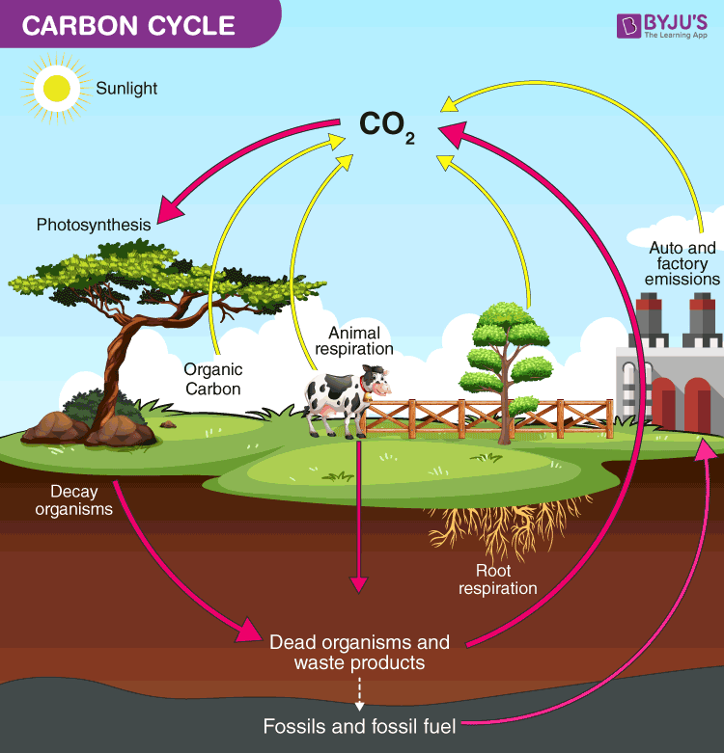

Slide 4
Carbon Cycle on Land
Carbon in the atmosphere is present in the form of carbon dioxide.
Carbon enters the atmosphere through natural processes such as respiration and industrial applications such as burning fossil fuels.
The process of photosynthesis involves the absorption of CO2 by plants to produce carbohydrates. The equation is as follows:
CO2 + H2O + energy → (CH2O)n +O2
Carbon compounds are passed along the food chain from the producers to consumers.
The majority of the carbon exists in the body in the form of carbon dioxide through respiration.
The role of decomposers is to eat the dead organism and return the carbon from their body back into the atmosphere. The equation for this process is:
(CH2O)n +O2 → CO2 + H2O

Slide 5
Oceanic Carbon Cycle
This is essentially a carbon cycle but in the sea. Ecologically, oceans take in more carbon than it gives out.
Hence, it is called a “carbon sink.” Marine animals convert carbon to calcium carbonate and this forms the raw building materials require to create hard shells, similar to the ones found in clams and oysters.
When organisms with calcium carbonate shells die, their body decomposes, leaving behind their hard shells.
These accumulate on the seafloor and are eventually broken down by the waves and compacted under enormous pressure, forming limestone.
When these limestone rocks are exposed to air, they get weathered and the carbon is released back into the atmosphere as carbon dioxide.

Slide 6
Importance of Carbon Cycle
Even though carbon dioxide is found in small traces in the atmosphere, it plays a vital role in balancing the energy and traps the long-wave radiations from the sun.
Therefore, it acts like a blanket over the planet. If the carbon cycle is disturbed it will result in serious consequences such as climatic changes and global warming.
Carbon is an integral component of every life form on earth. From proteins and lipids to even our DNA.
Furthermore, all known life on earth is based on carbon. Hence, the carbon cycle, along with the nitrogen cycle and oxygen cycle, plays a vital role in the existence of life on earth.

Slide 7
Key Points on Carbon Cycle
Carbon cycle explains the movement of carbon between the earth’s biosphere, geosphere, hydrosphere and atmosphere.
Carbon is an important element of life.
Carbon dioxide in the atmosphere is taken up by the green plants and other photosynthetic organisms and is converted into organic molecules that travel through the food chain.
Carbon atoms are then released as carbon dioxide when organisms respire.
The formation of fossil fuels and sedimentary rocks contribute to the carbon cycle for very long periods.
The carbon cycle is associated with the availability of other compounds as well.

Slide 8
Nitrogen Cycle
Nitrogen Cycle Definition
“Nitrogen Cycle is a biogeochemical process which transforms the inert nitrogen present in the atmosphere to a more usable form for living organisms.”
Furthermore, nitrogen is a key nutrient element for plants.
However, the abundant nitrogen in the atmosphere cannot be used directly by plants or animals.

Slide 10
What is Nitrogen Cycle?
Nitrogen Cycle is a biogeochemical process through which nitrogen is converted into many forms, consecutively passing from the atmosphere to the soil to organism and back into the atmosphere.
It involves several processes such as nitrogen fixation, nitrification, denitrification, decay and putrefaction.
The nitrogen gas exists in both organic and inorganic forms. Organic nitrogen exists in living organisms, and they get passed through the food chain by the consumption of other living organisms.
Inorganic forms of nitrogen are found in abundance in the atmosphere. This nitrogen is made available to plants by symbiotic bacteria which can convert the inert nitrogen into a usable form – such as nitrites and nitrates.
Nitrogen undergoes various types of transformation to maintain a balance in the ecosystem. Furthermore, this process extends to various biomes, with the marine nitrogen cycle being one of the most complicated biogeochemical cycles.

Slide 11
Stages of Nitrogen Cycle
Process of Nitrogen Cycle consists of the following steps – Nitrogen fixation, Nitrification, Assimilation, Ammonification and Denitrification. These processes take place in several stages and are explained below:
Nitrogen fixation
It is the initial step of the nitrogen cycle. Here, Atmospheric nitrogen (N2) which is primarily available in an inert form, is converted into the usable form -ammonia (NH3).
During the process of Nitrogen fixation, the inert form of nitrogen gas is deposited into soils from the atmosphere and surface waters, mainly through precipitation. Later, the nitrogen undergoes a set of changes, in which two nitrogen atoms get separated and combine with hydrogen to form ammonia (NH4+).
The entire process of Nitrogen fixation is completed by symbiotic bacteria which are known as Diazotrophs. Azotobacter and Rhizobium also have a major role in this process. These bacteria consist of a nitrogenase enzyme which has the capability to combine gaseous nitrogen with hydrogen to form ammonia.
Nitrogen fixation can occur either by the atmospheric fixation- which involves lightening or industrial fixation by manufacturing ammonia under high temperature and pressure condition. This can also be fixed through man-made processes, primarily industrial processes that create ammonia and nitrogen-rich fertilisers.

Slide 12
Types of Nitrogen Fixation
Atmospheric fixation: A natural phenomenon where the energy of lightning breaks the nitrogen into nitrogen oxides and is then used by plants.
Industrial nitrogen fixation: Is a man-made alternative that aids in nitrogen fixation by the use of ammonia.
Ammonia is produced by the direct combination of nitrogen and hydrogen and later, it is converted into various fertilisers such as urea.
Biological nitrogen fixation: We already know that nitrogen is not usable directly from the air for plants and animals.
Bacteria like Rhizobium and blue-green algae transform the unusable form of nitrogen into other compounds that are more readily usable.
These nitrogen compounds get fixed in the soil by these microbes.

Slide 13
Nitrogen Cycle in Marine Ecosystem
The process of the nitrogen cycle occurs in the same manner in the marine ecosystem as in the terrestrial ecosystem. The only difference is that it is carried out by marine bacteria.
The nitrogen-containing compounds that fall into the ocean as sediments get compressed over long periods and form sedimentary rock.
Due to the geological uplift, these sedimentary rocks move to land.
Initially, it was not known that these nitrogen-containing sedimentary rocks are an essential source of nitrogen.
But, recent researches have proved that the nitrogen from these rocks is released into the plants due to the weathering of rocks.

Slide 14
Importance of Nitrogen Cycle
Importance of the nitrogen cycle are as follows:
Helps plants to synthesise chlorophyll from the nitrogen compounds.
Helps in converting inert nitrogen gas into a usable form for the plants through the biochemical process.
In the process of ammonification, the bacteria help in decomposing the animal and plant matter, which indirectly helps to clean up the environment.
Nitrates and nitrites are released into the soil, which helps in enriching the soil with necessary nutrients required for cultivation.
Nitrogen is an integral component of the cell and it forms many crucial compounds and important biomolecules.

Slide 15
Phosphorus Cycle Definition
“Phosphorus cycle is a biogeochemical process that involves the movement of phosphorus through the lithosphere, hydrosphere and biosphere.”
What is Phosphorus Cycle?
Phosphorus is an important element for all living organisms. It forms a significant part of the structural framework of DNA and RNA. They are also an important component of ATP.
Humans contain 80% of phosphorus in teeth and bones.
Phosphorus cycle is a very slow process. Various weather processes help to wash the phosphorus present in the rocks into the soil. Phosphorus is absorbed by the organic matter in the soil which is used for various biological processes.
Since phosphorus and phosphorus-containing compounds are present only on land, atmosphere plays no significant role in the phosphorus cycle.
.

Slide 16
The phosphorus cycle is the biogeochemical cycle that describes the movement of phosphorus through the lithosphere, hydrosphere, and biosphere.
Unlike many other biogeochemical cycles, the atmosphere does not play a significant role in the movement of phosphorus, because phosphorus and phosphorus-based compounds are usually solids at the typical ranges of temperature and pressure found on Earth.
The production of phosphine gas occurs in only specialized, local conditions.
Therefore, the phosphorus cycle should be viewed from whole Earth system and then specifically focused on the cycle in terrestrial and aquatic systems.

Slide 17
Steps of Phosphorus Cycle
Following are the important steps of phosphorus cycle:
Weathering
Absorption by Plants
Absorption by Animals
Return to the Environment through Decomposition
Weathering
Phosphorus is found in the rocks in abundance. That is why the phosphorus cycle starts in the earth’s crust. The phosphate salts are broken down from the rocks. These salts are washed away into the ground where they mix in the soil.
Absorption by Plants
The phosphate salts dissolved in water are absorbed by the plants. However, the amount of phosphorus present in the soil is very less. That is why the farmers apply phosphate fertilizers on agricultural land.
The aquatic plants absorb inorganic phosphorus from lower layers of water bodies. Since phosphate salts do not dissolve in water properly, they affect plant growth in aquatic ecosystems.

Slide 18
Absorption by Animals
The animals absorb phosphorus from the plants or by consuming plant-eating animals. The rate of the phosphorus cycle is faster in plants and animals when compared to rocks.
Return of Phosphorus Back to the Ecosystem
When the plants and animals die they are decomposed by microorganisms During this process, the organic form of phosphorus is converted into the inorganic form, which is recycled to soil and water.
Soil and water will end up in sediments and rocks, which will again release phosphorus by weathering. Thus, the phosphorus cycle starts over.

Slide 19
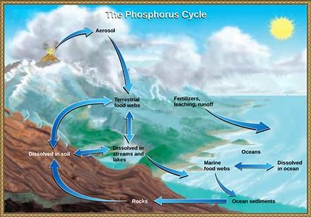

Slide 20
Thank you..

