Slide 1
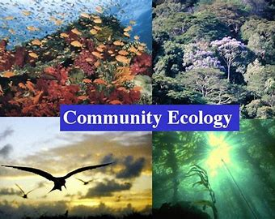
Community Ecology
Ms.a.r.mukhedkar
Hod botany .s.m.d.mohekar mahavidyalaya kalamb.

Slide 4
Community Ecology: Definition and Characteristics of Community Ecology!
Definition:
A population of a single species cannot survive by itself because there is inter dependence of one form of life on another.
An aggregation of populations of different species living together (in inter dependence) in a specific area, having a specific set of environmental conditions constitute a biotic community e.g., the various plants and animals in a pond or lake constitute one biotic community whereas the plants and animals in a particular forest constitute another biotic community.
Broadly speaking, there are two types of communities.

Slide 5
Major community
It is a large community which is self regulating, self sustaining and independent unit comprising of a number of minor commu­nities in it. Examples of major communities are: a pond, a lake, a forest, a desert, a meadow and grassland.
Each of these major communities in­cludes several minor communities.
b) Minor Community:
It is a smaller community which is not a self sustain­ing unit. It is dependent on other communities for its existence.
The major community exemplified by a forest has many minor communities namely the plant community (the plant population of the forest), the animal community (the animal population of the forest) and the microbial com­munity (bacteria and fungi population).

Slide 7
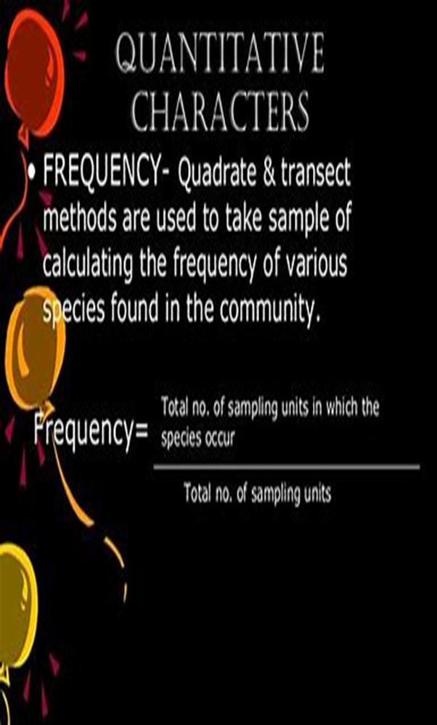

Slide 8
Characteristics of a Community:
A community has the following characteristics:
(a) Structure:
Structure of a community can be studied by determining the density, frequency and abundance of species.
(b) Dominance:
Usually a community has one or more species which occur in large number. Such species are called dominants and the community is often named after them.
(c) Diversity:
The community consists of different groups of plants and animals of different species, may be large and small, may belong to one life form or another but are essentially growing in a uniform environment.

Slide 9
Periodicity:
This includes study of various life processes (respiration, growth, reproduction etc.) in the various seasons of the year in the dominant species of a community. The recurrence of these important life processes at regular intervals in a year and their manifestation in nature is termed periodicity.
(e) Stratification:Natural forest communities possess a number of layers or stores or strata related to the height of plants, for example, tall trees, smaller trees, shrubs and herbaceous layers form the different strata. This phenomenon in a plant community is called stratification.
(f) Eco-tone and Edge-effect:
A zone of vegetation spreading or separating two different types of communities is called eco-tone. These are marginal zones and are easily recognizable.
Usually, in eco-tones, the variety of one species is larger than in any of the adjacent communities. A phenomenon of increased variety and intensity of plants at the common junction is called edge-effect and is essentially due t6 wider range of suitable environmental conditions.

Slide 10
(g) Ecological Niche:
Different species of animals and plants fulfill different functions in the ecological complex. The role of each is spoken of as its ecological niche i.e. the role that a specie plays in its ecosystem: what it eats, who eats it, its range of movement etc., in other words, the total range of its interaction with other species of its environment.
We can also say that ecological niche is a small habitat within a habitat, in which only a single species can survive. E.P. Odum has differentiated habitat and ecological niche by saying that the habitat is an organism’s address and the ecological niche is its profession.

Slide 11
h) Interspecific Association:
This is the study of two or more species grow­ing together in close association in regular occurrence.
(i) Community Productivity:
The study of production of biomass (organic matter) is known as production ecology. The net production of biomass and storage of energy by a community per unit time and area is called community productivity.
(j) Biotic Stability:
A biotic community has the ability to quickly regain equi­librium after a disturbance in population fluctuation. This is called biotic stability and is directly proportional to the number of interacting species it contains i.e. the diversity in the community.

Slide 12
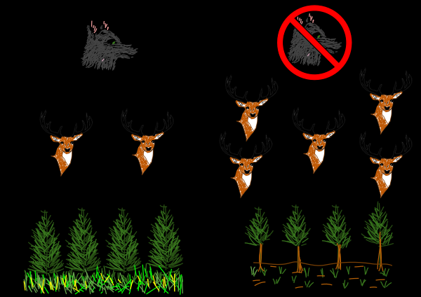
A simple trophic cascade diagram. On the right shows when wolves are absent, showing an increase in elks and reduction in vegetation growth. The left one shows when wolves are present and controlling the elk population.

Slide 13
Thank you..

