Slide 1
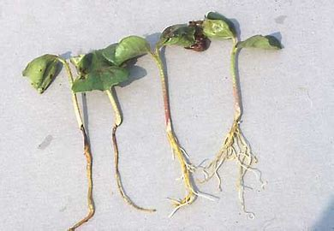
Damping off of Mustard
Ms.a.r.mukhedkar.
s.m.d.mohekar mahavidyalaya kalamb.

Slide 3
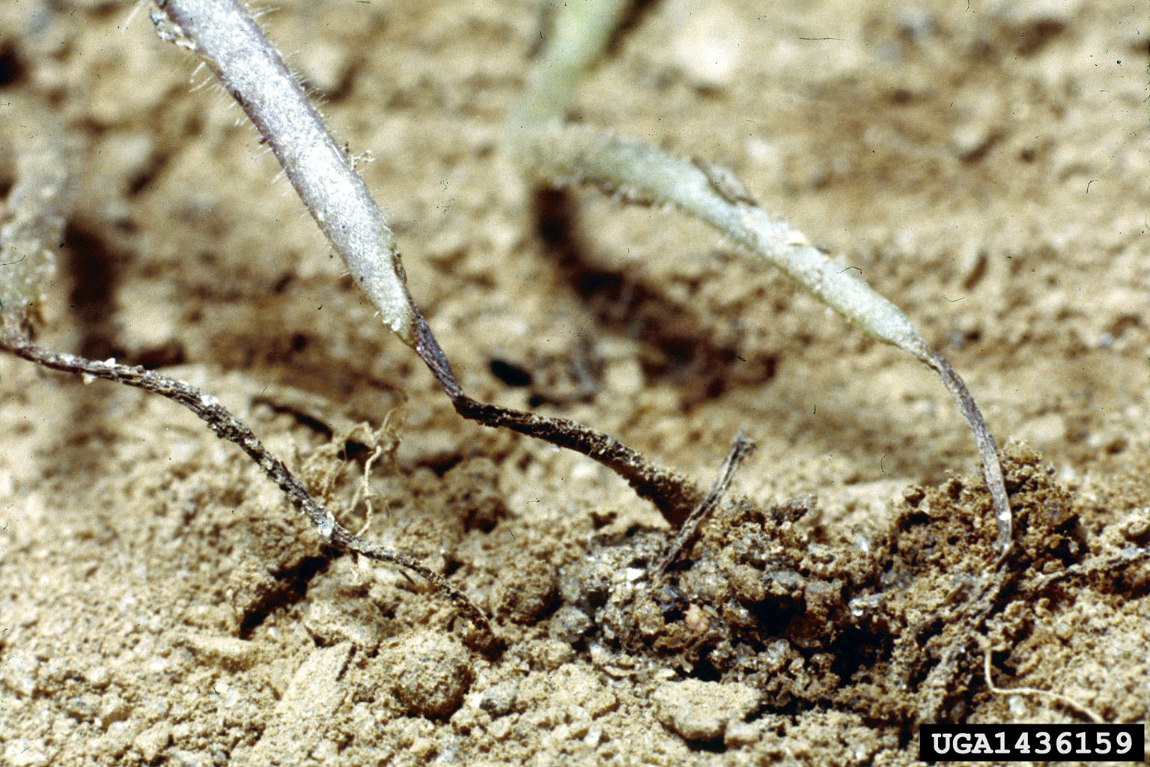
The production of mustard is affected by several diseases of fungal and viral origin.
Among the fungal diseases damping-off incited by Pythium aphanidermatum is a common problem in the mustard growing areas, especially under the moist conditions that generally prevails during sowing

Slide 4
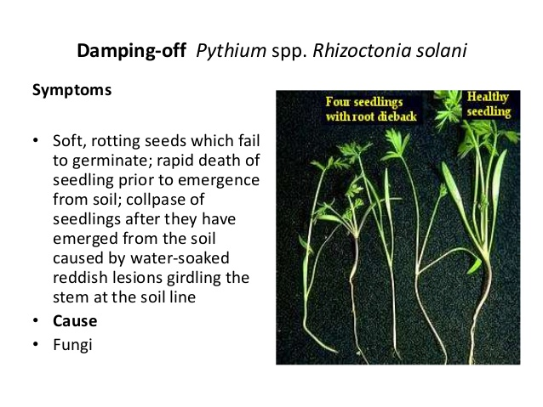
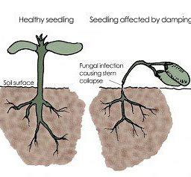
Symptoms of Damping Off Disease.
Shriveling and darkening are also signs.
Leaves can appear waterlogged and mushy.
When disease is only present in the roots, plant growth is stunted, leading to wilting and death.
Affected stems cause the plant to flop. You may even see a white, cobweb-like substance in stricken areas.

Slide 5
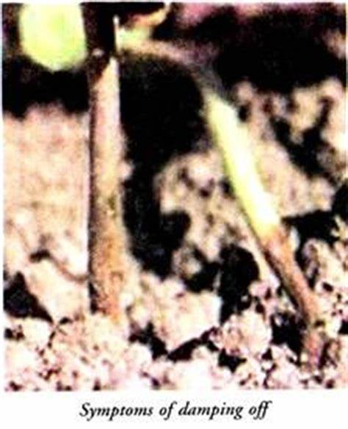
SYMPTOMS
Pre-emergence damping-off: Seeds may rot before germinating or seedlings may die prior to emergence.
Post-emergence damping-off: Young seedlings develop a rot at the crown; later, the tissue becomes soft and constricted and the plants wilt and fall over.
Pythium spp.: Seedlings turn dull green and cotyledons droop. Water-soaked lesions develop on the hypocotyls at the soil line and seedlings wilt and collapse. Seedlings may also rot in the soil before emergence.

Slide 7
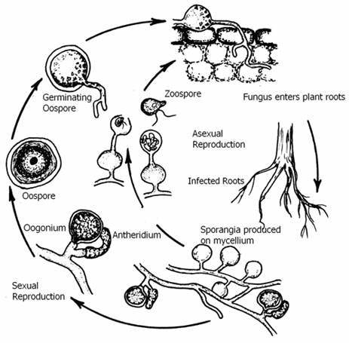

Slide 8
Prevention
Damping off can be prevented or controlled in several different ways. Sowing seeds in a sterilized growing medium can be effective, although fungal spores may still be introduced to the medium, either on the seeds themselves or after sowing (in water or on the wind).
To reduce survival of the pathogens, remove and discard diseased plants, and sterilize containers to remove dust, planting medium, and soil particles in which spores can survive.[3]
Maintaining drier conditions with better air circulation helps prevent the spread of the disease, although it can also prevent or slow down germination.
Spraying or drenching the soil with a recommended anti-fungal treatment (such as copper oxychloride) also helps suppress the disease.
Homemade solutions (including ones made from chamomile tea[8] or garlic) are used by some gardeners for this purpose.

Slide 9
0pen Field: In addition to the greenhouse measures described above, avoid soil compaction, prepare high beds to obtain better drainage and avoid long irrigation periods. Acremonium root rot can also be minimized by shallow planting in dry soil followed by irrigation.
Protected Culture: Ensure that substrate/soil consists of components which favor drainage and aeration. Use a reputable substrate/soil supplier. Implement sanitation measures for supplies and equipment. Manage irrigation practices to avoid long periods of high soil moisture. Use high quality seed to help reduce damping-off. Fungicidal soil drenches and seed treatments are available that help manage damping-off. The use of a biological control agent (e.g., Trichoderma harzianum) has been shown to be effective in controlling damping-off pathogens in various cucurbits.

Slide 10
Thank you…

