Slide 1
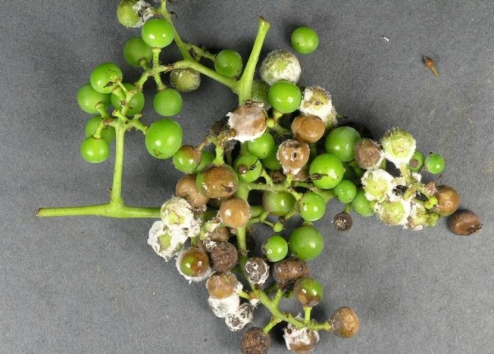
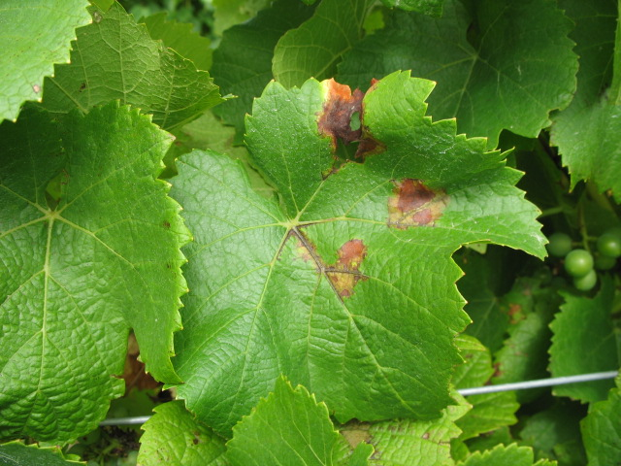
Downy Mildew of Grape

Slide 2
Downy mildew is an important disease of commercial and backyard grapes in Kentucky.
Warm, wet, humid weather conditions favor infection and disease development.
When flowers, clusters, and shoots become infected by downy mildew, yield losses result.
This disease may also predispose grapevines to winter injury.
Fungicides are available; however, sanitation is a critical step in prevention and management
Downy mildew is a major disease of grapes throughout the eastern United States.
The fungus causes direct yield losses by rotting inflorescences, berries, clusters and shoots.
Indirect losses can result from premature defoliation of vines due to foliar infections.
This premature defoliation is a serious problem because it predisposes the vine to winter injury.
It may take a vineyard several years to fully recover after severe winter injury.

Slide 3
Downy mildew is an extremely serious fungal disease of grapes that can result in severe crop loss. It is caused by the fungus Plasmopara viticola.
Host. Vitis vinifera L

Slide 4
Leaf symptoms begin as yellowish-green lesions on upper surfaces. Disease lesions expand, and affected areas turn brown, necrotic, or mottled (Figure 1). On the underside of lesions, white, downy fungal-like growth (sporulation) may be observed (Figure 2).
Late season infections result in a mosaic of small, angular, yellow to red-brown spots on upper surfaces and downy growth on the undersides of leaves.
Infected fruit turn light brown to purple, shrivel, and detach easily. White, cottony growth (sporulation) may be visible during periods of high humidity (Figure 3).
Severely infected leaves may curl and drop from vines. Infected shoots, petioles, tendrils, or cluster stems may become distorted, thickened, or curled.
Primary infection occurs in spring during wet periods. Spores are spread by wind or rain-splash.
Subsequent infections result from additional spore development during periods of high humidity and warm night temperatures.
Caused by the fungus-like organism Plasmopora viticola.
The downy mildew pathogen overwinters in fallen leaves.

Slide 5
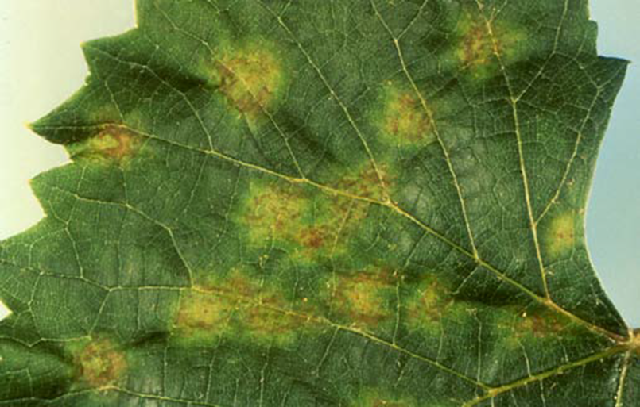
Symptoms
Figure 1. Pale yellow leaf spots on upper surface of grape leaf caused by downy mildew.
On leaves, infections can occur throughout the growing season.
Young infections are very small, greenish-yellow, translucent spots that are difficult to see. With time the lesions enlarge, appearing on the upper leaf surface as irregular pale-yellow to greenish-yellow spots up to 1/4 inch or more in diameter (Figure 1).
Figure 1. Pale yellow leaf spots on upper
surface of grape leaf caused by downy mildew.

Slide 6
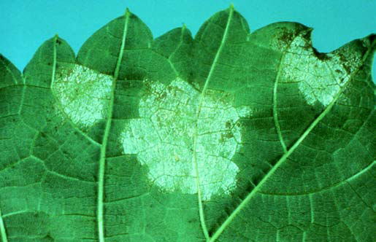
On the underside of the leaf, the fungus mycelium (the “downy mildew”) can be seen within the border of the lesion as a delicate, dense, white to grayish, cotton-like growth (Figure 2).
Infected tissue gradually becomes dark brown, irregular, and brittle. Severely infected leaves eventually turn brown, wither, curl and drop.
The disease attacks older leaves in late summer and autumn, producing a mosaic of small, angular, yellow to red-brown spots on the upper surface.
Lesions commonly form along veins, and the fungus sporulates in these areas on the lower leaf surface during periods of wet weather and high humidity
.
Figure 2. White “downy” fungus growth on the underside of infected leaves. This downy growth is directly under the pale-yellow spots on the upper surface.

Slide 7
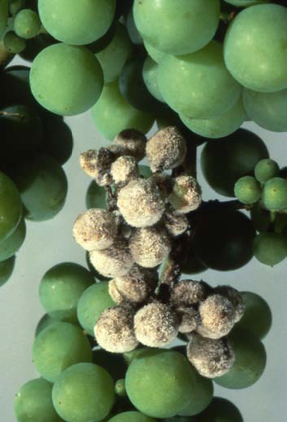
On fruit, most infection occurs during the period from early bloom through three to four weeks after bloom.
By three to four weeks after bloom, fruit are resistant to infection; however, the fruit stems (pedicels) remain susceptible.
When infected at this stage, young berries turn light brown and soft, shatter easily, and under humid conditions are often covered with the downy-like growth of the fungus (Figure 3).
Generally, little infection occurs during hot summer months. Infected fruit will never mature normally. On shoots and tendrils, early symptoms appear as water-soaked, shiny depressions on which the dense downy mildew growth appears.
Young shoots usually are stunted and become thickened and distorted. Severely infected shoots and tendrils usually die
Figure 3. Grape berries infected with downy mildew. Note the cottony growth on the surface of the berries.

Slide 8
Downy mildew is caused by the fungus Plasmopara viticola.
The fungus overwinters in infected leaves on the ground and possibly in diseased shoots.
The overwintering spore (oospore) germinates in the spring and produces a different type of spore (sporangium).
These sporangia are spread by wind and splashing rain. When plant parts are covered with a film of moisture, the sporangia release small swimming spores, called zoospores.
Zoospores, which also are spread by splashing rain, germinate by producing a germ tube that enters the leaf through stomates (tiny pores) on the lower leaf surface.
The optimum temperature for disease development is 64 to 76 degrees F (18 to 25 degrees C).
The disease can tolerate a minimum temperature of 54 to 58 degrees F (12 C to 13 degrees C), and a maximum temperature of about 86 degrees F (30 degrees C). Once inside the plant, the fungus grows and spreads through tissues

Slide 9
Infections are usually visible as lesions in about seven to 12 days.
At night during periods of high humidity and temperatures above 55 degrees F (13 degrees C), the fungus grows out through the stomates of infected tissue and produces microscopic, branched, tree-like structures (sporangiophores) on the lower leaf surface.
More spores (sporangia) are produced on the tips of these tree-like structures.
The small sporangiophores and sporangia make up the cottony, downy mildew growth.
Sporangia cause secondary infections and are spread by rain.

Slide 10
Life Cycle
The fungus overwinters in diseased leaves on the ground. Spores are released in the spring and spread to the leaves and berries by splashing rain and wind.
The fungus has two types of spores, both germinating into swimming spores. These spores swim to the stomates (breathing pores) of plants and initiate infection. Water is necessary for the spores to swim and infect, so outbreaks of the disease coincide with periods of wet weather.
Downy mildew is favored by all factors that increase the moisture content of soil, air, and the plant, with rainfall being the principal factor for infection during the growing season.
Downy mildew infection can become a severe problem when a wet winter is followed by a wet spring and a warm summer with frequent rainfall.

Slide 12
Any practice that speeds the drying time of leaves and fruit will reduce the potential for infection. Select a planting site where vines are exposed to all-day sun, with good air circulation and soil drainage. Space vines properly in the row, and, if possible, orient the rows to maximize air movement down the row.
Sanitation is important. Remove dead leaves and berries from vines and the ground after leaf drop. It may be beneficial to cultivate the vineyard before bud break to cover old berries and other debris with soil. Cultivation also prevents overwintering spores from reaching developing vines in the spring.
To improve air circulation, control weeds and tall grasses in the vineyard and surrounding areas. When pruning, select only strong, healthy, well-colored canes of the previous year’s growth.
Practices such as shoot positioning and leaf removal that help to open the canopy for improved air circulation and spray coverage are also very important.
Grape varieties vary greatly in their susceptibility to downy mildew.
In general, vinifera (Vitis vinifera) varieties are much more susceptible than American types, and the French hybrids are somewhat intermediate in susceptibility.
A good fungicide spray program is extremely important.

Slide 13
Downy mildew can be effectively controlled by properly timed and effective fungicides. For the most current spray recommendations, commercial growers are referred to Bulletin 506, Midwest Fruit Pest Management Guide, and backyard growers are referred to Bulletin 780,
Controlling Diseases and Insects in Home Fruit Plantings.
Integrated Pest Management Strategies
1. Maintain plant vigor. Make sure soils are welldrained. Fertilize according to soil test information obtained at least every other year.
2. Sanitation. Remove fallen leaves which are the source of overwintering inoculum.
3. Pruning. Prune out the ends of infected shoots.
4. Fungicides. Fungicides are an important control measure, especially on susceptible cultivars. They should be applied just before bloom, 7 to 10 days later (usually at the end of bloom), 10 to 14 days after that, and finally, 3 weeks after the third application. For cultivars very susceptible to downy mildew or where the disease was severe the previous season, an additional application is suggested about 2 weeks before the first blossom opens. Pesticides registered for use include captan, copper, fosetyl-Al, mancozeb, maneb, and ziram.
5. Cultivars. Select and plant resistant cultivars.

Slide 14
Avoid planting highly susceptible grape cultivars such as, Catawba, Chardonnay, Niagara, and White Riesling.
Select appropriate planting sites with full sun and good air circulation.
Maintain plant health with proper nutrition and irrigation practices.
Prune to improve air circulation and reduce canopy humidity.
Remove and destroy diseased plant material.
Commercial growers should refer to Midwest Fruit Pest Management Guide (ID-232) for recommended fungicides and application schedule.
Homeowners may apply fungicides containing copper or mancozeb beginning with new growth and continuing throughout the season. Always follow label directions when utilizing fungicides.

Slide 15
Thank you..

