Slide 1
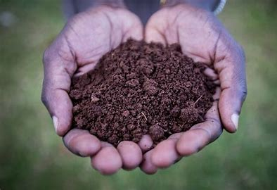
Plant Ecology .
Ms.Archana .R.Mukhedkar .
Head of Department Botany .
S.M.D.Mohekar mahavidyalaya,Kalamb.

Slide 3
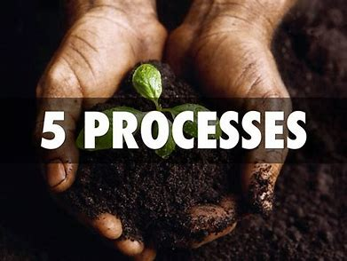

Slide 4
SOIL FORMATION :
is the process whereby fragmental material resulting from rock weathering is transformed into a medium that can support plant growth. When they are using soil formation than using physical disintegration and Chemical decomposition of rocks.

Slide 5
Soil formation is a process of two distinct phases:
(i)WEATHERING. Weathering of rocks and minerals i.e. disintegration (physical) and decomposition (chemical) of rocks and minerals;
ii)PEDOGENIC PROCESS:
The development or the formation of true soil by some soil forming factors and pedogenic processes. The first phase of soil formation i.e. weathering is considered as a destructive one and helps to change the consolidated rocks and minerals into unconsolidated material (parent material) whereas second phase of soil formation is considered as a constructive process and develops the soil profile.

Slide 8
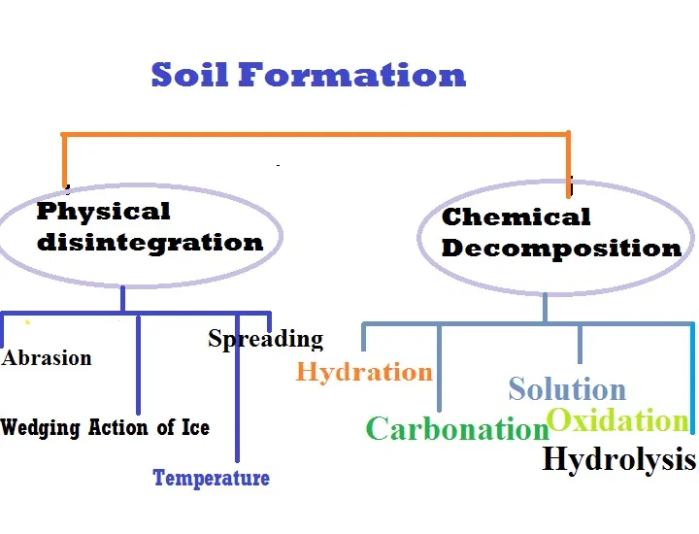

Slide 10
Physical disintegration
Physical Disitengration or weathering of rock occurs due to the following reasons
Abrasion
Wedging Action of Ice
Temperature Changes
Spreading of Roots of plants
Abrasion
Since water, wind, and glaciers move over the surface of the rock, abrasion and scouring take place, due to abrasion, the formation of soil starts.
Wedging Action of Ice
In very cold climates, water in the voids and minute cracks frozen. As the volume of ice formed is more than that of water, expansion occurs. Due to wedding action

Slide 11
Temperature changes
Different minerals of rock have different coefficients of thermal expansion. Unequal expansion and contraction of these minerals occur due to temperature changes. When the stresses induced due to such changes repeated many times, the particles get to detach from the rocks and the soil’s form.
Spreading of roots of Plants
Since the roots of trees and shrubs grow in the cracks and fissures of the rocks, forced act on the rocks. Thus, the segments of the rocks are forced apart and the disintegration of rocks occurs.

Slide 12
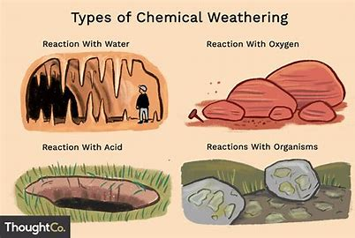
Chemical decomposition
When chemical decomposition or weathering of rocks takes place, original rock minerals are transformed into new minerals by chemical reactions. The soil also formed does not have properties of the parent rock. The chemical processes, which generally occur in nature –
Hydration
Carbonation
Oxidation
Solution
Hydrolysis

Slide 13
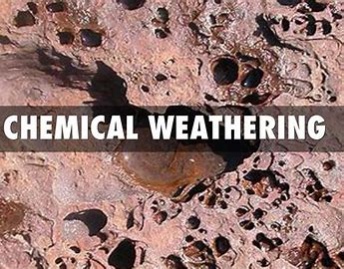
Hydration
In Hydration, water combines with the rock minerals and results in a new chemical compound formation. Due to chemical reactions, there is a change in volume and decomposition of rock into small particles.
Carbonation
In this chemical decomposition, carbon dioxide in the atmosphere combines with water to form carbonic acid. When the carbonic acid acts chemically with rocks and cases their decomposition.
oxidation
When oxygen ions combine with minerals in rocks, oxidation occurs. Oxidation results in the decomposition of rocks. Oxidation of rocks is somewhat also similar to the rusting of steel.
Solution
When the rocks minerals dissolved in water then some of the rock minerals form a solution with water. A chemical reaction takes place in the solution and the soil also formed.
Hydrolysis
In the hydrolysis process, water gets dissociated into H plus and OH minus. It is a chemical process when In rock minerals, the hydrogen cations replace the metallic ions such as calcium, sodium, and potassium and soil formed with a new chemical decomposition.

Slide 14
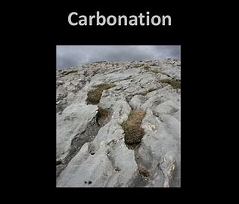

Slide 15
BIOLOGICAL WEATHERING
Biological weathering only refers to weathering caused by organisms -- animals, plants, fungi and microorganisms such as bacteria. While certain forms of biological weathering, such as the breaking of rock by tree roots, are sometimes categorized as either physical or chemical, biological weathering can be either physical or chemical.

Slide 16
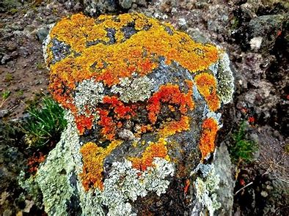
CHELATION is a biological process where organisms produce organic substances, known as chelates , that have the ability to decompose minerals and rocks by the removal of metallic cations. 5. Organisms can influence the moisture regime in soils and therefore enhance weathering

Slide 17
ii)PEDOGENIC PROCESS
Processes Involved in Soil Formation:
The soil forming processes or pedogenic processes are very complex because of simultaneously operating various chemical, mechanical and biological reactions. There are generally two categories of pedogenic processes involved in the formation of well-developed or mature soil i.e. basis or fundamental and specific pedogenic processes.
A. Basis or Fundamental Processes:
The basic or fundamental processes of soil formation are:
(i) Addition of water, organic and mineral matter to the soil,
(ii) Losses of these materials from the soil,
(iii) Movement or translocation of soil materials from one point to another within the soil profile, and
(iv) Transformation of the mineral and organic matter in the soil and formation of definite layers or horizons.

Slide 18
B. Specific Pedogenic Processes:
The basis or fundamental pedogenic processes bring about certain specific processes by means of a variety of reactions like Calcification. Decalcification, Podzolization, Laterization, Salinization, Gleization and Alkalization etc. The fundamental processes along with some important specific pedogenic processes and reactions are given in table

Slide 19
HUMIFICATION is the process of decomposition of organic matter and synthesis of new organic substances.
ELUVIATION is the mobilization and translocation of certain constituents namely clay, Fe3O3 , Al2O3, SiO2, humus, CaCO3 and other soluble salts etc. from one area of the soil body to the other area.
ILLUVIATION is the immobilization and accumulation of the eluviated constituents at a depth below the soil surface.
CALCIFICATION and Gypsification are the forming processes of arid and semi-arid regions and refer to the formation and accumulation of calcium carbonate and gypsum respectively.
ARGILLATION is a process by which the dispersed clay particles are migrated from upper to the lower soil horizons resulting a textural horizon

Slide 20
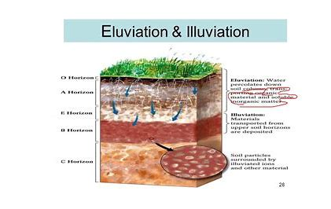
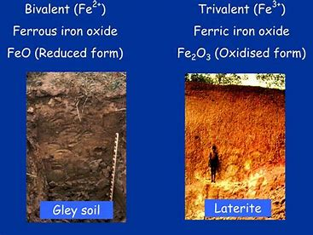

Slide 21
