Slide 1
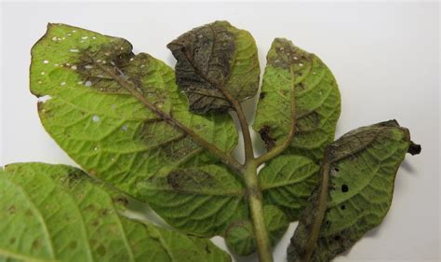
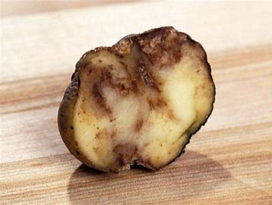
Late Blight of Potato ms.a.r.mukhedkar hod botany s.m.d.m.college ,kalamb

Slide 2
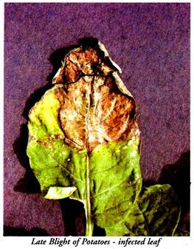
late blight is a serious fungal disease of potatoes.
It is worldwide in its distribution.
It occurs in potato growing areas of the world. Winter is the main potato growing season in India.
It is followed by hot summer months in the plains. The drought and high temperature kill the fungus in the soil.

Slide 3
The late blight epidemics are thus rare in the plains in India. It is destructive to the crop grown in the rainy season.
The disease occurs annually in the cooler Himalayan regions extending from Assam to Kashmir at an altitude of 6,000 ft. or more as the crop is grown in the rainy season.
Moreover, the temperature during the day is never above 22°-23°C which is favourable for the appearance of disease. The crops grown in the plains have been usually free from the epidemics of late blight because the chief predisposing factors (temperature and moisture) that render potato plants susceptible to disease are absent during the period of their growth.
The temperature is high for the development of the disease. Now it has established itself in the Indo- Gangetic plain and occurs annually in the states of Punjab, Uttar Pradesh, Bihar, and W. Bengal. The diseas

Slide 4
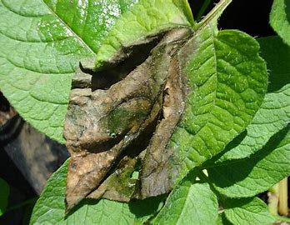
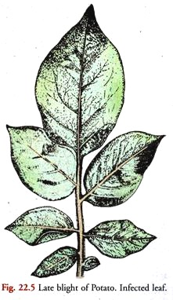
Effects of Late Blight:
The damage caused by the disease is frequently very high. Severe damage to the foliage shortens the growing season (Fig. 22.5)
. Consequently the tubers remain small and reduced in weight.
They are produced in smaller numbers. This results in the reduced yield.
In severe cases of infection there is complete loss of the crop, Infection also results in the decay of tubers in the field and storage.

Slide 5
Symptoms of Late Blight:
The disease first appears on the tops of the plants generally after the blossoming period but mostly in the month of January.
It may appear as well at any time during the growth period of the plant. The conditioning factor is the favourable environment.
The disease makes its appearance as small, dead, brownish to purplish black areas or lesions. These appear on the tips and margins of the leaflets, rachis, petiole and stem. Under favourable conditions (low temperature and high humidity) the lesions rapidly increase in size involving the whole surface of the leaf.
The disease generally first attacks the leaves, and petioles near the ground and the lesions appear on the lower surface of the leaflets on individual plants and then spreads upwards.

Slide 6
Finally, a rapid and general blighting of foliage occurs. The blighted leaves curl and shrivel in dry weather. Under moist conditions they dExamination of the lesions on the lower surface of the leaf on a dew morning reveals a delicate growth of the fungus parasite in the form of whitish powdery bloom. It consists of sporangiophores and sporangia (Fig. 22.7 E) of the pathogen pushing out through the stomata. The sporangia serve to spread the disease in the growing season.
Potato tubers are often infected in the field after the tops have been blighted.
They get separate infections while in the hill. There is brownish discoloration of the skin of those parts of the tubers which lie nearest the surface of the soil.
These dry rot spots remain firm and extend to about half an inch below the surface. During storage, the bacteria assist to set in the wet rot phase. In cool and dry conditions the progress of the disease is slower and the wet rot phase is generally checked.
Under moist conditions hyaline mycelial hyphae and sporangiophores push out through the lenticels and appear on the surface of infected tubers.
decay and emit a characteristic offensive odour.

Slide 7
Causal organism and over-wintering:
The causal organism is Phytophthora infestans (Mont.) De Bary. The mycelium is aseptate conenocytic, hyaline and branched.
The hyphae are both intercellular and intracellular.
they form rudimentary haustoria in the host leaf cells but in the tubers the haustoria are more common and elaborate (club-shaped, hooked or spirally twisted).
the mycelium overwinters in the infected tubers.
that the fungus overwinters in the soil but this remains unconfirmed. Kaung (1956) stated that in the temperate regions the fungus perannates in soil in the form of sporangia and germ tubes.

Slide 8
Disease Cycle (Fig. 22.7):
The infected tubers (A) are generally considered as the main source of primary infection in India. The survival of the fungus in the soil in the Indian climatic conditions in any form appears remote. According to the widely held view, the fungal parasite overwinters as a dormant mycelium in the infected tubers.
It becomes activated at the time of germination of the diseased seed tubers among the planting stock or waste tubers in dump heaps or infected tubers remaining in the ground after a previous crop. The activated mycelium invades the healthy sprouts (B).
The second view is that the thick-walled resting oospores which are found in abundance in the infected tubers are the important overwintering structures.
They play a significant role as the source of primary infection.
At the planting time, the resting oospore germinates. The germ tube after emergence usually ends in a terminal sporangium. The contents of the latter divide to form zoospores. The released zoospores invade the healthy sprouts and bring about

Slide 10
According to some, the sexual phase seems to play no role in the life history of the pathogen. The infected sprouts emerge above ground and produce shoots which contain the mycelium (C).
It grows and ramifies in the intercellular spaces absorbing nutrition by putting haustoria into the host cells (D).
Under suitable conditions of temperature and humidity, the mycelium pushes out hyahne, branched, indeterminate sporangiophores through the stomata of the host leaves (E).
The thin-walled, ovoid or lemon-shaped sporangia, each with an apiculate tip, are borne singly at the tips of sporangiophores or their branches.
As the sporangium reaches maturity, the supporting hyphal branch immediately below it swells slightly and continues to grow turning the attached sporangium to the side.
The elongation of the branch proceeds and a new sporangium is formed. The process is repeated. A fertile branch or sporangiophore is thus characterised by 9 or 10 such swellings occurring at intervals.
Each nodular swelling marks the point where the sporangium was borne. The mature sporangia are readily detached and spread by splashing rain or air currents to new potato plants (F1 and a).
the sporangia are formed within a temperature range of 3° to 26°C with an optimum of 18° to 22°C. The minimum relative humidity required is 91 percent with an optimum of 100 percent.

Slide 12
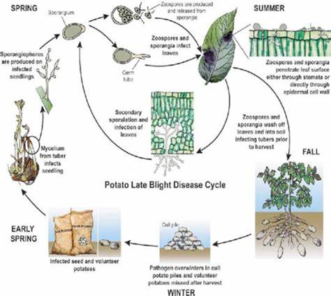
On reaching a suitable host (potato), the sporangia germinate on the leaves (F). Germination is influenced by moisture and temperature conditions.
Late Blight of Potato

Slide 13
(a) Indirect Germination:
In cool moist weather the sporangia function as zoosporangia (F1-3). The optimum temperature for the formation of zoospore is 12ºC (54°F).
In the indirect germination the protoplasmic contents of sporangium divided to form a number of (usually 8) biflagellate zoospores (F3).
They are liberated in a group through terminal pore formed by rupture of the apical papilla.
The released zoospores, after a brief period of activity in rain water or dew come to rest. Each retracts its flagella and secretes a wall around it.
The clothed zoospores (cyst) then germinates by pushing out a germ tube or infection thread (F4). The zoospores germinate rapidly at 12° to 15°C. Cool and moist nights are thus favourable for the formation and germination of zoospores.
The germ tubes show rapid growth at 21°C . After infection they grow best at a slightly higher temperature

Slide 14
a) Direct Germination:
Under dry and warmer conditions no zoospores are formed. The sporangium functions as a conidium (Fa).
It directly puts out a germ tube or infection thread (Fb).
The optimum temperature for this direct germination of sporangia is about 24° or ’25°C.
The indirect method of germination of sporangia by the formation of zoospores in a terrestrial late blight fungus is an instance of retention of an ancestral primitive character which was normally used by its aquatic ancestor.

Slide 15
(b) Spread of the Disease (Secondary Infection):
The infection thread produced on the surface of the host leaf in either of the two above-mentioned methods enters the host tissue (leaves or stem).
It makes its entry occasionally through the stoma but more often it penetrates directly through the cuticle by a penetration hypha arising from an appresorium (F4).
The lower surface of the leaf is more susceptible than the upper. The infected leaves produce another crop of sporangia.
These are carried by wind to the healthy plants which are thus infected. This constitutes secondary infection. The process is repeated.
As a result the disease spreads during the growing season over large tracts under potato cultivation.
The disease spreads quickly when cool and wet nights alternate with warm moist days. Low temperature and high humidity favour the spread of the disease.

Slide 16
Field infection of Potato Tubers:
The tubers get separate infections (G). It is caused by zoospores produced in foliage lesions (blighted tops) or present in the contaminated soil. Sporangia and zoospores come in contact with the tubers in two ways.
Firstly, by contact freshly lifted healthy and wounded tubers with diseased haulms and contaminated soil.
Secondly, during crop growth, the zoospores and sporangia washed down the stems into the soil by rain come in contact with the tubers.
Tuber infection is dependent on the germination of sporangia, release and motility of zoospores.
The released zoospores have to move through soil to the infection sites.
The longer the zoospores continue to swim and greater their number, the greater are the chances of infection. The germ tubes gain entrance through the eyes, wounds and lenticels.
), wet cool soil promotes infection but wet warm soil lowers it because cool water at 16°C or below 12-14°C favours indirect germination of sporangia and prolongs motility of zoospores.
The sexual phase seems to play no significant role in the life history of the pathogen.
The severity of late blight infection is governed by environmental conditions.

Slide 17
Control Measures of Late Blight:
Various methods of control of the disease are known.
These are:
1. Selection of Seed (Planting) Tubers:
The seed tubers should be free from the disease. This requires strict seed tuber inspection at the cutting time. This measure will eliminate direct infection.
2. Storage of Tubers at 40ºF or below:
Storage of potato tubers in cold storage rooms reduces or even checks the progress of the rot.
3. Growing Disease Resistant Varieties:
Considerable success has been achieved in the perfection of resistant varieties of potato at the potato breeding station, Simla. Growing these will provide an increasing opportunity to combat the disease

Slide 18
4. Use of Fungicides:
Resistance alone has not effectively checked the disease. Therefore the complete control of blight is accomplished by the application of protectant fungicides. These are applied before infection for effective control in two ways namely by spraying or dusting as follows:-
4a. Spraying:
The best method of control is the timely and repeated foliage spray schedule with copper fungicides such as Perenox, Blitox-50 and Fytolan. Dithane Z-78, and Dithane M-22 have proved more effective than the copper fungicides.
The spraying should start when the plants are 8 inches tail.
It should continue until the harvest time at 10 days’ interval. Both the surfaces of foliage should be properly protected by adequate spraying delivered with a considerable force in the form of fine mist.
Brestan 60, Dithane M-45 and Zineb useful for the control of late blight in Assam. Mistiming of sprays may have serious consequences for late blight control in N.E.U.S.A.
Mancozeb and Chlorothalonil are the major fungicides which are presently used. Both fungicides inhibit sporangial and spore germination but has little effect on the mycelium in the leaf tissu

Slide 19
4b. Dusting:
Some people claim that dusting the foliage with copper-lime dust is a more effective control measure. Dusting is done in the morning when the plants are wet with dew.
5. Sanitation:
Destruction or proper disposal of potato tuber refuge from pits and store houses IS another practical measure to reduce the incidence of disease.
6. Tuber treatment before storage:
The tubers should be dipped in 1: 1,000 mercuric chloride solution for 90 minutes before storage. Before use they should be washed.
7. Avoidance of injuries to tubers at harvest is also important.
8. In cool humid areas killing of foliage a few days before harvest proves beneficial. This is accomplished by spraying with herbicides or flame throwers or by the use of mechanical vine beaters

Slide 20
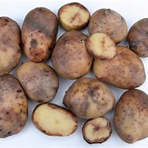
Thank you .

