Slide 1
Plant Pathology
Ms.Archana Mukhedkar.
Head OF Dept .Botany

Slide 2
Difine plant disease. Describe in detail tha classification of disease on the basis of symptoms and causal organism.
PLANT DISEASES
A plant disease is any abnormal condition that alters the appearance or function of a plant.
CAUSES OF PLANT DISEASES
Plant diseases are caused by both infectious (fungi, bacteria, viruses andnematodes) and non infectious agents (mineral deficiency, sun burns etc).
Infectious plant diseases are caused by living organisms that attack andobtain their nutrition from the plant they infect.
The parasitic organismthat causes disease is referred to as a pathogen and the plant invadedby the pathogen and serving as its food source is referred to as a host.
A favourable environment is critically important for disease development –

Slide 3
TWO CAUSES 1.LIVING OR ANIMATE 2 NONLIVING OR INANIMATE
1.LIVING OR ANIMATE
The main categories of microbes that cause plant diseases which are
fungi, bacteria, viruses and nematodes.
Fungi account for around 85 percent of plant diseases followed by viruses,
bacteria and nematodes.
2 NONLIVING OR INANIMATE
Environmental factors are important in the development of plant diseases
and determine whether the diseases become epidemic. These
include temperature, relative humidity, soil moisture, soil pH, soil type,
and soil fertility during the crop growth.

Slide 4
SYMPTOMS AND SIGNS OF PLANT DISEASES These are visible effects of disease on plants due to the interference in the development and/or function of the plant as it responds to the pathogen i.e. a result of invasion and infection by the pathogen. Symptoms may be classified as local or systemic, primary or secondary, and microscopic or macroscopic. Local symptoms are physiological or structural changes within a limited area of host tissue around the infection site, such as leaf spots, galls, and cankers.T Systemic symptoms are those involving the reaction of a greater part or all of the plant, such as wilting, yellowing, and dwarfing.

Slide 5
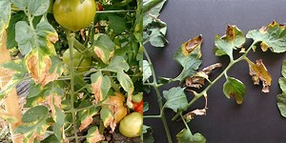
Macroscopic (morphological) symptoms can be classified as a.)Necrotic, b.)Hypoplastic c.) Hyperplastic A.Necrosis. is localized or the general death/degeneration of plant tissue (protoplast). It includes leaf spots, blight, rots etc. Some of the necrotic symptoms 1.Wilting is loss of turgor pressure in a plant leading to temporary or permanent drooping of leaves, shoots, or entire plants from lack of water or infection by different pathogens. This is usually a secondary symptom due to plugging of xylem tissue by an organism eg. Fusarium wilt of tomato, Bacterial wilt of Tomatoes, root knot disease of beans

Slide 6
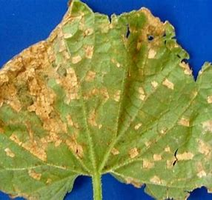
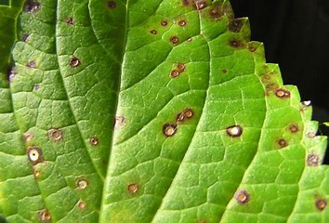
2.LEAF SPOT
Spot is a definite, localized, round to regular lesion, often with a border
of a different colour, characterized as to location (leaf spot, fruit spot) and
colour (brown spot, black spot);
if numerous or if spots enlarge andmerge, a large irregular
blotch or blight may develop
such as gray leafs pot of tomato; black spot of rose;
Angular leaf spot of beans, Leaf spot with yellow halo, Fruit spot e.t.c

Slide 7
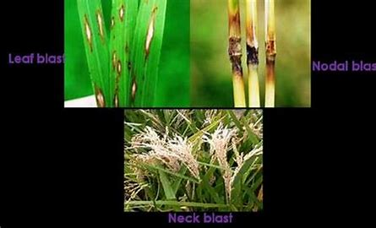
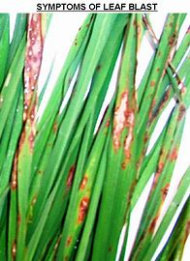
3.Blight is the sudden or total discoloration and killing of large area of a leaf, shoots, or stems or the entire plant; usually young tissues are attacked; the disease name is often coupled with the name of the hostand the part attacked—blossom blight, twig blight, tip blight 4. Blast is sudden blighting or death of young buds, flowers, or young fruit; failure to produce fruit or seeds such as Botrytis blight of roses, onion,strawberry; rice blast Magnaporthe oryzae (Pyricularia oryzae) Rice blast lesions on rice leaves Collar-rot symptoms of rice blast

Slide 8
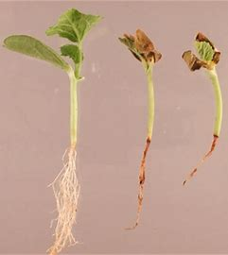
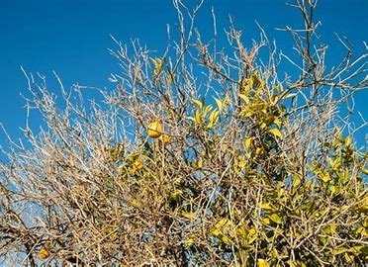
5.Damping off - decay of seed in soil, rapid death of germinating seedlings before emergence, or emerged seedlings suddenly wilting, toppling over,and dying from rot at or near the soil line such as pre-emergence damping-off and post-emergence damping-off; both are common in seedbeds. 6.Dieback -progressive browning and death of shoots, branches, and roots starting at the tips to down ward e.g. die back of chilli/ citrus

Slide 9
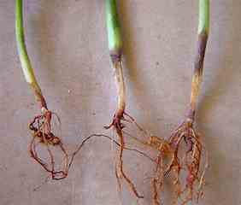
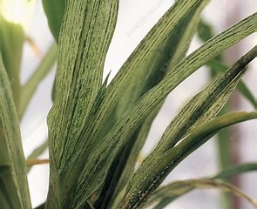
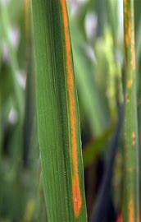
6. Rots refer to the decomposition and putrefaction of cells, later of tissues and organs. The rot may be dry, watery or mushy such as bacterial softrot. 7.Streak narrow, elongated, somewhat superficial necrotic lesions, with irregular margins, on stems or leaf veins such as virus streak 8.Stripe narrow, elongated, parallel, necrotic lesions especially in leaf diseases of cereals and grasses Helminthosporium stripe of barley, Red stripe of sugarcane caused by Pseudomonas rubrilineans
ROT
7STREAK

Slide 10
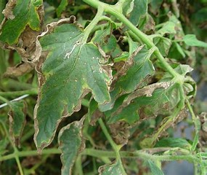
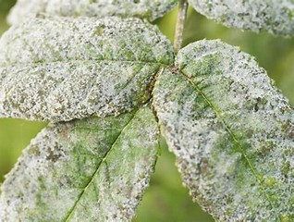
9.Canker a definite, dead, often sunken or swollen and cracked area on astem, limb, trunk, tuber, or root surrounded by living tissues. 10.Powdery mildew white, powdery to mealy, superficialgrowths of mycelia and conidiophores on surfaces ofleaves, stems, flowers, and fruit powdery mildew diseasesof capsicum, beans, mango etc.

Slide 11
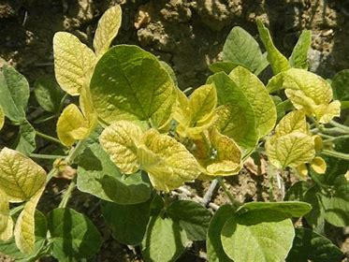
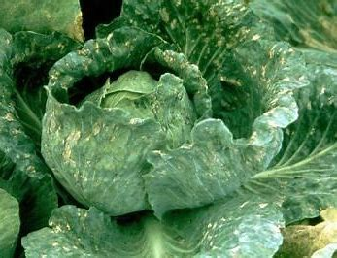
B.HYPOPLASTIC Hypoplasia is the failure of plants or organs to develop fully i.e to obtainnormal size.Abnormal size and pale colouration is the most common hypoplastic symptom. Other symptoms include: Dwarfing is the underdevelopment of the plant or some of its organs eg MSV or mosaic; curly top of beans; Chlorosis this is the yellowing or whitening of normal green tissue due to partial or complete failure of chlorophyll to develop this symptom can developed due to different diseases such as Fusarium yellows of beans Mosaic is the abnormal coloration yellowing, reddening, bronzing, or purpling in localized areas of leaves where chlorophyll has been destroyed; Symptoms such as a clearing along the leaf veins (vein clearing)

Slide 12
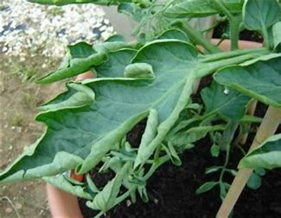
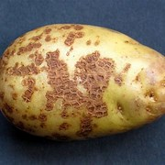
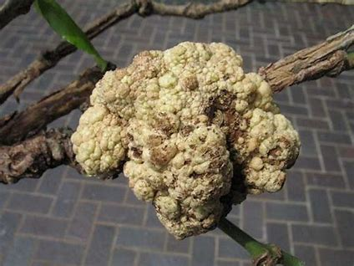
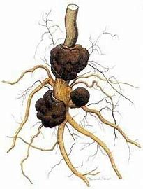
C.HYPERPLASTIC Hyperplasia is the overdevelopment (in size and colour) of the plant parts. Hypertrophy on the other hand is the exclusive development of a plants organ due to over hyperplasia and they include; 1.Leaf curls -overgrowth of tissue on one side of a leaf or petal resulting to leaves rolling. 2.Scabs roughened to crust like, more or less circular, slightly raised or sunken lesions on the surface of leaves, stems, fruit, or tubers e.g. common scab of potato, apple scab and wheat scab. 3.Tumours are symptoms that are caused by pathogens that stimulate uncontrolled multiplication of plant cells, resulting in the formation of abnormally large structures Crown galls.

