Slide 1
Environmental factors
light, temperature, water, and soil—greatly influence plant growth and geographic distribution. These factors determine the suitability of a crop for a particular location, cropping pattern, management practices, and levels of inputs needed. A crop performs best and is least costly to produce if it is grown under the most favorable environmental conditions. To maximize the production of any crop, it is important to understand how these environmental factors affect plant growth and development.

Slide 2
Climatic factors
Light
Sunlight is essential for any crop. Dry matter production often increases in direct proportion with increasing amounts of light. The amount of sunlight received by plants in a particular region is affected by the intensity of the incoming light and the
day length. The light intensity changes with elevation, latitude, and season, as well as other factors such as clouds, dust, smoke, or fog. The total amount of light received by a crop plant is also affected by cropping systems and crop density. Different plants differ in their light requirements:

Slide 3
Full sun :- thrive in full sun but grow poorly in shade.
Partial sun Partial shaid:- plants will produce an edible crop when grown in a shady location. However, these plants need at least 50-80% of full sun.
Full shade plants thrive in 30-50% of full sun but weaken in full sun. Shading sometimes is used to inhibit pigment development in crops in which the lack of color is an important quality factor.
Due to the tilt of the earth's axis and its travel around the sun, the day length (also called photoperiod) varies with season and latitude. Photoperiod controls flowering or the formation of storage organs in some species. Some plants flower when a specific day-length minimum has been passed:
Short-day plants flower when day length decreases.
Long-day plants flower when day length increases.
Day-neutral plants are not affected by day length, and can flower under any light period.

Slide 4
Temperature
Temperature influences photosynthesis, water and nutrient absorption, transpiration, respiration, and enzyme activity.
These factors govern germination, flowering, pollen viability, fruit set, rates of maturation and senescence, yield, quality, harvest duration, and shelf life.
plants have different temperature requirements. However, for most crop species, optimum temperatures usually range around 25ºC. Temperature requirements (usually based on night temperature) of plants are given below by the cardinal values and derived range for "effective growth" (growth range) and "optimum growth" (optimum range) that Krug (1991) has used for major vegetables.

Slide 5
Hot:- growth range 18-35ºC; optimum range 25-27ºC.
Warm:- growth range (10)12-35ºC; optimum range 20-25ºC.
Cool –hot:- growth range (5)7-30ºC; optimum range 20-25ºC.
Cool–Warm:- growth range (5)7-25ºC; optimum range 18-25ºC.

Slide 6
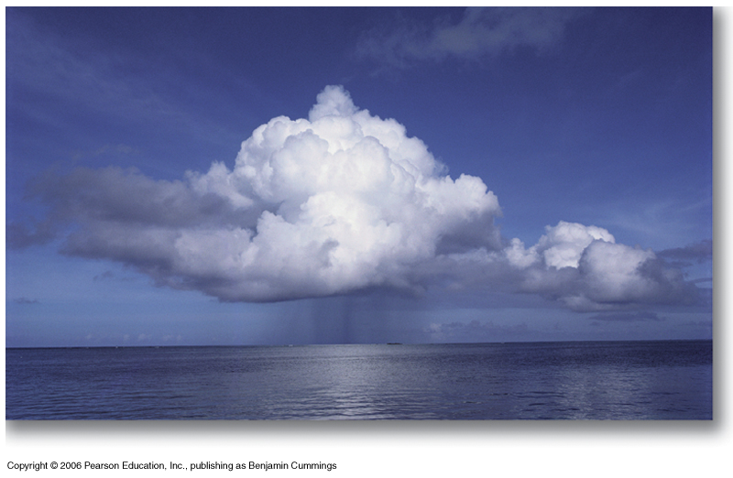
The Aquatic Environment
Outline:
Water cycle
Properties of water
Light and temperature in aquatic environments
Oxygen and carbon dioxide in water
Water movement in streams
Tides and estuaries
Notes:
Looking at physical and chemical characteristics of aquatic and terrestrial environments that determine the abundance and distribution of organisms.

Slide 7
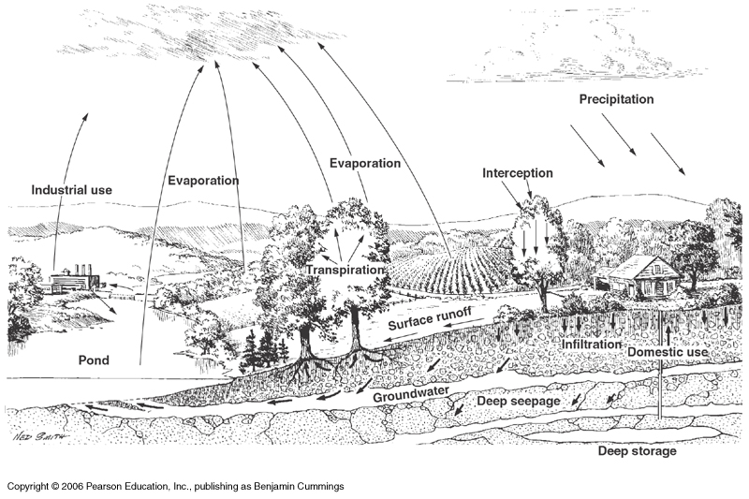
Water or hydrologic cycle
Notes:
Local scale, major pathways of water movement
Solar radiation drives the water cycle.

Slide 8
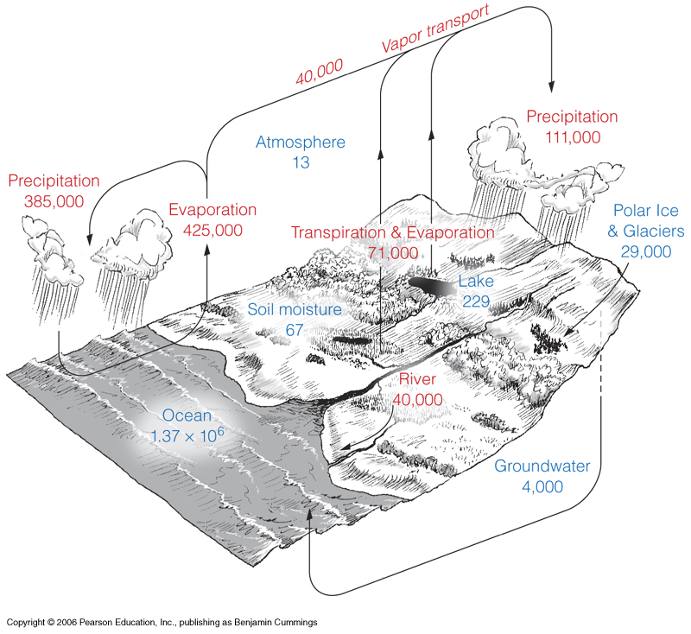
Water storages and fluxes
Notes:
Global water cycle; reservoirs[bodies of wtaer] BLUE 10^3 km^3; fluxes[exchanges between reservoirs] RED km^3
Oceans comprise mor ethan 97% fo all of water on Earth
Atmosphere only 13 BUT divide by output to get turnover time: 9 days for atmosphere, 3000 years for oceans
Major feature influencing adaptations of organisms in aquatic envrionments: water salinity: salt water (marine) versus freshwater

Slide 9
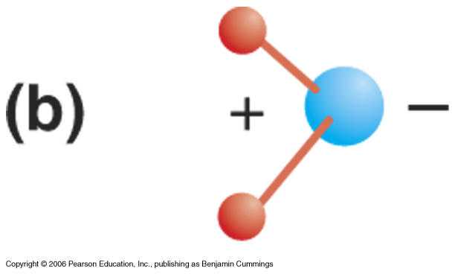
Physical properties of water
Notes:
Figure 4.3b
Polarity of water
Covalent bond b/w H and O (shared electrons) OR polar covalent bond
Water is an essential substace of life: 75-95% of the weight of all living cells is water

Slide 10
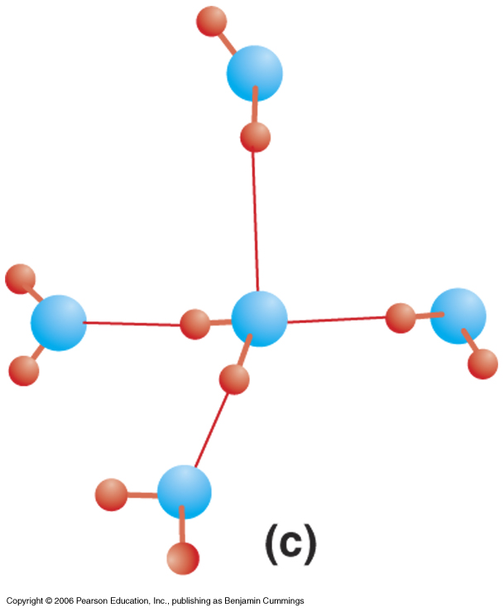
Physical properties of water
Notes:
Figure 4.3c
Hydrogen bond: b/w H of one water molecule and oxygen of another water molecule
Easily broken and refomed

Slide 11
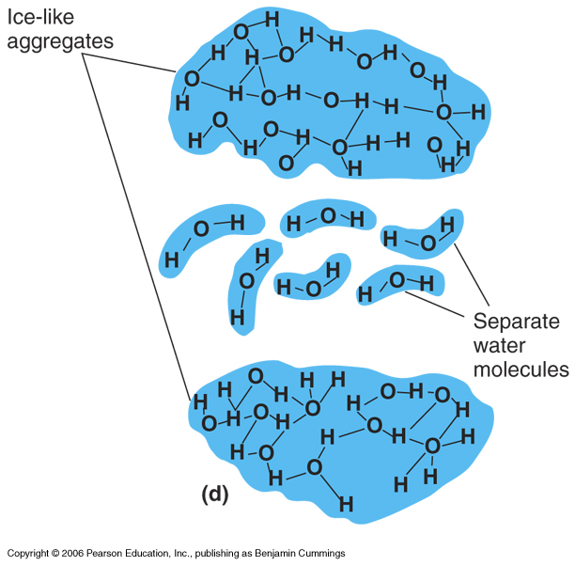
Physical properties of water
Notes:
Figure 4.3d
Unique properties of water:
High specific heat: number of calories necessary to raise 1 gram of water 1 degree Celcius = 1
Peculirar density-temperature relatiohsip:pure water densest when at 4 degrees.

Slide 12
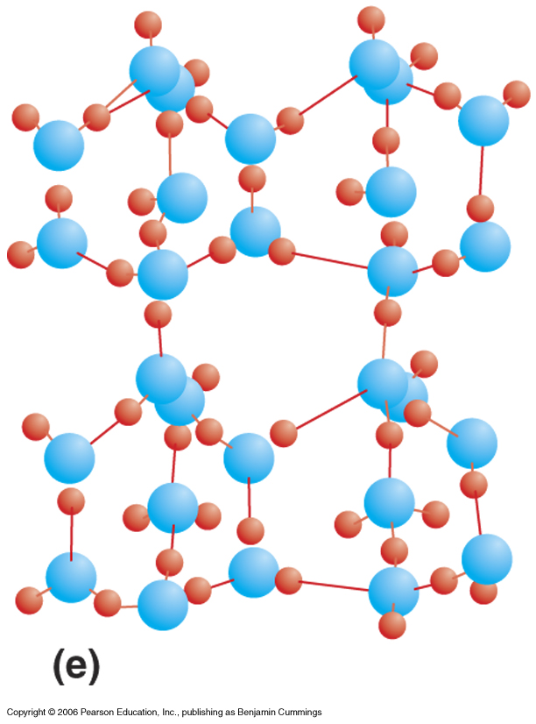
Physical properties of water
Notes:
Figure 4.3e
Talk about density here. Ice at 0 because of lattice arrangements, occupies more space, less dense, therefore floats.

Slide 13
Physical properties of water
High specific heat:
Specific heat: number of calories necessary to raise 1 gram of water 1 degree Celsius
Peculiar density-temperature relationship: pure water most dense when at 4 degrees Celsius.

Slide 14
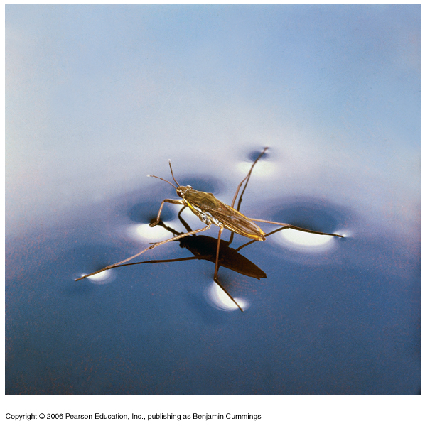
Physical properties of water: cohesion
Notes:
Figure 4.4
Hydrogen bonding, water molecules stick together, this property: cohesion
Surface tension, surface water molecules pulled down by other water molecules
Water strider

Slide 15
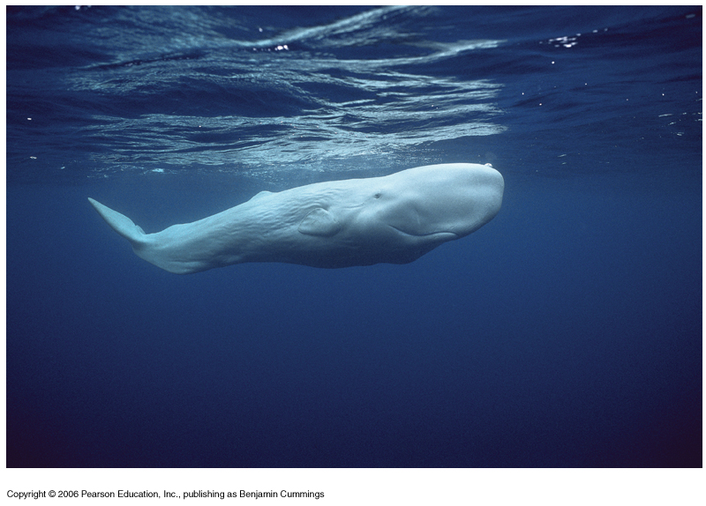
Physical properties of water: viscosity and buoyancy
Notes:
Figure 4.5
Cohesion is also responsible for the viscosity of water
Viscvosity measures the force necessary to separate the molecules and allow passage of an object through it… frictional resistance
Sperm wahle

Slide 16
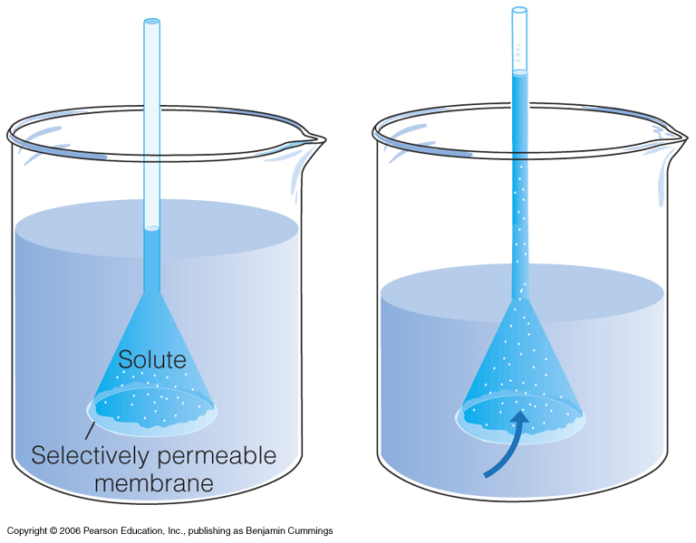
Diffusion and osmosis
Notes:
Diffusion is the net passive movement of particles from a region of higher concentration to a region of lower concentration
Osmosis: Special case of passive transport, across a selectively permeable membrane

Slide 17
Physical conditions in the aquatic environment
Light
Temperature
Oxygen
Salinity
Acidity

Slide 18
Physical conditions: 1. Light
Some incident sunlight is reflected from the water’s surface
The lower the angle of the sun, the greater the reflectance
The amount of light that penetrates the water’s surface varies with latitude, season
Light that does penetrate is absorbed by water molecules…

Slide 19
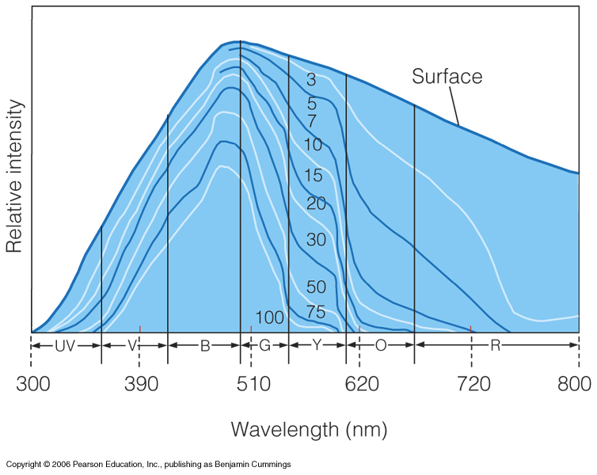
Fig. 4.6

Slide 20
Different wavelengths penetrate to different depths
E.g. for visible light:
Red: most rapidly absorbed
Blue: least rapidly absorbed --> greatest penetration
Suspended particles in the water also absorb and scatter light --> reduces penetration even further

Slide 21
Physical conditions 2. Temperature
Water is most dense at 4ºC
Lake in summer:
temperature drops with increasing depth
Stratification of water column
Epilimnion: warm surface water
Thermocline: rapid decline in temperature
Hypolimnion: cold, dense water (~4ºC)

Slide 23
Temperature
Tropical lakes: thermocline all year
Temperate lakes: only in summer
Autumn: surface cools --> temperature becomes uniform throughout (~4ºC)
Mixing of all parts = fall turnover
Increased nutrient levels at the surface

Slide 24
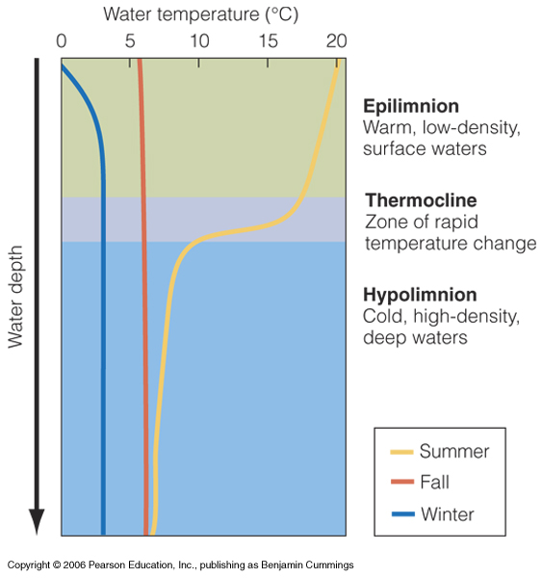
Fig. 4.7

Slide 25
Temperature
Temperate lakes in winter
surface colder than 4ºC
Bottom near 4ºC
Temperate lakes in spring
Ice melts --> surface warms --> ~4ºC throughout
Spring turnover

Slide 26
Temperature
Oceans: never undergo complete turnover
Winter: thermocline rises
Summer: thermocline descends
Bottom never mixes with top

Slide 27
Temperature
Flowing waters: temperature variable
Shallow waters: follow air temperature
Track changes slowly

Slide 28
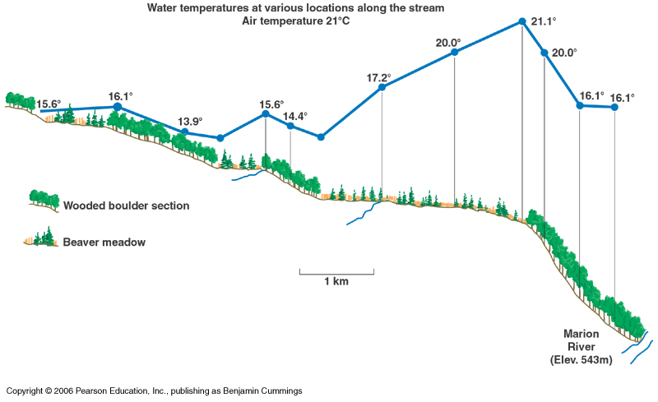
Notes:
Fig 4.8
Streams: temperature of flowing water is variable
Streams exposed are warmer
Important for fish: trout like cold water
Catfish: warmer water.
Forest harvesting…

Slide 29
Physical conditions: 3. Oxygen
Diffuses from air through surface
Solubility decreases as water temperature increases
Solubility decreases as salinity increases
Diffusion: 10,000 times slower than in air
Mixing of water by winds and currents is critical
Temperature stratification --> oxygen stratification

Slide 30
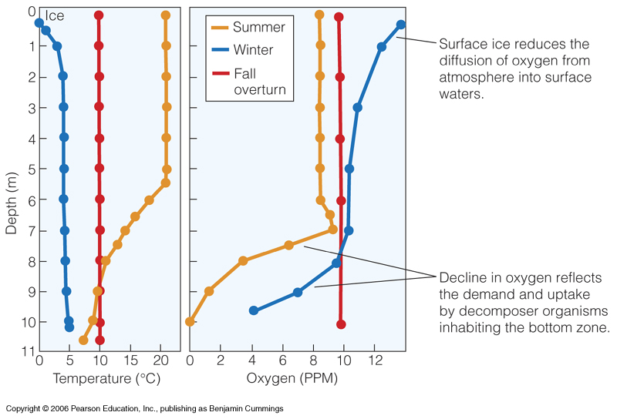
Notes:
Fig 4.9
Diffusion of gases: oxygen and carbo dioxide into water
Solubility increases as temp decreases..
Oxygen lost by uptake of organisms
Diffusion, plus mixing by turbulence

Slide 31
Oxygen
Oceans: Highest conc. near surface (upper 10-20m)
Photosynthesis
Wind mixing
Decreases to minimum at 500-1,000 m
Oxygen minimum zone
No turnover --> water never reoxygenated
Below 1,000 m : conc. increases again
Polar regions: surface (high conc.) waters cool, sink --> currents --> highly oxygenated deep waters carried to lower latitudes

Slide 32
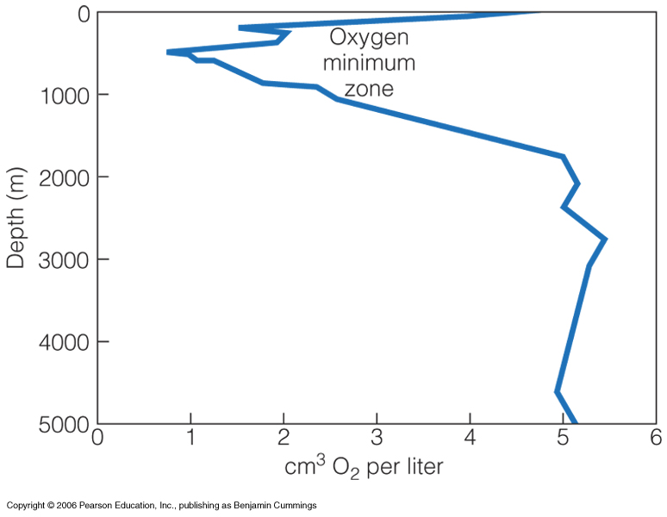
Notes:
Fig 4.10
Ocean versus lake
Oxgyen increase with depth thought to be related to polar water rich with oxygen
Oxygen 21% by volue in air, only 1% in freshwater at 10 C

Slide 33
Physical conditions: 4. Salinity
Flow of rivers into ocean: dissolved materials increase over time
Concentrations can’t increase beyond maximum solubility limit.
e.g. Ca²⁺ forms CaCO₃ (limestone)
e.g. Cl⁻ - highly soluble (max. 360 g/L)
Maximum not yet reached (today 19 g/L)
Total concentration of all salt in ocean: 3.5% or 35 ppt
Fresh water 0.065 to 0.3 ppt

Slide 34
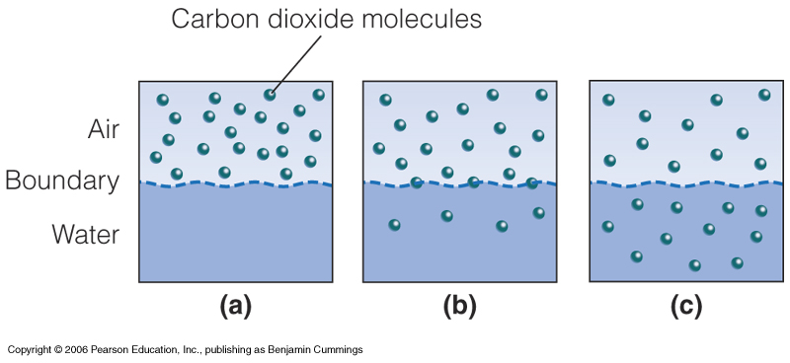
Physical conditions: 5. Acidity

Slide 35
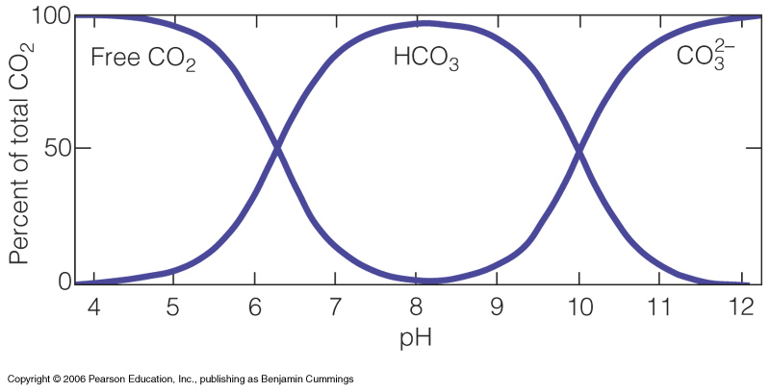

Slide 36
Factors affecting pH
Fresh water: underlying rock is important
Limestone:
raises pH
buffers against changes
Sandstone, granite
Lowers pH
Oceans: Na⁺, K⁺, Ca²⁺ raise pH
pH ~ 7.5-8.4

Slide 37
Effect of pH on living organisms
Direct effects: interference with physiological processes
Indirect effects: effect on other dissolved substances
E.g. Al³⁺: concentration increases below pH 5
Insoluble at higher pH

Slide 38
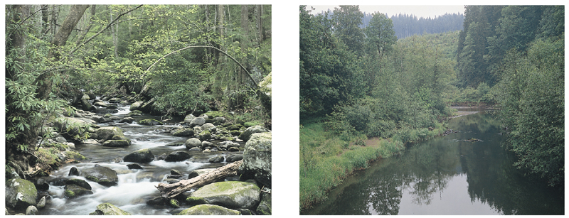
Water Movement
Fast flow --> rocky bottom
Slow flow --> silty bottom
Increase in water volume → increase flow rate

Slide 39
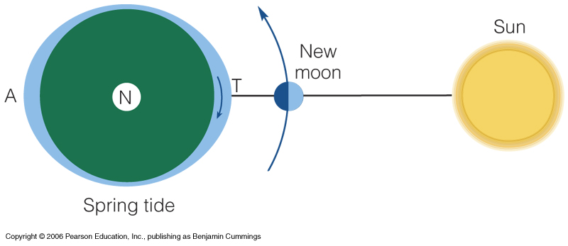
Tides
Water movement
Gravity of moon causes two “bulges” on opposite sides of the earth
Gravity of sun has similar but smaller effect

Slide 40
Water movement - Tides
In most locations: two high and two low tides within a 24hr period
Tides may vary depending on latitude, prevailing winds, contour of the land, depth of water, and other factors

Slide 41
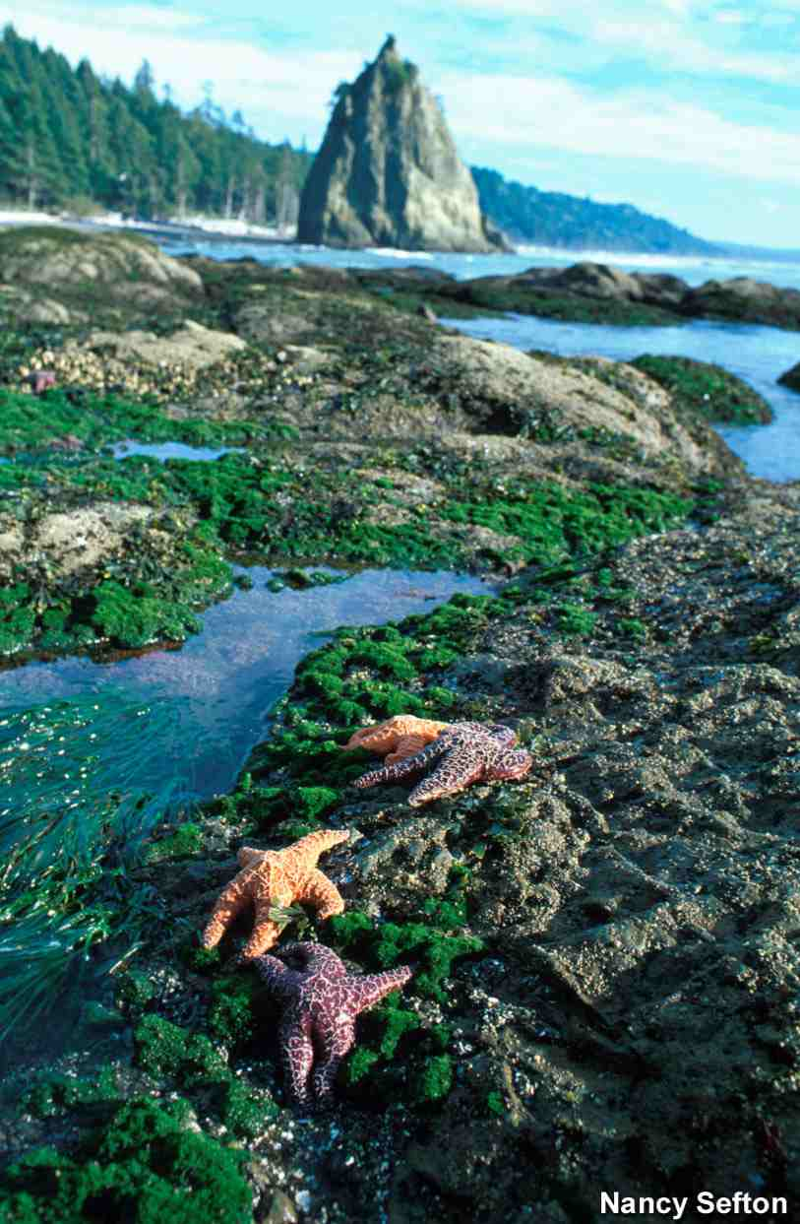
Water movement - Tides
Intertidal zone: between high and low tide levels on shoreline
Extreme fluctuations in water availability, salinity, sun intensity, temperature, and oxygen availability

Slide 42
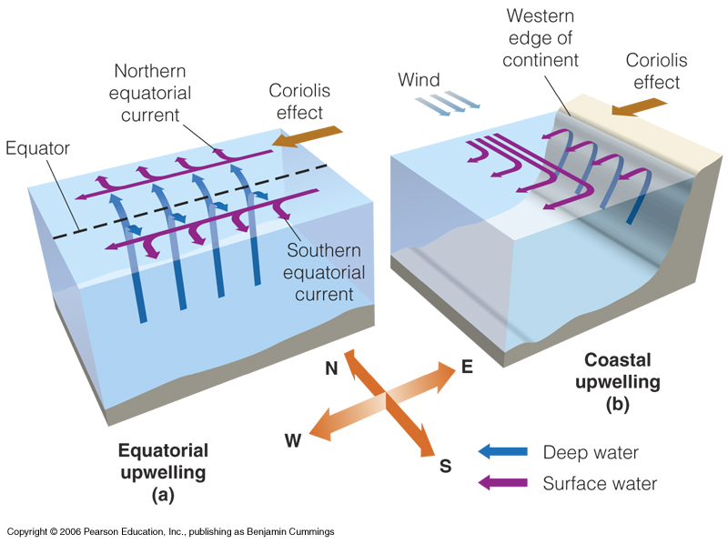
Water movement - upwelling
Notes:
Figure 4.14

Slide 43
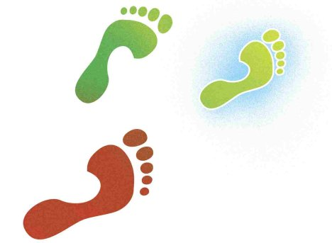
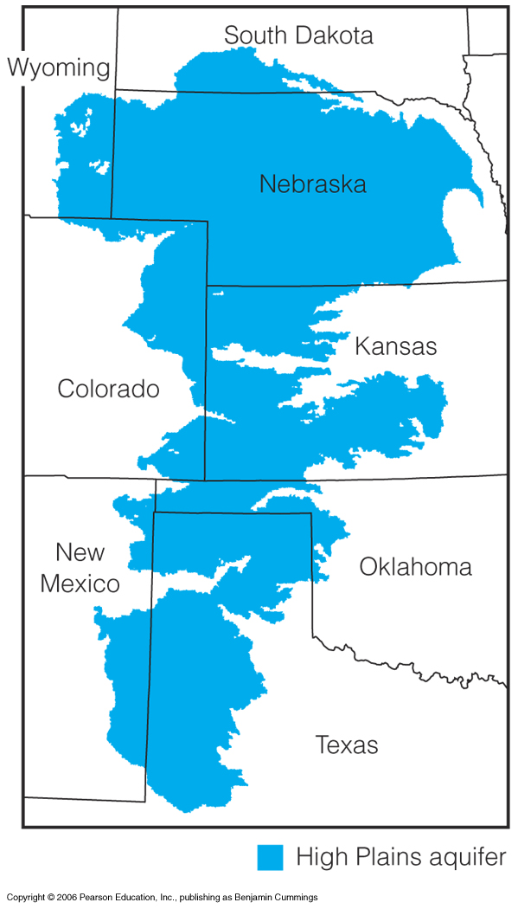
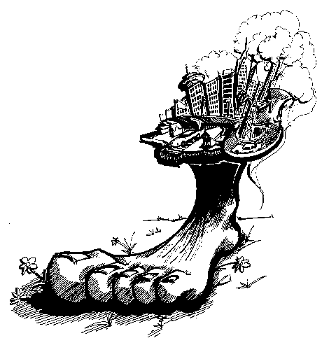
Notes:
Groundwater for irrigation, plus drinking..
Ogallala-aquifer
Thhickness of aquifer is 65 m on average
200,000 wells pumped at rates 50 time than recharge

Slide 65
What causes soil erosion??
removing plant cover by burning pasture or felling trees
having too many animals on the land
bad cultivation practices
wind
frost
rain and water runoff
extreme climatic effects

Slide 66
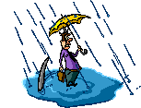
Lets start with water…

Slide 67
Even a single rain drop can dislodge soil, and start erosion

Slide 68
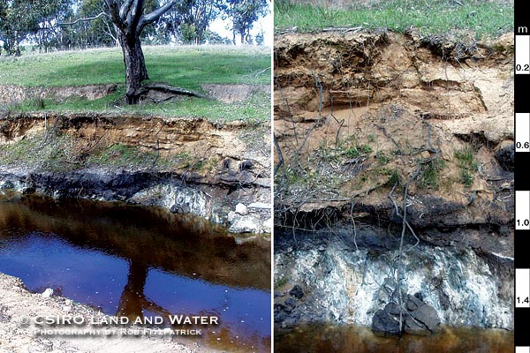
Example of gullies formed by erosion

Slide 69
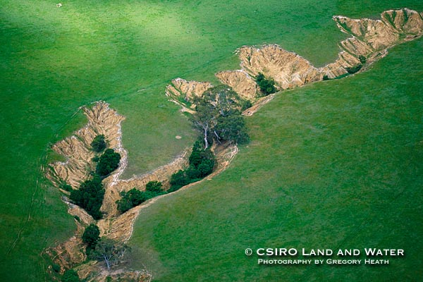
As gullies increase, more erosion takes place by collapsing of the
walls, and sediment can be carried far away.

Slide 70
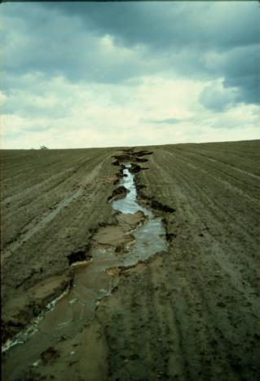

Slide 71
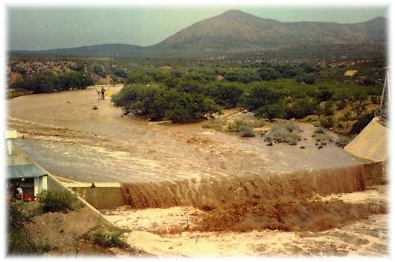
Note the color of the rive water….Why?

Slide 72
Now lets talk about wind

Slide 73
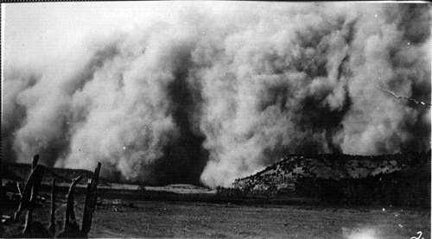
Severe dust storm. An example erosion by wind.

Slide 74
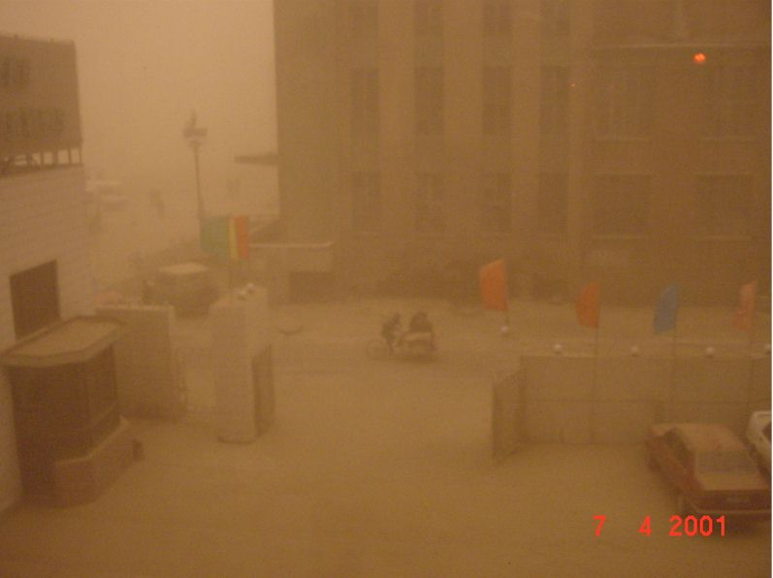
Dust storms can carry loose unprotected soil into cities, too.

Slide 75
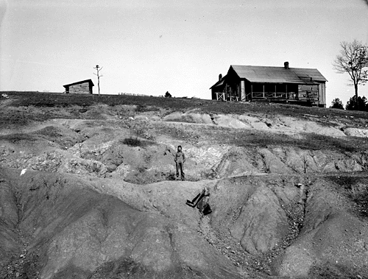
Results of both wind and water erosion

Slide 76
What about animals?

Slide 77
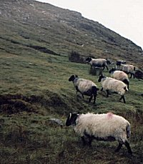
Many animals graze….is this good or bad for the soil??

Slide 78
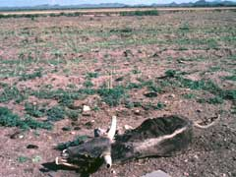
eventual desertification that
Overgrazing leads to the extinction of indigenous plant and animal species, soil erosion, and eventual desertification that renders once-fertile land barren.

Slide 79
How do people effect soil erosion?

Slide 81
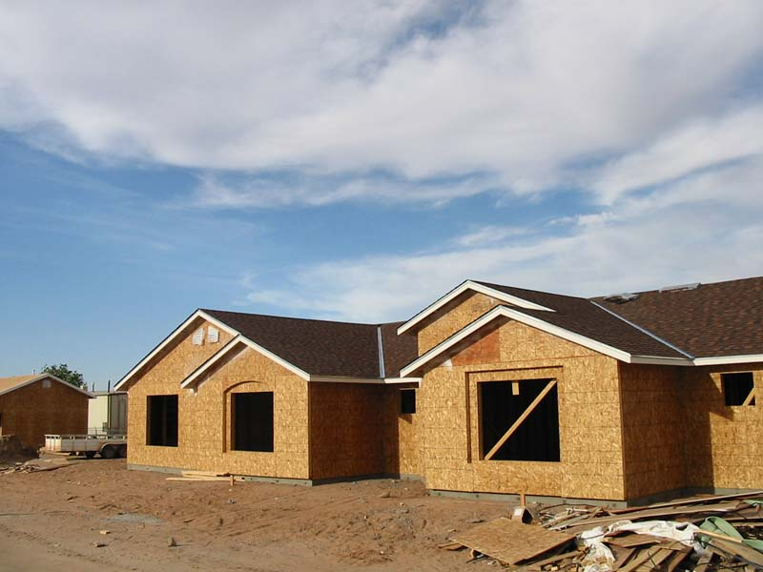
Residential construction effects on soil

Slide 82
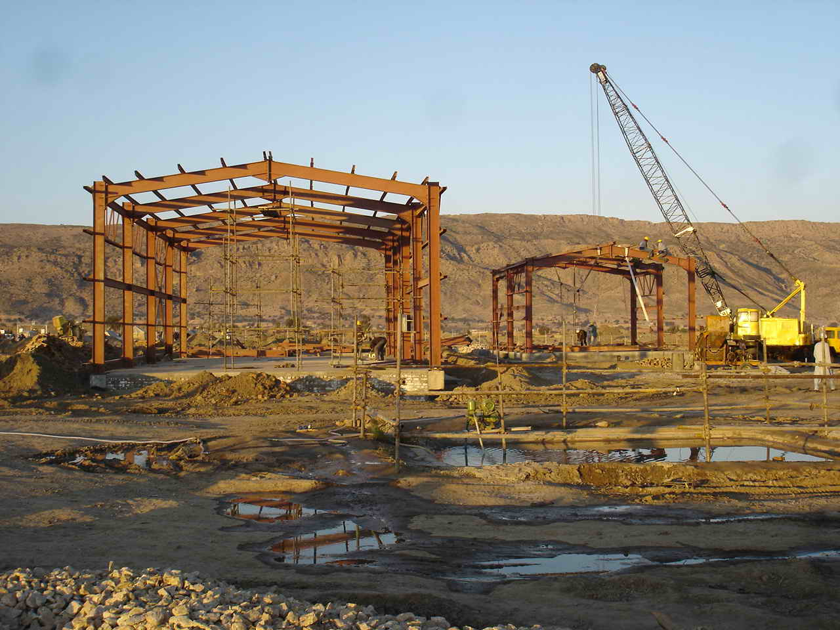
Commercial construction

Slide 83
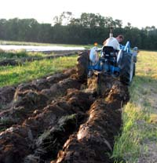
Traditional Plowing

Slide 84
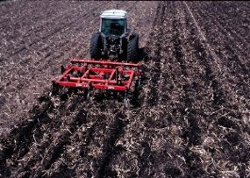

Slide 85
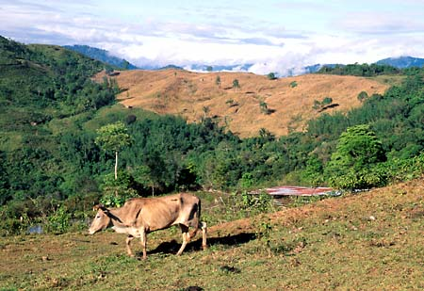
Deforestation

Slide 86
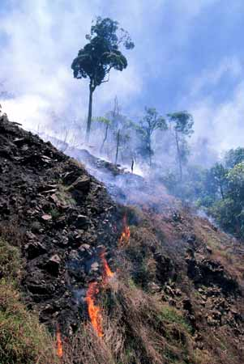

Slide 87
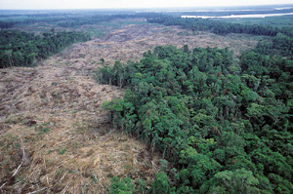

Slide 88
So what can we do?

Slide 89
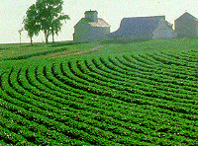
Contour Farming

Slide 90
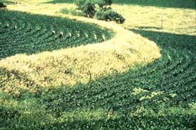

Slide 91
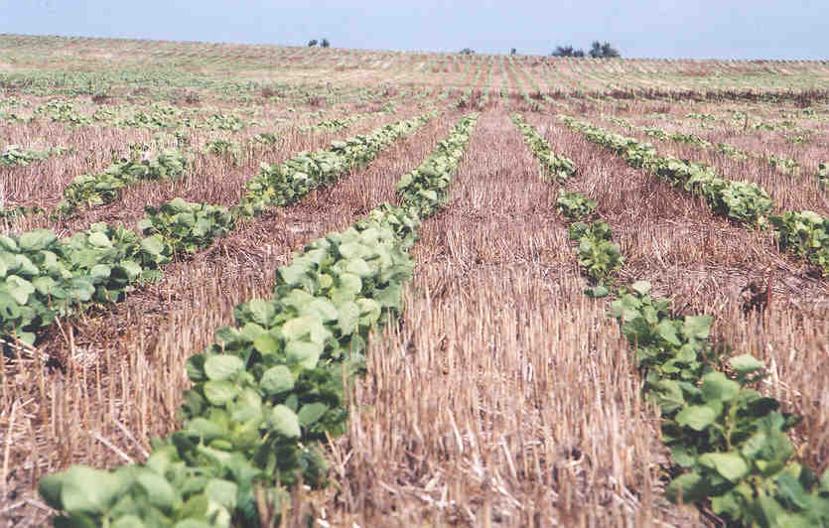
No-till Farming

Slide 92
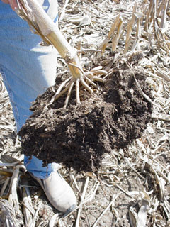
In no-till farming, the root structure of the previous years’ crop helps hold the soil together and prevent erosion.

Slide 93
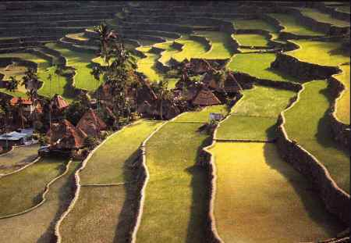
Terracing

Slide 94
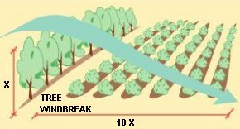
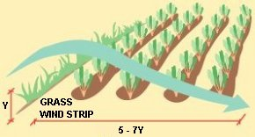
Wind breaks and Wind barriers
Wind barriers reduce the speed and soil carrying ability of the wind. Tree windbreaks protect an area about ten times their height. Grass wind barriers are more flexible and can be pushed down by high winds, reducing the protected distance to five to seven times the barrier height.

Slide 95
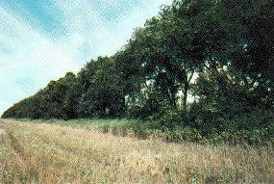
Wind break

Slide 96
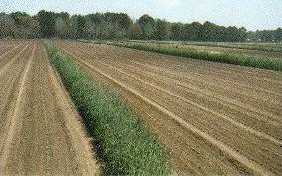
Wind barrier

Slide 97
Grassed waterways protect soil against the erosive forces of concentrated runoff from sloping lands. By collecting and concentrating overland flow, waterways absorb the destructive energy that would otherwise cause channel erosion and gully formation.

Slide 98
Soil mats during construction

Slide 99
Re-seeding and planting trees

Slide 100
Covering with mulch

Slide 101
Spraying water to prevent wind erosion

Slide 102
Retaining walls

Slide 104
Ecosystem
Dr. Shrikant B. Bhosale

Slide 105
Contents
What is an ecosystem
Three major principles of ecosystem
Components of an ecosystem
Abiotic components
Biotic components
Movement of energy and nutrients
Food chain
Food webs
Trophic levels, biomass and biome
Environmental Limitation in ecosystem development.

Slide 106
What is an ecosystem
An ecosystem is a grouping of organisms that interact with each other and their environment in such a way as to preserve the grouping.
There is a great variety of ecosystems in existence, all of them are characterized by general structural and functional attributes.

Slide 109
Three major principles of ecosystem
Nutrient cycling:
Movement of chemical elements from the environment into living organisms and from them back into the environment through organisms live, grow, die and decompose.
Energy flow:
Energy is required to transform inorganic nutrients into organic tissues of an organism.
Energy is the driving force to the work of ecosystem.
Structure
It refers to the particular pattern of inter-relationships that exists between organisms in an ecosystem.

Slide 110
Nutrient cycling

Slide 111
Energy flow

Slide 112
Structure

Slide 113
Ecosystem: Nutrient cycling, energy flow and structure

Slide 114
Components of an ecosystem

Slide 115
Abiotic components
They form the environment and determine the type / structure of ecosystem.
Sunlight (temperature)
Nutrients
Rainfall, minerals, carbon, nitrogen,…..
Type of ecosystems:
Tropical rainforest, Desert, Tundra, Grassland,…..

Slide 116
Distribution of vegetation / ecosystem

Slide 117
Biotic components
Producers (Autotrophs):
All green plants. They use solar energy, chlorophyll, inorganic nutrients and water to produce their own food. (Photosynthesis)
Consumers:
They consume the organic compounds in plant and animal tissues by eating.
Herbivores (plant feeders) Primary consumers
Carnivores (meat eaters) Secondary consumers
Omnivores (general feeders)

Slide 118
Biotic components
Decomposers
They are tiny organisms includes bacteria and fungi, which turn organic compounds in dead plants and animals into inorganic materials.
They cause the continual recirculation of chemicals within ecosystem (nutrient cycle)

Slide 120
Biotic components and food chain

Slide 121
Movement of energy and nutrients
Food chain
Food webs
Trophic level, biomass and biome

Slide 122
Food Chain
The particular pathway of nutrient and energy movement depends on which organism feeds on anther.
Decomposers

Slide 123
Food Webs

Slide 124
Trophic Levels
A trophic level means a feeding level.
First level – all producers
Second level – all herbivores
Third level – first level carnivores
Fourth level – second level carnivores
So on……..

Slide 125
Trophic levels
Energy and Nutrients passed through the ecosystem by food chains and webs from lower trophic level to the higher trophic level.
However, only 5% to 20% energy and nutrients are transferred into higher trophic level successfully.
For this reason, first trophic level has the largest number of organisms, and second trophic level is less than first one; the third level is less than second level, and so on.

Slide 126
Trophic levels

Slide 128
Biomass
Biomass means the total combined weight of any specified group of organisms.
The biomass of the first trophic level is the total weight of all the producers in a given area.
Biomass decreases at higher trophic levels.

Slide 129
Biomass

Slide 130
Biomass and productivity

Slide 132
Trophic Level (Food Pyramid)

Slide 133
Biome
This is a total different concept apart from Biomass.
Biome are defined as
“the world’s major communities, classified according to the predominant vegetation and characterized by adaptations of organism to that particular environment.

Slide 134
Nitrogen Cycle

Slide 135
Nitrogen cycle
Nitrogen cycle can be affected by man in five major ways:
Fertilizer production (mainly nitrates and ammonium salts) to grow more food by increasing yields, and replenishing lost nitrogen from the soil.
Burning of fossil fuels in cars, power plants, and heating which puts nitrogen dioxide into the atmosphere.
Increasing animals wastes (nitrates) from more people and from livestock and poultry grown in ranches.
Increased sewage flows from industry and urbanization.
Increased erosion of and runoff nearby streams, lakes and rivers from cultivation, irrigation, agricultural wastes, mining, urbanization and poor land use.

Slide 136
Phosphorus Cycle
The phosphorus cycle may also be referred to as the mineral cycle.
The phosphorus cycle is the movement of phosphorus from the environment to organisms and then back to the environment.
Phosphorus is mainly found in water, soil, and rock.
Phosphorus is essential for life.
Component of DNA
Building block of our bones and teeth.

Slide 137
Phosphorus Cycle
REMEMBER THIS!!!
Most phosphorus is found in rocks and soil.
The phosphorus cycle is the slowest cycle.
Excess phosphorus contributes to eutrophication.

Slide 139
Phosphorus Cycle
Unlike the other cycles, phosphorus cannot be found in air in the gaseous state.
The phosphorus cycle is the SLOWEST cycle.
Phosphorus is most commonly found in rock formations and ocean sediments as phosphate salts.
Phosphate salts that are released from rocks through weathering usually dissolve in soil water and will be absorbed by plants.

Slide 140
Phosphorus Cycle
Animals absorb phosphates by eating plants or plant-eating animals.
When animals and plants die, phosphates will return to the soils or oceans again during decomposition.
After that, phosphorus will end up in sediments or rock formations again, remaining there for millions of years. Eventually, phosphorus is released again through weathering and the cycle starts over.

Slide 141
Environmental Limitation in ecosystem development
Principles of limiting factors
Law of the maximum
Law of the minimum
Principle of holocoenotic environment
Limiting factors of an environment
Light
Temperature
Water
Wind
Topography
Soil
Biotic factors

Slide 142
Limiting factors of an environment
Light
Temperature
Water
Wind
Topography
Soil
Biotic Factors

Slide 143
Community Ecology

Slide 145
Definition of a community
Community is the associations of plants and animals occurring in a particular locality and dominated by one or more prominent species or by some physical characteristic.
An assemblage is a taxonomically related group that occurs in the same geographic area.

Slide 146
Biological Communities
Community
Species that occur at any particular locality
Characterized by
Species richness
Number of species present
Primary productivity
Amount of energy produced
Interactions among members govern many ecological and evolutionary processes

Slide 148
Biological Communities
Two views of structure and functioning of communities
Individualistic concept: a community is nothing more than an aggregation of species that happen to occur together at one place
Holistic concept: a community is an integrated unit; superorganism – more than the sum of its parts

Slide 149
Biological Communities
Most ecologists today favor the individualistic concept
In communities, species respond independently to changing environmental conditions
Community composition changes gradually across landscapes

Slide 150
Abundance of tree species along a moisture gradient in the Santa Catalina Mountains of Southeastern Arizona
Each line represents the abundance of a different tree species
Community composition changes continually along the gradient

Slide 151
Biological Communities
Sometimes the abundance of species in a community does change geographically in a synchronous pattern
Ecotones: places where the environment changes abruptly

Slide 154
Life Forms
• General appearance of plants based on their
morphological features such as shape, branching
pattern, crown and life span is regarded as life
forms.
• Raunkiaer’s life forms - Classification of plant life in to the height of perennating tissue
(embryonic or meristemic that remain inactive over winter prolonged dry periods) above ground.
Perennating tissues include buds, bulbs, tubers,
roots, and seeds.

Slide 155
Raunkiaer’s life forms
1. Phanerophytes
Woody perennials (Trees, shrubs) > 25 cm in height that have their leaf-producing buds elevated above ground on stems.
May be further subdivided according to plant height
megaphanerophytes,
mesophanerophytes &
nanophanerophytes

Slide 156
Raunkiaer’s life forms
2. Cryptophytes (Geophytes)
Grasses which have above-ground tissues that periods and survive unfavorable periods as BUDS buried in the ground on a BULB or RHIZOME.IE BACK IN WINTER or during prolonged dry
These can be:
Geophytes
Helophytes
Hydrophytes

Slide 157
Raunkiaer’s life forms
3. Therophytes
Annuals that survive unfavorable periods as SEEDS and complete their life cycle from seed to seed in one season. Many desert plants are by
necessity therophytes.
Raunkiaer’s life forms
4. Chamaephytes
Buds on persistent shoots near the ground – woody plants with
perennating buds borne close to the ground, no more than 25
cm above the soil surface, (e.g. Bilberry and Periwinkle).

Slide 160
Biological spectrum
When species within a community are classified into life forms and each life form is expressed as a PERCENTAGE, the result is a LIFE FORM SPECTRUM (Biological spectrum) that reflects the plants’ adaptations to the environment, especially climate, and provides a standard means for describing community structure.
The ratio of the life forms of different species in terms of percentage in any floristic community is called the biological spectrum.
Biological spectrum is also called phytoclimatic spectrum because each life form is related to a particular climate and the composition of a community in terms of life forms also indicates the climatic condition prevailing in the area.
Therefore, biological spectrum is a direct indicator of the environment that is occupied by the particular community.

Slide 161
Phytogeographical regions of India

Slide 162
Phytogeography is the study of distribution of plant species and elucidation of origin of flora.

Slide 163
Distribution of plants is mainly controlled by climatic factors.
1. Temperature, Altitude, Precipitation, Atm moisture, Light intensity and duration.
2. Type of soil.
3. Biotic factors play an important role in distribution and establishment of species.

Slide 164
Phytogeographical regions of India
Phyto geographical regions are also called as Botanical regions.
D. Chatterjee has divided India in to 9 botanical zones.

Slide 165
1. Western Himalayas.
2. Eastern Himalayas
3. Indus plain
4. Gangetic plain
5. Central India
6. Deccan
7. Western coasts Of
Malabar
8. Assam
9. Andaman and Nicobar

Slide 166
Western Himalayas
One of the most important botanical region of India.
It consists of Kasmir, Himachal pradesh, part of Punjab.

Slide 167
Average rain fall
100 cm to 200 cm.
Salmalia malbaricum
Shorea robusta
Butea monosperma.

Slide 168
Dalbergia sisso
Ficus glomeruta
Eugenia species

Slide 169
Eastern Himalayas
Extend from Sikkim to Assam
Heavy monsoon rainfall
Less snow fall
High humidity

Slide 170
Terminelia
Stericulia
Anthocephalus cadamba
Bauhinia

Slide 171
Michelia champaka
Cinnamomum sp.
Eugenia sp.

Slide 172
Abies sp.
Juniperous
Tsuga sp.

Slide 173
Rhododendron sp.

Slide 174
Indus plains
It includes punjab, Rajastan, Cutch,
Delhi,
Dry hot summer
Dry cold winter
Rain fall – Less than 70 cm
Vegetation is mainly bushy and thorny.

Slide 175
Acacia arabica
Prosopis sp.
Salvodora sp.
Zizyphus zuzuba
Mangifera sp.

Slide 176
Gangetic Plain
Richest vegetation in India
Covers U.P., Bihar, West Bengal and a part of Orissa.
Rain fall- 50 to 150 cm
Cultivable land

Slide 177
Wheat, Jowar, Bajra, Urad, Moong,Red gram.

Slide 178
Dry deciduous forests are common
Capparis, Dalbergia, Acacia species are very common.

Slide 179
Mangrove vegetation is common in tidal regions in W.B.
Rhizophora sp.
Sonneratia sp.
Acanthus ilifolius

Slide 180
Central India
Covers Madya pradesh and a part of Orissa, gujarat and Vindya.

Slide 181
Rain fall – 100 to 170 cm
Thorny vegetation in open areas
Teak and Sal trees are very common.

Slide 182
Deccan
Includes Southern peninsular India
Rain fall- 100cm.
Divided in to Deccan plateau and coromondel coast.

Slide 183
Teak forest are common.
Pterocarpus, Borassus,
Clematis,
Coromondel coast consists of halophytic sp.

Slide 236
Hydrophytes: pictures

Slide 237
Hydrophytes: pictures

Slide 238
2. Xerophyte Adaptations
1. Well established root systems.
Grow deeply and in all directions in order to anchor the plants in sandy soil and against the wind.
Helps to maximize water uptake.

Slide 239
1. Xerophytes possess adaptations to prevent excessive water loss
2. Sunken stomata:
creates local humidity/decreases exposure to air currents;
3. Presence of hairs:
creates local humidity next to leaf/decreases exposure to air currents by reducing flow around stomata;
4. Fewer stomata:
decreases transpiration as this is where water is lost;
5. Thick waxy cuticle:
makes more waterproof impermeable to water due to the high heat and intense sunlight.

Slide 240
Xerophytes possess adaptations to prevent
excessive water loss
6. Short Life Cycles
Grow from seeds to mature plants, produce flowers, fruits and seeds in a short amount of time.
These few days can coincide with the few days of rain.
7. Many desert plants are called C4 or CAM (Crassulacean acid metabolism) plants.
These plants only open their stomata in the dark at night.
The cooler temperatures allow the plant to take up CO₂ through their stomata without sacrificing water.
Examples: orchids, cactus, pineapple (CAM) crabgrass, corn (maize) sugarcane (C4)

Slide 241
Transverse Section Through Leaf of Xerophytic Plant

Slide 242
Xerophytes: pictures

Slide 243
Xerophytic Plants

Slide 244
3. Halophytic Plants

Slide 245
3. Halophytes
80% of the earth is covered by saline water
Very few plants are able to tolerate saline conditions without serious damage
Plants that survive in saline environments are termed halophytes
Most halophytes prefer saline conditions but can survive in freshwater environments
Most halophytes are restricted to saline environments

Slide 246
What is a halophyte?
Plants capable of normal growth in saline habitats and also able to thrive on “ordinary” soil (Schimper, 1903).
Plant which can tolerate salt concentrations over 0.5% at any stage of life (Stocker, 1928).
Plants which grow exclusively on salt soil (Dansereau, 1957).

Slide 247
Halophyte picture

Slide 248
Halophyte picture

Slide 249
Comparison between hydrophytes, xerophytes and halophytes and their adaptations:
1. Morphological features.
Hydrophytes | Xerophytes | Halophytes
Leaves: The submerged leaves are thin, much dissected while aerial leaves are large, entire or slightly lobed. | Leaves: Leaves may be thin or rigid, fleshy and leathery. | Leaves: Leaves are thick and their surfaces are reduced.

Slide 250
Hydrophytes | Xerophytes | Halophytes
Stem: There are well developed creeping underground stems (rhizomes) with profuse adventitious roots embedded in the mud. The stem is soft and tender | Stem: Stem is aerial, mostly erected but with limited growth. The stem is rigid and stout. | Stem: Well developed aerial stem and much branched. The stem ranges from soft to hard woody type.

Slide 251
Hydrophytes | Xerophytes | Halophytes
Roots: No elaborate root system occurs. No root systems develop in totally submerged hydrophytes. | Roots: Large elaborate root system occurs. Roots are mostly tap roots penetrating great depth of soil. | Roots: Tap root system is not much elaborate and deeply penetrating. In many cases, roots are negatively geotropic.

Slide 252
2. Anatomical features:
Hydrophytes | Xerophytes | Halophytes
Plants surfaces are not coated with any waxy or hairy coverings. | Plants are coated with waxy and hairy outgrowths. | Similar to xerophytes.
No development of cuticle. | Plant organs are well cuticled. | Like xerophytes.

Slide 253
Hydrophytes | Xerophytes | Halophytes
Stomata are either absent or when present they are restricted on the upper surface of leaves. Stomata are not sunken. | Stomata are sunken and they are present on the lower surface of the leaves only. | Stomata are either sunken or lie at near the level of the lower spidermis.
Stems and other plant parts are traversed by air cavities to maintain buoyancy. | Air cavities are absent, instead present hypodermal water storage tissues. | Like xerophytes.

Slide 254
Hydrophytes | Xerophytes | Halophytes
The xylem and other woody lignified tissues are poorly developed. | Xylem and lignified tissues are highly developed. | Lignification of woody tissues is extremely poor.
Mechanical tissues extremely reduced or not at all developed. | Development of mechanical tissues with extensive lignification does occur. | Mechanism tissues are less developed.
Glandular hairs and many types of secreting plant organs do not occur. | Various types of glandular hairs and secretory organs are present. | Secretory organs are found to be present in many plants.

Slide 255
3. Physiological features:
Hydrophytes | Xerophytes | Halophytes
Rate of transpiration is less. Removal of water takes place by guttation. | Rate of transpiration is decreased or entirely checked by heavy cutinisation of epidermis and by the formation of sunken stomata. | Like xerophytes, the rate of transpiration is checked by various kinds of morphological and anatomical modification of leaves.
The growth rate of submerged plants is reduced due to weak light intensity. | The growth rate of plants is slow due to maximum utilization of carbohydrates in the formation of cell wall. | The growth rate of plants is normal.

Slide 256
Hydrophytes | Xerophytes | Halophytes
Gases exchange of submerged organs with the atmospheric air takes place by air communicating system through stomata. O₂ and CO₂ present in the air cavities are used in respiration and photosynthesis respectively by internal circulation. | Gases exchange of both aerial and underground plant parts with the atmosphere takes place normally. | Gases exchange of the aerial plant parts takes place normally but the respiration of underground parts i.e. roots take place by the formation of negatively geotropic roots known as pneumatophores.

Slide 257
Hydrophytes | Xerophytes | Halophytes
Absorption of water and mineral salts takes place by the entire permeable plant surface under water. | Absorption of water and mineral salts takes place by the help of long-seated root system. | Absorption of water and mineral salts takes place slowly and selectively by the elaborate root system.

Slide 258
THANKS

