Slide 1
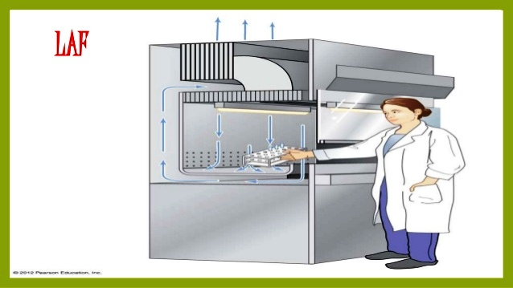
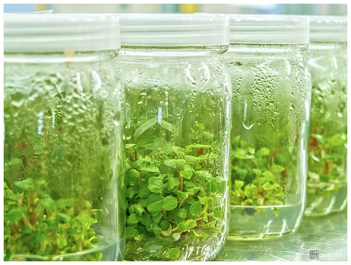
Dr. Shrikant B. Bhosale S. M. Dnyandeo Mohekar College Kallmb Dist. Osmanabd.
Plant Tissue Culture

Slide 2
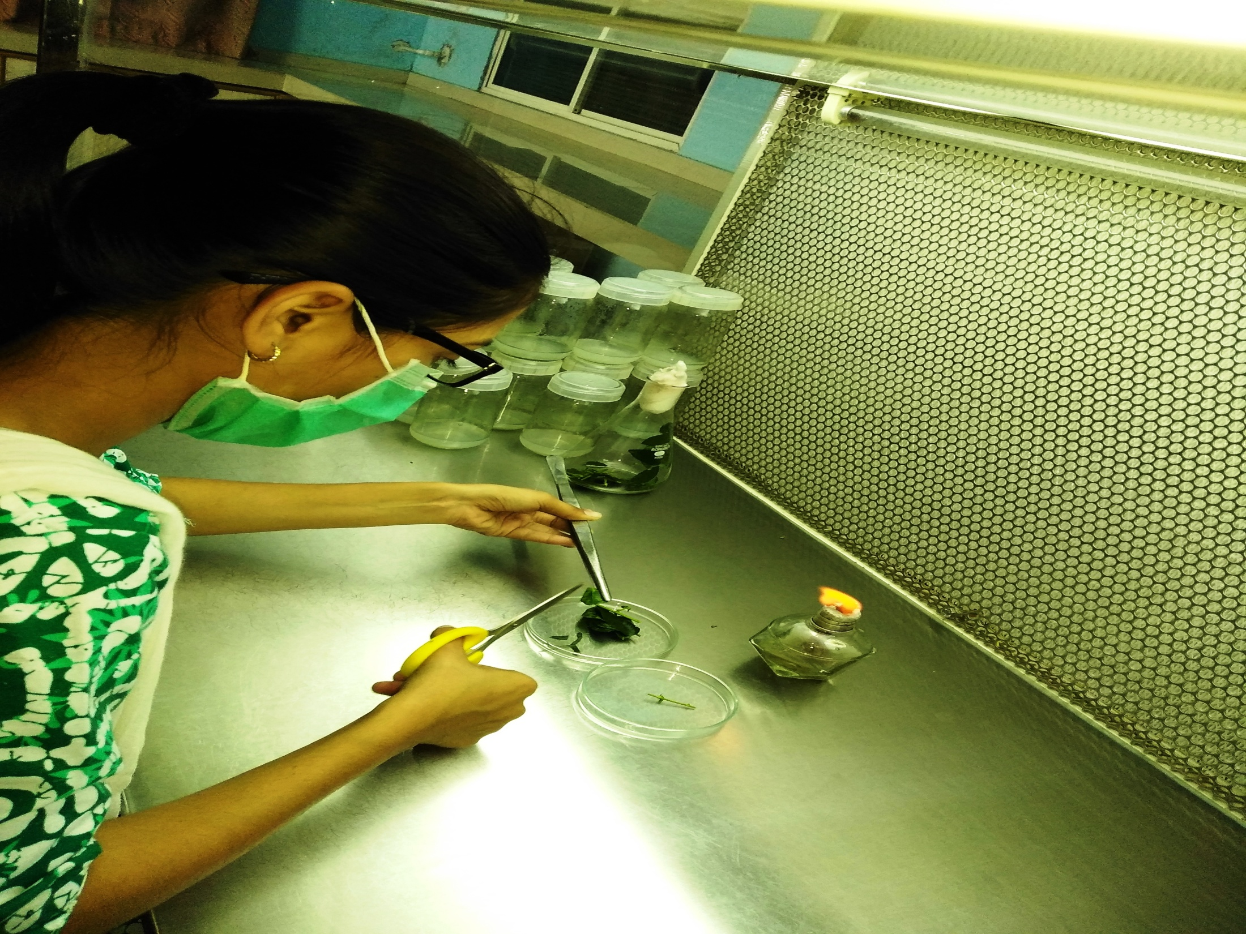
INTRODUCTION TO TISSUE CULTURE

Slide 3
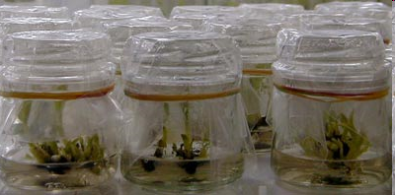
What is plant tissue culture?
Plant tissue culture is a technique of growing plant cells, tissues, organs, seeds or other plant parts in a sterile environment on a nutrient medium

Slide 4
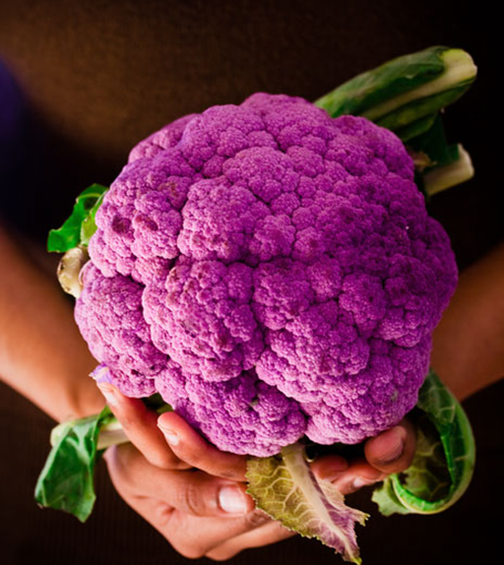
WHY?
The production of clones of plants that produce particularly good flowers, fruits, or have other desirable traits.
To quickly produce mature plants.
The production of multiples of plants in the absence of seeds or necessary pollinators to produce seeds.
The regeneration of whole plants from plant cells that have been genetically modified.

Slide 5
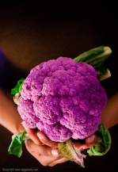
WHY?
The production of plants in sterile containers reduces disease transmission
Allows production of plants from seeds that otherwise have very low chances of germinating and growing, i.e.: orchids
To clean particular plants of viral and other infections and to quickly multiply these plants as 'cleaned stock' for horticulture and agriculture.

Slide 6
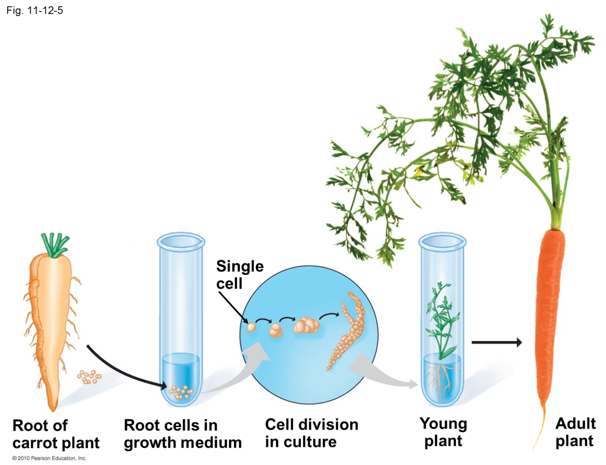
How?
Adult plant cells are totipotent, meaning they have the ability to give rise to a fully differentiated plant. Because of this, it is possible to collect cells from a mature plant and use those cells to produce clones of that plant.

Slide 7
Plant tissue Culture Basics
Modern plant tissue culture is performed under aseptic conditions
Living plant materials from the environment are naturally contaminated on their surfaces (and sometimes interiors) with microorganisms, so surface sterilization of starting material (explants) in chemical solutions (usually alcohol and sodium or calcium hypochlorite is required).

Slide 8
Plant tissue Culture Basics
Explants are then usually placed on the surface of a solid culture medium, but are sometimes placed directly into a liquid medium, when cell suspension cultures are desired.
Culture media are generally composed of inorganic salts plus a few organic nutrients, vitamins and plant hormones.

Slide 9
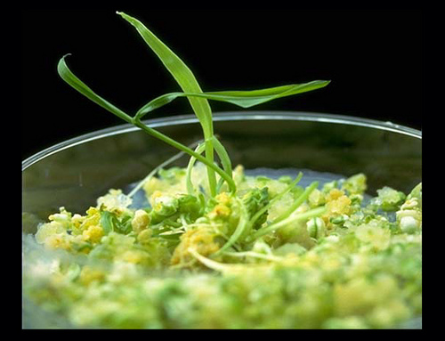
Plant tissue Culture Basics
As cultures grow, pieces are typically sliced off and transferred to new media (subcultured) to allow for growth or to alter the morphology of the culture.

Slide 10
High Efficiency Particulate Air
High Efficiency Particulate Air
General plant tissue culture laboratory design
Glassware washing and storage area
Media preparation and sterilization area
Refrigerator/freezer
Balances
Hot plate/stirrer
PH meter
Autoclave
Growth room
Aseptic transfer area
Laminar flow hoods
High Efficiency Particulate Air

Slide 11
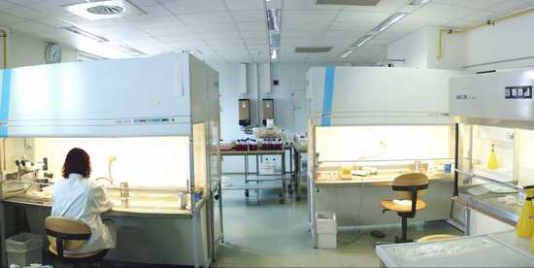
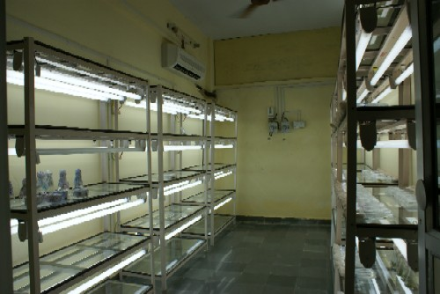

Slide 12
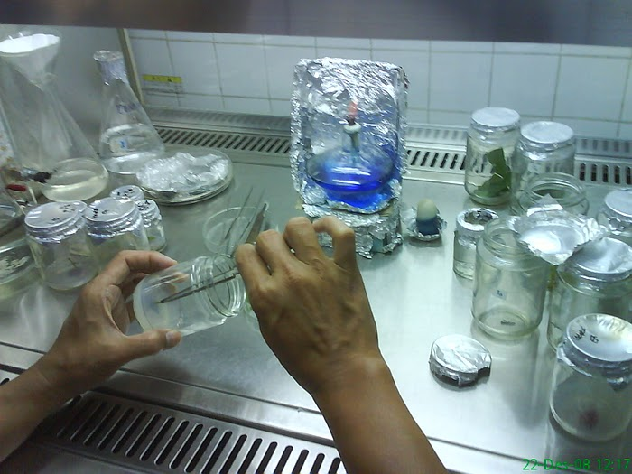

Slide 13
Sterilization methods:
Why?
Micro-organism contamination can over grow the plant culture resulting in culture death
Micro-organism contamination exhaust the nutrient media
Micro-organism can change in secondary metabolite structure or produce other compounds .
What?
The explant or culture
The vessels
The media
The instruments
The environment where handling is taking place

Slide 14
How?
Heat sterilization:
a. Dry heat: 130-180 °C for 2-4 hours
Used for glassware, metal instruments
Autoclave: 121 °C, 1.06 kg/cm2 (15 Ib) for 15 to 20 minutes
Used for glassware, media and aqueous solutions and plastic caps
Sterilization by filtration: for heat labile aqueous solutions
Ethanol: used for handling surface sterilization and also for explant.
Chemical sterilization: using sodium or calcium hypochlorite, sliver nitrate, mercuric chloride or some other bactericidal chemicals

Slide 15
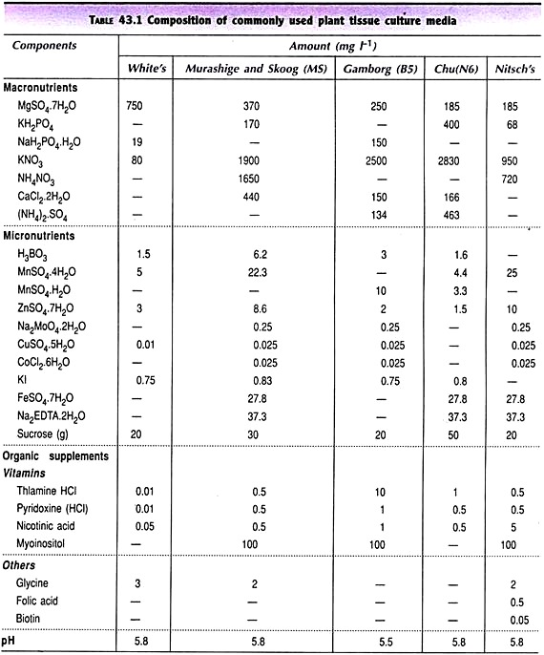

Slide 16
Major Constituents
Salt Mixtures
Organic Substances
Natural Complexes
Inert Supportive Materials
Growth Regulators

Slide 17
Murashige and Skoog
Medium With Vitamins and Sucrose
 | Medium Components (mg./L -)MS | Name of Components | (mg./L ) |  | FOR 1000 ML STOCK SOLUTION-A (50 ml./L)
 | Macronutrients |  |  |  | mg | gm
1 | NH4NO3 | Ammonium nitrate | 1650.0 | X 20 | 33000 | 33
2 | KNO3 | Potassium nitrate | 1900.0 | X 20 | 38000 | 38
3 | CaCl2.2H2O | Calcium chloride | 440.0 | X 20 | 8800 | 8.800
4 | MgSO4.7H2O | Magnesium sulphate | 370.0 | X 20 | 7400 | 7.400
5 | KH2PO4 | Potassium phosphate monobasic | 170.0 | X 20 | 3400 | 3.400

Slide 18
 |  | Name of Components | (mg./L ) |  | FOR 500 ML STOCK SOLUTION-B(10 ml./L)
 | Micronutrients |  |  |  | mg | gm
6 | KI | Potassium Iodide | 0.83 | X50 | 41.5 | 0.415
7 | H3BO3 | Boric acid | 6.20 | X50 | 310 | 0.310
8 | MnSO4.4H2O | Manganese sulphate monohydrate | 22.30 | X50 | 1115 | 1.115
9 | ZnSO4.7H2O | Zinc sulphate | 8.6 | X50 | 430 | 0.430
10 | Na2MoO4.2H2O | Sodium Molybdic acid | 0.25 | X50 | 12.5 | 0.125
11 | CuSO4.5H2O | Copper sulphate pentahydrate | 0.025 | X50 | 1.25 | 0.0125
12 | CoCl2.6H2O | Cobalt chloride hexahydrate | 0.025 | X50 | 1.25 | 0.0125
13 | Na2EDTA | EDTA disodium salt dihydrate | 37.3 | X50 | 1865 | 1.865
14 | FeSO4.7H2O | Ferrous sulphate heptahydrate | 27.8 | X50 | 1390 | 1.390

Slide 19
 | Vitamins and other supplements | (mg./L ) |  | FOR 500 ML STOCK SOLUTION-C (10 ml./L)
 |  |  |  | mg | gm
15 | Inositol | 100.0 | X50 | 5000 | 5.000
16 | Thiamine HCl | 0.1 | X50 | 0.5 | 0.05
17 | Pyridoxine HCl | 0.5 | X50 | 0.25 | 0.025
18 | Nicotinic acid | 0.5 | X50 | 0.25 | 0.025
 |  |  |  | FOR 500 ML STOCK SOLUTION-D (10 ml./L)
 |  |  |  | mg | gm
19 | Glycine | 2.0 | X50 | 100 | 0.100

Slide 20
Macronutrient salts
Nitrogen – Influences plant growth rate, essential in plant nucleic acids (DNA), proteins, chlorophyll, amino acids, and hormones.
Phosphorus – Abundant in meristematic and fast growing tissue, essential in photosynthesis, respiration.
Potassium – Necessary for cell division, meristematic tissue, helps in the pathways for carbohydrate, protein and chlorophyll synthesis.

Slide 21
Macronutrient salts
Calcium - Involved in formation of cell walls and root and leaf development. Participates in translocation of sugars, amino acids, and ties up oxalic acid (toxin).
Iron - Involved in respiration , chlorophyll synthesis and photosynthesis. FeNaEDTA = sodium salt of EDTA sequesters iron, making it available to plants.
Magnesium - Involved in photosynthetic and respiration systems. Active in uptake of phosphate and translocation of phosphate and starches.

Slide 22
Micronutrient salts
Sulfur - Involved in formation of nodules and chlorophyll synthesis, structural component of amino acids and enzymes.
Manganese - Involved in regulation of enzymes and growth hormones. Assists in photosynthesis and respiration.

Slide 23
Micronutrient salts
Molybdenum - Involved in enzymatic reduction of nitrates to ammonia. Assists in conversion of inorganic phosphate to organic form.
Zinc - Involved in production of growth hormones and chlorophyll. Active in respiration and carbohydrate synthesis.
Boron - Involved in production of growth hormones and chlorophyll. Active in respiration and carbohydrate synthesis.
Copper -Involved in photosynthetic and respiration systems. Assists chlorophyll synthesis and used as reaction catalyst.

Slide 24
Organic Compounds
Carbon Sources – Sucrose, sometimes Glucose or Fructose (Plants Need Carbon)
Vitamins –
Adenine – part of RNA and DNA
Inositol – part of the B complex, in phosphate form is part of cell membranes, organelles and is not essential to growth but beneficial
Thiamine – essential as a coenzyme in the citric acid cycle.

Slide 25
Natural Complexes
Coconut endosperm
Fish emulsion
Protein hydrolysates
Tomato juice
Yeast extracts
Malt extract
Potato agar
Charcoal
Activated charcoal is used as a detoxifying agent. Detoxifies wastes from plant tissues, impurities
Impurities and absorption quality vary
Concentration normally used is 0.3 % or lower
Charcoal for tissue culture
acid washed and neutralized
never reuse

Slide 26
Growth regulators
auxin - Roots
cytokinin - Shoots
gibberellin – Cell Enlargement
abscisic acid – Plant stress hormone
ethylene – BAD!
Auxins
Callus formation, rooting of cuttings, and the induction of adventive embryogenesis
IAA
IBA
NAA
2,4-D
2,4,5-T
Picloram

Slide 27
Cytokinins
-Enhances adventitious shoot formation
BA
2iP
Kinetin
Zeatin
Gibberellin
Not generally used in tissue culture
Tends to suppress root formation and adventitious embryo formation

Slide 28
Abscisic Acid
Primarily a growth inhibitor but enables more normal development of embryos, both zygotic and adventitious
Ethylene
Question is not how much to add but how to get rid of it in-vitro
Natural substance produced by tissue cultures at fairly high levels especially when cells are under stress
Enhances senescense Supresses embryogenesis and development in general

Slide 29
Hormone Combinations
Callus development
Adventitious embryogenesis
Rooting of shoot cuttings
Adventitious shoot and root formation

Slide 30
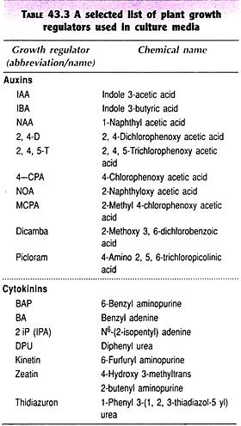

Slide 36
single cell clone

Slide 44
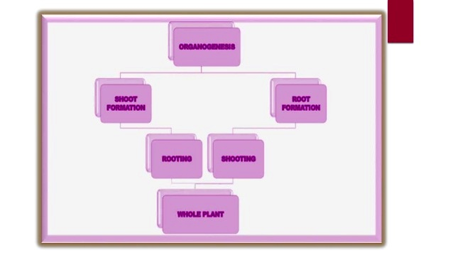
ORGANOGENESIS

Slide 47
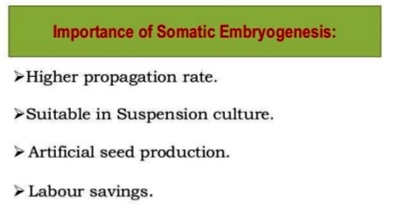

Slide 49
(Pre Embryonic Determined Cells)
(Induced Embryonic Determined Cells)

Slide 50
Embryo Culture
Isolation & growth of an immature or mature embryo in vitro, with the goal of obtaining a viable plant.
The first attempt to grow the embryos of angiosperms was made by Hannig (1904) from two Crucifers Cochleria & Raphanus.

Slide 51
Types of Embryo culture
Mature Embryo Culture
It is the culture of mature embryos derived from ripe seeds.
This type of culture is done when embryos do not survive invivo or become dormant for long periods of time.
This culture is done to eliminate the inhibition of seed germination.
Immature Embryo Culture/ Embryo rescue
It is the culture of immature embryos to rescue the embryos of wide crosses.
This type of culture is mainly used to avoid embryo abortion with the purpose of producing a viable plant.

Slide 52
Media Requirement
For Mature embryos-
Basal salt medium with a carbon energy source.
For Immature embryos-
Different vitamins, amino acids & growth regulators are required.
Culture-medium factors
mineral salts – K, Ca, N most important
carbohydrate and osmotic pressure
- 2% sucrose works well for mature embryos
- 8-12% for immature embryos
- transfer to progressively lower levels as
embryo grows

Slide 53
Culture-medium factors
Amino acids
- reduced N is often helpful
- up to 10 amino acids can be added to
replace N salts, incl. glutamine, alanine,
arginine, aspartic acid, etc.
- requires filter-sterilizing a portion of the
medium
natural plant extracts
- Coconut milk (liquid endosperm of
coconut)
- enhanced growth attributed to undefined
hormonal factors and/or organic
compounds
- others – extracts of dates, bananas, milk,
tomato juice

Slide 54
Culture-medium factors
Plant Growth Regulators
- globular embryos – require low conc. of
auxin and cytokinin
- heart-stage and later – moderate level of
auxin & low level of cytokinin
- GA and ABA regulate "precocious
germination"

Slide 55
Embryo Rescue
In immature embryo culture, wide hybrids often suffer from early spontaneous abortion due to several barriers which operate at pre- & post- fertilization levels.
Pre- fertilization barriers include all factors that hinder effective fertilization .
(due to inhibition of pollen tube growth)
Post fertilization barriers retard the development of the zygote after fertilization and normal development of the seed.
(due to failure of endosperm)
This is known as embryo-endosperm incompatibility where the endosperm produces toxins that kills the embryo.

Slide 56
ANTHER CULTURE
Anther culture is a technique by which the developing anthers at a precise and critical stage are excised aseptically from unopened flower bud and are cultured on a nutrient medium where the microspores within the cultured anther develop into callus tissue or embryoids that give rise to haploid plantlets either though organogenesis or embryogenesis.

Slide 57
POLLEN CULTURE
Pollen or microspore culture is an in vitro technique by which the pollen grains preferably at the uninucleated stage ,are squeezed out aseptically from the intact anther and then cultured on nutrient medium where the microspores, without producing male gametes , develop into haploid embryoids or callus tissue that give rise to haploid plantlets by embryogenesis or organogenesis.

Slide 58
Normal pollen development
Pollen mother cells are in anther primordia
First phase - meiosis - pollen mother cell (PMC) A tetrad froms from each PMC
Second phase - microspores released from tetrads
Third phase - microspores mature into pollen grains - first pollen mitosis
Generative and vegetative cells formed
Second pollen mitosis, maybe after germination

Slide 59
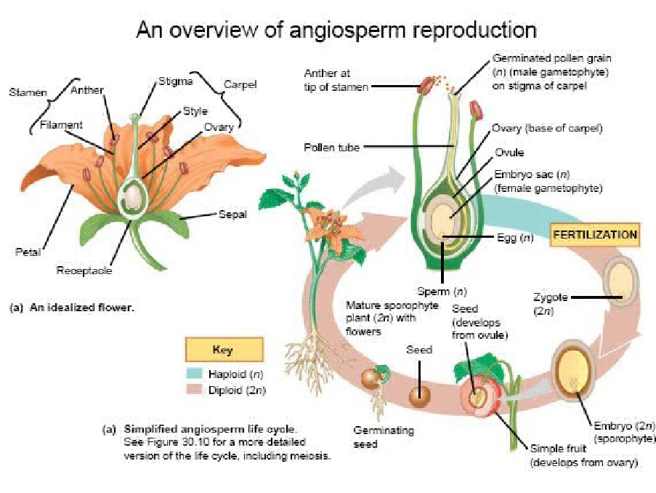

Slide 60
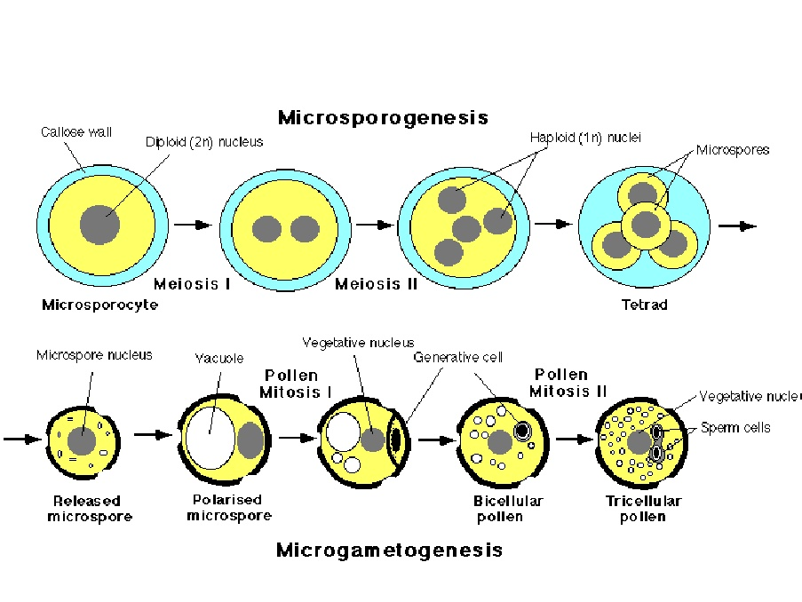

Slide 61
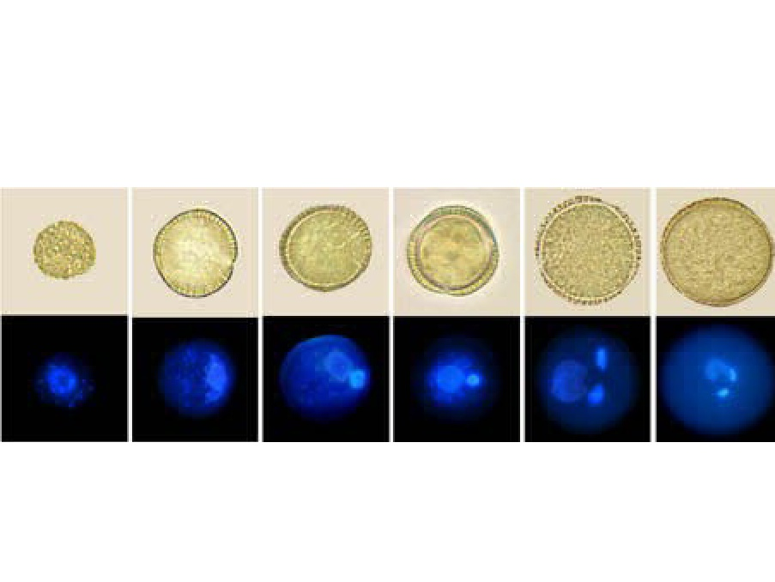

Slide 62
PRINCIPLE OF ANTHER AND POLLEN CULTURE
The production of haploid plants exploiting the totipotency of microspore .
In this process the normal development and function of the pollen cell to become a male gamete is stopped and is diverted forcedly to a new metabolic pathway for vegetative cell division .

Slide 63
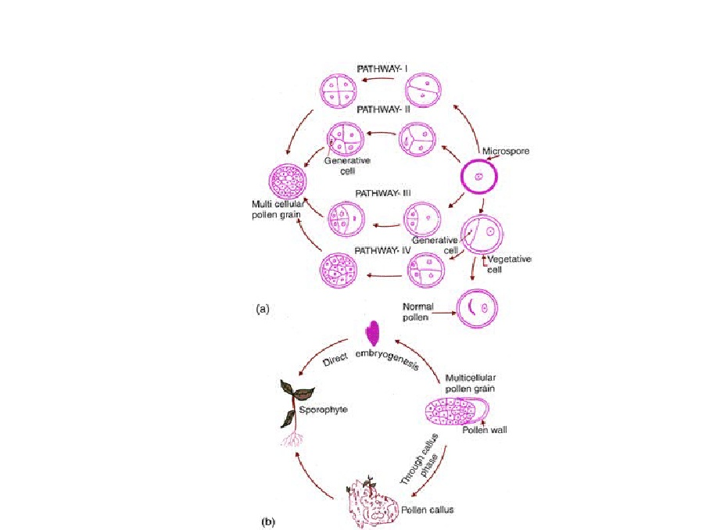

Slide 64
ADVANTAGE OF POLLEN CULTURE OVER ANTHER CULTURE
During anther culture there is always the possibility that somatic cells of the anther that are diploid will also respond to the culture condition and so produce unwanted diploid calli or plantlets.
Sometimes the development of microspores inside the anther may be interrupted due to growth inhibiting substances leaking out of the anther wall in contact with nutrient medium.
Of interest because formation of embryo is known to be from one cell only and thus no chimeras are formed
Much more difficult than anther culture
Cultured either isolated microspores or pollen
–Brassica oleracea

Slide 65
IMPORTANCE OF POLLEN AND ANTHER CULTURE
(1)Utility of anther and pollen culture for basic research:-
(a) cytogenetic studies.
(b) Study of genetic recombination in higher plants.
(c) Study of mode of differentiation from single cell to hole organism.
(d) Study of factor controlling pollen embryogenesis of higher plants.
Anther and pollen culture are use for mutation study. Example :- Nitrate reductae mutants are reported in Nicotiana tabacum.
Anther and pollen culture use for plant breeding and crop improvement.
Anther culture are use to obtain the alkaloid Example :- Homozygous recombination Hyoscyamus niger having higher alkaloid content is obtain by anther culture.
Haploid are use in molecular biology and genetic engineering. Example:- Haploid tissue of Arbidopsis and lycopersicon have been used for the transfer and expression of three genes from Escherchia coli....
of double haploid that are homozygous and fertile.

Slide 66
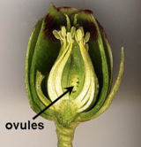
Ovule Culture
Haploids can be induced from ovules
The number of ovules is less and thus is used
less than anther culture
May be by organogenesis or embryogenesis
Used in plant families that do not respond to androgenesis
–Liliaceae
–Compositae

Slide 67
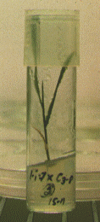
Haploids & their applications
Definition
The term haploid refers to those plants which possess a gametophytic number of chromosomes (n) in their sporophytes.

Slide 68
Overview of floral organs

Slide 69
Haploid Plant Formation
In vitro methods:
Anther culture (androgenesis) - production of haploid plants from microspores
Anther culture for production of haploids reported in about 250 species
Solanaceae, Cruciferae, Gramineae, Ranunculaceae most common
Ovule culture (gynogenesis) - production of haploid plants from unfertilized egg cell.
Androgenesis
Haploid plant derived from male gametophyte of an angiosperm plant (most common method in vitro).
Haploids can be obtained by the culture of excised anthers & culture of isolated pollen.

Slide 70
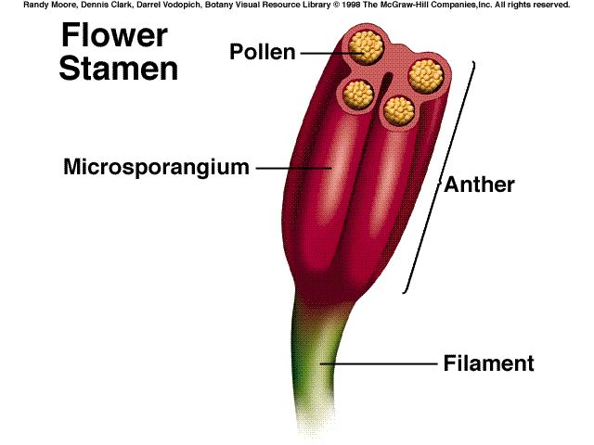
Reproductive floral organs: male
Stamen – male floral organ, consists of:
-Anther – A typical anther shows 2 anther lobes & each lobe possesses 2 microsporangia or pollen sacs.
-Filament – stalk-like structure that holds anther
-Pollen – immature male gametophyte

Slide 71
Processes Leading to Production of Haploid Plants
Formation in vivo
–Spontaneous occurrence in low frequency –Induction by physical and/or chemical treatment –Chromosome elimination following interspecific hybridization.
Specific for some plants such as barley. Not widespread.
Parthenogenesis - from unfertilized egg
Apogamy - from other cells of the mega-gametophyte, example
Chromosome elimination - chromosome elimination in somatic cells, most common method used with plant breeding.

Slide 72
Haploids and Agricultural applications for haploids -
Haploid - Gametic number of chromosomes, (n) which may not be equivalent to x.
Application:
Rapid generation of homozygous genotypes after chromosome doubling
Reduce time for variety development, e.g. 10 to 6 years or less
Homozygous recombinant line can be developed in one generation instead of after numerous backcross generations
Selection for recessive traits in recombinant lines is more efficient since these are not masked by the effects of dominant alleles
Haploids are very valuable in plant breeding for several reasons
Since they carry only one allele of each gene, mutations and recessive characteristics are expressed in the plant.
Plants with lethal genes are eliminated from the gene pool.
Can produce homozygous diploid or polyploid plants - valuable in breeding
Shorten the time for inbreeding for production of superior hybrids genotypes.

Slide 73
CRYOPRESERVATION

Slide 74
Cryopreservation
Definition/benefits
Cryoprotectants
Procedures
Contamination check
Media preparation
Freezing cells/recovery
Post-thawing considerations

Slide 75
Inventory management
Seed lot system
Low temperature storage
Biological materials management
Inventory control
Safety considerations

Slide 76
DEFINITION
The use of very low temperatures to structurally preserve intact living cells and tissue
Unprotected freezing is normally lethal to cells while controlled cooling can be used to produce stable conditions that preserve life
Notes:
To add bullets: Go to the “Home” tab. In the “Paragraph” section click on the “Increase List Level” icon, which is the fourth icon from the left on the top row.
To add or remove Page numbers, Date & Time, or Footer text: Go to the “Insert” tab. In the “Text” section click on the “Header & Footer” icon and update accordingly.
ATCC Colors:
Purple: R:28 G:23 B:86
Green: R:204 G:204 B:51
Gray: R:153 G:153 B:153
ATCC Secondary Colors:
Cyan: R:0 G:174 B:239
Blue Gray: R:195 G:200 B:214
Deep Red: R:157 G:13 B:15
Yellow: R:255 G:212 B:87
Salmon: R:230 G:103 B:74
Gray Green: R:54 G:66 B:74
Orange: R:239 G:130 B:0
Light Gray Green: R:142 G:215 B:176

Slide 77
Benefits of cryopreservation
Generation of safety stocks
Saves time and money
Preservation of cells
Insurance against phenotypic drift
Standard for experiments
Notes:
To add bullets: Go to the “Home” tab. In the “Paragraph” section click on the “Increase List Level” icon, which is the fourth icon from the left on the top row.
To add or remove Page numbers, Date & Time, or Footer text: Go to the “Insert” tab. In the “Text” section click on the “Header & Footer” icon and update accordingly.
ATCC Colors:
Purple: R:28 G:23 B:86
Green: R:204 G:204 B:51
Gray: R:153 G:153 B:153
ATCC Secondary Colors:
Cyan: R:0 G:174 B:239
Blue Gray: R:195 G:200 B:214
Deep Red: R:157 G:13 B:15
Yellow: R:255 G:212 B:87
Salmon: R:230 G:103 B:74
Gray Green: R:54 G:66 B:74
Orange: R:239 G:130 B:0
Light Gray Green: R:142 G:215 B:176

Slide 78
Cryopreservation principles
Fast Cooling Rate
Slow Cooling Rate
Less osmotic imbalance
Less dehydration
More ice crystals
More osmotic imbalance
More dehydration
Less ice crystals
Notes:
To add bullets: Go to the “Home” tab. In the “Paragraph” section click on the “Increase List Level” icon, which is the fourth icon from the left on the top row.
To add or remove Page numbers, Date & Time, or Footer text: Go to the “Insert” tab. In the “Text” section click on the “Header & Footer” icon and update accordingly.
ATCC Colors:
Purple: R:28 G:23 B:86
Green: R:204 G:204 B:51
Gray: R:153 G:153 B:153
ATCC Secondary Colors:
Cyan: R:0 G:174 B:239
Blue Gray: R:195 G:200 B:214
Deep Red: R:157 G:13 B:15
Yellow: R:255 G:212 B:87
Salmon: R:230 G:103 B:74
Gray Green: R:54 G:66 B:74
Orange: R:239 G:130 B:0
Light Gray Green: R:142 G:215 B:176

Slide 79
Cryopreservation principles
Ideal
High levels of ice formation and increased solute concentration have a negative impact on cell viability
Optimal cooling rate for cell viability is 1 to 3°C/min
High
Negative effect on viability
Ice
formation
Solute
concentration
Low
0.1
1.0
10
Rate of cooling (°C/min)
Notes:
To add bullets: Go to the “Home” tab. In the “Paragraph” section click on the “Increase List Level” icon, which is the fourth icon from the left on the top row.
To add or remove Page numbers, Date & Time, or Footer text: Go to the “Insert” tab. In the “Text” section click on the “Header & Footer” icon and update accordingly.
ATCC Colors:
Purple: R:28 G:23 B:86
Green: R:204 G:204 B:51
Gray: R:153 G:153 B:153
ATCC Secondary Colors:
Cyan: R:0 G:174 B:239
Blue Gray: R:195 G:200 B:214
Deep Red: R:157 G:13 B:15
Yellow: R:255 G:212 B:87
Salmon: R:230 G:103 B:74
Gray Green: R:54 G:66 B:74
Orange: R:239 G:130 B:0
Light Gray Green: R:142 G:215 B:176

Slide 80
Cryoprotectants
Dimethyl sulfoxide (DMSO) and glycerol are the two most widely used cryoprotectants
Aid in preserving cells
Encourage dehydration
Minimize solution effects
Notes:
To add bullets: Go to the “Home” tab. In the “Paragraph” section click on the “Increase List Level” icon, which is the fourth icon from the left on the top row.
To add or remove Page numbers, Date & Time, or Footer text: Go to the “Insert” tab. In the “Text” section click on the “Header & Footer” icon and update accordingly.
ATCC Colors:
Purple: R:28 G:23 B:86
Green: R:204 G:204 B:51
Gray: R:153 G:153 B:153
ATCC Secondary Colors:
Cyan: R:0 G:174 B:239
Blue Gray: R:195 G:200 B:214
Deep Red: R:157 G:13 B:15
Yellow: R:255 G:212 B:87
Salmon: R:230 G:103 B:74
Gray Green: R:54 G:66 B:74
Orange: R:239 G:130 B:0
Light Gray Green: R:142 G:215 B:176

Slide 81
Cryoprotectants
Cell type | Cryoprotectant | Temperature | Number of cells
Animal cells | DMSO (5-10%) or Glycerol (5-10%) | -140°C | 10⁶ to 10⁷/mL
Bacteria | Glycerol (5-10%) | -80°C | 10⁷/mL
Yeast | Glycerol (10%) | -140°C | 10⁷/mL
Protozoa | DMSO (5-10%) or Glycerol (10-20%) | -140°C | 10⁵ to 10⁷/mL
Plant cells | DMSO (5-10%) and Glycerol (5-10%) | -140°C | 3% to 20% cell volume
Animal viruses (free) | None | -80°C | NA
Animal viruses (infected cells) | DMSO (7%) | -10°C | 10⁶/mL
Notes:
To add bullets: Go to the “Home” tab. In the “Paragraph” section click on the “Increase List Level” icon, which is the fourth icon from the left on the top row.
To add or remove Page numbers, Date & Time, or Footer text: Go to the “Insert” tab. In the “Text” section click on the “Header & Footer” icon and update accordingly.
ATCC Colors:
Purple: R:28 G:23 B:86
Green: R:204 G:204 B:51
Gray: R:153 G:153 B:153
ATCC Secondary Colors:
Cyan: R:0 G:174 B:239
Blue Gray: R:195 G:200 B:214
Deep Red: R:157 G:13 B:15
Yellow: R:255 G:212 B:87
Salmon: R:230 G:103 B:74
Gray Green: R:54 G:66 B:74
Orange: R:239 G:130 B:0
Light Gray Green: R:142 G:215 B:176

Slide 82
Cryopreservation procedure
Check for contamination
Media preparation
Freezing cells in a controlled-rate chamber
Recovering cryopreserved cells
Post thawing considerations
Notes:
To add bullets: Go to the “Home” tab. In the “Paragraph” section click on the “Increase List Level” icon, which is the fourth icon from the left on the top row.
To add or remove Page numbers, Date & Time, or Footer text: Go to the “Insert” tab. In the “Text” section click on the “Header & Footer” icon and update accordingly.
ATCC Colors:
Purple: R:28 G:23 B:86
Green: R:204 G:204 B:51
Gray: R:153 G:153 B:153
ATCC Secondary Colors:
Cyan: R:0 G:174 B:239
Blue Gray: R:195 G:200 B:214
Deep Red: R:157 G:13 B:15
Yellow: R:255 G:212 B:87
Salmon: R:230 G:103 B:74
Gray Green: R:54 G:66 B:74
Orange: R:239 G:130 B:0
Light Gray Green: R:142 G:215 B:176

Slide 83
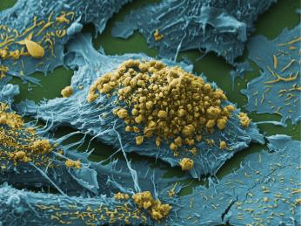
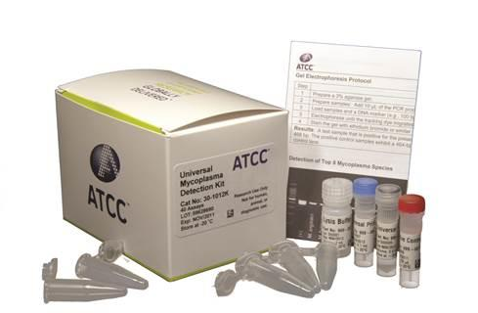
Contamination
Sources
Contaminated cell lines
Improper aseptic technique
Types
Microbial – Bacteria, mycoplasma, fungi, viruses
Cellular – Cross contamination
Signs
Turbid media
Rapid decline in pH – color change
Morphological changes
Filamentous structures
Notes:
To add bullets: Go to the “Home” tab. In the “Paragraph” section click on the “Increase List Level” icon, which is the fourth icon from the left on the top row.
To add or remove Page numbers, Date & Time, or Footer text: Go to the “Insert” tab. In the “Text” section click on the “Header & Footer” icon and update accordingly.
ATCC Colors:
Purple: R:28 G:23 B:86
Green: R:204 G:204 B:51
Gray: R:153 G:153 B:153
ATCC Secondary Colors:
Cyan: R:0 G:174 B:239
Blue Gray: R:195 G:200 B:214
Deep Red: R:157 G:13 B:15
Yellow: R:255 G:212 B:87
Salmon: R:230 G:103 B:74
Gray Green: R:54 G:66 B:74
Orange: R:239 G:130 B:0
Light Gray Green: R:142 G:215 B:176

Slide 84
Media preparation
Classical Cell Culture Media
Dulbecco’s Modified Eagles Medium (DMEM) and Eagle’s Minimum Essential Medium (EMEM)
RPMI-1640 (for suspension cells)
5-10% DMSO
20% fetal bovine serum (FBS) or bovine serum albumin (BSA)
Additional cryprotectant properties
Necessary for post-thaw cell survival
ATCC Serum-free Freezing Media (ATCC® 30-2600™)
All in one media
10% DMSO with proteins and additives for cell survival
Cell Suspension
3 x 10⁶ to 5 x 10⁶ cells/mL
1 mL total volume
Notes:
To add bullets: Go to the “Home” tab. In the “Paragraph” section click on the “Increase List Level” icon, which is the fourth icon from the left on the top row.
To add or remove Page numbers, Date & Time, or Footer text: Go to the “Insert” tab. In the “Text” section click on the “Header & Footer” icon and update accordingly.
ATCC Colors:
Purple: R:28 G:23 B:86
Green: R:204 G:204 B:51
Gray: R:153 G:153 B:153
ATCC Secondary Colors:
Cyan: R:0 G:174 B:239
Blue Gray: R:195 G:200 B:214
Deep Red: R:157 G:13 B:15
Yellow: R:255 G:212 B:87
Salmon: R:230 G:103 B:74
Gray Green: R:54 G:66 B:74
Orange: R:239 G:130 B:0
Light Gray Green: R:142 G:215 B:176

Slide 85
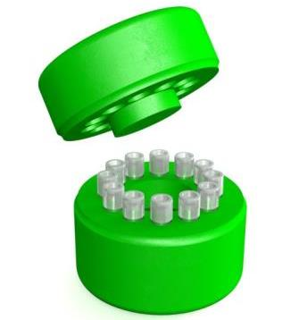
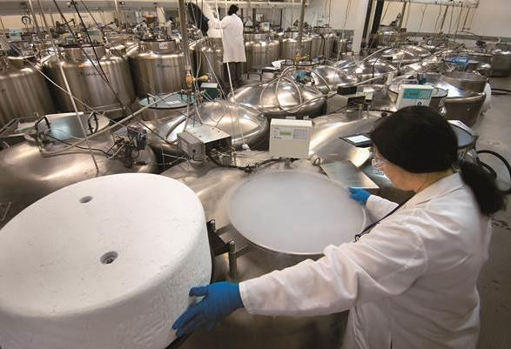
Freezing cells
-70°C
Controlled rate freeze chamber
-140°C
Liquid nitrogen tank
A few hours to 24 hours
-1°C/min cooling rate
Notes:
To add bullets: Go to the “Home” tab. In the “Paragraph” section click on the “Increase List Level” icon, which is the fourth icon from the left on the top row.
To add or remove Page numbers, Date & Time, or Footer text: Go to the “Insert” tab. In the “Text” section click on the “Header & Footer” icon and update accordingly.
ATCC Colors:
Purple: R:28 G:23 B:86
Green: R:204 G:204 B:51
Gray: R:153 G:153 B:153
ATCC Secondary Colors:
Cyan: R:0 G:174 B:239
Blue Gray: R:195 G:200 B:214
Deep Red: R:157 G:13 B:15
Yellow: R:255 G:212 B:87
Salmon: R:230 G:103 B:74
Gray Green: R:54 G:66 B:74
Orange: R:239 G:130 B:0
Light Gray Green: R:142 G:215 B:176

Slide 86
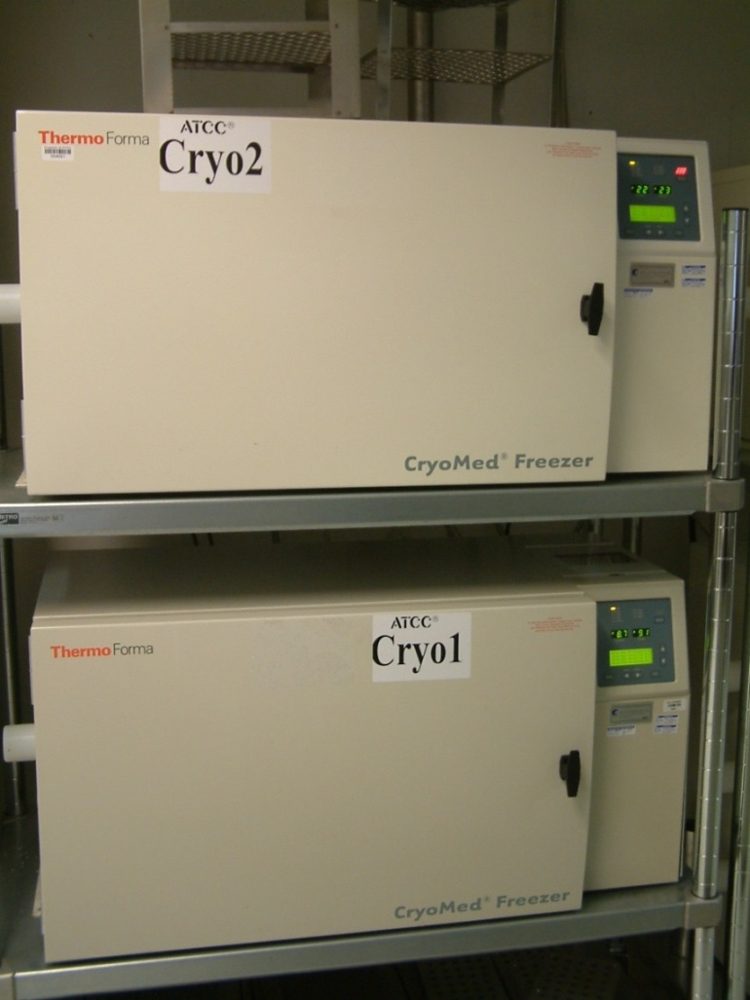
Freezing cells
Controlled rate freezer
Programmable electronic freezing unit
Reliable, consistent rate of cooling
Expensive, maintenance cost
Notes:
To add bullets: Go to the “Home” tab. In the “Paragraph” section click on the “Increase List Level” icon, which is the fourth icon from the left on the top row.
To add or remove Page numbers, Date & Time, or Footer text: Go to the “Insert” tab. In the “Text” section click on the “Header & Footer” icon and update accordingly.
ATCC Colors:
Purple: R:28 G:23 B:86
Green: R:204 G:204 B:51
Gray: R:153 G:153 B:153
ATCC Secondary Colors:
Cyan: R:0 G:174 B:239
Blue Gray: R:195 G:200 B:214
Deep Red: R:157 G:13 B:15
Yellow: R:255 G:212 B:87
Salmon: R:230 G:103 B:74
Gray Green: R:54 G:66 B:74
Orange: R:239 G:130 B:0
Light Gray Green: R:142 G:215 B:176

Slide 87
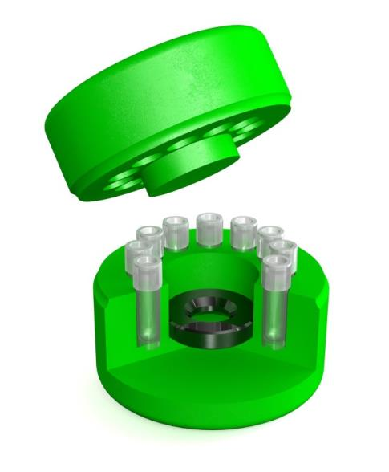
Freezing cells
CoolCell® (ATCC® ACS-6000™)
Reliable -1°C/min cooling rate
4 Hours in -70°C Freezer
Comfortable to touch
No alcohol use or maintenance
Thermoconductive alloy
Insulated
polyethylene
material
Notes:
To add bullets: Go to the “Home” tab. In the “Paragraph” section click on the “Increase List Level” icon, which is the fourth icon from the left on the top row.
To add or remove Page numbers, Date & Time, or Footer text: Go to the “Insert” tab. In the “Text” section click on the “Header & Footer” icon and update accordingly.
ATCC Colors:
Purple: R:28 G:23 B:86
Green: R:204 G:204 B:51
Gray: R:153 G:153 B:153
ATCC Secondary Colors:
Cyan: R:0 G:174 B:239
Blue Gray: R:195 G:200 B:214
Deep Red: R:157 G:13 B:15
Yellow: R:255 G:212 B:87
Salmon: R:230 G:103 B:74
Gray Green: R:54 G:66 B:74
Orange: R:239 G:130 B:0
Light Gray Green: R:142 G:215 B:176

Slide 88
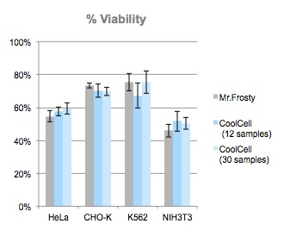
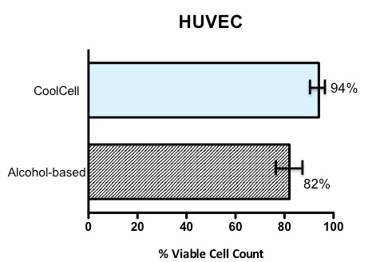
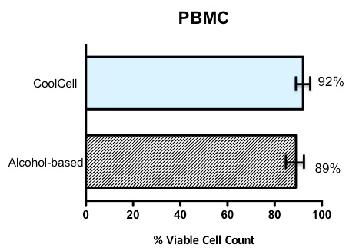
Freezing cells
Can be used with most cell types
Verified use with organoids
Performs as well or better than comparable products
Notes:
To add bullets: Go to the “Home” tab. In the “Paragraph” section click on the “Increase List Level” icon, which is the fourth icon from the left on the top row.
To add or remove Page numbers, Date & Time, or Footer text: Go to the “Insert” tab. In the “Text” section click on the “Header & Footer” icon and update accordingly.
ATCC Colors:
Purple: R:28 G:23 B:86
Green: R:204 G:204 B:51
Gray: R:153 G:153 B:153
ATCC Secondary Colors:
Cyan: R:0 G:174 B:239
Blue Gray: R:195 G:200 B:214
Deep Red: R:157 G:13 B:15
Yellow: R:255 G:212 B:87
Salmon: R:230 G:103 B:74
Gray Green: R:54 G:66 B:74
Orange: R:239 G:130 B:0
Light Gray Green: R:142 G:215 B:176

Slide 89
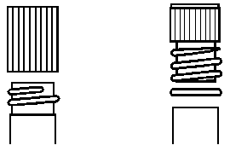
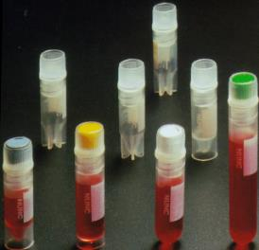
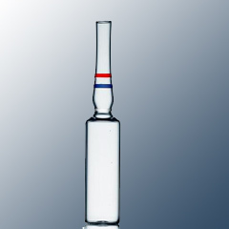
Vial selection
Several types of vials (small bottle) exist for storage at ultra low and cryogenic temperatures
Plastic vials
Internal thread
External thread
Straws
Glass ampoules (heat sealed)
Considerations for vial (small bottle) type selection
Storage temperature
Liquid submersion
Head space
Effect on warming
Material stresses
Ideal
External
Internal
Notes:
To add bullets: Go to the “Home” tab. In the “Paragraph” section click on the “Increase List Level” icon, which is the fourth icon from the left on the top row.
To add or remove Page numbers, Date & Time, or Footer text: Go to the “Insert” tab. In the “Text” section click on the “Header & Footer” icon and update accordingly.
ATCC Colors:
Purple: R:28 G:23 B:86
Green: R:204 G:204 B:51
Gray: R:153 G:153 B:153
ATCC Secondary Colors:
Cyan: R:0 G:174 B:239
Blue Gray: R:195 G:200 B:214
Deep Red: R:157 G:13 B:15
Yellow: R:255 G:212 B:87
Salmon: R:230 G:103 B:74
Gray Green: R:54 G:66 B:74
Orange: R:239 G:130 B:0
Light Gray Green: R:142 G:215 B:176

Slide 90
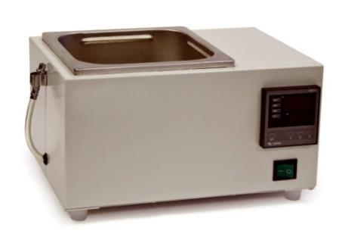
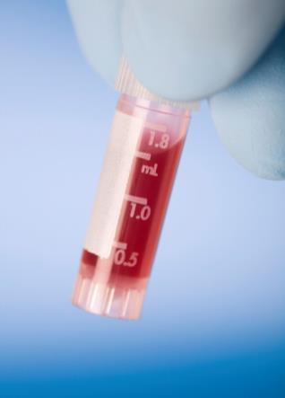
Post thawing
Thaw as quickly as possible
Thaw in 37°C water bath for 2 minutes
Transfer to 10 mL centrifuge tube
Add 9 mL of growth media (10% FBS)
Dropwise to avoid osmotic shock
Centrifuge, resuspend in 2 mL of growth media
Notes:
To add bullets: Go to the “Home” tab. In the “Paragraph” section click on the “Increase List Level” icon, which is the fourth icon from the left on the top row.
To add or remove Page numbers, Date & Time, or Footer text: Go to the “Insert” tab. In the “Text” section click on the “Header & Footer” icon and update accordingly.
ATCC Colors:
Purple: R:28 G:23 B:86
Green: R:204 G:204 B:51
Gray: R:153 G:153 B:153
ATCC Secondary Colors:
Cyan: R:0 G:174 B:239
Blue Gray: R:195 G:200 B:214
Deep Red: R:157 G:13 B:15
Yellow: R:255 G:212 B:87
Salmon: R:230 G:103 B:74
Gray Green: R:54 G:66 B:74
Orange: R:239 G:130 B:0
Light Gray Green: R:142 G:215 B:176

Slide 91
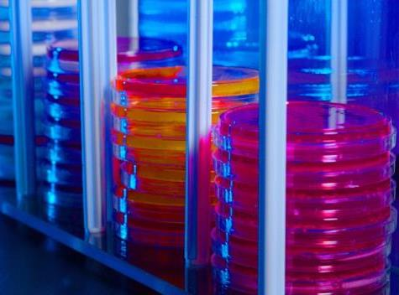
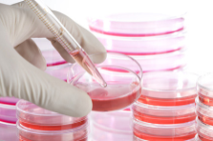
Post thawing considerations
Cell recovery – measuring viability of cells
Microbial cells
Serial dilutions
Animal/human cells
Stain
Animal embryos
Morphology
Vessel selection
Cell culture dishes
Flasks
Multiwell plates
Roller bottles
Notes:
To add bullets: Go to the “Home” tab. In the “Paragraph” section click on the “Increase List Level” icon, which is the fourth icon from the left on the top row.
To add or remove Page numbers, Date & Time, or Footer text: Go to the “Insert” tab. In the “Text” section click on the “Header & Footer” icon and update accordingly.
ATCC Colors:
Purple: R:28 G:23 B:86
Green: R:204 G:204 B:51
Gray: R:153 G:153 B:153
ATCC Secondary Colors:
Cyan: R:0 G:174 B:239
Blue Gray: R:195 G:200 B:214
Deep Red: R:157 G:13 B:15
Yellow: R:255 G:212 B:87
Salmon: R:230 G:103 B:74
Gray Green: R:54 G:66 B:74
Orange: R:239 G:130 B:0
Light Gray Green: R:142 G:215 B:176

Slide 92
Inventory management
Seed lot system
Low temperature storage
Biological materials management
Inventory control
Safety considerations
Notes:
To add bullets: Go to the “Home” tab. In the “Paragraph” section click on the “Increase List Level” icon, which is the fourth icon from the left on the top row.
To add or remove Page numbers, Date & Time, or Footer text: Go to the “Insert” tab. In the “Text” section click on the “Header & Footer” icon and update accordingly.
ATCC Colors:
Purple: R:28 G:23 B:86
Green: R:204 G:204 B:51
Gray: R:153 G:153 B:153
ATCC Secondary Colors:
Cyan: R:0 G:174 B:239
Blue Gray: R:195 G:200 B:214
Deep Red: R:157 G:13 B:15
Yellow: R:255 G:212 B:87
Salmon: R:230 G:103 B:74
Gray Green: R:54 G:66 B:74
Orange: R:239 G:130 B:0
Light Gray Green: R:142 G:215 B:176

Slide 93
Seed lot system
Preserved cultures remain as close as possible to the original culture
Seed stock is archived for future replenishment
Distribution stock are used for distribution
Authentication compares:
Seed, Distribution, Initial culture
Culture received
Distribution
stock
Seed
stock
Notes:
Enterococcus faecium, Staphylococcus aureus, Klebsiella pneumoniae, Acinetobacter baumanii, Pseudomonas aeruginosa, and Enterobacter species – These organisms cause the majority of US hospital infections and effectively “escape” the effects of antibacterial drugs.
Most infections are due to methicillin-resistant S. aureus (MRSA), vancymocin-resistant E. faecium (VRE), and fluoroquinolone-resistant P. aeruginosa
New issue – panantibiotic resistant infections. Commonly caused by Acinetobacter species.
These infections are very hard if not impossible to treat. In some cases, doctors have relied on older medications such as Colistin, which is very toxic

Slide 94
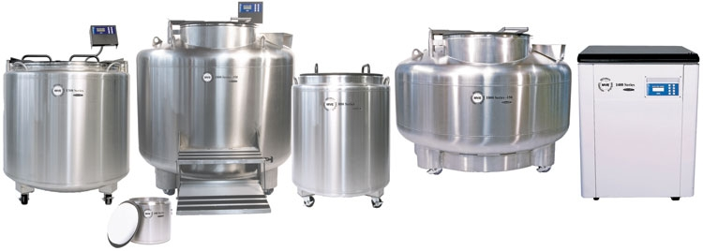
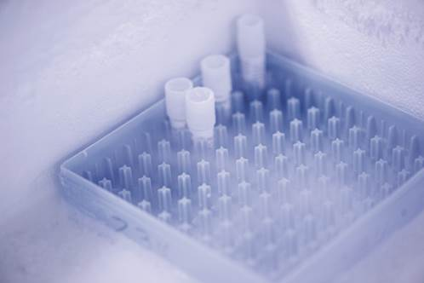
Low temperature storage
For the best security, always store your cells in liquid nitrogen freezers
Notes:
To add bullets: Go to the “Home” tab. In the “Paragraph” section click on the “Increase List Level” icon, which is the fourth icon from the left on the top row.
To add or remove Page numbers, Date & Time, or Footer text: Go to the “Insert” tab. In the “Text” section click on the “Header & Footer” icon and update accordingly.
ATCC Colors:
Purple: R:28 G:23 B:86
Green: R:204 G:204 B:51
Gray: R:153 G:153 B:153
ATCC Secondary Colors:
Cyan: R:0 G:174 B:239
Blue Gray: R:195 G:200 B:214
Deep Red: R:157 G:13 B:15
Yellow: R:255 G:212 B:87
Salmon: R:230 G:103 B:74
Gray Green: R:54 G:66 B:74
Orange: R:239 G:130 B:0
Light Gray Green: R:142 G:215 B:176

Slide 95
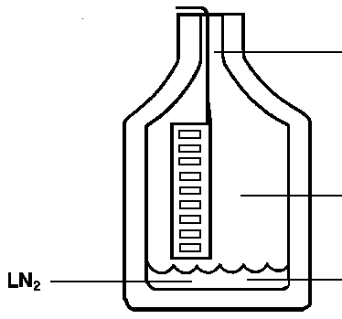
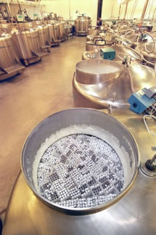
Low temperature storage
Mammalian cells
Long-term storage should be below -140°C
-140°C for an indefinite length of time
-80°C for less than 1 year
Vials should be stored in a liquid nitrogen unit above the volume of liquid at the bottom of the tank
This temperature should be between -140°C and -180°C
-150°C
-178°C
-196°C
Notes:
To add bullets: Go to the “Home” tab. In the “Paragraph” section click on the “Increase List Level” icon, which is the fourth icon from the left on the top row.
To add or remove Page numbers, Date & Time, or Footer text: Go to the “Insert” tab. In the “Text” section click on the “Header & Footer” icon and update accordingly.
ATCC Colors:
Purple: R:28 G:23 B:86
Green: R:204 G:204 B:51
Gray: R:153 G:153 B:153
ATCC Secondary Colors:
Cyan: R:0 G:174 B:239
Blue Gray: R:195 G:200 B:214
Deep Red: R:157 G:13 B:15
Yellow: R:255 G:212 B:87
Salmon: R:230 G:103 B:74
Gray Green: R:54 G:66 B:74
Orange: R:239 G:130 B:0
Light Gray Green: R:142 G:215 B:176

Slide 96
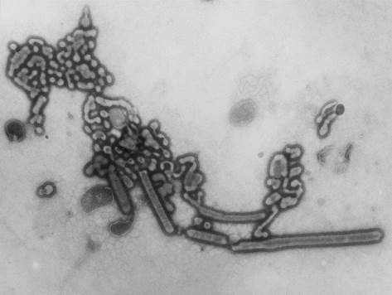
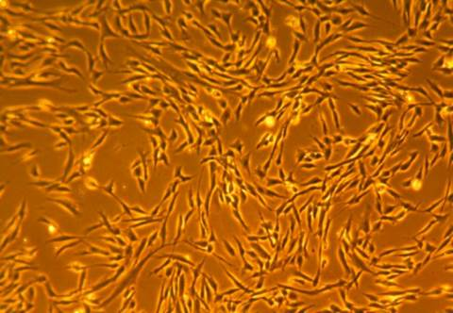
Biological materials management
Ensuring preserved material remains unchanged
Manageable levels of biological material
Keeping material that is needed
Continuing monitoring for contamination
Removing unwanted, contaminated, misidentified items
Create a system of identification
Complete characterization of new material
Cataloging and data recording
Notes:
To add bullets: Go to the “Home” tab. In the “Paragraph” section click on the “Increase List Level” icon, which is the fourth icon from the left on the top row.
To add or remove Page numbers, Date & Time, or Footer text: Go to the “Insert” tab. In the “Text” section click on the “Header & Footer” icon and update accordingly.
ATCC Colors:
Purple: R:28 G:23 B:86
Green: R:204 G:204 B:51
Gray: R:153 G:153 B:153
ATCC Secondary Colors:
Cyan: R:0 G:174 B:239
Blue Gray: R:195 G:200 B:214
Deep Red: R:157 G:13 B:15
Yellow: R:255 G:212 B:87
Salmon: R:230 G:103 B:74
Gray Green: R:54 G:66 B:74
Orange: R:239 G:130 B:0
Light Gray Green: R:142 G:215 B:176

Slide 97
Inventory control
Record keeping of vital information
Preservation methodology used
Location/identification of stored material
Preservation date
Number of passages
Notes:
To add bullets: Go to the “Home” tab. In the “Paragraph” section click on the “Increase List Level” icon, which is the fourth icon from the left on the top row.
To add or remove Page numbers, Date & Time, or Footer text: Go to the “Insert” tab. In the “Text” section click on the “Header & Footer” icon and update accordingly.
ATCC Colors:
Purple: R:28 G:23 B:86
Green: R:204 G:204 B:51
Gray: R:153 G:153 B:153
ATCC Secondary Colors:
Cyan: R:0 G:174 B:239
Blue Gray: R:195 G:200 B:214
Deep Red: R:157 G:13 B:15
Yellow: R:255 G:212 B:87
Salmon: R:230 G:103 B:74
Gray Green: R:54 G:66 B:74
Orange: R:239 G:130 B:0
Light Gray Green: R:142 G:215 B:176

Slide 98
Inventory control
Locator codes
For rapid and easy retrieval
Freezer unit number
Code for freezer section or rack
Box/canister number
Grid spot within each box
Good inventory control practices minimizes the time needed to find material, reducing the risk that the freezer unit and biological materials will warm
Notes:
To add bullets: Go to the “Home” tab. In the “Paragraph” section click on the “Increase List Level” icon, which is the fourth icon from the left on the top row.
To add or remove Page numbers, Date & Time, or Footer text: Go to the “Insert” tab. In the “Text” section click on the “Header & Footer” icon and update accordingly.
ATCC Colors:
Purple: R:28 G:23 B:86
Green: R:204 G:204 B:51
Gray: R:153 G:153 B:153
ATCC Secondary Colors:
Cyan: R:0 G:174 B:239
Blue Gray: R:195 G:200 B:214
Deep Red: R:157 G:13 B:15
Yellow: R:255 G:212 B:87
Salmon: R:230 G:103 B:74
Gray Green: R:54 G:66 B:74
Orange: R:239 G:130 B:0
Light Gray Green: R:142 G:215 B:176

Slide 99
Summary
Freezing cells
-1°C/min is ideal for most cells
10% DMSO, 20% FBS, or 20% BSA – mammalian cells
Cell recovery
Thaw quickly in a 37°C water bath
Bring cells out of DMSO slowly
Inventory management
Store at -140°C in Liquid Nitrogen
Maintain biological inventory to keep needed material; discard unwanted material
Use a controlled rate freezing container, i.e. CoolCell
Measure the viability of cells
Record, document, and track all material
Follow safety guidelines!
10% glycerol - bacteria
Notes:
To add bullets: Go to the “Home” tab. In the “Paragraph” section click on the “Increase List Level” icon, which is the fourth icon from the left on the top row.
To add or remove Page numbers, Date & Time, or Footer text: Go to the “Insert” tab. In the “Text” section click on the “Header & Footer” icon and update accordingly.
ATCC Colors:
Purple: R:28 G:23 B:86
Green: R:204 G:204 B:51
Gray: R:153 G:153 B:153
ATCC Secondary Colors:
Cyan: R:0 G:174 B:239
Blue Gray: R:195 G:200 B:214
Deep Red: R:157 G:13 B:15
Yellow: R:255 G:212 B:87
Salmon: R:230 G:103 B:74
Gray Green: R:54 G:66 B:74
Orange: R:239 G:130 B:0
Light Gray Green: R:142 G:215 B:176

Slide 100
Plant Tissue Culture Applications
The commercial production of plants used as potting, landscape, and florist subjects
To conserve rare or endangered plant species.
To screen cells rather than plants for advantageous characters, e.g. herbicide resistance/tolerance.
Large-scale growth of plant cells in liquid culture in bioreactors for production of valuable compounds, like plant-derived secondary metabolites and recombinant proteins used as biopharmaceuticals.

Slide 101
Plant Tissue Culture Applications
To cross distantly related species by protoplast fusion and regeneration of the novel hybrid.
To produce clean plant material from stock infected by viruses or other pathogens.
Production of identical sterile hybrid species can be obtained

Slide 102
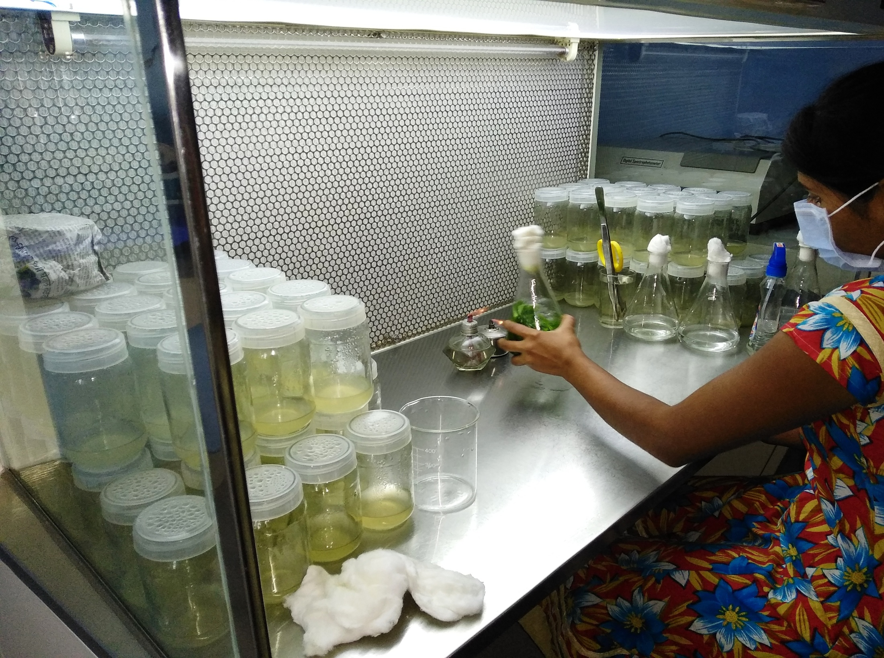

Slide 103
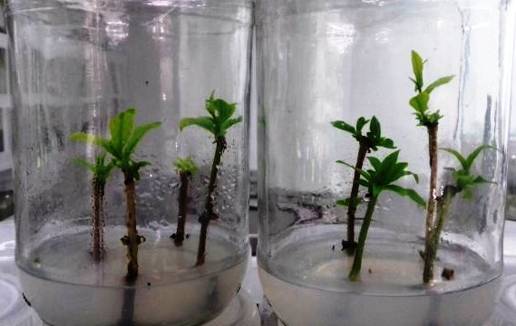
THANK YOU

