Slide 1
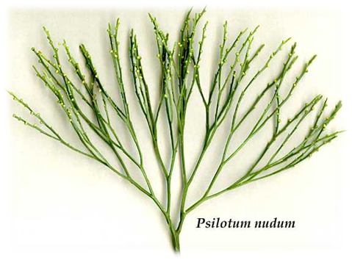
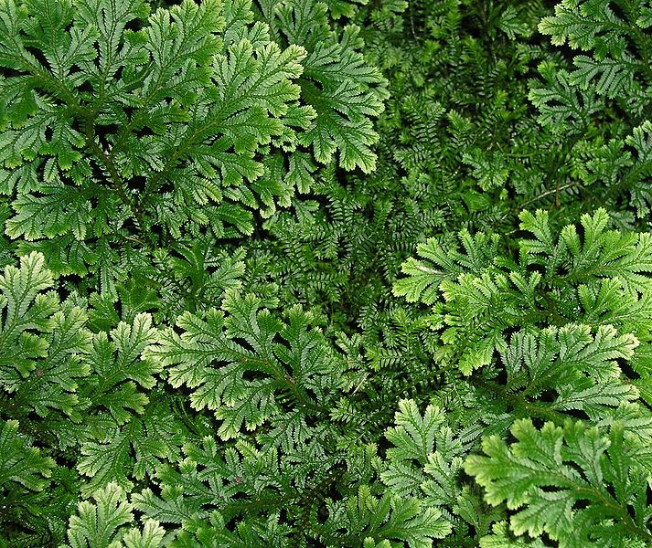
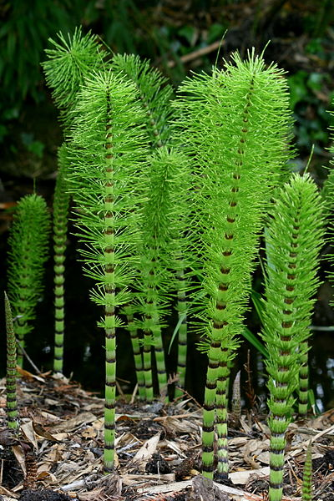
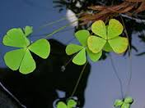
Pteridophytes
Dr. Shrikant B. Bhosale
S. M. Dnyandeo Mohekar College Kallmb Dist. Osmanabd (413507)
Psilotum
Selaginella
Lycopodium
Equisetum
Marsilea

Slide 3
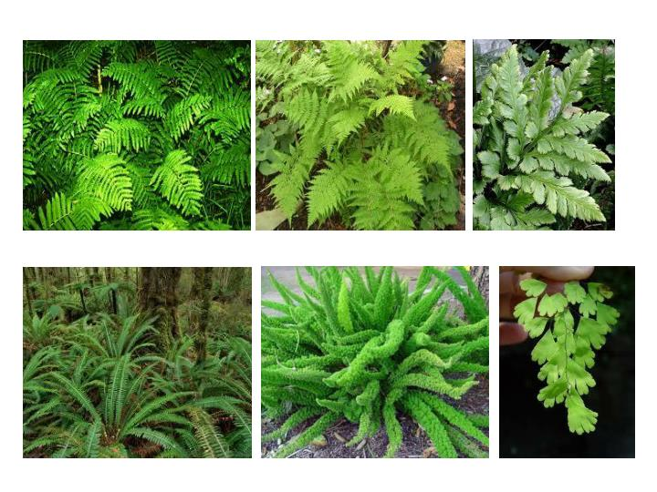

Slide 11
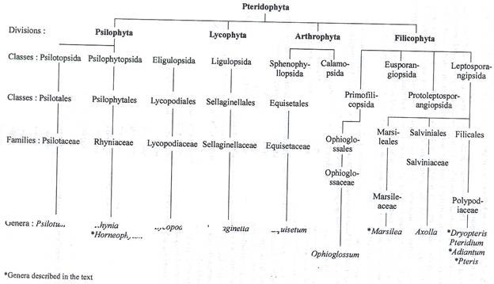

Slide 13
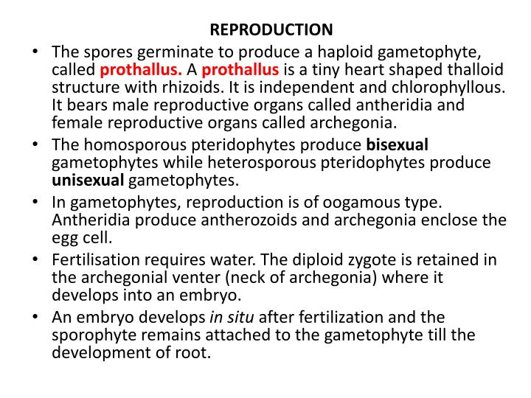

Slide 14
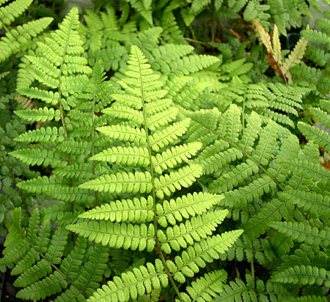
Fern Life Cycle

Slide 15
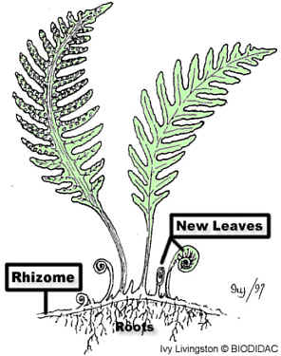
1) Sporophyte creates and releases haploid spores
Adult
Sporophyte
.
.
.
.
ground

Slide 16
2) Haploid spores land in the soil
.
.
.
.
ground

Slide 17
3) From the haploid spores, gametophyte grows in the soil
Let’s zoom in
Fern gametophytes are called a prothallus
ground

Slide 18
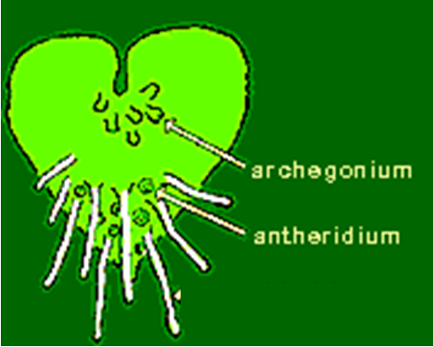
4) Sperm swim through water from the male parts (antheridium) to the female parts (archegonia)…zygote created
Let’s zoom back out
egg
zygote
egg
zygote
egg
zygote

Slide 19
5) Diploid sporophyte grows from the zygote
sporophyte
Fern gametophytes are called a prothallus
ground

Slide 20
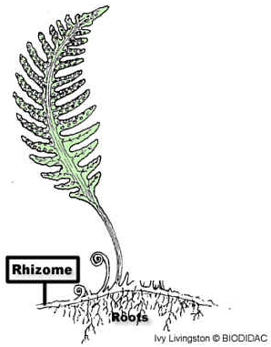
6) Fiddle head uncurls….fronds open up
7) Cycle repeats
-- Haploid spores created and released
.
.
.
fiddlehead
frond
.
ground

Slide 21
2) Haploid spores land in the soil
.
.
.
.
ground

Slide 22
3) From the haploid spores, gametophyte (called the prothallus) grows in the soil
Let’s zoom in
ground

Slide 23
4) Sperm swim through water from the male antheridium to the female archegonia
Let’s zoom back out
egg
zygote
egg
zygote
egg
zygote

Slide 24
5) Diploid sporophyte grows from the zygote
fiddlehead
sporophyte
ground

Slide 25
6) Fiddlehead uncurls….fronds open up.
7) Cycle repeats
.
.
.
.
ground

Slide 27
Psilotum
Kingdom: | Plantae
Division: | Pteridophyta
Class: | Psilotopsida
Order: | Psilotales
Family: | Psilotaceae
Genus: | Psilotum
Psilotum (whisk fern) is a genus of fern-like vascular plants, one of two genera in the family Psilotaceae, order Psilotales, and class Psilotopsida (the other being Tmesipteris). The name of the genus is from Greek psilos = bare, referring to the lack of the usual plant organs, such as leaves.

Slide 28
General characteristics of Psilotum:
i.) The sporophytes are dichotomously branched with an underground rhizome and upright branches.
ii.) The upright branches are leafless.
iii.) Rhizoids present instead of roots.
iv.) Stem have a relatively simple vascular cylinder.
v.) The sporangia are borne in groups (trilocular) and form synangia.
vi.) Spores produced are all alike (homosporous).
vii.) The development of gametophyte is exosporic and form monoecious subterranian gametophyte.
viii.) The development of embryo is exoscopic.

Slide 29
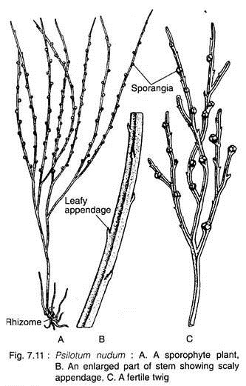
Sporophyte:
The plant body of Psilotum is sporophytic branched rhizome system and dichotomously branched, slender, upright, green aerial systems that bears small appendages and synangia (singular: synangium).
Aerial Stem: Any one of the rhizome tips may turn upward and undergo several dichotomies to give rise to a green aerial shoot. The aerial shoots are slender, generally erect but may be pendent in epiphytes (P. flaccidum). They are perennial and become shrubby by repeated dichotomies and sometimes attain a height up to one meter.

Slide 30
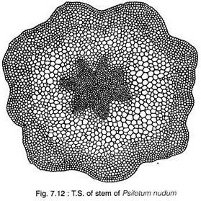
The aerial stems are photosynthetic and the general appearance is xerophytic although the plants grow in very moist environment. In T.S., the aerial system is covered by an epidermis, followed by extensive cortical areas, single-layered endodermis and stele. The stele is siphonostelic in the basal part which becomes actinostelic in the younger branches. The epidermis is single-layered, in which the outer tangential cell walls are heavily cutinised and covered by a layer of cuticle. The epidermis is broken regularly by stomata .The stomata of Psilotum do not have subsidiary cells.

Slide 31
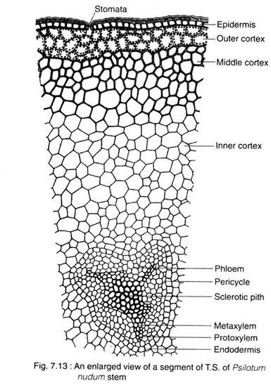
At the extreme base, the stem is protostelic (actinostelic). In the middle portion the stele is siphonostelic as the centre of the xylem is occupied by a patch of elongated sclerenchymatous cells (sclerotic pith).

Slide 32
Rhizome:
The basal subterranean branched rhizome is generally hidden beneath the soil or humus. It bears numerous rhizoids, instead of roots, which perform the functions of absorption.
In T. S., the rhizome reveals an outermost epidermis, cortex, endodermis, pericycle and stele. The epidermis is indistinct and gives rise to 2-celled rhizoid. The cortex is extensive, parenchymatous and differentiated into outer, middle and inner layers.
The outer cortical layer is characterised by the presence of intracellular endophytic mycorrhiza. The cells of middle cortex are large with starch grains, while the cells of the inner cortex are often dark brown in colour because of the presence of phlobaphene (an oxidative product of tannins).

Slide 33
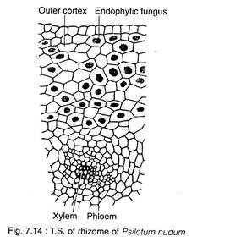
Appendages:
These are small scale-like structures helically arranged on the upper part of the aerial system. Internally, the appendage is composed of parenchymatous photosynthetic cells, bounded by a single-layered cutinized epidermis. There is no stomata in the appendages.

Slide 34
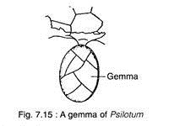
Reproduction in Psilotum:
The Psilotum reproduces vegetatively as well as by spores.
i. Vegetative Reproduction:
The sporophyte as well as gametophyte of Psilotum propagate vegetatively through the production of Gemmae. They are small, multicellular and ovoid structures developing on surface of rhizome (in sporophytic plant body) or prothallus (in the gametophyte).
After detachment from the parent body, gemmae of sporophyte may germinate to form a subterranean shoot, while the gemmae of prothallus, on germination, form a new prothallus.

Slide 35
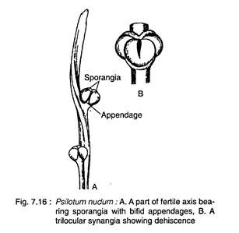
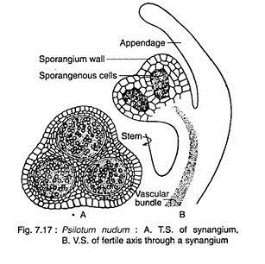
ii. Reproduction by Spores:
Spore-Producing Structure:
At maturity, many of the dichotomously branched aerial shoots become fertile and produce trilocular sporangia known as synangia. The mature synangium is generally a three lobed structure and each lobe of the synangium corresponds to a sporangium.
The synangia located at the tip of very short axis, measuring 1-2 mm in diameter.

Slide 36
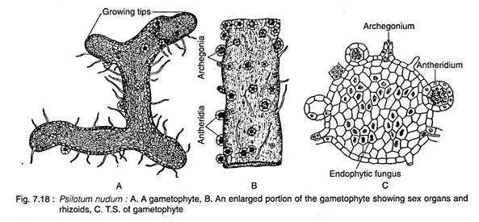
Gametophyte:
The mature gametophyte shows a striking similarity with a piece of sporophytic rhizome. It grows as saprophyte with an associated fungus.
Spores germinate exosporically to form the gametophyte. The mature gametophytes are brown, cylindrical and usually dichotomously branched, but may sometimes become irregular. The surface of the gametophyte is covered by long unicellular, brownish rhizoids. The gametophyte grows by means of apical meristem

Slide 37
Sex Organs:
The gametophytes of Psilotum are monoecious (i.e., homothallic). Sex organs i.e., antheridia and archegania, are superficial and scattered over the surface of the gametophyte. Generally, antheridia are more in number than archegonia.
Antheridium:
The antheridium develops from a single superficial cell (antheridial initial) of the prothallus. The periclinal division of the superficial cell produces an outer jacket initial and an inner primary androgonial cell. The outer jacket initial undergoes repeated anticlinal divisions and forms a single layered jacket. The inner primary androgonial cell divides in various planes and produces a mass of developing androgonial cells, the last generation of which are the androcytes.

Slide 38
Archegonium:
The archegonium is also developed from a single superficial cell (archegonial initial) of the prothallus. The initial cell undergoes periclinal division to form an outer primary cover cell and an inner central cell. The anticlinal divisions followed by periclinal divisions of the outer cover cell produces a long projecting neck arranged in four vertical rows of cells with four to six cells in each row.

Slide 39
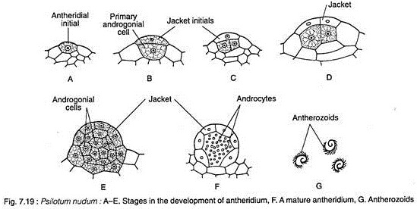

Slide 40
Fertilisation:
At maturity, the cell wall of the lower tier of neck cells becomes thick walled and cutinized. The apical, however, breaks away in presence of water and the mucilagenous contents of the neck cells are released. Thus, a free passage is formed for the entry of the antherozoids.
Fertilisation is accomplished by the union of a multiflagellate sperm and egg, resulting in the formation of a diploid zygote.

Slide 41
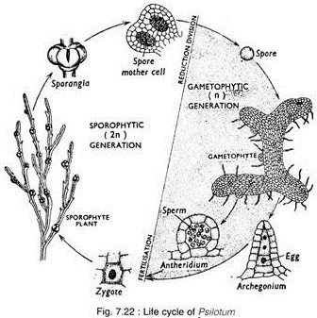

Slide 42
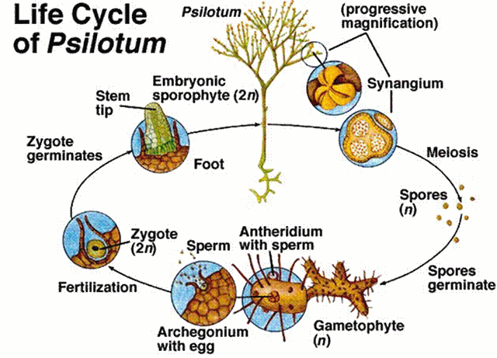

Slide 43
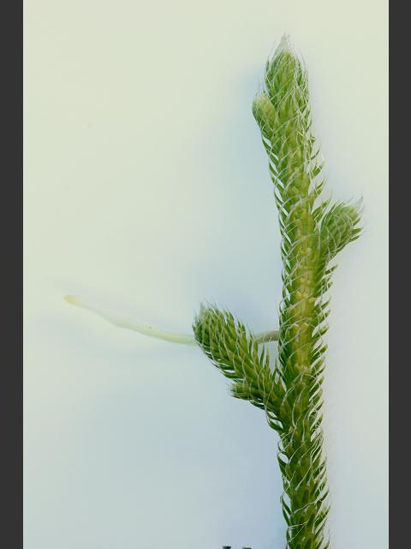
Lycopodium
Kingdom: | Plantae
Division: | Pteridophyta
Class: | Lycopodiopsida
Order: | Lycopodiales
Family: | Lycopodiaceae
Genus: | Lycopodium
Characteristic Features:
The living Lycopodiales are the representatives of a group which, during the Carboniferous period, formed the chief vegetation. The modern representatives are small and herbaceous sporophytes. The leaves are small and simple. Each leaf possesses an unbranched midrib. There are no leaf gaps in the stele of the stem. The sporophylls may or may not be restricted to the terminal portion of branches and organized into definite strobili. The sporophylls and simple vegetative leaves may be similar or dissimilar. They possess homosporous sporangia (all the spores of one kind only). The antheridia remain embedded in the tissue of the prothallus. The antherozoids are biflagellate.

Slide 44
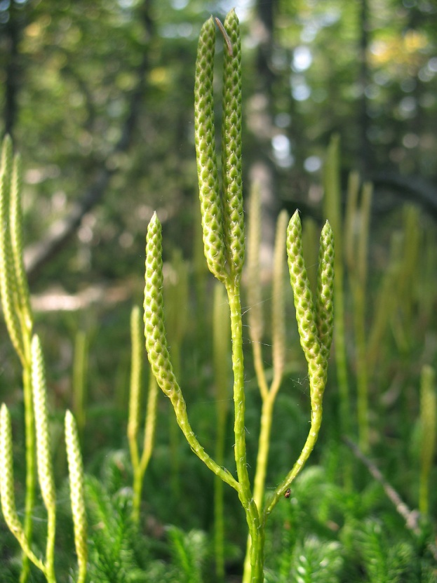
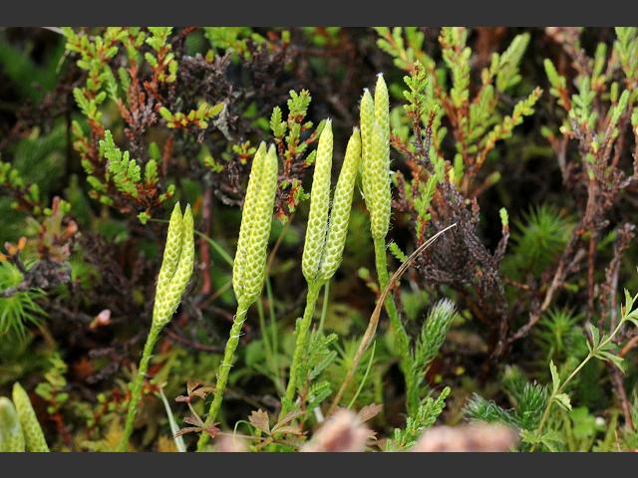

Slide 45
Habit and Habitat of Lycopodium:
Lycopodium is commonly known as ‘club moss’ due to their moss like appearance and club shaped strobili. It has about 400 species, which are cosmopolitan in distribution. They are found in colder arctic region as well as in temperate, tropical and sub-tropical regions but they are abundantly found in tropical zones.
Thirty three species of Lycopodium have been reported from India. Mostly it is found growing in moist and shady places which are rich in humus and other organic matters.
It has got 2 sub-genuses:
(i) Urostachya—branching dichotomous and roots originate from the base of the stem.
(ii) Rhopalostachya—stem prostrate with erect branching and roots arise adventitiously from all along the stem.

Slide 46
External Morphology of Lycopodium
The herbaceous plant body is sporophytic. Usually they may have either prostrate
stem with erect leafy branches or weak pendent stem (epiphytes).
The plant body is distinctly differentiated into following three regions
(i) Stem, (ii) Roots, and (iii) Leaves.
(i) Stem:
In the sub-genus Urostachya stem is erect (terrestrial) or pendent (epiphytic) and may be branched (dichotomously) or unbranched. In the sub-genus Rhopalostachya the stem is prostrate with erect branches.
(ii) Root:
Usually small, adventitious roots are present. In the sub-genus Urostachya roots originate only from the base of the stem (not arising from the whole length of the stem
(iii) Leaves:
Leaves are simple, sessile, small in size, eligulate and possess a single unbranched midrib and are known as microphylls. Usually the leaves are spirally arranged (e.g., L. clavatum) but may be arranged in whorls (e.g., L. cernuum) or pairs (e.g., L. alpinum).

Slide 47
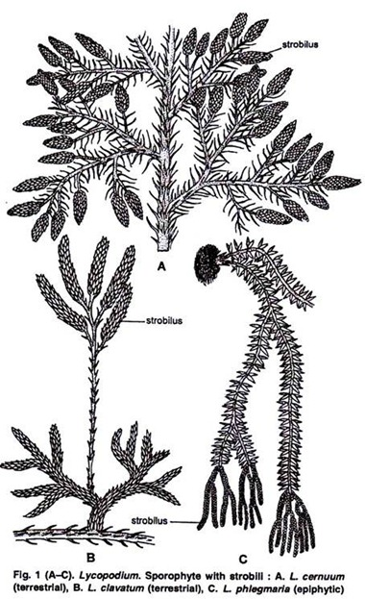

Slide 48
Internal Structure of Lycopodium:
(a) Stem:
A transverse section (T.S.) of the stem of Lycopodium is somewhat circular in outline and can be differentiated into following three regions:
1. Epidermis:
It is the outermost covering layer comprising of single cell in thickness. The epidermis is cutinised on the outer side and interrupted at places by the presence of stomata.
2. Cortex:
Inner to the epidermis is present a wide zone of cortex which shows a great variation in its structure in different species.
3. Endodermis
Next to the cortex is present a single layer of well-defined cells known as endodermis with conspicuous casparian strips but at maturity the endodermis may or may not be a distinct structure. Endodermis is followed by pericycle which is composed of one or more layers of compactly arranged parenchymatous cells.
4. Stele:
It is made up of only primary xylem and primary phloem. It is a protostele i.e., pith is absent and the stele is situated in the centre. The arrangement of xylem and phloem tissues is different in different species and the stele is also named differently.

Slide 49
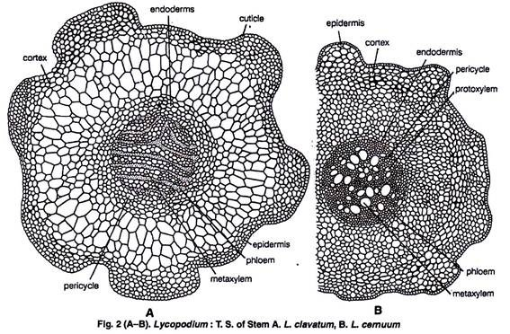

Slide 50
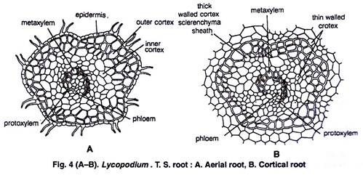
(b) Root:
The roots are adventitious:A transverse section (T.S.) of the aerial root of Lycopodium is somewhat circular in outline and shows the following internal structure:
Epidermis: It is the outermost covering layer and is only one cell thick. The cells are thin walled. Epidermis is provided with numerous root hairs present in pairs (characteristic of Lycopodium).
(ii) Cortex: Just below the epidermis is present a wide zone of cortex. It is differentiated into outer sclerenchyma and inner parenchyma. The outer one gives the mechanical strength to the root.
(iii) Stele: It may be di-, tetra-, or polyarch. In prostrate species it is polyarch i.e., having 6-10 plates of xylem arranged radially (star shaped).

Slide 51
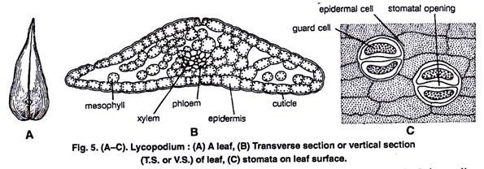
(c) Leaf:
T. S. of the leaf shows epidermis, mesophyll tissue and a single median vascular bundle:
1. Epidermis:
It is the outermost surrounding layer and is only one cell in thickness. The cells of epidermis are parenchymatous and cutinised on their outer side. The epidermis is also interrupted by the presence of stomata.
2. Mesophyll:
It occupies a wide zone between the epidermis and the vascular bundle. It is usually made up of thin walled chlorenchymatous cells which may be with or without intercellular spaces.
3. Vascular bundle:
In the centre of the leaf is situated only a single concentric vascular bundle made up of only xylem and phloem. The vascular bundle is surrounded on all sides by a sclerenchymatous sheath.

Slide 52
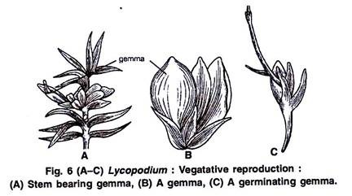
Reproduction in Lycopodium:
Lycopodium reproduces by two methods vegetatively and by spores.
1. Vegetative reproduction:
It takes place by the following methods:
(i) Gemmae or bulbils:
certain buds like structures known as gemmae or bulbils are usually produced in large number on new stem tips annually. The morphological nature of gemmae is still not fully known. The gemmae when fall on ground, develop root primodia and soon form the root.

Slide 53
(ii) Death and decay:
Species with creeping stem reproduces vegetatively by the death and decay of older parts of the stem up to the point of branching. This separates the branches which later on grow independently.
(iii) Resting buds:
The whole of the plant body except the growing tip of rhizome is dead during winter. This tip portion of the rhizome acts as resting bud which in the coming spring resumes growth and develops into a new plant.
(iv) Fragmentation:
In several epiphytic species fragments of the plant body are capable of giving rise to new plants.

Slide 54
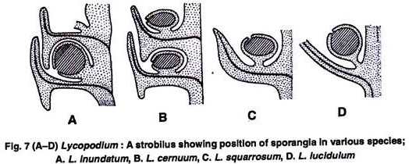
2. Sexual Reproduction:
Spore Producing Organs:
The plants are homosporous i.e., produces only one type of spores (without differentiation of mega- and microspores). These spores are produced in sporangia which, in turn, are produced on fertile leaves known as sporophylls. Usually the sporophylls are grouped together to form a compact structure known as strobili (Sing. strobilus) which are terminal structures.
Strobilus (Reproductive organ):
The sporophylls are loosely arranged. The leaves of the apical portion of the branches only bear sporangia and are called sporophylls. The rest behave as vegetative leaves. The sporophylls may be of the same size or of different size from the foliage leaves in different species. The arrangement of sporophylls is same on the central axis as that of the vegetative leaves
Longitudinal section (L.S.) of strobilus shows the presence of a strobilus axis in the centre.

Slide 55
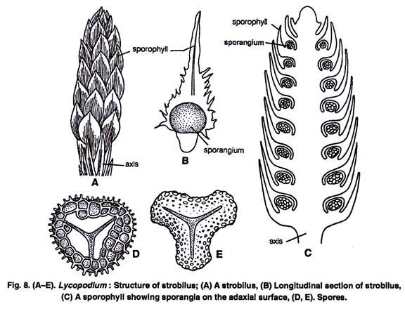

Slide 56
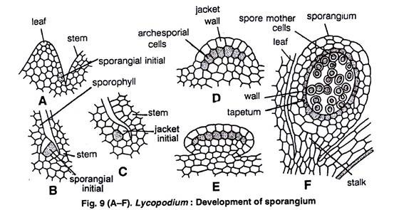

Slide 57
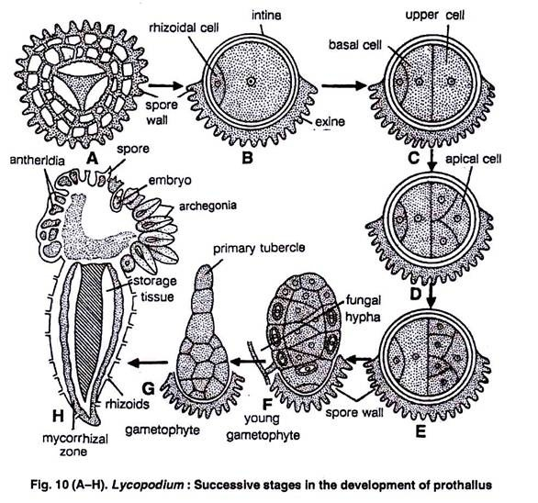
GAMETOPHYTIC GENERATION:
The development of the gametophyte (prothallus) takes place from the haploid spores which are the unit of gametophytic generation.

Slide 58
Development of sex organs:
Both the sex organs i.e., antheridia (male) and archegonia (female) develop on the same prothallus.
antheridium:
A single superficial cell situated just away from the meristematic cells gives rise to an antheridium. This superficial cell is known as antheridial initial .This cell divides periclinally to form an outer cell known as jacket initial (primary wall cell) and an inner cell known as primary androgonial initial or cell .
Development of archegonium:
Just like antheridium, the archegonium also arises from a single superficial cell called archegonial initial, situated just away from the meristematic cells at the apex. The archegonial initial divides by periclinal division into an upper primary cover cell and lower basal central cell.

Slide 59
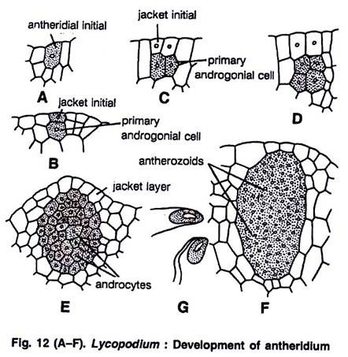

Slide 60
Fertilization:
At the time of fertilization the neck canal cells and the ventral canal cell disorganise and the cells of the upper-most tier of neck slightly separate apart forming a passage upto the egg. Fertilization is brought about in the presence of water.
The biflagellate antherozoids reach the archegonium by swimming in water on the surface of prothallus. The antherozoids are perhaps attracted towards the neck of archegonium by a chemotactic movement. They enter the archegonium through neck and reach the egg.
Only the nucleus of one antherozoid fuses with the egg nucleus thus forming a diploid structure-known as oospore (2n).

Slide 61
Economic Importance of Lycopodium:
Different species of Lycopodium are differently important as for example, some species of Lycopodium (L. obscurum) are used in making Christmas wreaths. L. volubile is used for table decoration.
Extract from the plant of Lycopodium was used as kidney stimulant in the old times. The spores of Lycopodium are highly inflammable and have been used to produce stage lighting, for the theatres. The spores used in pharmacy as water repellent protective dusting powder for tender skin etc.

Slide 62
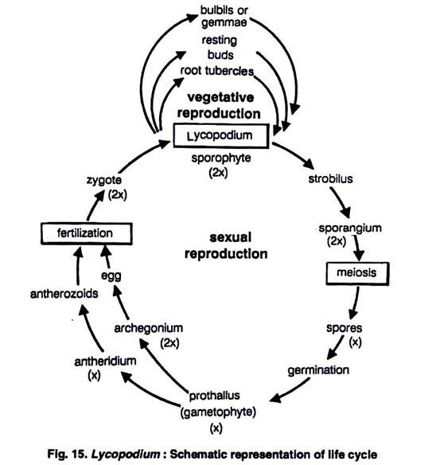

Slide 63
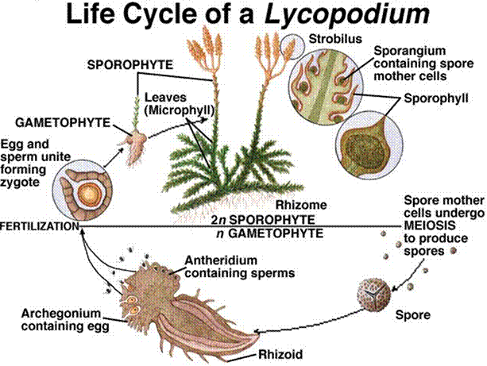

Slide 64
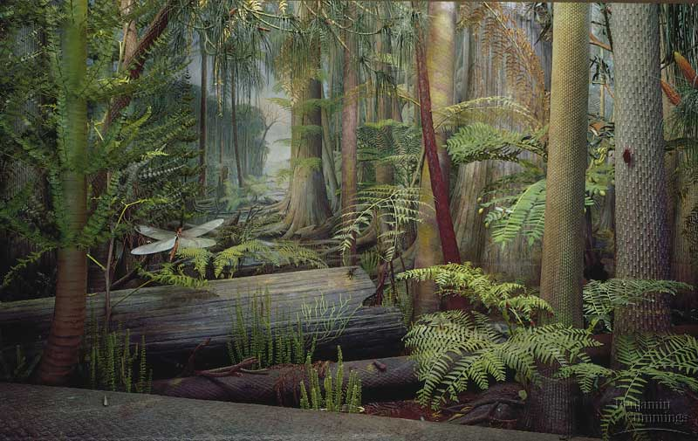
Thank you

Slide 65
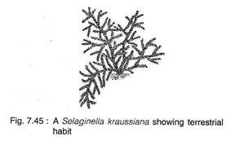
SELAGINELLA
Kingdom: | Plantae
Division: | Lycopodiophyta
Class: | Isoetopsida
Order: | Selaginellales
Family: | Selaginellaceae
Genus: | Selaginella
Selaginella is the sole genus of vascular plants in the family Selaginellaceae, the spikemosses or lesser clubmosses.

Slide 66
Resurrection Plant:
Some xerophytic species rolls up into a compact ball of seemingly dead leaves and stems during dry seasons, but unrolls to carry on normal activities when put in water. Such plants are commonly known as the “resurrection plants” and are often sold as curiosities.
General characteristics of Selaginella:
The sporophyte is herbaceous and the shoot is dorsiventral and radial and creeping or erect.
The leaves are small (microphyllous) and a ligule is present at the base of each leaf and sporophyll.
Rhizophore is (a leafless structure where from roots arises) present in some species.
Sporophylls are usually aggregated into strobili at the apices of the branch, heterosporous.
Heterothallic (dioecious) gametophytic prothalli.
Antherozoids are biciliate.

Slide 67
Habit and Habitat of Selaginella:
Selaginella shows considerable variation in size, symmetry and morphology. Mostly they are herbaceous perennials, however, a few are annu­als (Selaginella pygmaea).
Majority are dorsiventral, prostrate and creeping on the surface and few are scandent
Most of the species of Selaginella grow on the ground in humid, shady habitats. A few species are xerophytic and grow in arid conditions on exposed rock surfaces. They have the ability to survive desiccation.

Slide 68
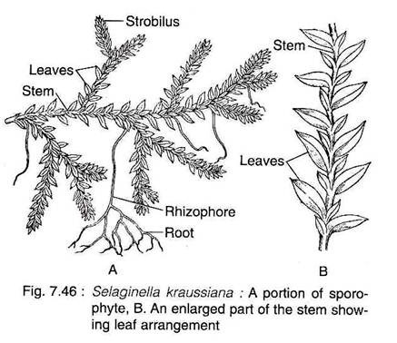
STRUCTURE OF SELAGINELLA:
The Sporophyte:
The plant body of Selaginella is differentiated into well developed roots, stem and leaves. Besides, some species also have rhizophore

Slide 69
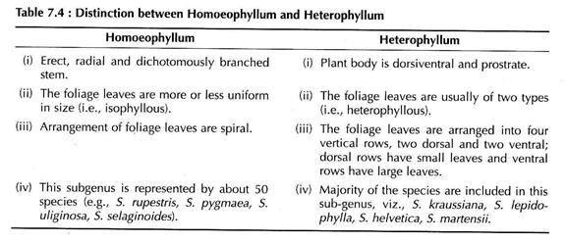
Hieronymus (1902) divided the genus Selaginella into two sub-genera viz., Homoeophyllum and Heterophyllum on the basis of general structure of the plant body

Slide 70
Stem
The stem is generally erect and radially con­structed in the subgenus Homoeophyllum. The species belonging to the subgenus Heterophyllum are prostrate and dorsiventral. The branching is dichotomous in the member of Homoeophyllum and somewhat lateral in Heterophyllum.
The anatomy of the mature stem is very distinct and is differentiated into an outer epidermis, middle cortex and centrally located stele. The outer cell walls of the epidermis are cutinised. It is devoid of stomata and hairs. In many species there are several layers of thick walled cells (hypodermis) beneath the epidermis, which merge gradually with thinwalled chlorophyllous cells of the cortex.
The cortex is usually made up of compactly arranged angular parenchymatous cells without intercellular spaces. The most part of the cortex of xerophytic species is comprised of thickwalled sclerenchymatous cells. There is much variation in the vascular cylinder among the different species of Selaginella. The number of stele varies from species to species and sometimes even in the same species. This is due to the dissection of the main stele. Young plants invariably show monostelic configuration.

Slide 71
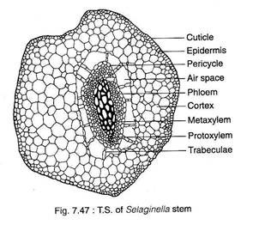

Slide 72
Rhizophores:
(Greek rhiza = root; phora = bearer).
In many species of Selaginella, peculiar leafless, prop-like cylindrical, structures, originate from the stem at the point of branching. These grow downwards into the surface and form many adventitious roots at their free ends. They are known as rhizophores.
A T.S. of the rhizophore shows features very much similar to the root, however, with some mild variations. The epidermis is singlelayered and highly cutinised. The cortex is extensive and may be differentiated into an inner thin-walled parenchymatous and outer thick-walled sclerenchymatous zone (hypodermis). The stele is protostelic and surrounded by a layer of endodermis.

Slide 73
Morphological Nature of Rhizophore:
The morphological nature of rhizophore is controversial because of its unusual position and structure. It has been interpretated by various plant scientists as root, stem or an organ sui generis (i.e., an organ, neither a stem nor a root).
Similarities with Root:
Rhizophores are positively geotropic in nature.
It does not bear leaves.
Monarch xylem like that of root.
Presence of root cap in some species.
Transport of auxin in rhizophore is acropetal which is similar to root.

Slide 74
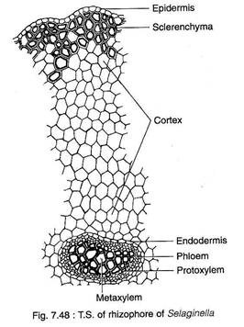
II. Similarities with Stem:
Exogenous in origin like stem.
Absence of root caps and root hairs.
Production of roots endogenously from the tip.
it is a specialised stem behaves like root.

Slide 75
Leaf:
The leaves of all species are microphyllous, sessile and simple, attaining a length of a few millimeters. The leaves may be ovate, lanceolate or orbicular in shape with one vein running nearly the entire length of the leaf. All the leaves are of same type and the arrangement is spiral in subgenus Homoeophyllum.
In the subgenus Heterophyllum, the leaves are of two types small leaves and large leaves, that are arranged in four rows along the stem. There are two rows of small leaves on the dorsal side of the stem and two rows of larger leaves on the ventral side or in a lateral position
A small, membranous, tonguelike structure, ligule (latin ligula = a small tongue), is located at the base of each vegetative, leaf and sporophyll. The ligule is found on the ventral (upper) surface of the leaf.

Slide 76
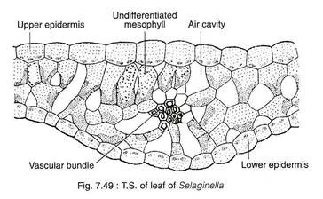
A T.S. of a leaf shows two epidermal layers, mesophyll tissue, stele and stomata. The cells of upper and lower epidermal layers may be similar in most of the species. However, they may be somewhat different in some species. where the upper epidermis consists of conical cells, but the cells of the lower epidermis are smaller.

Slide 77
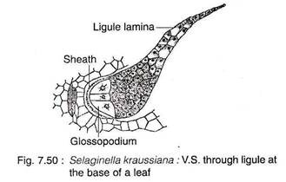
Ligule:
The ligule has a basal cupshaped sheath with often casparian strips (and an adjacent hemispherical glossopodium (Greek glossa ‘tongue’ and podiun ‘foot’) made up of a group of large, vacuolated cells. The remaining cells are more or less cubical in shape. The terminal end of ligule is thin and single layered. The basal portion of the ligule is somewhat sunken into the tissues of the leaf. The ligule acts as a water absorbing structure which keeps the young leaf primordium and sporangium of sporophyll moist during their early development.

Slide 78
REPRODUCTION IN SELAGINELLA:
The sporophyte of Selaginalla reproduces by vegetative and sexual methods.
i. Vegetative Reproduction:
The vegetative reproduction in Selaginella takes place by tubers, dormant buds and fragmentation.
Bulbils and dormant buds are produced in aerial branches, while tubers may be aerial or underground. In favourable condition they germinate to produce new sporophytic plants. In S. rupestris, the trailing branches of the stem develop adventitious branches, that separate from the parent plant and grow into new sporophyte.
ii. Reproduction by Spores:
Numerous haploid spores are produced in the sporangium. The sporangium are located in the sporophylls and the sporophylls are compactly arranged to form cones or strobili.

Slide 79
Strobilus:
All the species of Selaginella forms strobili or cones. Generally strobili occur terminally on side branches, the apical meristem of the cone may continue meristematic activity producing foliage (vegetative) leaves and, therefore, produces a shoot with sporophylls (sporangium bearing leaves) and foliage leaves in alternate segments along the axis.
Selaginella is heterosporous and, therefore, sporangia are of two types viz., microsporangia and megasporangia. The sporophylls associated with these two types of sporangia are designated as microsporophylls and megasporophylls respectively.
There is variation in distribution of sporangia within the strobili of different species. Strobili either consists entirely of microsporangia or of megasporangia. However, the mixed condition is more common
The lower portion of a strobilus consists of megasporangia and the upper portion of microsporangia or the two types of sporangia may be mixed indiscriminately.

Slide 80
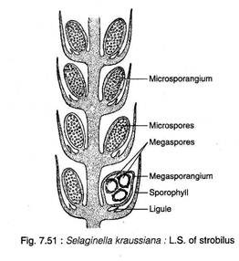

Slide 81
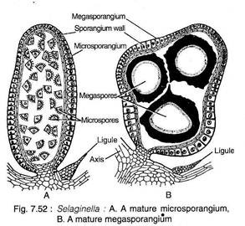
Sporangium:
The mature sporangia are stalked with two layered jacket. The microsporangia are slightly elongated and reddish to bright orange in colour. Megasporangia are larger than microsporangia and are frequently lobed. The megasporangia are whitish yellow or light orange in colour.

Slide 82
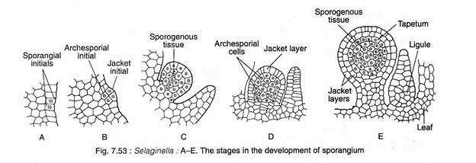
Development of Sporangium:
Initially the development of micro and megasporangia are similar. The sporangial development is of eusporangiate type i.e., the sporangium develops from a group of initial cells

Slide 83
Gametophyte:
The haploid spores germinate to form the endosporic gametophytes. The development of microspores and megaspores generally starts while they are still inside their respective sporangia. Therefore, the spores are shed at multicellular stage.
Male Gametophyte:
The microspore germinates to form the male gametophyte. The first unequal division (1-1) in a microspore results in the formation of a small lenticular prothallial cell (vegetative cell) and a large antheridial initial. The prothallial cell does not divide further. The antheridial initial divides (2-2) vertically forming two primary antheridial cells.
The upper two cells divide anticlinally (3-3) by means of a curved transverse wall forming four antheridial cells and the lower two cells do not divide con­stituting the first jacket cells of the antheridium. The antheridial cells nearer to the prothallial cell divide (4-4) periclinally by means of a curving vertical wall to form two small distal cells (2nd jacket cells) and two large inner cells (androgonial cells).

Slide 84
The other two antheridial cells divide (5-5) anticlinally to form two distal cells (3rd jacket cells and two proximal cells which again divide periclinally (6-6) by means of a curving vertical wall to form two outer (4th jacket) cells and two inner antrogonial cells.
Since the whole process of development of male gametophyte takes place inside the microspore wall, the development is endosporic (where gametophyte develops inside the spore wall) and the gametophyte is an extremely reduced structure.

Slide 85
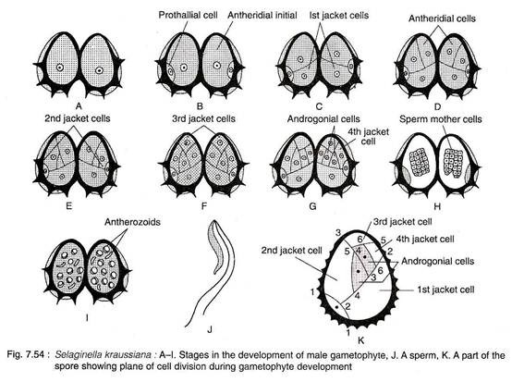

Slide 86
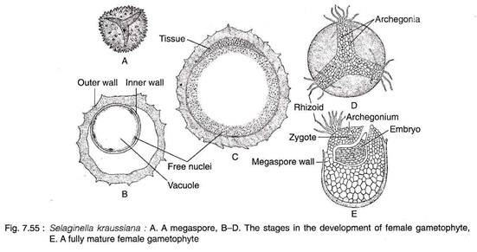
Female Gametophyte:
Like the male gametophyte, the megagametophyte (female gametophyte) development of Selaginella begins while the megaspores are still inside the megasporangium

Slide 87
Development of Archegonium:
Archegonia originate in the apical region of the female gametophyte. Each archegonium develops from a single superficial cell (archegonial initial) which divides periclinally to form a primary cover cell and a central cell.
The primary cover cell follows two vertical divisions at right angle to each other to form four neck initials which again divide transversely to form eight neck cells, arranged in two tiers. The central cell divides periclinally to form an outer primary neck canal cell and an inner primary venter cell.
The primary neck cell does not divide further so that a neck canal cell is formed, while the primary venter cell divides transversely into a ventral canal cell and an egg. Thus, a single archegonium consists of eight neck cells arranged in two rows of four cells each, one neck canal cell, one ventral canal cell and an egg.
The venter, along with the inner tier of neck, lies embedded in the gametophytic tissue, while the terminal neck cells extend above the surface of the gametophytic tissue.

Slide 89
FERTILISATION:
In majority of the species, fertilisation takes place after the megasporangium gets settled on the substratum, but in some cases fertilisation occurs while the female gametophyte is still within the sporangium. Biflagellate sperms (haploid) are liberated, then they swim to the archegonia through a thin film of water and fertilise the egg (haploid) to form diploid zygote
The Embryo (The New Sporophyte):
After fertilisation, the diploid sporophytic generation (i.e. zygote) is established. The first division of the zygote is generally transverse. The upper cell (epibasal) develops into one- or several celled suspensor (that are toward the archegonial neck) and the lower cell (hypobasal) to the embryonic cell. The embryo is endoscopic (embryonic cell directed toward the base of the archegonium) in nature.

Slide 93
Equisetum
Equisetum (horsetail, snake grass, puzzlegrass) is the only living genus in Equisetaceae, a family of vascular plants that reproduce by spores rather than seeds.
Kingdom: | Plantae
Division: | Pteridophyta
Class: | Equisetopsida
Order: | Equisetales
Family: | Equisetaceae
Genus: | Equisetum
Equisetum is a "living fossil" as it is the only living genus of the entire class Equisetopsida, which for over one hundred million years was much more diverse and dominated the understory of late Paleozoic forests. Some Equisetopsida were large trees reaching to 30 meters tall. The genus Calamites of the family Calamitaceae, for example, is abundant in coal deposits from the Carboniferous period

Slide 94
Habit and Habitat of Equisetum:
The plant body of Equisetum has an aerial part and an underground rhizome part. The rhizome is perennial, horizontal, branched and creeping in nature. The aerial part is herbaceous and usually annual. Majority of the species are small with a size range in between 15 and 60 cm in height and 2.0 cm in diameter.
However some species grow up in higher heights though their stem are relatively thin showing vinelike habit and climb over adjacent forest trees.

Slide 95
Equisetums generally grow in wet or damp habitats and are particularly common along the banks of streams or irrigation canals. However, some species are adapted to xeric condition. Some species of Equisetum are indicators of the mineral content of the soil in which they grow. Some species accumulate gold (about 4.5 ounce per ton of dry wt.), thus they are considered as ‘gold indicator plants.
Hence these plants help in prospection/exploration for new ore deposits. In Equisetum, silica is deposited on the outer wall of the epidermal cells giving the characteristic rough feeling, thus it provides a protective covering against predators and pathogens.

Slide 96
Structure of Equisetum:
The Sporophyte:
The sporophytic plant body of Equisetum is differentiated into stem, roots and leaves
Stem:
The stem of Equisetum has two parts: perennial, underground, much branched rhizome and an erect, usually annual aerial shoot. The branching is monopodial, shoots are differentia­ted into nodes and internodes.
In majority of the species, all the shoots are alike and chlorophyllous and some of them bear strobili at their apices. Sometimes shoot shows dimorphism (two types of shoots i.e., vegetative and fertile).
Some shoots are profusely branched, green (chlorophyllous) and purely vegetative. The others are fertile, unbranched, brownish in colour (achlorophyllous) and have terminal strobili.
The underground rhizome and the aerial axis appear to be articulated or jointed due to the presence of distinct nodes and internodes. Externally, the internodes have longitudinal ridges and furrows and, internally, they are hollow, tube-like structures. The ridges of the successive internodes alternate with each other and the leaves are normally of the same number as the ridges on the stem.

Slide 97
Internal Features of Stem:
In T.S., the stem of Equisetum appears wavy in outline with ridges and furrows. The epidermal cell walls are thick, cuticularised and have a deposition of siliceous material.

Slide 98
Stomata are distributed only in the furrows between the ridges. A hypodermal sclerenchymatous zone is present below each ridge which may extend up to stele. The cortex is differentiated into outer and inner regions.
The outer cortex is chlorenchymatous, while the inner cortex is made up of thin-walled parenchymatous cells. There is a large air cavity in the inner cortex corresponding to each furrow and alternating with the ridges, known as vallecular canal. These are schizolysigenous canals extending the entire length of internodes and form a distinct aerating system.
New leaves and branches of Equisetum are produced by the apical meristem, however, most of the length of the stem are due to the activity of intercalary meristem located just above each node. The activity of intercalary meristem causes rapid elongation of the inter- nodal region.

Slide 99
The stele is ectophloic siphonestele which is surrounded by an outer endodermal layer. An inner endodermis is also present in some species of Equisetum. The endoder­mis is followed by a single-layered pericycle.
The vascular bundles are arranged in a ring which lies opposite to the ridges in position and alternate with the vallecular canals of the cortex. Vascular bundles are conjoint, collateral and closed. In the mature vascular bundle, protoxylum is disorganised to form a carinal cavity which lies opposite to the ridges.
The metaxylem tracheids (scalariform or reticulate) are present on both sides of the phloem. In some species vessels with reticulate perforations are reported. The central part of the internode of aerial shoot is occupied by a large pith cavity which is formed due to rapid elongation of the internodal region.
The vascular bundles remain unbranched until they reach the level of node. At the nodal region, each vascular bandle trifurcates (divided into three parts).
The middle branch of the trifurcation enters the leaf. Each lateral branch of the trifurcate bundle joins a lateral strand of an adja­cent trifurcate bundle to form a vascuiar bundle of internode. Thus the vascular bun­dles of internode alternate with those of inter­nodes above and below.

Slide 100
In the nodal region, the xylem is extensively developed as a conspicuous circular ring. There are no vallecular or carinal canals at this level. In addition, a plate of pith tissue occurs at the node which separates one internode from another.
The internal structures of the shoot of Equisetum is peculiar because it shows xerophytic as well as hydrophytic features.

Slide 101
The xerophytic features are:
Ridges and furrows in the stem,
Deposition of silica in the epidermal cells,
Sunken stomata,
Sclerenchymatous hypodermis,
Reduced and scaly leaves, and
photosynthetic tissue in the stem.
The hydrophytic characteristics on the other hand are (i) we 11-developed aerating system like carinal canal, vallecular canal and central pith cavity, and
(ii) reduced vascular elements.

Slide 102
Root:
The primary root is ephemeral. The slender adventitious roots arise endogenously at the nodes of the stems. In T.S., the root shows epidermis, cortex and stele from periphery to the centre. The epidermis consists of elongated cells, with or without root hairs.
The cortex is extensive; cells of the outer cortex often have thick walls (sclerenchymatous) and those of the inner cortex are thinner parenchymatous. The stele is protostelic where the xylem is triarch or tetrarch, or, in smaller roots, may be diarch.
A large metaxylem element is present in the centre of the stele and the protoxylem strands lie around it. The space between the protoxylem groups is filled with phloem. There is no pith.

Slide 103
Leaves:
The leaves of Equisetum are small, simple, scale like and isophyllous; they are attached at each node, united at least for a part of the length and thus form a sheath around the stem. The sheath has free and pointed teeth like tips.
The number of leaves per node varies according to the species. The species with narrow stems have few leaves and those with thick stem have many leaves
The number of leaves at a node corresponds to the number of ridges on the internode below. The leaves do not perform any photosynthetic function and their main function is to provide protection to young buds at the node.

Slide 104
Reproduction by Spores:
Spores are produced within the sporangia. The sporangia are borne on the sporangiophores which are aggregated into a compact structure termed strobilus or cone or sporangiferous spike.
Strobilus:
The strobilus are terminal in position and generally are borne terminally on the chloro­phyllous vegetative shoot. However, they may be borne terminally on a strictly non- chlorophyllous axis
The stro­bilus is composed of an axis with whorls of spo­rangiophores. Each sporangio­phore is a stalked structure bearing a hexagonal peltate disc at its distal end On the under surface of the sporangiophore disc 5-10 elongate, cylindrical hanging sporangia are borne near the periphery in a ring.
The flattened tips of the sporangiophores fit closely together which provide protection to the developing spo­rangia. The axis bears a ring-like outgrowth, the so-called annulus immediately below the whorls of sporangiophores which provide additional protection during early development.
The annu­lus has been interpreted as a rudimentary leaf sheath by some botanists, whereas others con­sider it to be sporangiophoric in nature as occa­sionally it bears small sporangia.

Slide 105
Development of Sporangium:
The mode of development of sporangium is eusporangiate, as it is not entirely formed from a single initial. Superficial cells adjacent to the original initial may also take part in the develop­ment of sporangium.
Sporangia are initiated in single superficial cell around the rim of the young sporangiophore. The periclvnal division of the sporangium initial forms an inner and an outer cell. The inner cell, by further divisions in various planes, gives rise to sporogenous tissue.
The outer cell, by periclinal and anticlinal divi­sions, gives rise to irregular tiers of cells, the inner tiers of which may transform into sporoge­nous tissue and the outer tiers become the future sporangial wall cells.
The innermost layer of the sporangial wall differentiates as the tapetum. The sporogenous cells separate from each other, round off and eventually transform into spore mother cell. All but the two outermost wall layers disorganise to form periplasmodial fluid.
However, not all of the sporogenous cells func­tion as spore mother cells. Many of them degene­rates to form a multinucleate nourishing sub­stance for the spore mother cells. Each spore mother cell undergoes meiotic division (reductional division) and produces spore tetrad. All spores in a sporangium are of same size and shape i.e., homosporous.

Slide 106
Structure of Mature Sporangium:
The mature sporangium is an elongated sac­like structure, attached to the inner side of the peltate disc of the sporangiophore. It is surrounded by a jacket layer which is com­posed of two layers of cells. The inner layer is generally compressed and the cells of the outer layer have helical thickenings which are involved in sporangial dehiscence.
Dehiscence of Sporangium:
At maturity, the strobilar axis elongates, as a result the sporangiophores become separated and exposed. Then the sporangium splits open by a longitudinal line due to the differential hygroscopic response of the wall cells.

Slide 107
Spores:
The spores are spherical and filled with densely packed chloroplasts. The spore wall is laminated and shows four concentrate layers. The innermost is the delicate intine, followed by thick exine, the middle cuticular layer and the outermost epispore or perispore. The intine (endospore) and exine (exospore) are the true walls of the spore.
The outer two layers i.e., cuti­cular layer and epispore are derived due to the disintegration of the nonfunctional spore mother cells and tapetal cells. At maturity, the epispore (the outermost layer) splits to produce four ribbon like bands or strips with flat spoon-like tips.
These bands are free from the spore wall except for a common point of attachment and remain tightly coiled around the spore wall until the sporangium is fully matured.
These are called elaters. The elaters are hygroscopic in nature. The spores remain moist at early stages of develop­ment, thus the elaters are spirally coiled round the spore. The spores dry out at maturity and conse­quently the elaters become uncoiled.
These uncoiled elaters become entangled with the elaters of other spores. Through these actions the elaters help in the dehiscence process and also the dispersal of spores in large groups from the spo­rangium.
The elaters of Equisetum are different from those of the bryophytes

Slide 108
Gametophyte Generation:
Equisetum is a homosporous pteridophyte. The haploid spores germinate to form gameto­phyte. The germination takes place immediately if the spores land on a suitable substratum. If the spores do not germinate immediately, their via­bility decrease significantly.

Slide 109
The spores swell up by absorbing water and shed their exine. The first division of the spore results in two unequal cells: a small and a large cell.. The smaller cell elongates and forms the first rhizoid. The larger cell divides irregularly to produce the prothallus. The prevailing environmental conditions deter­mine the size and shape of the prothallus.
If a large number of spores are developed together within a limited space, then the prothalli formed are of thin filamentous type. But a relatively thick and cushion-shaped prothalli are formed from sparsely germinating spores. Mature gametophy­tic plants may range in size from a few milli­meters up to 3 centimeters e.g., E. debile) in diameter.
They are dorsiventral and consist of a basal non-chlorophyllous cushion-like portion from which a number of erect chlorophyllous muticellular lobes develop upwards. Unicellular rhizoids are formed from the basal cells of cushion

Slide 110
The prothallus bears sex organs and repro­duces by means of sexual method.

Slide 111
Sexuality in Equisetum:
The gametophytic plant body bears sex organs i.e., antheridium (male) and archegonium (female). The gametophyte are basically bisexual (homothallic) i.e., they bear both male and female sex organs. Although, some unisexual (dioecious) members are also reported Some are initially unisexual and then become bisexual.
This early sex determination appears to be related to the environmental conditions viz., temperature, light, humidity and the supply of nutrients as well. Ducket (1977), in order to explore the sexuality in Equisetum, observed that some of the fragments of male gametophyte remained male throughout the successive subcultures under laboratory conditions.
Some other fragments produced archegonia, which subsequently bore antheridia in increasing numbers. This pheno­menon supports the contention that Equisetum gametophytes are potentially bisexual. However, Hanke (1969) observed that gametophyte of Equisetum bogotense were unisexual (bearing antheridia) and never change to bisexual type.
However, the initial male gametophyte of E. ramo­sissimum, E. variegatum and E. bogotense never became bisexual.
Schratz (1928) observed that 50% spores germinate to produce male gametophytes, while the remaining 50% spores produce female gametophytes though they do not loose their male potentiality (i.e., antheridia develop later if fertilisation fails). He termed this as ‘incipient heterospory’.
A study of sexuality based on enzymatic analysis revealed the intragametophytic self- fertilisation in E. arvense.
Equisetum is homosporous and, therefore, definite sex-determining mechanism is absent. But, the sexuality demonstrated by some of the members appears to be related to environmental factors. Therefore, it is termed as environmental sex determination.

Slide 112
Sex Organs of Equisetum:
i. Antheridium:
In monoecious species, antheridia develop later than archegonia. They are of two types — projecting type and embedded type. Antheridia first appear on the lobes of the gametophyte. The periclinal division of the superficial antheridial initial gives rise to jacket initial and an androgonial cell.
The jacket initial divides anticlinally to form a single-layered jacket. The repeated divisions of androgonial cells form numerous cells which, on metamor­phosis, produce spermatids/antherozoids. The antherozoids escape through a pore created by the separation of the apical jacket cell.
The apical part of the antherozoid is spirally coiled, whereas the lower part is, to some extent, expanded. Each antherozoid has about 120 flagella attached to the anterior end.

Slide 113
ii. Archegonium:
Any superficial cell in the marginal meristem acts as an archegonial initial which undergoes periclinal division to form a primary cover cell and an inner central cell. The cover cell, by two vertical divisions at right angle to each other, forms a neck. The cen­tral cell divides transversely to form a primary neck canal cell and a venter cell.
Two neck canal cells are produced from the pri­mary neck canal cell. While, the venter cell, by a transverse division, forms the ventral canal cell and an egg.
At maturity, an archego­nium has a projecting neck comprising of three to four tiers of neck cells arranged in four rows, two neck canal cells of unequal size, a ventral canal cell, and an egg at the base of the embed­ded venter. The archegonia are confined to cushion region in- between the aerial lobes

Slide 116
Fertilisation:
Water is essential for fertilisation. The game­tophyte must be covered with a thin layer of water in which the motile antherozoides swim to the archegonia. The neck canal cells and ventral canal cell of the archegonia disintegrate to form a passage for the entry of antherozoids.
Many antherozoids pass through the canal of the archegonium but only one of them fuses with the egg. Thus diploid zygote is formed. Generally more than one archegonia are fertilised in a pro­thallus.

Slide 117
Embryo (The New Sporophyte):
The embryo is the mother cell of the next sporophytic generation. Unlike most pterido­phytes, several sporophytes develop on the same prothallus. The first division of the zygote is transverse. This results in an upper epibasal cell and lower hypobasal cell. The embryo is there­fore exoscopic (where the apical cell is duacted outward i.e., towards the neck of the archegoni­um) in polarity.
No suspensor is formed in Equisetum. The epibasal and hypobasal cells then divide at right angles to the oogonial wall, and as a result a tour-celled quadrant stage is established. All the four cells of the quadrant are of different size and shape.
The four-celled embryo undergoes subsequent divi­sions and the future shoot apex originate from the largest cell and leaf initials from the remai­ning cells of one quadrant of the epibasal hemi­sphere.
One cell of the epibasal quadrant and a portion of the adjacent quadrant of the hypobasal region contribute to the development of root. The first root develops from one of the epibasal quadrants and a portion of the adjacent hypobasal quadrant. The shoot grows rapidly.

Slide 118
Later the root grows directly downward and penetrate the gametophytic tissue to reach the soil or substratum. A number of such sporophytes may develop from a large mature gametophyte if more than one egg is fertilised

Slide 121
Marsilea
Kingdom: | Plantae
Division: | Pteridophyta
Class: | Polypodiopsida / Pteridopsida (disputed)
Order: | Salviniales
Family: | Marsileaceae
Genus: | Marsilea
Marsilea is a genus of approximately 65 species of aquatic ferns of the family Marsileaceae. The name honours Italian naturalist Luigi Ferdinando Marsigli (1656–1730)

Slide 122
There are about 65 species of Marsilea distributed all over the world. They are more commonly found in tropical regions, such as, Africa and Australia. Gupta and Bhardwaja (1957) have recorded about ten species of Marsilea from our country. About six species of Marsilea are known to occur in the United States.
They are hydrophytic or amphibious plants. They grow rooted in the mud of marshes and shallow pools. Marsilea vestita and some other species grow in shallow ponds. A single plant of M. vestita may grow in all directions until it covers an area twenty-five metres or more in diameter.
In M. vestita and most of other species the sporocarps develop to maturity only on the plants that are not submerged. M. minuta and some other species produce sporocarps in the aquatic habitat; on the other hand M. aegyptiaca never produces the sporocarps in the aquatic habitat. An Australian species M. hirsuta can survive in dry conditions throughout the year.

Slide 123
External Morphology:
Stem:
The species of Marsilea possess a rhizome which creeps on or just beneath the surface of the soil. The rhizome is slender, branched and possesses nodes and internodes. The leaves are borne alternately along the upper side of the rhizome usually at the nodes. One or more adventitious roots come out from each node on the underside of the rhizome. The rhizome is dichotomously branched and is capable of indefinite growth in all directions and covers an area more than twenty-five metres in diameter.

Slide 124
Leaves:
The leaves arise from the nodes and are arranged alternately in two rows on the upper side of the creeping rhizome. The leaves are long petiolate and palmately compound, each having four leaflets in many species, but sometimes the number of leaflets varies from 3-8. A young leaf shows circinate vernation. At maturity the pinnae are extended perpendicular to the peti­ole. The venation is of closed reticulate type.
In T.S., the petiole differentiates into epider­mis, cortex and stele The epidermis is cutinised and composed of a single-layered rectangular cells.
The cortex is differentiated into outer and inner cortex. The outer cortex consists of aerenchyma having many air-cavities separated by one-celled thick septa.
The stele is protostelic with diarch and exarch xylem. The xylem has two large metaxylem elements at the centre and proto­xylem elements at each end towards the peri­phery. Phloem bands are present on either side of Marsilea minuta. T.S. of petiole the xylem.

Slide 125
The stele is protostelic, generally triangular in outline and is externally bounded by endoder­mis. A single-layered pericycle is present just inside the endodermis.
The xylem is mesarch, consists of two out­wardly curved strands. Protoxylem patches are present at both the ends with one or more metaxylem in the centre. The xylem is surroun­ded by phloem. Pith is absent.
The vertical section of the leaflet shows epi­dermis, stomata, mesophyll and vascular bun­dles. Stomata are present in the upper epidermis (in submerged species) or on both the upper and lower epidermis (in terrestrial and amphibious species).
Mesophyll tissue is differentiated into palisade and spongy parenchyma and generally associated with vertical airspaces. The vascular bundles are concentric with a central core of xylem surrounded by phloem. Each vascular bundle is separated from the mesophyll tissue by a layer of endodermis.

Slide 126
Root:
In the transverse section of the root, the epidermis, cortex and stele may be seen. The epidermis is single layered and composed of thin-walled parenchymatous cells. The cortex of the root is differentiated into two regions. The outer region consists of large air spaces or lacunae separated by septa from each other the inner zone of the cortex consists of a few layers of sclerotic cells.
Inner to the cortex there is single layered endodermis. Just beneath the endodermis there is single-layered pericycle. In the centre of the stele there is typical diarch and exarch structure with a diametric plate like strand of xylem. The phloem bands are found on either side of the xylem plate.

Slide 127
Reproduction:
The reproduction in Marsilea takes place by vegetative and sexual methods.
Vegetative propagation:
The vegetative reproduction takes place by means of specially developed structures known as tubers. In the dry conditions certain branches develop from the rhizome, which swell because of the storage of food material, and are termed as tubers. These tubers survive in the unfavourable and drought conditions, and on the return of favourable conditions they germinate into new plants, e.g., M. hirsuta.
Sexual reproduction:
The plant is a sporophyte. It bears the special structures known as sporocarps which contain micro and megasporangia in them. It is heterosporous. The sporocarps are borne on short peduncles above the base of the petiole. In most cases the peduncle is unbranched and bears a single sporocarp at its apex. In M. quadrifolia the peduncle is dichotomously branched and bears 2 to 5 sporocarps. The sporocarps may be oval or bean-shaped. In the earlier stages of its development it is soft and green but later on it becomes sufficiently hard and brown in colour. In majority of the species of Marsilea near the point of attachment of the stalk or peduncle at the base, there are usually one and sometimes more protuberances in the median plane. Such protuberan­ces consist of one or two teeth and raphe.

Slide 129
Reproduction by Spores:
Marsilea is a heterosporous fern. It produces two types of spores i.e., the microspores and the megaspores. The microspores and megaspores are produced in microsporangia and mega­sporangia, respectively, and the sporangia are enclosed in special bean-shaped structures called sporocarps.
When young, the sporocarps are soft and green, but turns dark brown and hard at maturity. Sporocarps withstand desiccation and are repor­ted to be viable even after twenty to twenty five years.
The sporocarp develops at the short branch of petiole called pedicel or stalk. In most species they occur singly, but in some species the num­ber varies from two to twenty

Slide 130
The mode of attachment of sporocarps with the peti­ole is of following types:
(a) Sporocarps are attached to one side of the petiole in a single row e.g., M. polycarpa, M. caribaca, M. subangulata, M. detlexa.
(b) Pedicels of the sporocarps are fused in groups and then attached to the petiole by a common stalk e.g., M. quadrifolia.
(c) Pedicels of all the sporocarps remain free and are attached to the petiole at a single point (e.g., M. minuta).
(d) A single sporocarp attached to the base of the petiole by the pedicel (e.g., M. coro- mandelica, M. uncinata).
The place of attachment of the pedicel with the body of the sporocarp is known as raphe The distal end of the raphe in some species is marked by the presence of one or two protuberances or teeth-like projections known as horns or tubercles.
The sporocarp wall is hard, thick, thus resis­tant against mechanical injury. Anatomically, the wall is differentiated into three layers. The outer layer is epidermis made up of single-layered cuboidal cell with sunken stomata.
The middle layer is made up of radially elongated compact­ly arranged thick-walled palisade cells. This is followed by second palisade layer which is com­prised of more elongated thin-walled palisade cells.

Slide 131
nother bundle called placental bundle deve­lops from the point of forking of lateral bundle which enters into the receptacle bearing spo­rangia and dichotomises. Thus a closed net­work of vascular system is formed within the sporocarp.
A vertical longitudinal section (VLS) of sporocarp away from the plane of the stalk reveals many sori arranged in vertical rows. In this plane of section either megaspo­rangia or microsporangia are visible. Each sorus is surrounded by an indusium. The development of sori is of gradate type. The gelatinous mucilage ring is more prominent in dorsal side. A horizontal longitudinal section (HLS) cuts each sorus transversely and it is seen that each sorus is an elongated structure, covered by a delicate indusium.
The sori are gradate, basipetal in arrangement with a row of largest sporangia (megasporangia) at top and two rows of smaller sporangia (microsporangia) on two sides (Fig. 7.123). The mucilage ring is present in the form of two masses, one in the dorsal and the other in the ventral sides.

Slide 132
A vertical transverse section (VTS) of the sporocarp shows only the sori on two sides Both the sori contain megasporangia if the section is taken through the megasporangia or the sori contain only microsporangia if it is taken through the microsporangia. The sporophore is seen in the form of two masses on either side. The mucilage ring is present only on the dorsal side.

Slide 133
Development of Sporangium:
Sporangial development is of the leptosporangiate type. The development of both the micro- and megasporangia is almost alike. The sporangial initials for megasporangium and microsporangium are formed at top and at the sides of the receptacle, respectively.
The initial cell divides periclinally (transversely) into an outer and an inner cell. The inner cell doe not take part in further development. The outer cell undergoes three successive diagonal divisions and forms a tetrahedral apical cell with three cutting faces.
This apical cell cuts off two seg­ments along each of its three cutting faces which forms the stalk of the sporangium. Now the api­cal cell divides with the help of an arched peri­clinal wall towards its outer face and forms an outer jacket initial and an inner tetrahedral archesporial cell. The outer jacket initial divides anticlinally to form a single-layered jacket.
The archesporial cell divides periclinally to forms an outer tapetal initial and an inner primary sporogenous cell. Anticlinal and periclinal divi­sions of the tapetal initial forms a two-layered thick tapetum.
The primary sporogenous cell divides to form a mass of either 8 or 16 spore mother cells. Spore mother cells (2n) undergo meiotic division to form 32 or 64 haploid spores (n). The developments of both the sporangia are similar up to this stage.

Slide 134
Opening of the Sporocarp:
The sporangium wall of Marsilea shows no sign of cellular specialisation (e.g., formation of annulus) required for dehiscence of sporangium. A sporocarp is a hard structure and it does not open until two or three years after their formation. This delay is probably due to the imperviousness of the hard sporocarp wall.
Hence the sporocarp may remain viable for even 50 years. The tissues slowly swell up by absorbing water in natural conditions. Thus the swelling puts pressure on the wall of the sporocarp and eventually it splits open along its ventral side into two halves.
Splitting is followed by the emergence of a long, worm-like gelatinous structure to which the sori are attached. The mucilaginous cord may became ten or fifteen times larger than the sporocarp. Following the release of the sori from the sporo­carp, the indusia and the sporangial wall disinte­grate and the spores are liberated.

Slide 135
Gametophyte:
Marsilea is heterosporous i.e., they produce microspores and megaspores which eventually germinate to form the male and female gameto­phytes, respectively.
Male Gametophyte:
The microspores are small, globose struc­tures with a thick outer ornamented exine and inner thin intine. The outer exine is covered by a thin layer called perispore. The microspore con­tains a distinct haploid nucleus and its cytoplasm is rich in starch grains.
The microspores germinate inside the spore wall (endosporic type) almost immediately after its release. It divides asymmetri­cally to form a small prothallial cell and a large apical cell (1-1). A division (2-2) of apical cell diagonal to prothallial cell forms two antheridial cells.
Then both the antheridial cells divide diag­onally (3-3) with curving wall forming the first jacket cell and large wedge-shaped cell. The jacket cells do not divide, but the wedge-shaped cell divides periclinally (4-4) to form smaller inner cell (2nd jacket) and a large outer cell. Further, the periclinal division (5-5) of outer cell forms 3rd jacket and primary androgonial cell.
At this stage the male gametophyte consists of one prothallial cell, 6 jacket cells and 2 androgonial cells. After several divisions of the primary androgonial cells, sixteen androcytes are formed surrounded by jacket cells.

Slide 137
Female Gametophyte:
The megaspore is an oval or elliptic structure, the wall of which imbibes water and expands to form a gelatinous mass around the megaspore. The spore wall expands to form a small papilla (protuberance) at the apical end where the nucle­us is located in a dense part of cytoplasm. The remaining portion of the spore is filled with a frothy cytoplasm full of starch grains

Slide 138
The first division in the apical nucleus of the large megaspore is transverse, forming a small nipple-shaped apical cell and a very large basal nutritive or prothallial cell. The prothallial cell provides the nutrition to the grow­ing female gametophyte.
The apical cell further divides by three intersecting vertical walls to establish an axial cell surrounded by three late­ral cells. Now the axial cell func­tions as archegonial initial which divides pericli­nally to form an outer primary cover cell and an inner central cell.
A small neck (2 tiers of 4 cells each) is derived from the primary cover cell. The central cell divides transversely to form an upper primary canal cell (behaves as neck canal cell) and lower primary venter cell
The primary ventral cell again divides transverse­ly to form a ventral canal cell and an egg. The growth of the archegonial complex ruptures the megaspore wall at the apical end and forms a conspicuous gelatinous mass with funnel-shaped papilla or protuberance. Now, the megaspore splits through the triradiate fissure and archego­nium becomes exposed.
Fertilisation disintegration of the neck canal cell and ventral canal cell create a passage for the antherozoids to fertilise the egg. The antherozoids, after libe­ration from ruptured male gametophyte, enter through the gelatinous protuberances and moves downwards to the archegonium. One of the antherozoids eventually fuses with the egg to form a diploid zygote.

Slide 139
The Embryo
The zygote is the mother cell of the next sporophytic generation. The first division of the zygote is vertical (in relation to the neck of the archegonium) followed by a transverse division resulting in the quadrant stage (four-celled stage) of the embryo. Subsequent deve­lopment of the upper two cells forms the root and leaf, whereas the lower two cells give rise to the foot and shoot apex.
With the development of the embryo the vegetative cells of the surrounding gametophyte divides periclinally and form a two- to three-layered sheath (calyptra) around the embryo. The primary root grows vertically and establishes the sporeling in the soil. The young sporophyte has a well-developed primary root and leaf.

