Slide 1
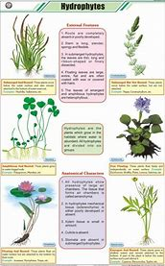
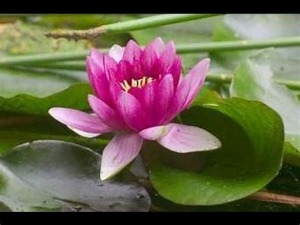
anatomical adaptations of hydrophytes

Slide 2
B. Anatomical Modifications:
The anatomical modifications in hydrophytes aim mainly at:
1. Reduction in protecting structures,
2. Increase in the aeration,
3. Reduction of supporting or mechanical tissues, and
4. Reduction of vascular tissues.

Slide 3
Various anatomical adaptations of hydrophytes are listed below:
1. Reduction in protecting structures:
Cuticle is totally absent in the submerged parts of the plants. It may be
present in the form of very fine film on the surfaces of parts which
exposed to atmosphere.
(b) Epidermis in hydrophytes is not a protecting layer but it absorbs water,
minerals and gases directly from the aquatic environment. Extremely thin cellulose walls of epidermal cells facilitate the absorption process.
(c) Epidermal cells contain chloroplasts, thus they can function as photosynthetic tissue, especially where the leaves and stems are very thin, e.g. Hydrilla (Fig. 8.8).
(d) Hypodermis in hydrophytes is poorly developed. Its cells are extremely thin wall

Slide 4
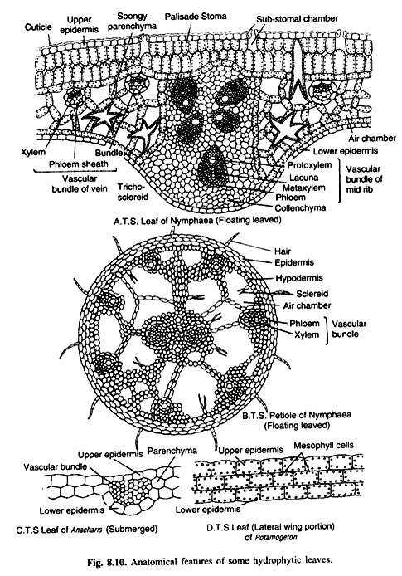
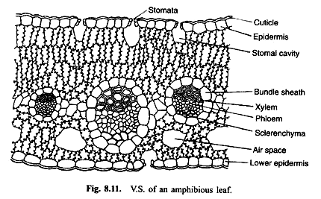
2. Increase in the aeration:
(a) Stomata are totally absent in submerged parts of the plants (Fig. 8.9, 8.10 C & D). In some exceptional cases, vestigial and functionless stomata have been noticed. In these cases exchange of gases takes place directly through cell walls. In the floating leaves, stomata develop in very limited number and are confined only to the upper surface (Fig. 8.10 A). In amphibious plants stomata may be scattered on all the aerial parts and they develop comparatively in larger number per unit area than those on the floating leaves (Fig. 8.11).

Slide 5
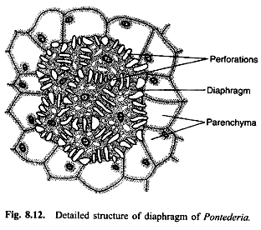
(b) Air chambers:
Aerenchyma in submerged leaves and stem is very much developed. Air chambers are filled with respiratory gases and moisture. These cavities are separated from one another by one or two cells thick chlorenchymatous partitions. The different types of air chambers are shown in Figs. 8.8, 8.9 A, and 8.10. CO2 present in the air chambers is used in the photosynthesis and the O2 produced in the process of photosynthesis and also that already present in the air chambers is used in respiration.
The air chambers also develop finely perforated cross septa which are called diaphragms (Fig. 8.12). The diaphragms afford better aeration and perhaps check floating. The Aerenchyma provides buoyancy and mechanical support to aquatic plants. Air chambers are abundantly found in the fruits of hydrophytes rendering them buoyant and thus facilitating their dispersal by water

Slide 6
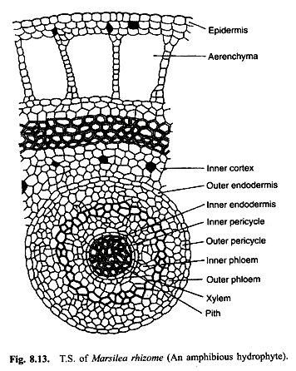
3. Reduction of supporting or mechanical tissues:
(a) Mechanical tissues are absent or poorly developed in the floating and submerged parts of plants because buoyant nature of water saves them from physical injuries. The thick walled sclerenchymatous tissue is totally absent m submerged and floating hydrophytes. They may, however, develop in the cortex of amphibious plants particularly in the aerial or terrestrial parts (Figs. 8.13, 8.14 B, D). Generally elongated and loosely arranged spongy cells are found in the plant body. These thin-walled cells, when turgid, provide mechanical support to the plants (Figs. 8.15, 8.16 and 8.17).
(a) The reduction of absorbing tissue (roots act chiefly as anchors and root hairs are lacking).
(b) In water lily and some other plants, special type of star shaped lignified cells, called asterosclereids, develop which give mechanical support to the plants (Fig. 8.10 A, B).

Slide 7
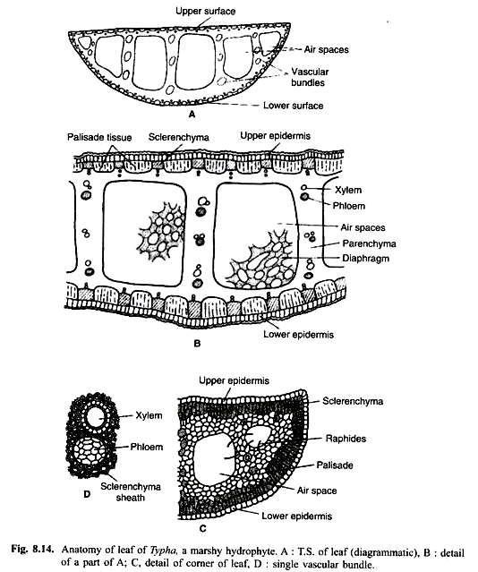
4. Reduction of vascular tissues:
Conducting tissue is very poorly developed. As the absorption of water and nutrients takes place through the entire surface of submerged parts, there is little need of vascular tissues in these plants. In the vascular tissues, xylem shows greatest reduction. In some cases, it consists of only a few tracheids while in some, xylem elements are not at all developed (Fig. 8.18). Some aquatic plants, however, show a lacuna in the centre in the place of xylem. Such spaces resemble typical air chambers (Fig. 8.8).
Phloem tissue is also poorly defined in most of the aquatic plants but in some cases it may develop fairly well. Sieve tubes of aquatic plants are smaller than those of mesophytes. Phloem parenchyma is extensively developed. Endodermis may or may not be clearly defined. The Vascular bundles are generally aggregated towards the centre. Secondary growth in thickness does not take place in the aquatic stem and roots.

Slide 8
