Slide 1
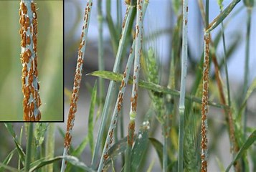
Stem rust (black rust of wheat)

Slide 2
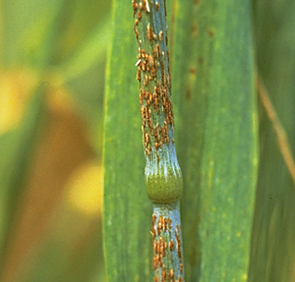
DISEASE: Stem rust (black rust)
PATHOGEN: Puccinia graminis f. sp. tritici
HOSTS: Wheat and barley, common barberry (and some additional
Berberis, Mahoberberis, and Mahonia spp.)
Stem rust was once the most feared disease of cereal crops.
It is not as damaging now due to the development of resistant cultivars, but outbreaks may occur when new pathogen races arise against which the existing kinds of resistance are ineffective.
Stem rust remains an important threat to wheat and barley and, thus, to the world food supply. Anton deBary first demonstrated the heteroecious life cycle of a rust fungus with Puccinia graminis, the causal agent of stem rust

Slide 3
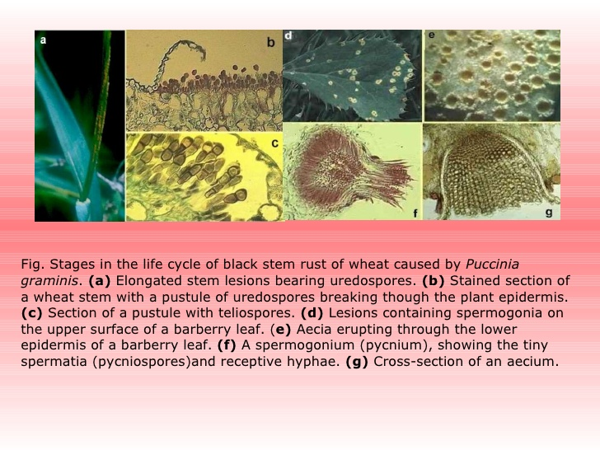

Slide 4
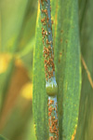
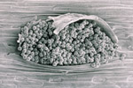
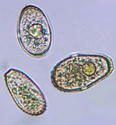
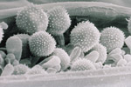
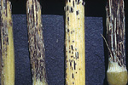
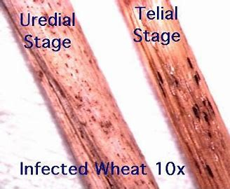
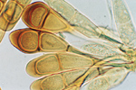
SYMPTOMS AND SIGNS
On wheat and other grass hosts:
Plants do not usually show obvious disease symptoms until 7 to 15 days after infection when the oval pustules (uredinia) of powdery, brick-red urediniospores break through the epidermis
Microscopically, these red spores are covered with fine spines .
The pustules may be abundant and produced on both leaf surfaces and stems of grass hosts. Later in the season, pustules (telia) of black teliospores begin to appear in infected grass species .
Microscopically, teliospores are two celled and thick walled (Figure 6).

Slide 5
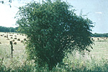
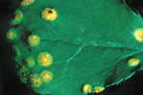
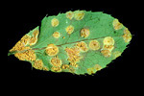
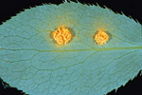
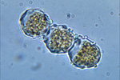
On barberry and other alternate hosts:
Pycnia appear on barberry plants in the spring, usually in the upper leaf surfaces.
They are often in small clusters and exude pycniospores in a sticky honeydew.
Five to 10 days later, cup-shaped structures filled with orange-yellow, powdery aeciospores break through the lower leaf surface.
The aecial cups are yellow and sometimes elongate to extend up to 5 mm from the leaf surface .
Microscopically, aeciospores have a slightly warty surface .

Slide 6
Pathogen Biology
Rust fungi are obligate parasites. In nature, they require living host tissue for growth and reproduction; they cannot exist as saprophytes.
In the absence of living host tissue, they survive as spores. In most rust fungi, only the teliospores are adapted to survive apart from a living host plant for more than a few months under field conditions.
Puccinia graminis is heteroecious. This word describes rust fungi that require two unrelated host plants, such as wheat and barberry, to complete their life cycle.
Puccinia graminis is macrocyclic, producing all five spore stages: basidiospores, pycniospores (spermatia), aeciospores, urediniospores (uredospores), and teliospores. Anton deBary, in 1865, first recognized the nature of the heteroecious life cycle, but the role of each spore stage was not completely understood until John Craigie, a Canadian scientist, studied the pathogen in 1927.

Slide 7
Although stem rust is caused by a single species of fungus, Puccinia graminis, there is considerable genetic variation within the species. In 1884, Eriksson discovered host-specific subspecies or "special forms" of the fungus.
Each special form is designated in Latin as a forma specialis or "f. sp." All of the formae speciales have an identical appearance, but vary in host range.
The pathogen that causes stem rust of wheat (Triticum aestivum) is Puccinia graminis f. sp. tritici. Other formae speciales include P. graminis f.sp. secalis, causal agent of stem rust of rye (Secale cereale), and P. graminis f.sp. avenae, causal agent of stem rust of oat (Avena sativa). Both Puccinia graminis f. sp. tritici and P. graminis f.sp. secalis cause stem rust in barley. About 1916, E.C. Stakman and others determined that within P. graminis f.sp. tritici are further genetic subdivisions called races. Later, races were found within other formae speciales as well.

Slide 9
The disease cycle of wheat stem rust starts with the exposure of each new wheat crop to spores of Puccinia graminis f. sp. tritici, which are the primary inoculum. The source of the first spores that infect the new wheat crop differs depending on the region in which the wheat is grown.
In warm climates, wheat is planted in late fall and harvested in early summer. The first spores to infect the young wheat plants in the fall are urediniospores.
They generally come from infected volunteer wheat plants. Seed spilled in the field or on roadsides at harvest time often sprout and produce scattered volunteer plants.
These plants can become infected from spores produced on late-maturing wheat plants still in the field. The infected volunteer wheat plants serve as a bridge that carries P. graminis f. sp. tritici through the summer to the next fall-sown crop of wheat.
In regions with temperate climates, wheat may be planted either in the fall (winter wheat) or the spring (spring wheat) depending on the severity of the winters . For example, few winter wheat varieties can survive well through the severe winters of Minnesota, North Dakota, and Manitoba, so most of the wheat grown there is spring wheat.
The first rust spores to infect wheat in the spring in temperate regions may be aeciospores from barberry, the alternate host, or urediniospores from infected wheat in distant regions with milder winters.
Therefore, we describe two disease cycles for stem rust - with or without barberry.

Slide 10
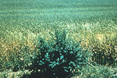
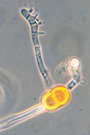
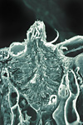
Disease cycle, with barberry
Barberry is the most dangerous source of primary inoculum of stem rust in temperate regions. If barberry grows near wheat fields, it will be a consistent source of aeciospores for the earliest infections of wheat in the spring
Puccinia graminis overwinters as black, thick-walled, diploid teliospores that are produced on wheat or other grass hosts toward the end of the growing season
Karyogamy (fusion of two haploid nuclei to form a diploid nucleus) and meiosis (reduction division to produce four haploid basidiospores) take place in the teliospore. Teliospores are produced in a telium.
In the spring, each teliospore germinates to produce thin-walled, colorless, haploid basidiospores
Basidiospores infect the alternate hosts such as common barberry.

Slide 11
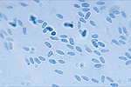
Basidiospores germinate and produce a haploid mycelium which colonizes the leaf tissue. From this mycelium, pycnia are formed inside the leaf but with the tops extending through the surface, usually in the upper surface, of barberry leaves. Pycnia produce receptive hyphae and pycniospores (Figure 15).
No further development will occur until the receptive hyphae in the pycnium are fertilized by pycniospores from a pycnium of a different mating type. Pycnia and pycniospores are referred to as spermagonia and spermatia by some authors, but the former are the preferred terms of rust specialists.
Pycniospores (Figure 16) are produced in a sticky honeydew that is attractive to insects and helps ensure that successful cross-fertilization occurs (figure 8). Insects carry pycniospores from one pycnium to another as they forage across the leaves feeding on the honeydew. Splashing raindrops also disperse pycniospores and aid in cross-fertilization. Fertilization of pycnia is critical in the rust fungus life cycle, because it gives rise to the dikaryotic mycelium. After the nucleus of the pycniospore joins that of the receptive hypha, the paired, haploid nuclei divide in tandem in the mycelium throughout the remaining stages of the life cycle. All stem rust infections of wheat or other grasses involve dikaryotic spores and dikaryotic mycelium

Slide 12
Over a period of days, the dikaryotic mycelium grows through the barberry leaf until a new structure, the aecium, breaks through the lower surface of the leaf to release the dikaryotic aeciospores .
Aeciospores, although produced on barberry plants, can infect only wheat or other grass host of P. graminis.
Aeciospores differ from urediniospores, which also infect wheat, in their appearance - slightly warty rather than spiny - and in the way in which they are formed - in chains in an aecium rather than on individual stalks in a uredinium.
On wheat, aeciospores germinate, the germ tubes penetrate into the plants, and the fungus grows as dikaryotic mycelium. Within 1 to 2 weeks, the mycelium in each infection produces a uredinium filled with brick-red, spiny, dikaryotic urediniospores that break through the leaf or stem epidermis .

Slide 13
In heteroecious rusts, this important spore stage is called the "repeating stage," because urediniospores are the only rust spores that can infect the host plant on which they are produced. Under favorable environmental conditions, multiple, repeated infections of the same wheat plant and neighboring wheat plants can result in explosive epidemics
Toward the end of the growing season, black overwintering teliospores are formed in telia , and the life cycle is completed. Because karyogamy and meiosis take place in the teliospore , this spore stage is an important source of genetic recombination in addition to its role as a survival spore.

Slide 14
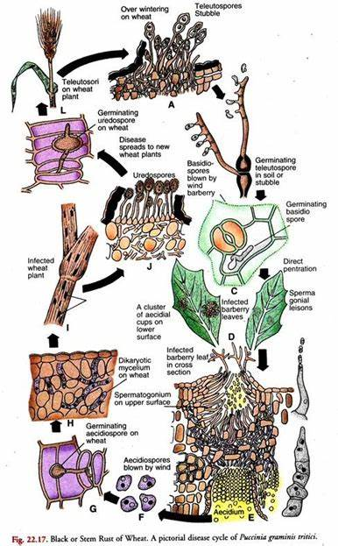

Slide 15
Control measures:
Though the fungus grows well on its alternate host to complete its life- cycle, this survival of pathogen least contributes to disease development in India. In our country, however, the problem is of perennating the pathogen on self-sown wheat plants and other collateral hosts growing on hills. If this source could be destroyed, possibilities of rust incidence in plains could be minimized or completely eliminated.
But, this appears practically not possible because such hosts may be present in very inaccessible places where the search for them may be almost impossible. However, it has been suggested that if immune or resistant varieties for the hilly regions could be raised and the area saturated with them, the amount of inoculum could be drastically minimized.
(ii) Mixed cropping of wheat and barley with suitable crop renders good crop insurance even if the main crop fails.

Slide 16
(iii) Reduction in proportion of nitrogen in the N.RK ratio in a fertilizer can help reduce rust incidence in a susceptible variety.
(iv) A variety of chemicals have been tested against rust incidence. These include – Sulphur dust; Nabam and ZnSo4 at 14 day interval; Zineb, Maneb, and Zinc as four foliar spray at 10-14 day interval; Dithane M-45; antibiotics; and systemic fungicides like Vivatx, Plantvax as foliar sprays and seed treatment. Propiconazole (Tilt) at 0.1% has been found effective in controlling stem rust (also brown and yellow rusts) because it persists for 12 days and completely inhibits uredospore germination.
(v) Since the pathogen evolves new physiological races, the resistant varieties of one time become susceptible on the other. This is the reason why this aspect requires continuous investigation followed by time to time recommendation of resistant varieties.
All India coordinated Wheat Improvement Programme recommends varieties resistant to rusts time to time. At present, varieties like HD 2278. HW 741, WL 614, Sonara 63, 64, etc. are considered resistant to stem rust of wheat.

Slide 17
THANK YOU…

