Slide 1
Glycolysis = breakdown of sugars; glycogen, glucose, fructose
Where in body?
Where in cell?
What are the inputs?
What are the outcomes?
Oxygen required?

Slide 2
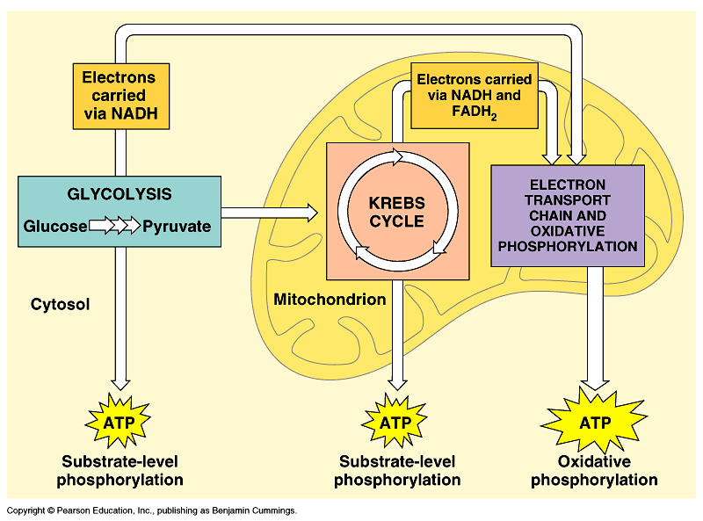

Slide 3
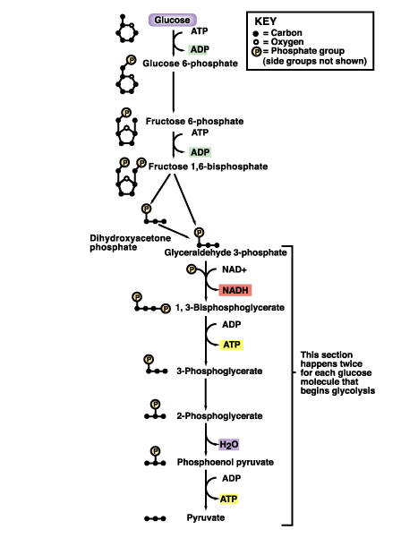
Gibbs Free Energy Changes
Rxn# Enzyme ΔG°'(kJ/mol) ΔG(kJ/mol)
1 Hexokinase -16.7 -33.5
Phosphogluco-isomerase +1.7 -2.5
3 Phosphofructokinase -14.2 -22.2
4 Aldolase +23.9 -1.3
5 Triose phos. Isomerase +7.6 +2.5
6 G-3-PDH +12.6 -3.4
7 Phosphoglycerate kinase -37.6 +2.6
8 Phosphoglycerate mutas +8.8 +1.6
9 Enolase +3.4 -6.6
10 Pyruvate kinase -62.8 -33.4
1
1
2
3
4
5
Identify:
endergonic rxns
exergonic rxns
coupled reactions
oxidation/reduction rxns
transfer reactions
6
7
8
9
10

Slide 4
When do we use glycolysis?
What are the advantages of using glycolysis for energy supply?
What are the disadvantages?
How is glycolysis regulated?

Slide 5
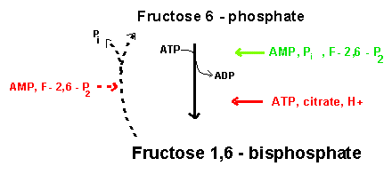
Hexokinase inhibited by glucose –6-phosphate; also there are several isoforms; lowest Km in liver
Phosphofructokinase (PFK)
(+)
(-)
Pyruvate kinase inhibited by ATP and acetylCoA; activated by fructose 1,6 bisphosphate

Slide 6
Where do the intermediates in glycolysis go?
  G-6-P goes off to make the ribose for nucleotides
  F-6-P -amino sugars-glycolipids and glycoproteins
  G-3-P/DHAP-lipids
  3PG-serine
  PEP-aromatic amino acids, pyrimidines, asp and asn
  Pyruvate-alanine
  This pathway not only important in glucose metabolism--generates intermediates for other important building blocks
  G-6-P = glucose 6 phosphate, F-6-P = fructose 6 phosphate, G-3-P = glyceraldehyde 3 phosphate, DHAP = dihydryoxacetonephosphate, 3PG = phosphoglyceraldehyde, Pyr = pyruvate

Slide 7
What are the possible fates of pyruvate?
Ethanol (fermentation)
Acetyl coA (mammals and others)
  TCA/Krebs cycle
Oxaloacetate - gluconeogenesis
Lactate (mammals and others)
  End product of anaerobic glycolysis
  Gluconeogenesis in liver via the Cori cycle

Slide 8
Cori cycle
oxaloacetate

Slide 9
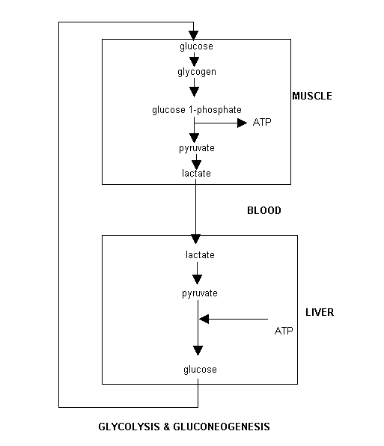
Cori Cycle

Slide 10
Energy Balance Sheet for the Oxydation of Glucose via Glycolysis
Gains:
4 ATP
2 pyruvate
2 NADH + H+
Net Gain:
+ 2 ATP
Losses:
2ATP
Glucose
Phosphate
NAD+ (recycled)
Mitochondria for further oxidation via the TCA/Krebs cycle

Slide 11
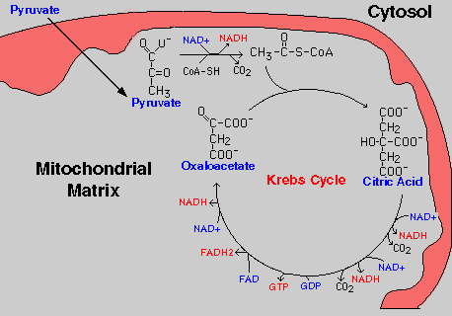
Oxidation of pyruvate via the TCA/Krebs/Citric Acid Cycle

Slide 12
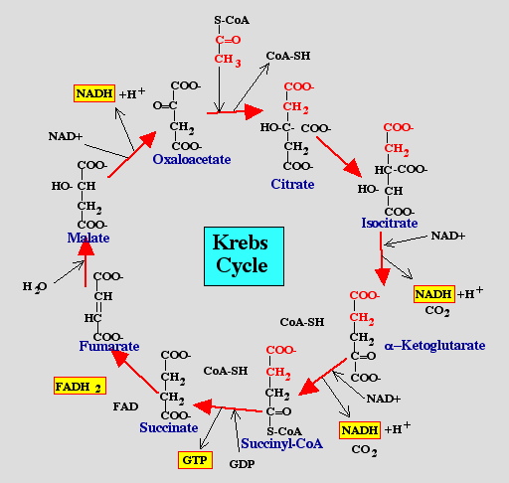
Pyruvate
CO2
NAD+
NADH
Acetyl CoA
All compounds are tricarboxylic acids
Carbons from glucose are shown in red
Carbons from glucose are lost as CO2 (decarboxylation)
Several NADH + H+ are generated via oxidation of intermediates
One high energy phosphate compound (GTP)is produced

Slide 13
When do we oxidize pyruvate via the Krebs cycle?
What do we need to accomplish the oxidation of pyruvate?
NAD+ and FAD+; each can carry 2 e-
oxygen; needs 2 e- to fill outer valence shell of electrons
glucose
Where are the Krebs cycle enzymes and electron transport proteins located?
Krebs cycle enzymes are located in the mitochondrial matrix
Electron transport proteins in the inner mitochondrial membrane

Slide 14
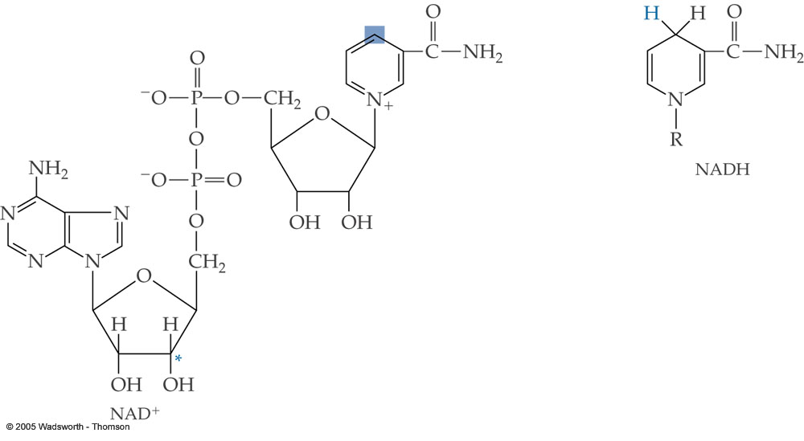

Slide 15
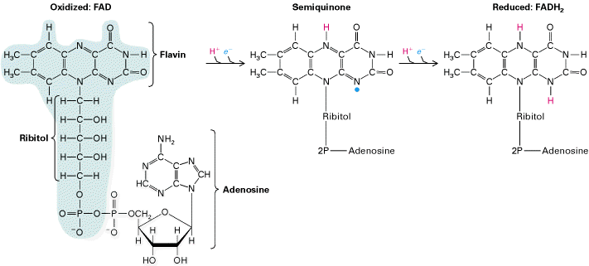

Slide 16
Prosthetic groups = Fe, Flavin, Fe-S, Cu
Coenzyme Q (ubiquinone)
Cytochrome c
Complex I = NADH ubiquinone oxidoreductase
Complex II = succinate-ubiquinone oxidoreductase
Complex III = cytochrome c oxidoreductase

Slide 17
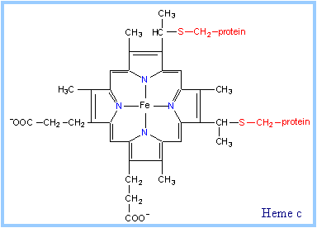
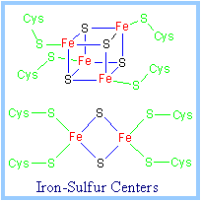

Slide 18
Electron transport proteins
each can accept or give up two electrons
one protein in each complex also acts as a hydrogen pump
electron entry point is determined by the energy state of the electrons

Slide 19
Pyruvate
CO2
NAD+
NADH
Acetyl CoA

Slide 20
Entry point for electrons carried by FADH2
Entry point for electrons carried by NADH+ H+

Slide 21
Net Energy Yield from the Oxidation of Pyruvate via the TCA cycle
From Glycolysis:
+2NADH +2ATP
From TCA:
+2FADH +8NADH +2GTP
ETC:
3ATP/NADH
2ATP/FADH
+4ATP +30ATP
+38ATP TOTAL
+
+
Do you know why?

Slide 23
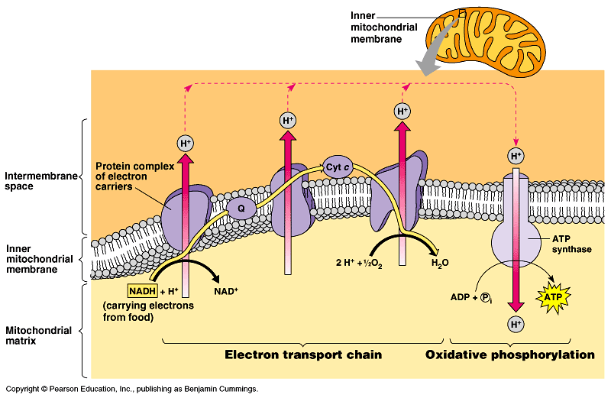
b. Electrons are passed from one protein to the next until they reach an oxygen molecule. Oxygen then accepts the electrons and bonds with two (2) hydrogen ions to form water.

Slide 24
c. So how does ATP get made? By passing electrons to the outside of the membrane, we have set up a hydrogen ion gradient across a membrane that can be used to perform work; in this case, the gradient is across the mitochondrial membrane and the work is the synthesis of ATP. The work is carried out by allowing the hydrogen ions to flow back into the cell, much like water will flow over a dam or through a water mill, during which the flow can be used to do useful work. The gradient that results is known as the proton-motive force.

Slide 25
d. Relatively high concentrations of H⁺ in the intermembrane space lead to the flow of H⁺ ions into the mitochondrial matrix through a channel; this channel is formed by a special enzyme called an ATP synthase (i.e. synthesizer of ATP).
e. ATP synthase, the enzyme that makes ATP, is located on the inner membrane of the mitochondrion. This process of making ATP is known as oxidative phosphorylation. The entire process of using the proton motive force to make ATP is called chemiosmosis.
Figure 9.14 (p. 167) – ATP synthase, a molecular mill.

Slide 26
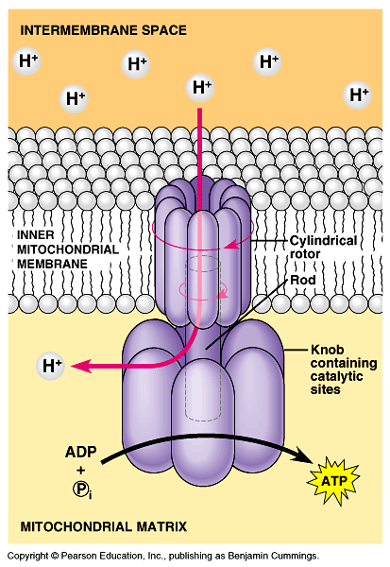

Slide 27
C. A review of cellular respiration
Figure 9.16 (p. 173) – Review: how each molecule of glucose yields many ATP molecules during cellular respiration.

Slide 28
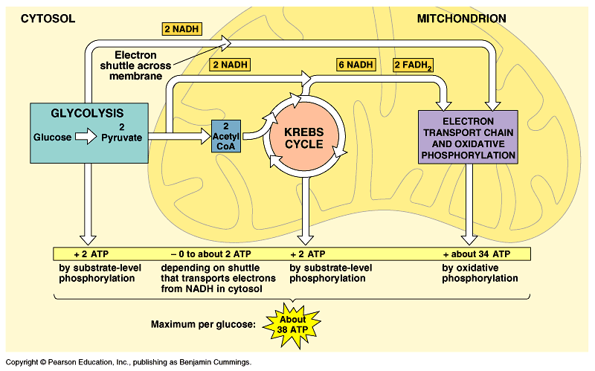

Slide 29
Glucose → NADH → electron transport chain → proton-motive force → ATP
1. Glycolysis: +2 ATP
2. Krebs Cycle: +2 ATP
3. Electron Transport Chain: +34 ATP
Total Gain: + 38 ATP
- Energy stored in glucose that is not consumed during cellular respiration is lost as heat. We use that to maintain a high body temperature; excess is dissipated by sweating, etc.

Slide 30
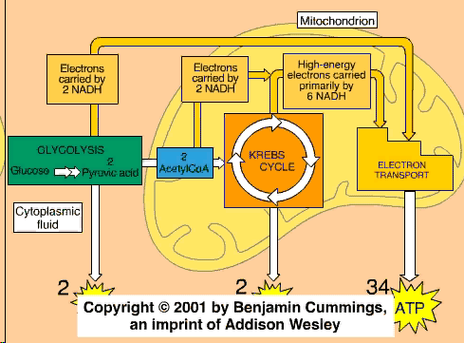

Slide 31
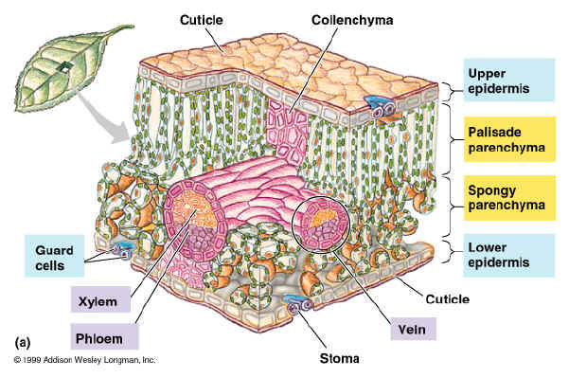
Plant leaves have many types of cells!
PHOTOSYNTHESIS

Slide 32
Photosynthesis
Autotrophic Process: Plants and plant-like organisms make their energy (glucose) from sunlight.
Stored as carbohydrate in their bodies.
6CO₂ + 6H₂O + sunlight → C₆H₁₂O₆ + 6O₂
An anabolic, endergonic, carbon dioxide (CO₂) requiring process that uses light energy (photons) and water (H₂O) to produce organic macromolecules (glucose).
6CO₂ + 6H₂O → C₆H₁₂O₆ + 6O₂
SUN
photons
glucose

Slide 33
Question:
Where does photosynthesis take place?

Slide 34
Plants
Autotrophs: self-producers.
Location:
1. Leaves
a. stoma
b. mesophyll cells
Mesophyll
Cell
Chloroplast
Stoma

Slide 35
Stomata (stoma)
Pores in a plant’s cuticle through which water and gases are exchanged between the plant and the atmosphere.
Oxygen
(O₂)
Carbon Dioxide
(CO₂)
Guard Cell
Guard Cell

Slide 36
Mesophyll Cell
Nucleus
Cell Wall
Chloroplast
Central Vacuole

Slide 37
Chloroplast
Organelle where photosynthesis takes place.
Stroma
Outer Membrane
Thylakoid
Granum
Inner Membrane

Slide 38
Thylakoid
Thylakoid Membrane
Thylakoid Space
Granum

Slide 39
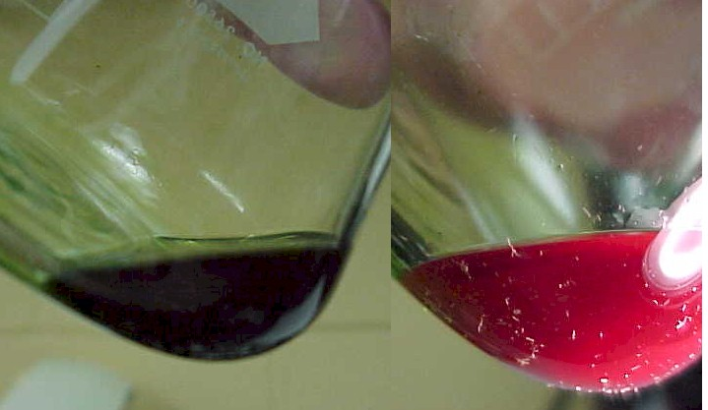
Question:
Why are plants green?
(b) fluorescence of isolated chlorophyll in solution

Slide 40
Chlorophyll Molecules
Located in the thylakoid membranes.
Chlorophyll have Mg⁺ in the center.
Chlorophyll pigments harvest energy (photons) by absorbing certain wavelengths (blue-420 nm and red-660 nm are most important).
Plants are green because the green wavelength is reflected, not absorbed.

Slide 41
Wavelength of Light (nm)
400
500
600
700
Short wave
Long wave
(more energy)
(less energy)

Slide 42
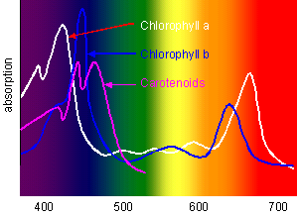
Absorption of Chlorophyll
Absorption
violet blue green yellow orange red
wavelength

Slide 43
The Hill Reaction
Leaf extracts rich in chloroplasts, when radiated,
evolve oxygen and acquire the capacity to reduce
hydrogen acceptors.
Robert Hill, 1937
light
2H₂O + 2A
2AH₂ + O₂
Hill used 2,6-dichlorophenolindophenol
light
A = BLUE
AH₂ = COLORLESS
Hill separated the light from the dark reaction.
Hill showed that light induced an electon flow
that drove an unfavorable energy reaction.

Slide 44
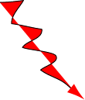
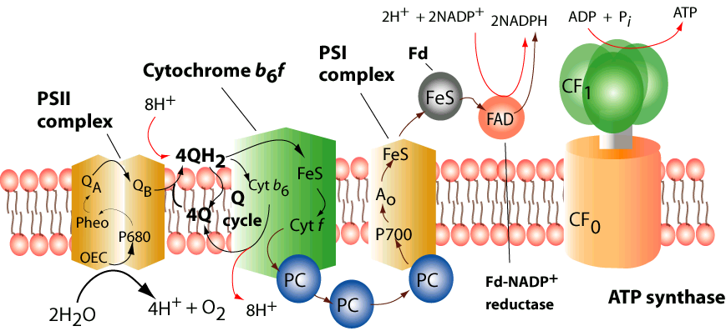
3H⁺
Stroma
Thylacoid lumen
3H⁺

Slide 45
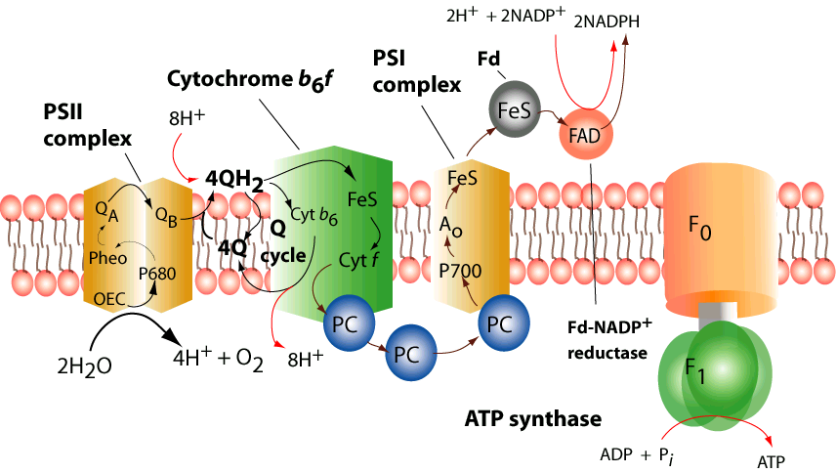
Stroma
Inner Membrane
3H⁺
Matrix
Thylacoid lumen
3H⁺

Slide 46
Question:
During the fall, what causes the leaves to change colors?

Slide 47
Fall Colors
In addition to the chlorophyll pigments, there are other pigments present.
During the fall, the green chlorophyll pigments are greatly reduced revealing the other pigments.
Carotenoids are pigments that are either red or yellow.

Slide 48
PHOTOSYNTHESIS
2 Phases
  Light-dependent reaction
  Light-independent reaction
Light-dependent: converts light energy into chemical energy; produces ATP molecules to be used to fuel light-independent reaction
Light-independent: uses ATP produced to make simple sugars.

Slide 49
PHOTOSYNTHESIS
Light-dependent reaction (LIGHT Reaction)
  Requires light
  Occurs in chloroplast (in thylakoids)
  Chlorophyll (thylakoid) traps energy from light
  Light excites electron (e-)
    Kicks e- out of chlorophyll to an electron transport chain
    Electron transport chain: series of proteins in thylakoid membrane
      Bucket brigade

Slide 50
PHOTOSYNTHESIS
Light-dependent reaction (LIGHT Reaction)
  Energy lost along electron transport chain
  Lost energy used to recharge ATP from ADP
  NADPH produced from e- transport chain
    Stores energy until transfer to stroma
    Plays important role in light-independent reaction
  Total byproducts: ATP, NADP, O₂

Slide 51
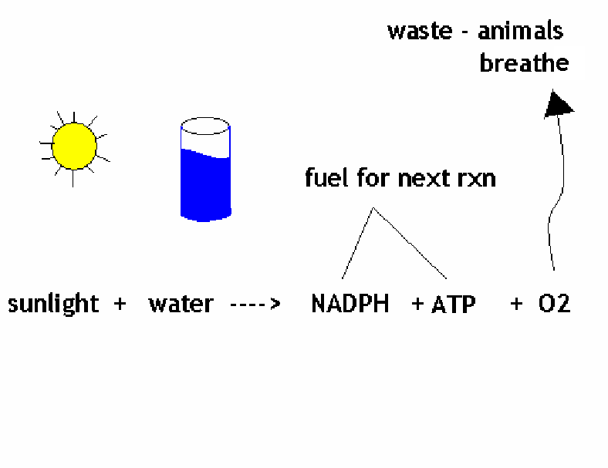
PHOTOSYNTHESIS
How did we get O₂ as a byproduct?!
  Photolysis: replaces lost electrons by splitting water

Slide 52
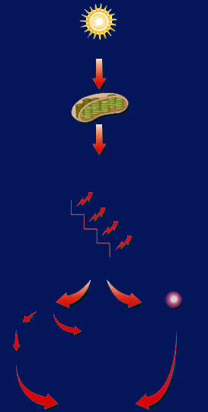
Sun
Light energy transfers to chlorophyll.
At each step along the transport chain, the electrons lose energy.
Chlorophyll passes energy down through the electron transport chain.
Energized electrons provide energy that
splits
H₂O
to ADP
bonds
P
forming ATP
H⁺
NADP⁺
oxygen
released
NADPH
for the use in light-independent reactions

Slide 53
PHOTOSYNTHESIS
Light-independent reaction (Dark Reaction)
  Does not require light
  Calvin Cycle
    Occurs in stroma of chloroplast
    Requires CO₂
    Uses ATP and NADPH as fuel to run
    Makes glucose sugar from CO₂ and Hydrogen

Slide 54
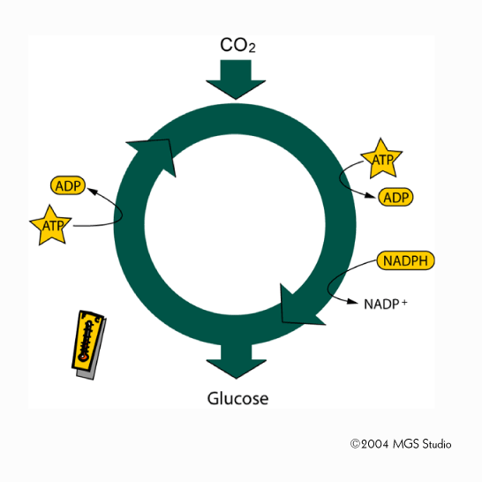

Slide 55
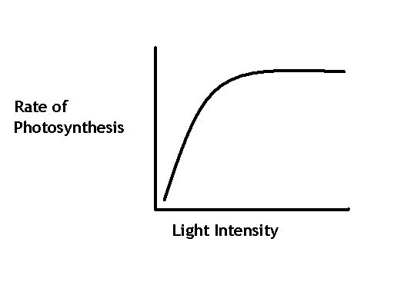
PHOTOSYNTHESIS
What affects photosynthesis?
  Light intensity: as light increases, rate of photosynthesis increases

Slide 56
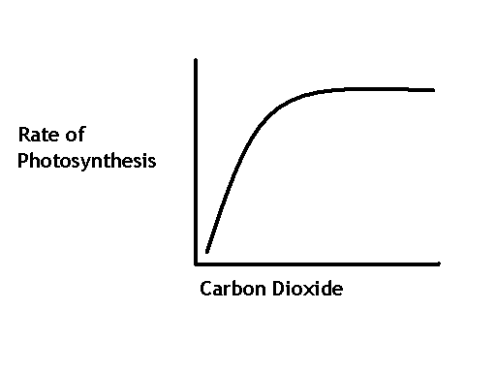
PHOTOSYNTHESIS
What affects photosynthesis?
  Carbon Dioxide: As CO₂ increases, rate of photosynthesis increases

Slide 57
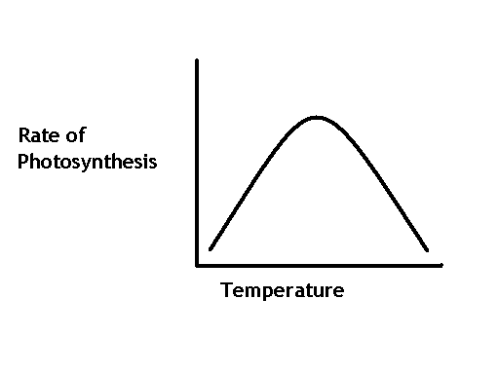
PHOTOSYNTHESIS
What affects photosynthesis?
  Temperature:
    Temperature Low = Rate of photosynthesis low
    Temperature Increases = Rate of photosynthesis increases
    If temperature too hot, rate drops

Slide 58
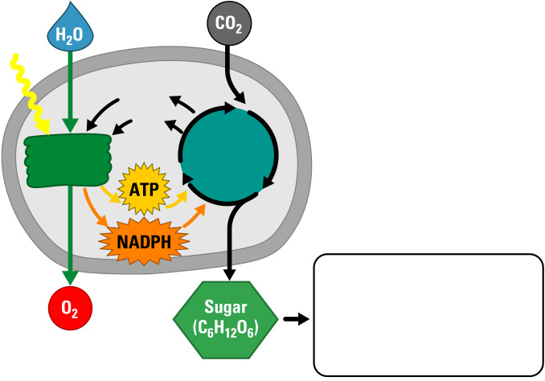
A Photosynthesis Road Map
Chloroplast
Light
Stroma
Stack of
thylakoids
NADP⁺
ADP
+ P
Light
reactions
Calvin
cycle
Sugar used for
• Cellular respiration
• Cellulose
• Starch
• Other organic compounds

Slide 59
1. Light Reaction (Electron Flow)
Occurs in the Thylakoid membranes
During the light reaction, there are two possible routes for electron flow.
A. Cyclic Electron Flow
B. Noncyclic Electron Flow

Slide 60
The photosystems
Two types of pigment systems have been found
PHOTOSYSTEM I Mainly chlorophyll a
PHOTOSYSTEM II Chlorophyll b, some chlorophyll a plus other pigments
© 2010 Paul Billiet ODWS

Slide 61
The photosystems
These photosystems bring about three reactions:
Photolysis of water to provide electrons (e⁻) and protons (H⁺)
Photophosphorylation to produce ATP from coupled redox reactions in an electron transport chain
Reduction of NADP to NADPH + H⁺ (NADP is therefore the final electron acceptor)
© 2010 Paul Billiet ODWS

Slide 62
  More +ve REDOX POTENTIAL More -ve
e⁻
Cyclic
photophosphorylation
Ferredoxin
e⁻
NADPH reductase
Plastoquinone
Cytochrome b₆ – f complex
NADP
NADPH + H⁺
Non-cyclic
photophosphorylation
ADP
ATP
Plastocyanin
PHOTOSYSTEM I
PHOTOSYSTEM II
H₂O O₂ + 4H⁺
REACTION PATHWAY
© 2010 Paul Billiet ODWS

Slide 63
A. Cyclic Electron Flow
Occurs in the thylakoid membrane.
Uses Photosystem I only
P700 reaction center- chlorophyll a
Uses Electron Transport Chain (ETC)
Generates ATP only
ADP + ATP
P

Slide 64
A. Cyclic Electron Flow
Primary
Electron
Acceptor
e⁻
SUN
e⁻
e⁻
ATP
produced
by ETC
Photons
e⁻
P700
Accessory
Pigments
Photosystem I

Slide 65
B. Noncyclic Electron Flow
Occurs in the thylakoid membrane
Uses PS II and PS I
P680 rxn center (PSII) - chlorophyll a
P700 rxn center (PS I) - chlorophyll a
Uses Electron Transport Chain (ETC)
Generates O₂, ATP and NADPH

Slide 66
B. Noncyclic Electron Flow
Primary
Electron
Acceptor
2e⁻
Enzyme
Reaction
Primary
Electron
Acceptor
2e⁻
2e⁻
ETC
SUN
2e⁻
2e⁻
NADPH
P700
Photon
ATP
P680
Photon
H₂O
1/2O₂ + 2H⁺
Photosystem I
Photosystem II

Slide 67
B. Noncyclic Electron Flow
ADP + → ATP
NADP⁺ + H → NADPH
Oxygen comes from the splitting of H₂O, not CO₂
H₂O → 1/2 O₂ + 2H⁺
P
(Reduced)
(Reduced)
(Oxidized)

Slide 68
ATP
NADP⁺
NADPH
PS-I
(P700)
Z Scheme of the Light Reaction
PS-II
(P680)

Slide 69
Calvin Cycle (C₃ fixation)
(36C)
(6C)
6C-C-C-C-C-C
6CO₂
(unstable)
6C-C-C
6C-C-C
12PGA
(36C)
6ATP
6ATP
(30C)
6C-C-C-C-C
6NADPH
6NADPH
RuBP
(36C)
6ATP
6C-C-C
6C-C-C
12G₃P
(30C)
(6C)
C₃
C-C-C-C-C-C
Glucose
glucose

Slide 70
Calvin Cycle
Remember: C3 = Calvin Cycle
C₃
Glucose

Slide 71
Photorespiration
Occurs on hot, dry, bright days.
Stomates close.
Fixation of O₂ instead of CO₂.
Produces 2-C molecules instead of 3-C sugar molecules.
Produces no sugar molecules or no ATP.

Slide 72
Photorespiration
Because of photorespiration: Plants have special adaptations to limit the effect of photorespiration.
1. C4 plants
2. CAM plants

Slide 73
C4 Plants
Hot, moist environments.
15% of plants (grasses, corn, sugarcane).
Divides photosynthesis spatially.
Light rxn - mesophyll cells.
Calvin cycle - bundle sheath cells.

Slide 74
C4 Plants
Malate
Malate
C-C-C-C
C-C-C-C
Transported
CO₂
CO₂
C₃
Vascular
Tissue
glucose
C-C-C
ATP
PEP
C-C-C
Pyruvic Acid
Mesophyll Cell
Bundle Sheath Cell

Slide 75
CAM Plants
Hot, dry environments.
5% of plants (cactus and ice plants).
Stomates closed during day.
Stomates open during the night.
Light rxn - occurs during the day.
Calvin Cycle - occurs when CO₂ is present.

Slide 76
CAM Plants
Night (Stomates Open)
Day (Stomates Closed)
Vacuole
C-C-C-C
C-C-C-C
C-C-C-C
CO₂
Malate
Malate
Malate
CO₂
C₃
C-C-C
ATP
C-C-C
glucose
PEP
Pyruvic acid

Slide 77
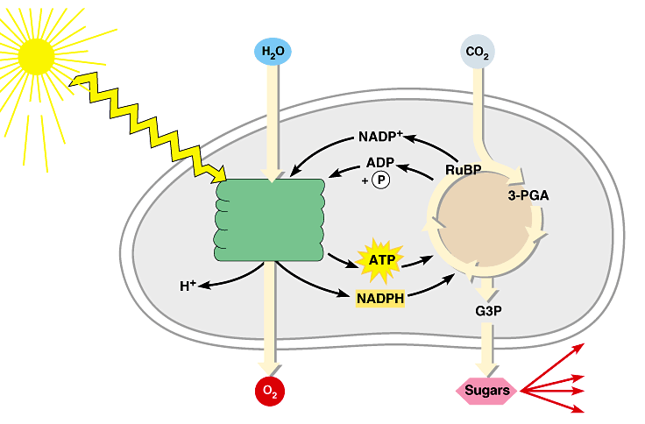
Review: Photosynthesis uses light energy to make food molecules
A summary of the chemical processes of photosynthesis
Chloroplast
Light
Photosystem II
Electron transport chains Photosystem I
CALVIN CYCLE
Stroma
Electrons
Cellular respiration
Cellulose
Starch
LIGHT REACTIONS
CALVIN CYCLE
Other organic compounds

Slide 78
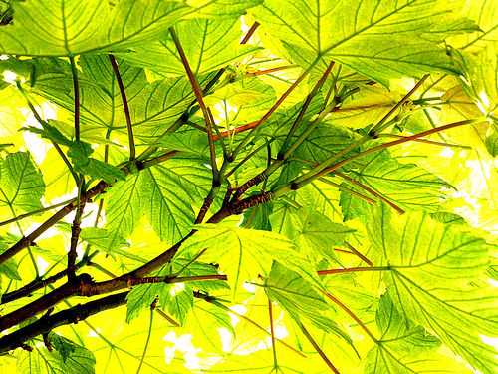
It's not that easy bein' green… but it is essential for life on earth!

Slide 79
ENZYMES
A protein with catalytic properties due to its power of specific activation
© 2007 Paul Billiet ODWS

Slide 80
Chemical reactions
Chemical reactions need an initial input of energy = THE ACTIVATION ENERGY
During this part of the reaction the molecules are said to be in a transition state.
© 2007 Paul Billiet ODWS

Slide 81
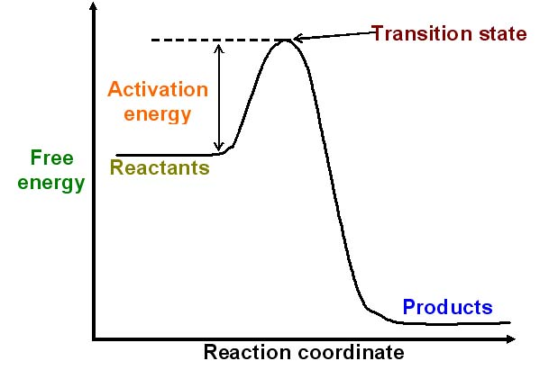
Reaction pathway
© 2007 Paul Billiet ODWS

Slide 82
Making reactions go faster
Increasing the temperature make molecules move faster
Biological systems are very sensitive to temperature changes.
Enzymes can increase the rate of reactions without increasing the temperature.
They do this by lowering the activation energy.
They create a new reaction pathway “a short cut”
© 2007 Paul Billiet ODWS

Slide 83
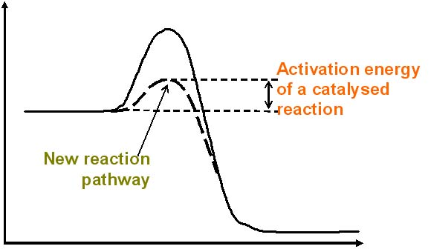
An enzyme controlled pathway
Enzyme controlled reactions proceed 108 to 1011 times faster than corresponding non-enzymic reactions.
© 2007 Paul Billiet ODWS

Slide 84
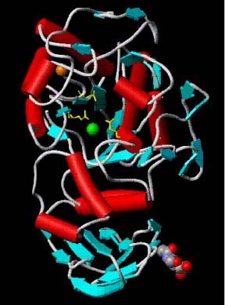
Enzyme structure
Enzymes are proteins
They have a globular shape
A complex 3-D structure
Human pancreatic amylase
© Dr. Anjuman Begum
© 2007 Paul Billiet ODWS

Slide 85
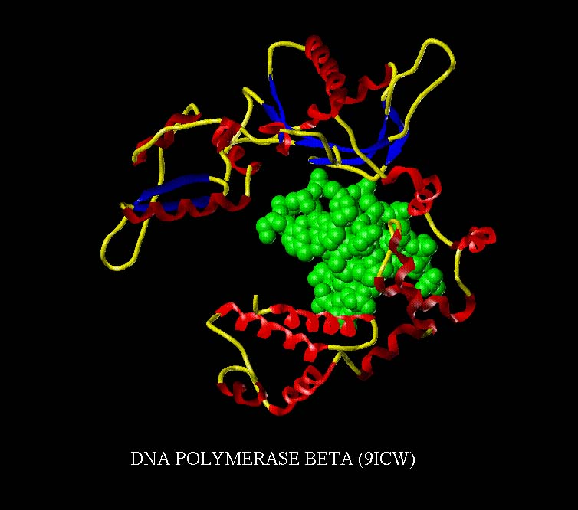
The active site
One part of an enzyme, the active site, is particularly important
The shape and the chemical environment inside the active site permits a chemical reaction to proceed more easily
© H.PELLETIER, M.R.SAWAYA
ProNuC Database
© 2007 Paul Billiet ODWS

Slide 86
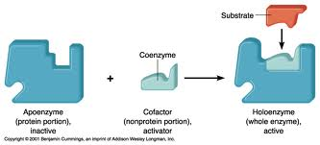
APOENZYME and HOLOENZYME
The enzyme without its non protein moiety is termed as apoenzyme and it is inactive.
Holoenzyme is an active enzyme with its non protein component.

Slide 87
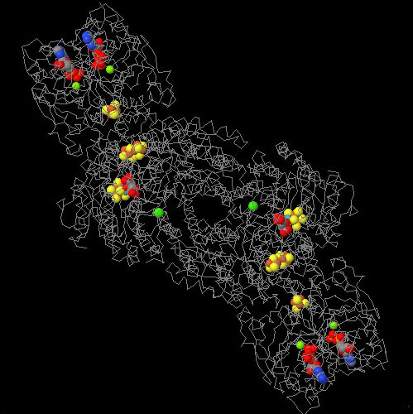
Cofactors
An additional non-protein molecule that is needed by some enzymes to help the reaction
Tightly bound cofactors are called prosthetic groups
Cofactors that are bound and released easily are called coenzymes
Many vitamins are coenzymes
Nitrogenase enzyme with Fe, Mo and ADP cofactors
Jmol from a RCSB PDB file © 2007 Steve Cook
H.SCHINDELIN, C.KISKER, J.L.SCHLESSMAN, J.B.HOWARD, D.C.REES
STRUCTURE OF ADP X ALF4(-)-STABILIZED NITROGENASE COMPLEX AND ITS
IMPLICATIONS FOR SIGNAL TRANSDUCTION; NATURE 387:370 (1997)
© 2007 Paul Billiet ODWS

Slide 88
The substrate
The substrate of an enzyme are the reactants that are activated by the enzyme
Enzymes are specific to their substrates
The specificity is determined by the active site
© 2007 Paul Billiet ODWS

Slide 89
The Lock and Key Hypothesis
Fit between the substrate and the active site of the enzyme is exact
Like a key fits into a lock very precisely
The key is analogous to the enzyme and the substrate analogous to the lock.
Temporary structure called the enzyme-substrate complex formed
Products have a different shape from the substrate
Once formed, they are released from the active site
Leaving it free to become attached to another substrate
© 2007 Paul Billiet ODWS

Slide 90
The Lock and Key Hypothesis
S
E
E
E
Enzyme-substrate complex
Enzyme may be used again
P
P
Reaction coordinate
© 2007 Paul Billiet ODWS

Slide 91
The Lock and Key Hypothesis
This explains enzyme specificity
This explains the loss of activity when enzymes denature
© 2007 Paul Billiet ODWS

Slide 92
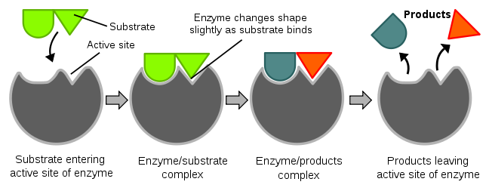
ACTIVE SITES
Enzyme molecules contain a special pocket or cleft called the active sites.
Notes:
The area on the enzyme where the substrate or substrates attach to is called the active site.
Enzymes are usually very large proteins and the active site is just a small region of the enzyme molecule.

Slide 93
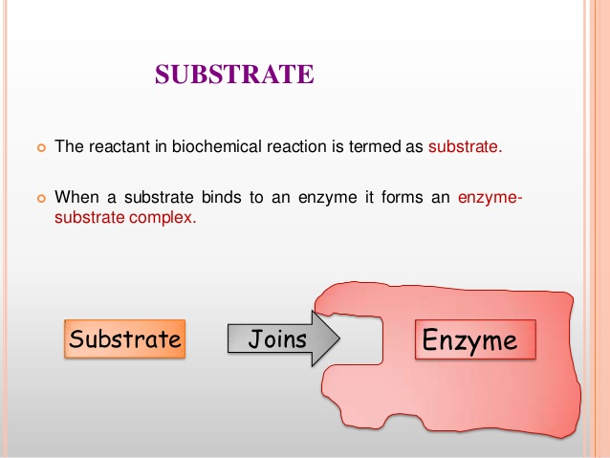
In enzymatic reactions, the substance at the beginning of the process, on which an enzyme begins it’s action is called substrate.

Slide 94
Types of Cofactors
Coenzyme:
The non-protein component, loosely bound to apoenzyme by non-covalent bond.
Examples : vitamins or compound derived from vitamins.
Prosthetic group
The non-protein component, tightly bound to the apoenzyme by covalent bonds is called a Prosthetic group.

Slide 95
Enzyme Specificity
Enzymes have varying degrees of specificity for substrates
Enzymes may recognize and catalyze:
- a single substrate
- a group of similar substrates
- a particular type of bond

Slide 96
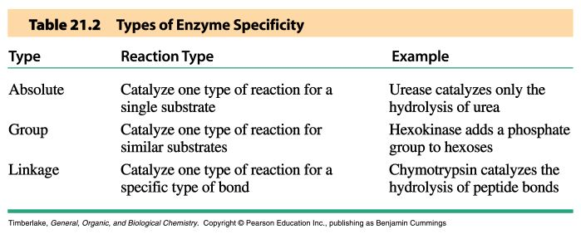

Slide 97
Important Terms to Understand Biochemical Nature
And Activity of Enzymes
Activation energy or Energy of Activation:
All chemical reactions require some amount of energy to get them started.
OR
It is First push to start reaction.
This energy is called activation energy.
Notes:
97

Slide 98
Structure of enzymes
Enzymes
Complex or holoenzymes (protein part and nonprotein part – cofactor)
Simple (only protein)
Apoenzyme (protein part)
Cofactor
Prosthetic groups
usually small inorganic molecule or atom;
usually tightly bound to apoenzyme
Coenzyme
-large organic molecule
-loosely bound to apoenzyme
Notes:
98

Slide 99
Mechanism of Action of Enzymes
Enzymes increase reaction rates by
decreasing the Activation energy:
Enzyme-Substrate Interactions:
  Formation of Enzyme substrate complex by:
  Lock-and-Key Model
  Induced Fit Model

Slide 100
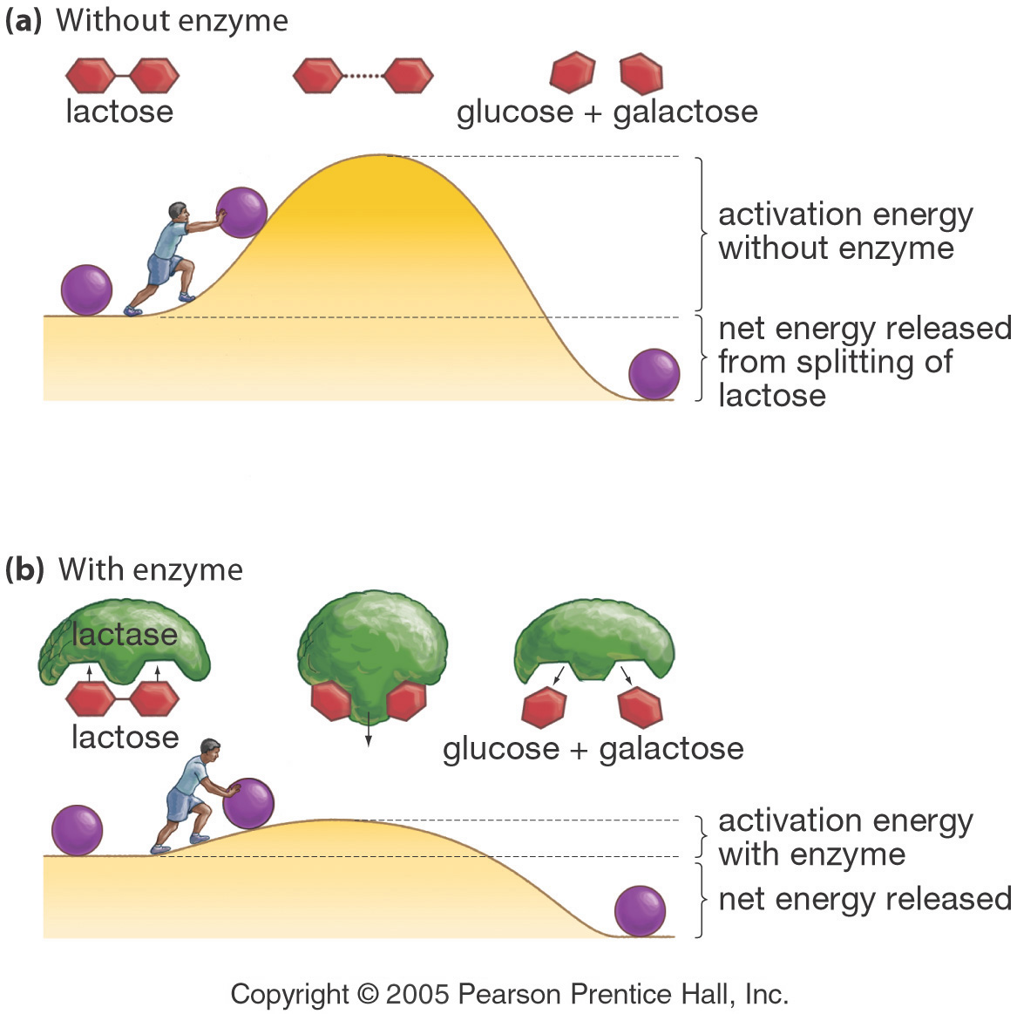
Enzymes Lower a Reaction’s Activation Energy
Notes:
100
Energy and Enzymes
01/01/2002
G. Podgorski, Biol. 1010
100
Activation energy is the push needed to start a reaction

Slide 101
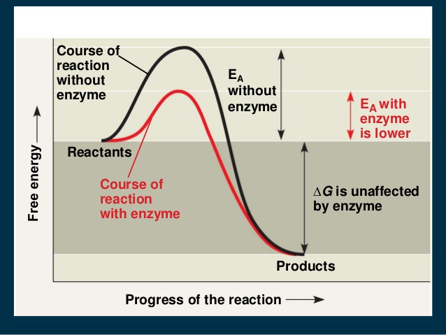

Slide 102
Lock-and-Key Model
In the lock-and-key model of enzyme action:
- the active site has a rigid shape
- only substrates with the matching shape can fit
- the substrate is a key that fits the lock of the active site
This is an older model, however, and does not work for all enzymes

Slide 103
Induced Fit Model
In the induced-fit model of enzyme action:
- the active site is flexible, not rigid
- the shapes of the enzyme, active site, and substrate adjust to maximumize the fit, which improves catalysis
- there is a greater range of substrate specificity
This model is more consistent with a wider range of enzymes

Slide 104
Enzyme Catalyzed Reactions
When a substrate (S) fits properly in an active site, an enzyme-substrate (ES) complex is formed:
E + S  ES
Within the active site of the ES complex, the reaction occurs to convert substrate to product (P):
ES → E + P
The products are then released, allowing another substrate molecule to bind the enzyme
- this cycle can be repeated millions (or even more) times per minute
The overall reaction for the conversion of substrate to product can be written as follows:
E + S  ES → E + P

Slide 105
Enzyme-substrate complex
Step 1:
Enzyme and substrate combine to form complex
E + S ES
Enzyme Substrate Complex
+

Slide 106
Enzyme-product complex
Step 2:
An enzyme-product complex is formed.
ES EP
ES
transition state
EP
Notes:
Within the active site of the ES complex, the reaction occurs to convert substrate to product (P):

Slide 107
Product
The enzyme and product separate
EP E + P
The product
is made
Enzyme is ready
for
another
substrate.
EP
Notes:
The products are then released, allowing another substrate molecule to bind the enzyme
- this cycle can be repeated millions (or even more) times per minute
The overall reaction for the conversion of substrate to product can be written as follows:
E + S  ES → E + P

Slide 108
What Affects Enzyme Activity?
Three factors:
1. Environmental Conditions
2. Cofactors and Coenzymes
3. Enzyme Inhibitors
108

Slide 109
1. Environmental Conditions
1. Extreme Temperature are the most dangerous
- high temps may denature (unfold) the enzyme.
2. pH (most like 6 - 8 pH near neutral)
3. substrate concentration .
109

Slide 110
2. Cofactors and Coenzymes
Inorganic substances (zinc, iron) and vitamins (respectively) are sometimes need for proper enzymatic activity.
Example:
  Iron must be present in the quaternary structure - hemoglobin in order for it to pick up oxygen.
110

Slide 111
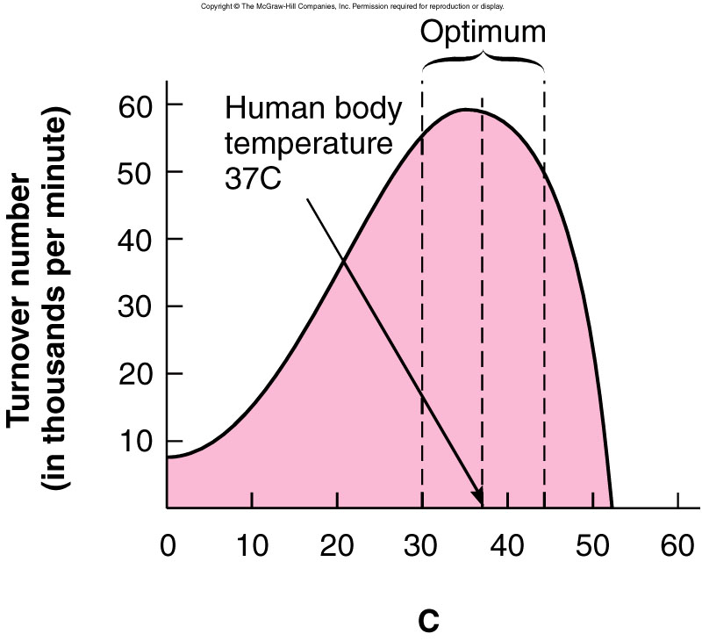
Environmental factors
Optimum temperature The temp at which enzymatic reaction occur fastest.
Notes:
The temp at which enzymatic reaction occur fastest is called Optimum temperature
111

Slide 112
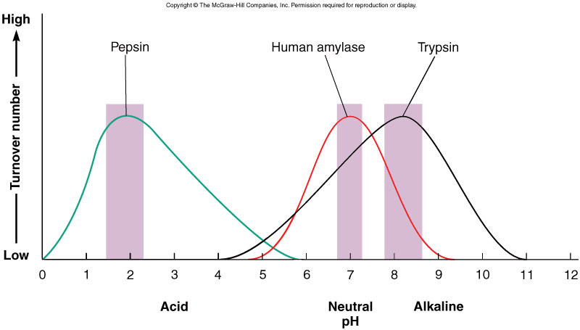
Environmental factors
pH also affects the rate of enzyme-substrate complexes
  Most enzymes have an optimum pH of around 7 (neutral)
    However, some prefer acidic or basic conditions
Notes:
pepsin (a stomach enzyme) functions best at a low (acidic) pH. At pH 1, pepsin is in it’s functional shape; it would be able to bind to its substate. At pH 5, the enzyme’s shape is different and it no longer has an active site able to bind the substrate. The change in enzyme activity is observed as a difference in reaction rate.
112

Slide 113
Substrate Concentration and Reaction Rate
The rate of reaction increases as substrate concentration increases (at constant enzyme concentration)
Maximum activity occurs when the enzyme is saturated (when all enzymes are binding substrate)

Slide 114
Naming Enzymes
The name of an enzyme in many cases end in –ase
For example, sucrase catalyzes the hydrolysis of sucrose
The name describes the function of the enzyme
For example, oxidases catalyze oxidation reactions
Sometimes common names are used, particularly for the digestion enzymes such as pepsin and trypsin
Some names describe both the substrate and the function
For example, alcohol dehydrogenase oxides ethanol

Slide 115
Enzymes Are Classified into six functional Classes (EC number Classification) by the International Union of Biochemists (I.U.B.). on the Basis of the Types of
Reactions That They Catalyze
EC 1. Oxidoreductases
EC 2. Transferases
EC 3. Hydrolases
EC 4. Lyases
EC 5. Isomerases
EC 6. Ligases
Notes:
115

Slide 116
Principle of the international classification
Each enzyme has classification number
consisting of four digits:
Example, EC: (2.7.1.1) HEXOKINASE
Notes:
116

Slide 117
EC: (2.7.1.1) these components indicate the following groups of enzymes:
2. IS CLASS (TRANSFERASE)
7. IS SUBCLASS (TRANSFER OF PHOSPHATE)
1. IS SUB-SUB CLASS (ALCOHOL IS PHOSPHATE ACCEPTOR)
1. SPECIFIC NAME
ATP,D-HEXOSE-6-PHOSPHOTRANSFERASE (Hexokinase)

Slide 118
1. Hexokinase catalyzes:
Glucose + ATP → glucose-6-P + ADP

Slide 119
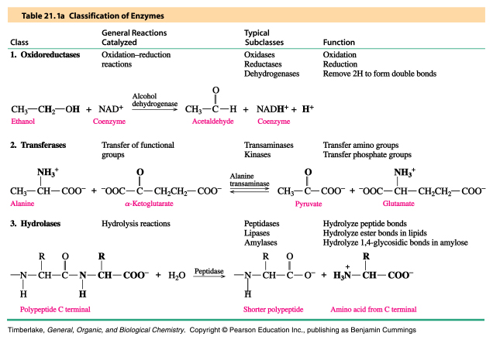
Oxidoreductases, Transferases and Hydrolases

Slide 120
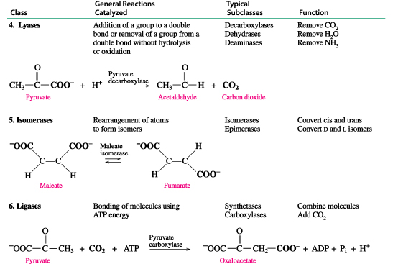
Lyases, Isomerases and Ligases

Slide 121
EC 1. Oxidoreductases
Biochemical Activity:
  Catalyse Oxidation/Reduction Reactions Act on many chemical groupings to add or remove hydrogen atoms.
Examples:
  Lactate dehydrogenase.
  Glucose Oxidase.
  Peroxidase.
  Catalase.
  Phenylalanine hydroxylase.
Notes:
121

Slide 122
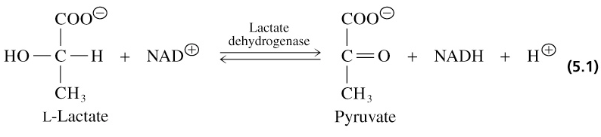
1. Oxidoreductases
Catalyze oxidation-reduction reactions
- oxidases - peroxidases - dehydrogenases
Notes:
122

Slide 123
Transferases
Biochemical Activity:
  Transfer a functional groups (e.g. methyl or phosphate) between donor and acceptor molecules.
Examples:
  Transaminases (ALT & AST).
  Phosphotransferases (Kinases).
  Transmethylases.
  Transpeptidases.
  Transacylases.
Notes:
123
Kinases are specialized transferases that regulate metabolism by transferring phosphate from ATP to other molecules.AST,ALT,hexokinase
Kinases are specialized transferases that regulate metabolism by transferring phosphate from ATP to other molecules.AST,ALT,hexokinase

Slide 124
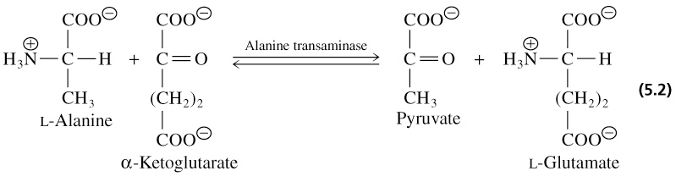
Transferases
Catalyze group transfer reactions
Notes:
124

Slide 125
Hydrolases
Biochemical Activity:
  Catalyse the hydrolysis of various bonds Add water across a bond.
Examples:
  Protein hydrolyzing enzymes (Peptidases).
  Carbohydrases (Amylase, Maltase, Lactase).
  Lipid hydrolyzing enzymes (Lipase).
  Deaminases.
  Phosphatases.
Notes:
125

Slide 126
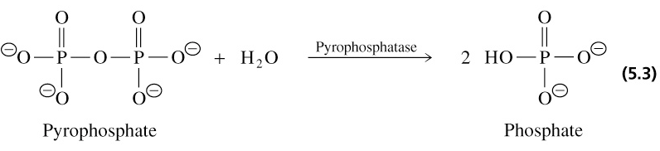
Hydrolases
Catalyze hydrolysis reactions where water is the acceptor of the transferred group
- esterases - peptidases - glycosidases
Notes:
126

Slide 127
Lyases
Biochemical Activity:
  Cleave various bonds by means other than hydrolysis and oxidation.
  Add Water, Ammonia or Carbon dioxide across double bonds, or remove these elements to produce double bonds.
Examples:
  Fumarase.
  Carbonic anhydrase.
Notes:
127

Slide 128
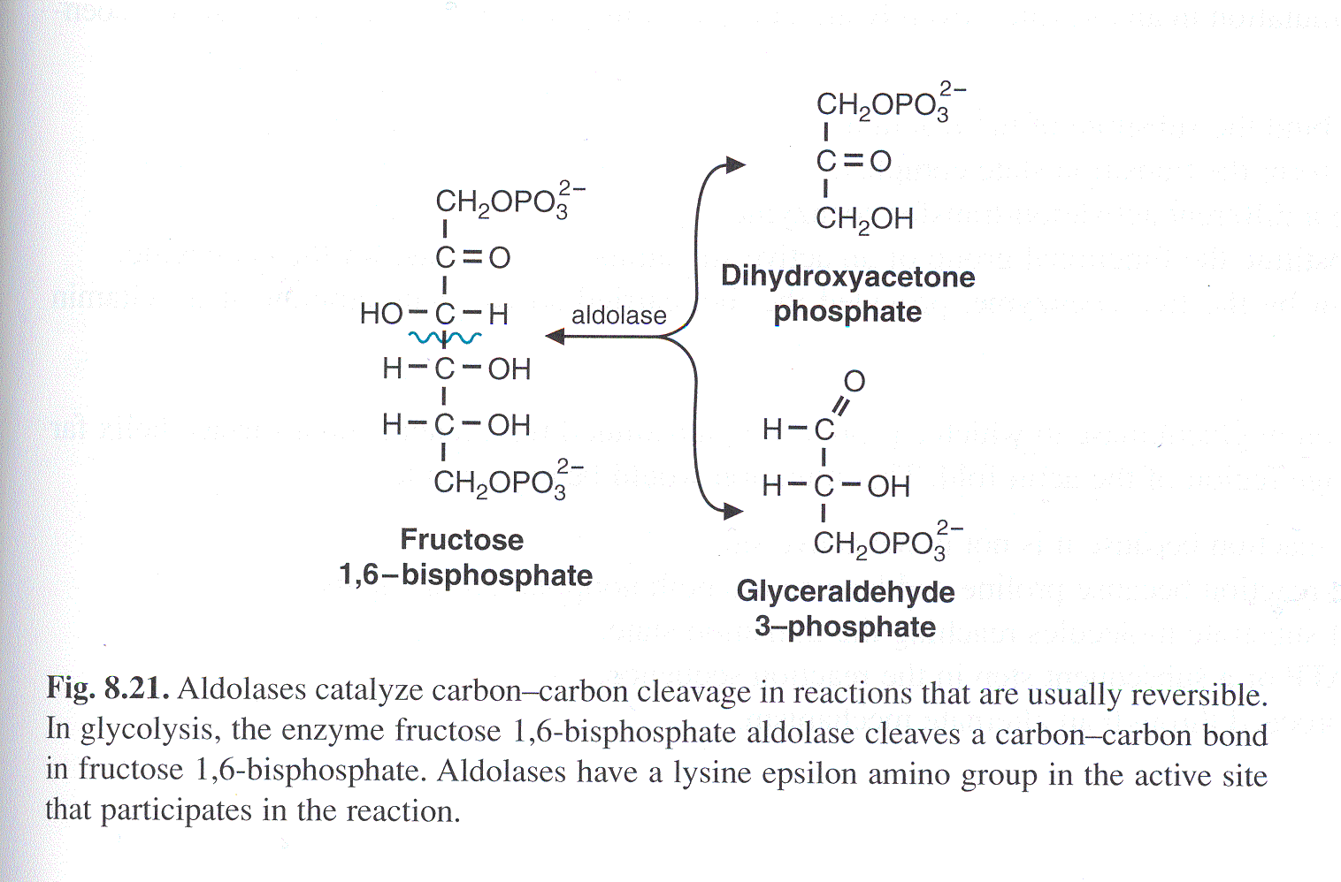
Lyases
Notes:
128

Slide 129
Isomerases
Biochemical Activity:
  Catalyse isomerization changes within a single molecule.
  Carry out many kinds of isomerization:
    L to D isomerizations.
    Mutase reactions (Shifts of chemical groups).
Examples:
  Isomerase.
  Mutase.
Notes:
129
Isomerases are a general class of enzymes which convert a molecule from one isomer to another.. The general form of such a reaction is as follows:
A–B → B–A

Slide 130
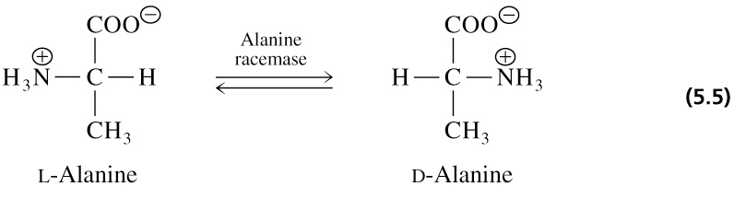
Isomerases
Catalyze isomerization reactions
Notes:
facilitate intramolecular rearrangements in which bonds are broken and formed or they can catalyze conformational changes.
130

Slide 131
Ligases
Biochemical Activity:
  Join two molecules with covalent bonds Catalyse reactions in which two chemical groups are joined (or ligated) with the use of energy from ATP.
Examples:
  Acetyl~CoA Carboxylase.
  Glutamine synthetase
Notes:
131

Slide 132
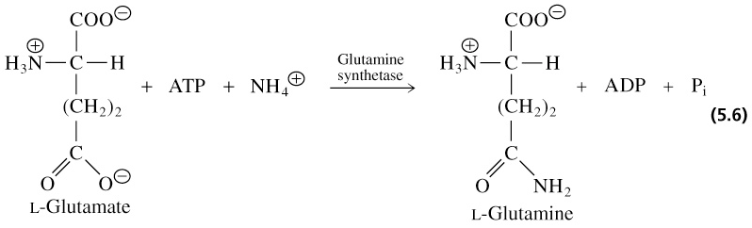
Ligases (synthetases)
Catalyze ligation, or joining of two substrates
Require chemical energy (e.g. ATP)
Notes:
132

Slide 133

Notes:
133

Slide 134

MECHANISM OF ENZYME ACTION

Slide 135


Slide 136


Slide 137



Slide 138



Slide 139


Slide 140




Slide 141




Slide 142


Slide 143


Slide 144



Slide 145


Slide 146


Slide 147
PLANT GROWTH REGULATORS
(PLANT HORMONES)
Internal and external signals that regulate plant growth are mediated, at least in part, by plant growth-regulating substances, or hormones (from the Greek word hormaein, meaning "to excite").
Plant hormones differ from animal hormones in that:
  No evidence that the fundamental actions of plant and animal hormones are the same.
  Unlike animal hormones, plant hormones are not made in tissues specialized for hormone production. (e.g., sex hormones made in the gonads, human growth hormone - pituitary gland)
  Unlike animal hormones, plant hormones do not have definite target areas (e.g., auxins can stimulate adventitious root development in a cut shoot, or shoot elongation or apical dominance, or differentiation of vascular tissue, etc.).

Slide 148
  plant growth regulators are necessary for, but do not control, many aspects of plant growth and development. - better name is growth
  regulator.
  the effect on plant physiology is dependent on the amount of present and tissue sensitivity to the plant growth regulator
  substances produced in small quantities by a plant, and then transported elsewhere for use
    have capacity to stimulate and/or inhibit physiological processes
  at least five major plant hormones or plant growth regulators:
    auxins, cytokinins, gibberellins, ethylene and abscisic acid

Slide 149
General plant hormones
  PLANT GROWTH REGULATORS ARE NECESSARY FOR, BUT DO NOT CONTROL, MANY ASPECTS OF PLANT GROWTH AND DEVELOPMENT. - BETTER NAME IS GROWTH
  REGULATOR.
  THE EFFECT ON PLANT PHYSIOLOGY IS DEPENDENT ON THE AMOUNT OF
  HORMONE PRESENT AND TISSUE SENSITIVITY TO THE PLANT GROWTH REGULATOR
  substances produced in small quantities by a plant, and then transported elsewhere for use
    have capacity to stimulate and/or inhibit physiological processes
  at least five major plant hormones or plant growth regulators:
    auxins, cytokinins, gibberellins, ethylene and abscisic acid

Slide 150

EARLY EXPERIMENTS ON PHOTROPISM SHOWED THAT A STIMULUS (LIGHT) RELEASED CHEMICALS THAT INFLUENCED GROWTH
Results on growth of coleoptiles of canary grass and oats suggested that the reception of light in the tip of the shoot stimulated a bending toward light source.

Slide 151

Auxin
Auxin increases the plasticity of plant cell walls and is involved in stem elongation.
Arpad Paál (1919) - Asymmetrical placement of cut tips on coleoptiles resulted in a bending of the coleoptile away from the side onto which the tips were placed (response mimicked the response seen in phototropism).
Frits Went (1926) determined auxin enhanced cell elongation.

Slide 152

Demonstration of transported chemical

Slide 153
Auxin
Discovered as substance associated with phototropic response.
Occurs in very low concentrations.
  Isolated from human urine, (40mg 33 gals⁻¹)
  In coleoptiles (1g 20,000 tons⁻¹)
Differential response depending on dose.

Slide 154

Auxins

Slide 155
Auxin
Auxin promotes activity of the vascular cambium and vascular tissues.
  plays key role in fruit development
Cell Elongation: Acid growth hypothesis
  auxin works by causing responsive cells to actively transport hydrogen ions from the cytoplasm into the cell wall space

Slide 156

Signal-transduction pathways in plants
Auxin interacts with calcium ions which in turn calmodulin, a protein, which regulates many processes in plants, animals, and microbes.

Slide 157

Loosening of cell wall

Slide 158

Polar transport of Auxin

Slide 159
Auxin
Synthetic auxins
  widely used in agriculture and horticulture
    prevent leaf abscission
    prevent fruit drop
    promote flowering and fruiting
    control weeds
Agent Orange - 1:1 ratio of 2,4-D and 2,4,5-T used to defoliate trees in Vietnam War.
    Dioxin usually contaminates 2,4,5-T, which is linked to miscarriages, birth defects,leukemia, and other types of cancer.

Slide 160
Additional responses to auxin
abscission - loss of leaves
flower initiation
sex determination
fruit development
apical dominance

Slide 161


Control of abscission by auxin

Slide 162

Apical Dominance
Lateral branch growth are inhibited near the shoot apex, but less so farther from the tip.
Apical dominance is disrupted in some plants by removing the shoot tip, causing the plant to become bushy.

Slide 163


Slide 164


Slide 165


Slide 166


Slide 167


Gibberellin

Slide 168


Discovered in association with In 1930's, bakanae or foolish seedling disease of rice (Gibberella fujikuroi)
In 1930's, Ewiti Kurosawa and colleagues were studying plants suffering from bakanae, or "foolish seedling" disease in rice.
Disease caused by fungus called, Gibberella fujikuroi, which was stimulating cell elongation and division.
Compound secreted by fungus could cause bakanae disease in uninfected plants. Kurosawa named this compound gibberellin.
  Gibberella fujikuroi also causes stalk rot in corn, sorghum and other plants.
  Secondary metabolites produced by the fungus include mycotoxins, like fumonisin, which when ingested by horses can cause equine leukoencephalomalacia - necrotic brain or crazy horse or hole in the head disease.
  Fumonisin is considered to be a carcinogen.

Slide 169
Gibberellins
Gibberellins are named after the fungus Gibberella fujikuroi which causes rice plants to grow abnormally tall.
  synthesized in apical portions of stems and roots
  important effects on stem elongation
  in some cases, hastens seed germination

Slide 170
Effects of Gibberellins
Cell elongation.
  GA induces cellular division and cellular elongation; auxin induces cellular elongation alone.
  GA-stimulated elongation does not involve the cell wall acidification characteristic of auxin-induced elongation
  Breaking of dormancy in buds and seeds.
  Seed Germination - Especially in cereal grasses, like barley. Not necessarily as critical in dicot seeds.
Promotion of flowering.
Transport is non-polar, bidirectional producing general responses.

Slide 171

Gibberellins and Fruit Size
Fruit Formation - "Thompson Seedless" grapes grown in California are treated with GA to increase size and decrease packing.

Slide 172


Wild Radish – Rosette & Bolt
A FLOWERING ANNUAL
YEAR ONE
YEAR ONE

Slide 173


Common Mullen – Rosette & Bolt
A FLOWERING BIENNIAL
YEAR ONE
YEAR TWO

Slide 174
Commercial uses - GA inhibitors
Cycocel, Bonsai, Sumagic
height control in flowering pot plants (lilies, orchids)
height control in bedding plants
Apply as GA₃, or GA₄₊₇
increase flower size on certain ornamentals (eg, “gibbing” camellias)
increase berry separation and size in bunch grapes
overcome shallow dormancies in vegetative buds
stimulate seed germination

Slide 175

Mobilization of reserves

Slide 176

Cytokinins

Slide 177
Discovery of cytokinins
Gottlieb Haberlandt in 1913 reported an unknown compound that stimulated cellular division.
In the 1940s, Johannes van Overbeek, noted that plant embryos grew faster when they were supplied with coconut milk (liquid endosperm), which is rich in nucleic acids.
In the 1950s, Folke Skoog and Carlos Miller studying the influence of auxin on the growth of tobacco in tissue culture. When auxin was added to artificial medium, the cells enlarged but did not divide. Miller took herring-sperm DNA. Miller knew of Overbeek's work, and decided to add this to the culture medium, the tobacco cells started dividing. He repeated this experiment with fresh herring-sperm DNA, but the results were not repeated. Only old DNA seemed to work. Miller later discovered that adding the purine base of DNA (adenine) would cause the cells to divide.
Adenine or adenine-like compounds induce cell division in plant tissue culture. Miller, Skoog and their coworkers isolated the growth facto responsible for cellular division from a DNA preparation calling it kinetin which belongs to a class of compounds called cytokinins.
In 1964, the first naturally occurring cytokinin was isolated from corn called zeatin. Zeatin and zeatin riboside are found in coconut milk. All cytokinins (artificial or natural) are chemically similar to adenine.
Cytokinins move nonpolarly in xylem, phloem, and parenchyma cells.
Cytokinins are found in angiosperms, gymnosperms, mosses, and ferns. In angiosperms, cytokinins are produced in the roots, seeds, fruits, and young leaves

Slide 178
Function of cytokinins
Promotes cell division.
Morphogenesis.
Lateral bud development.
Delay of senescence.

Slide 179
Cytokinins
Cytokinins, in combination with auxin, stimulate cell division and differentiation.
  most cytokinin produced in root apical meristems and transported throughout plant
    inhibit formation of lateral roots
      auxins promote their formation

Slide 180

Cytokinins

Slide 181

Interaction of cytokinin and auxin in tobacco callus (undifferentiated plant cells) tissue
Organogenesis: Cytokinins and auxin affect organogenesis
High cytokinin/auxin ratios favor the formation of shoots
Low cytokinin/auxin ratios favor the formation of roots.

Slide 182
Applications of Cytokinins:
1. Cell division:
2. Breaking of dormancy:
3. Counteraction of apical dominance:
4. Delay in senescence:

Slide 183

Abscisic acid
In 1940s, scientists started searching for hormones that would inhibit growth and development, what Hemberg called dormins.
In the early 1960s, Philip Wareing confirmed that application of a dormin to a bud would induce dormancy.
F.T. Addicott discovered that this substance stimulated abscission of cotton fruit. he named this substance abscisin. (Subsequent research showed that ethylene and not abscisin controls abscission).
Abscisin is made from carotenoids and moves nonpolarly through plant tissue.

Slide 184
Functions of abscisic acid
General growth inhibitor.
Causes stomatal closure.
Produced in response to stress.

Slide 185

Abscisic Acid
Abscisic acid is produced chiefly in mature green leaves and in fruits.
  suppresses bud growth and promotes leaf senescence
  also plays important role in controlling stomatal opening and closing

Slide 186
Applications of Abscisic Acid:
As Antitranspirant:
Application of small quantities of ABA to the leaves reduces the rate of transpiration in a plant by inducing closer of a stomata. This way a lot of water can be conserved by the crop.
2. Other Uses:
It is also used in inducing flowering in short day plants, rooting of stem cuttings in some plants, and for inducing dormancy in buds and seeds.
Abscission of leaves and flowers
Senescence
Cell division and cell elongation:
Growth promotion
Dormancy
ABA as a Stress Hormone
Fruit GrowthParthenocarpyFlowering

Slide 187
Discovery of ethylene
In the 1800s, it was recognized that street lights that burned gas, could cause neighboring plants to develop short, thick stems and cause the leaves to fall off. In 1901, Dimitry Neljubow identified that a byproduct of gas combustion was ethylene gas and that this gas could affect plant growth.
In R. Gane showed that this same gas was naturally produced by plants and that it caused faster ripening of many fruits.
Synthesis of ethylene is inhibited by carbon dioxide and requires oxygen.

Slide 188
Ethylene
H H
\ /
C = C
/ \
H H

Slide 189
Functions of ethylene
Gaseous in form and rapidly diffusing.
Gas produced by one plant will affect nearby plants.
Fruit ripening.
Epinasty – downward curvature of leaves.
Encourages senescence and abscission.
Initiation of stem elongation and bud development.
Flowering - Ethylene inhibits flowering in most species, but promotes it in a few plants such as pineapple, bromeliads, and mango.
Sex Expression - Cucumber buds treated with ethylene become carpellate (female) flowers, whereas those treated with gibberellins become staminate (male) flowers.

Slide 190
Commercial uses - ethylene application
Applied as ethylene gas or Ethephon or Ethrel sprays
flower initiation (bromelliads, pineapples)
stimulation of ripening (bananas, tomatoes)
degreening of citrus
abscission induction prior to mechanical harvest (cherries)
increased color development in once-over harvested processor type tomatoes

Slide 191
water absorption and ascent of sap
Absorption of Water
The internal structure of the plant body is considered to carry out the mechanism of gaseous exchange. As a result plants absorb water through transpiration to meet the water deficiency.
Plants absorb water from the soil by their roots. The movement of water takes place by:
· Active transport: Requires metabolic energy.
· Passive transport: Does not require metabolic energy.
Ø Sources of Water
The principle source of soil water is the rain. Following are the different types of water which can or cannot use by the plants.
· Run-away water
The water of this drains away along the slopes after a heavy rainfall or irrigation and not available to the plants.
· Gravitational water
The water of this percolates downwards through the large pores between the soils particles under the influence of gravity and reaches the water table or ground water and is not available to the plants.

Slide 192

Hygroscopic water
The water of this forms a thin layer or film on the soil particles due to the surface forces (adsorption) and is an available to the plants.
Capillary water
The water of this forms a film around the soil particles and is available to the plants. The soil colloids are of great significance as water fills into spaces between the non-colloidal particles.

Slide 193
Mechanism of Water Absorption
Water is highly essential for plants for various metabolic activities. They get their water from soil. The way in which the water from the soil enters the roots known as mechanism of water absorption takes place by two routes as follows:
Active Absorption
The absorption of water by roots with the utilization of metabolic energy which is generated by the root respiration known as active absorption.
The force of water absorption originates due to the root respiration hence the root cells actively participate.
Based on this absorption, two theories have bveen proposed as follows:
· Active Osmotic Water absorption(By Atkins & Priestley)
According to this theory water moves up from the soil to roots along an increasing gradient of Diffusion Pressure Defict (DPD),
It the solute concentration is high water potential will be low in root cells hence water can enter from soil to roots through endosmosis.
· Active Non-Osmostic Water absorption(By Thimann & Kramer
According to this theory water absorbed against concentration gradient.
There is no direct evidence for this but some scientists suggested that the involvement of energy from respiration. In conclusion the evidences supports active absorption of water is they poor.

Slide 194

Passive absorption
`The absorption of water by roots without the utilization of metabolic energy known as passive absorption. In this only root act as an organ of absorption hence it also called as water absorption through roots.
It occurs rapidly in transpiring plants during day time because of opening of stomata and atmosphere condition .The force for absorption is created at the leaf end i.e., transpiration pull which helps to suck the water from xylem.
Structure
of root
involved in
absorption
of water

Slide 195
Ascent of Sap
The upward movement of water against gravitational force from the root to the shoot known as Ascent of Sap.
Ø Pathway
The water absorbed by the root hairs moves upwards via root tissues (cortex, passage cells of endodermis, pericycle) and finally reaches to the xylem.
After entrance, it starts its upward movement until it reaches the mesophyll cells and finally evaporates through stomata. Only a small amount of water is utilized by plants for metabolism rest is lost in transpiration.
Ø Mechanism
Various theories have been proposed to explain the mechanisms of this are as follows:
· Vital theories
According to this theory, living cells are required for ascent of sap. These have been proposed by the chief advocators namely Godlewski (Relay Pump theory), Bose (Pulsation theory) and Molish.
These theories were discarded because it was discovered that some poisons can also be translocated. Thus fundamental basic of these theories failed.
Poisons: Picric acid, Carbolic acid.
·

Slide 196
Root Pressure theory
In 1956, Stocking defined root pressure as "the pressure developing in tracheary elements of xylem as a result of metabolic activities of roots”.
The xylem of root is completely filled with water hence a +ve hydrostatic pressure develops within the roots due to accumulation of absorbed water known as root pressure.
Ø Experiment
· Aim: To know the pressure developing in the root.
· Apparatus: potted plant, glass tube, rubber tube. Manometer
· Procedure
ü Take a potted plant and cut the stem.
ü Then take a glass tube filled with water and attach this to the root with the help of rubber tube.

Slide 197

· Observation: After sometime water level raises in the tube(for easy observation add a drop of colour to the water)
· Result: The pressure created by the leaf from the root
· Note : Root pressure can push water upwards by not more than a few meters can be observed in many plants but it is not adequate to push water to greater heights(125m)
· Objections
ü It has not been observed in conifers,
ü It is generally low during summer in temperature regions when the rate of transpiration is high.
ü Ascent of sap continuos even in the absence of root pressure.
· Note: Root pressure is a force for ascenrt of sap in herbs and shrybs but not in trees.

Slide 198
Physical theories
The theories which consider the dead cells of xylem top be responsible for ascent of sap known as physical theories.
Some of the theories are Biochem’s Capillary theory, Jamin’s Chain theory, Sach’s imbibitions theory and cohesion tension theory which is widely accepted.
Ø Cohesion tension/Transpiration pull theory(Dixon & Jolly I n1894)
This theory is based on the following features like
· Cohesion and adhesion of water molecules.
· Continuity of water column.
According to the theory, evaporation of water from the cells of the leaf is responsible for raising water from the root. As a result water potential reduces in the cells next to the xylem.
Therefore water enters these cells from the xylem sap which has higher water potential directed towards the cell walls of xylem vessels.
The xylem vessels are full of water and this water leaves hence an upward tension is created in the water column. Due to these upward tension i.e., transpiration pull water ascends up with a n unbroken water column.

Slide 199

The cohesive forces of attraction between the water molecules and adhesive forces between the water molecules and walls of xylem vessels. Due to the transpiration pull an upward movement of water from roots to the leaves is created in accordance with water potential gradient.
ü Cohesion: Water molecules have a strong mutual attraction which tends to stick together.
ü Adhesion: Water molecules tend to stick to the wall of the xylem elements.

Slide 200

Experiment
Aim: To know the water moving from root to stem.
Apparatus: Beaker, glass tube, wet sponge.
Procedure
Take a beaker with full of water.
Then take a glass tube with water and immerse into the beaker.
Finally take a wet sponge and fit it to the tube.
Observation
Water evaporates from sponge.
Sponge obsorbs water from the glasss tube.
Glass tube takes water fro mthe beaker.
Result: Water pulled up from the beaker by the sponge.
Note: Sponge: Leaf, Glass tube: Stem, Beaker: Root & Soil.

Slide 201
Objections
Formation of gas bubbles in the xylem hence there will be obstruction to the water column continuity known as embolism.
Tracheids are more efficient because their septa grant stability to the ascending column of water .The gradual elimination of tracheids by vessels in the course of evolution does not support this continuation.
Evidences
Osmotic potential of 10 – 20 bars develops in the cells of leaves hence the tension can raise water up to a height of 330 – 600feet.
Cohesive force between the water molecules is 30 – 200 atm. pressure, this force is sufficient to prevent the breakage of water column.

Slide 202


Slide 203


Slide 204


Slide 205


Slide 206


Slide 207


Slide 208


Slide 209


Slide 210


Slide 211


Slide 212


Slide 213


Slide 214


Slide 215


Slide 216


Slide 217


Slide 218


Slide 219


Slide 220


Slide 221


Slide 222


Slide 223


Slide 224


Slide 225


Slide 226


Slide 227


Slide 228


Slide 229


Slide 230


Slide 231


Slide 232


Slide 233


Slide 234


Slide 235


Slide 236


Slide 237


Slide 238


Slide 239


Slide 240


Slide 241


Slide 242


Slide 243


Slide 244


Slide 245


Slide 246


Slide 247


Slide 248


Slide 249


Slide 250


Slide 251


Slide 252


Slide 253


Slide 254

Plants acquire their nutrients from soil and air
THE UPTAKE AND TRANSPORT OF PLANT NUTRIENTS
As a plant grows, its roots absorb water, minerals (inorganic ions), and some oxygen from the soil
  Its leaves take carbon dioxide from the air
Figure 32.1A

Slide 255
Ion-Exchange:
The ions adsorbed on the surface of the walls or membranes of root cells may be exchanged with the ions of same sign from external solution. For example, the cation K⁺ of the external soil solution may be exchanged with H⁺ ion adsorbed on the surface of the root cells. Simi­larly, an anion may be exchanged with OH– ion. There are two theories regarding the mecha­nism of ion exchange:
The further process of the absorption of mineral salts may be of two types:
(1) Passive and
(2) Active
(1) Passive Absorption of Mineral Salts:
When the concentration of mineral salts is higher in the outer solution than in the cell sap of the root cells, the mineral salts are absorbed according to the concentration gradient by simple process of diffusion. This is called as passive absorption because it does not require expenditure of metabolic energy.
It is now known that during passive absorption, the mineral salts may diffuse through cell membranes directly through lipid bilayer but mainly through trans­-membrane ion-selective protein channels or trans-membrane carrier proteins. Carrier or chan­nel mediated passive transport of mineral salts across the membrane is also called as facili­tated diffusion

Slide 256
2) Active Absorption of Mineral Salts:
It has often been observed that the cell sap in plants accumulates large quantities of min­eral salts ions against the concentration gradient. For example in alga Nitella the cell sap accumulated K⁺ and phosphate ions to such an extent that their concentrations were thou­sands and hundreds times greater than in the pond water in which the plant was growing.
This cannot be explained by simple diffusion or Donnan’s Equilibrium and has led people to believe that absorption and accumulation of mineral salts against the concentration gradient is an active process which involves the expenditure of metabolic energy through respiration.
Following evidences favour this view:
(i) The factors like low temp., deficiency of O₂, metabolic inhibitors etc. which inhibit metabolic activities like respiration in plants also inhibit accumulation of ions.
(ii) Rate of respiration is increased when a plant is transferred from water to salt solution (Salt Respiration).
It has now been accepted that active absorption of mineral salts involves the operation of a carrier compound present in the plasma membrane of the cells.

Slide 257

The Carrier Concept:
According to this theory the plasma membrane is impermeable to free ions. But some compound present in it acts as carrier and combines with ions to form carrier-ion-complex which can move across the membrane. On the inner surface of the membrane this complex breaks releasing ions into the cell while the carrier goes back to the outer surface to pick up fresh ions

Slide 258
Following observations strongly support the carrier concept of active absorption of min­eral salts:
i) Isotopic Exchange:
Several times, it has been found that actively absorbed radioactive ions (such as ³⁵S0₄) cannot diffuse back or be exchanged with other ions in the outer solution indicating thereby that the plasma membrane is not permeable to free ions.
(ii) Saturation Effects:
Beyond a certain limit, increased concentration of salts in outer solution does not bring about an increase in the rate of mineral salt absorption. It is because the active sites on the carrier compound become saturated with ions.
(iii) Specificity:
Active sites on carrier compound may be specific which can bind only some specific ions. This also explains the selective and unequal absorption of ions by the plants. There are two common hypotheses based on the carrier concept to explain the mechanism of active salt absorption, although they are not universally accepted.

Slide 259
Translocation in the Plant

Slide 260


Slide 261


Slide 262


Slide 263
Protoplasmic Streaming Theory:
This theory was propounded by De Vries (1885) and supported by Curtis (1935). According to this
theory the movement of solute is caused by combined effect diffusion and cytoplasmic streaming
Diffusion occurs from sieve tube to sieve tube across the porous sieve plate. By cytoplasmic
streaming movement solutes are carried by up and down movement from one end of sieve to other end.
This process continues to transport solute for a very little distance This process can be
Objections: Thaine reported that cyclosis does not occur in mature sieve tube cells.

Slide 264
Land colonization
Prompted greater shoot growth to reach and compete for sunlight
Prompted development of a deeper root system
SEPARATES PHOTOSYNTHESIZING REGIONS FROM AREAS WHERE SUGARS ARE USED
REQUIRES A DRIVING FORCE FOR THIS LONG-DISTANCE TRANSPORT

Slide 265
Phloem transport
A highly specialized process for redistributing:
  Photosynthesis products
  Other organic compounds (metabolites, hormones)
  some mineral nutrients
Redistributed from
  SOURCE SINK

Slide 266
Phloem transport: Sources and sinks
Source:
  Any exporting region that produces photosynthate above and beyond that of its own needs
Sink:
  any non-photosynthetic organ or an organ that does not produce enough photosynthate to meets its own needs

Slide 267

How the growing parts of the plant are provided with sugar to synthesize new cells
A system of vascular tissue runs through all higher plants.
It evolved as a response to the increase in the size of plants, which caused an progressing separation of roots and leaves in space.
The phloem is the tissue that translocates assimilates from mature leaves to growing or storage organs and roots.
Photosynthesis
Translocation
New growth

Slide 268
Sources and sinks
Photosynthesis provides a
sugar source
Direction of transport through phloem is determined by relative locations of areas of supply, sources and areas where utilization of photosynthate takes place, sinks.
Source: any transporting organ capable of mobilizing organic compounds or producing photosynthate in excess of its own needs, e.g., mature leaf, storage organ during exporting phase of development.
Sink: non photosynthetic organs and organs that do not produce enough photoassimilate to meet their own requiements, e.g., roots, tubers, develpoping fruits, immature leaves.
Translocation
New growth is a
sugar sink

Slide 269
Multiple sources and sinks
The flow of water in plants is almost always from roots to leaves.
Translocation of sucrose can be in any direction – depending on source and sink location and strength.
Source
Developing apex
Sink
Source
Translocation
Examples:
Beta maritima (wild beet) root is a sink during the first growing season.
In the second season the root becomes a source, sugars are mobilized and used to produce a new shoot.
In contrast, in cultivated sugar beets roots are sinks during all phases of development.
Source
Sink
Sink
Sink
Sink
Sink

Slide 270
Source-sink pathways follow patterns
Although the overall pattern of transport can be stated as source to sink
Not all sources supply all sinks in a plant
Certain sources preferentially supply specific sinks
In the case of herbaceous plant, such as Sugar-beet, the following occurs:

Slide 271
Source-sink pathways follow patterns
Proximity: – of source to sink is a significant factor.
  Upper nature leaves usually provide photosynthesis products to growing shoot tip and young, immature leaves
  Lower leaves supply predominantly the root system
  Intermediate leaves export in both directions
Development: – Importance of various sinks may shift during plant development
  Roots and shoots major sinks during vegetative growth
  But fruits become dominant sinks during reproductive development

Slide 272
Source-sink pathways follow patterns
Vascular connections: –Source leaves preferentially supply sinks with direct vascular connections
  A given leaf is connected via vascular system to leaves above and below it on the stem
Modifications of translocation pathways: - Interference with a translocation pathway by mechanical wounding (or pruning)
  vascular interconnections can provide alternate pathways for phloem transport

