Slide 1
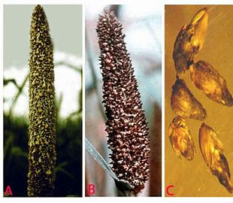
Topic :ergot of Bajra ms.A.R.Mukhedkar HOD botany

Slide 3
The ergot of Bajra (pearl millet) was first reported from south India. The first report of its occurrence in epidemic form was made in 1956 from south ‘Satara’ area of Maharashtra.
Severe epidemics of the disease are known to occur in Delhi, U.R, Rajasthan, Maharashtra, Karnataka, Tamil Nadu, A.R, and Haryana. Natarajan et al. (1974) estimated the average incidence to be about 62.4% with grain loss of about 58%.
The damage caused by the disease depends upon the weather at the time of ear formation.
Presence of toxic alkaloids in the ergot adds to the importance of the disease. The sclerotia contain ‘ergo-toxin’ which, when consumed in excessive quantities, proves to be toxic to life.
But, when taken in prescribed quantities it proves to be beneficial as it has some medicinal value too

Slide 4
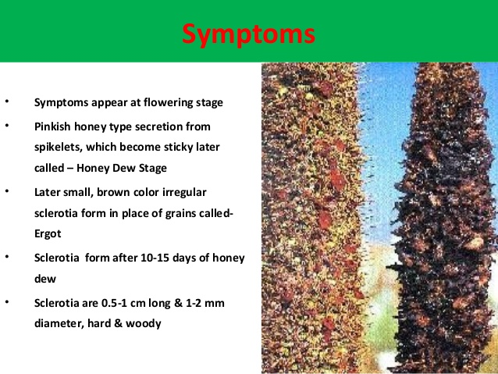

Slide 5
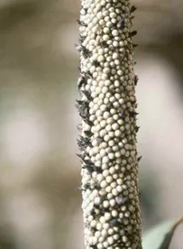
On panicles, droplets of creamy to pink, mucilaginous fluid are seen exuding from the infected florets.
The sticky fluid called 'honeydew' contains numerous conidia.
When excessive amounts of honeydew are produced, it drops on to the foliage and the ground.
The droplets on the panicle become darker and coalesce to form compact patches. Infected florets do not produce grains because the ovaries are replaced by compact, dark, hard fungal masses known as sclerotia.
These sclerotia are often larger than the grains and protrude out of the glumes.

Slide 6
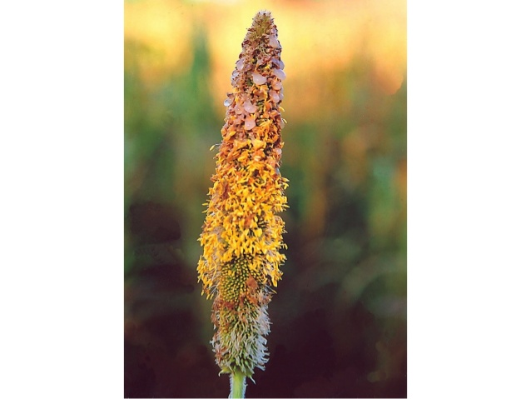
Causal Organism of Ergot Disease:
The fungus attacks the ovary and grows profusely producing masses of hyphae.
These hyphae produce, firstly, small conidiophores which, later on, give rise to conidia.
One can see honey dew-­like droplets oozing out of infected ovary of the affected ears which are full of conidia.
However, after sometimes, the masses of hyphae filling in the ovary harden in addition with the honey dew-­like substance and give rise to sclerotia.
The sclerotia become somewhat elongated and project out the surface of the ear.
These are the sclerotia which borne sex-organs therein at maturity.

Slide 7
The life cycle of C. fusiformis begins when the sclerotia germinate to produce stalked stromata bearing asci and ascospores in perithecia.
The ejected airborne ascospores infect the stigmas of flowering pearl millet [Pennisetum glaucum] panicles before pollination.
Honeydew oozes out of the infected florets 5-7 days after infection
. This honeydew contains numerous macroconidia and microconidia that serve as secondary inoculum for the disease The conidia are disseminated from one panicle to another by rain-splash, wind currents, contact and also by insects. Both types of conidia initiate infection when they land on the stigmas of flowering pearl millet.
Optimal conditions for conidial germination in the laboratory were found to be 25°C and 100% relative humidity. Germination of at least 60% was obtained between 20 and 30°C and with relative humidity greater than 80%
Dense, brown, fusiform sclerotia form in the infected florets within 15-20 days of the appearance of honeydew.
These sclerotia are the survival form of the fungus and may fall to the ground or be included with harvested seed. In the following season,
the sclerotia germinate by forming 1-16 fleshy stipes, each with a globular capitulum containing pyriform perithecia) reported that the conidia to conidia cycle of plant to plant transmission took 4-6 days, with mature sclerotia observed 20-25 days after inoculation.

Slide 8
The uninucleate ascospores germinated to produce conidia.
The nucleus of most ascospores migrated into the conidium.
In some ascospores, the nucleus divides into two, resulting in two primary conidia.
The conidial nuclei could then migrate into secondary conidia without undergoing any division. Likewise, the asexual conidia in honeydew, germinated to provide secondary, tertiary and quaternary conidia. The nucleus migrated into successive conidia without division.
, last-formed conidia were infective to pearl millet whether they were of ascosporic or conidial origin. Thus, apparently, the infectiousness of ascospores and conidia falling on unsuitable substrates may be sustained over time (secondary) sporulation also occurs in the macroconidia from honeydew of this and other species of Claviceps.
Conidial infection occurs through the stigma, style or ovary wall
Hyphae are located below the ovary wall 3 days after inoculation and subsequently the fungus shows preferential growth towards the ovary wall. The whole ovary is replaced by hyphae by 10 days after infection. Fungal spread is always intercellular.
Honeydew production begins 5 days after inoculation and persists for 1 week.

Slide 9
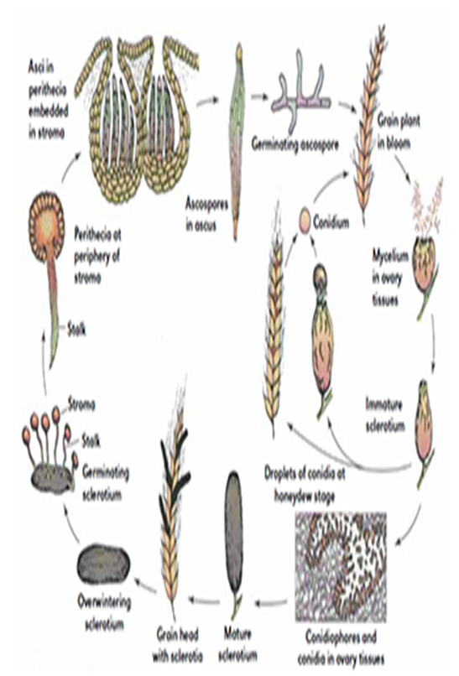
C. fusiformis
The fungus produces two types of conidia: macroconidia and microconidia
, both in culture and in honeydew on infected pearl millet panicles. Macroconidia hyaline, fusiform, unicellular, 12.0-26.5 x 2.5-6.0 µm, producing 1-3 germ tubes from their ends or sides. Microconidia hyaline, globular, unicellular, 2.5-11.0 x 1.0-5.0 µm, producing only one germ tube.
Both macroconidia and microconidia are able to produce additional microconidia in chains from conidiophores formed by the germ tubes
Sclerotia elongate to globose, 3.6-6.1 x 1.3-1.6 mm, pale to dark brown, with or without conidia-containing cavities Germination by 1-16 fleshy purplish stipes, 6-26 mm long, each bearing apical globular capitulum, light to dark brown with numerous perithecial ostioles.
Asci interspersed with paraphyses, emerge through ostioles. Ascospores hyaline, filiform, non-septate, 103-176 x 0.5 µm

Slide 10
Ergot Disease Cycle:
(i) Perennation:
These are the sclerotial bodies which help pathogen perennate from season to season.
They remain in the soil or with plant debris, overcome the unfavourable circumstances, and germinate in favourable conditions during the next season producing ascospores to cause primary infection.
The fungus infects various collateral hosts like other species of Pennisetum, Cenchrus ciliaris, and C. setigerus producing ergot. The role of these collateral hosts in the perennation of the pathogen may also be significant.
(ii) Primary Infection:
Primary infection on healthy crop plants is brought into being after the sclerotia germinate in about a month’s time. The sclerotia germinate producing stripes, which bear perithecial heads that contain many perithecia embedded in them. Perithecia represent the fruiting bodies of the fungus and produce many asci inside. No paraphyses have been reported.
Asci, however, contain filiform, hyaline, septate, thin walled, ascospores (eight in number in each ascus) which get disseminated when the wall of the asci are burst-open.
The disseminated ascospores, then fall on spike and under suitable conditions, germinate, enter inside the ovary, and cause primary infection. After the primary infection is established, the hyphae fill in the ovaries, mature, and lead to conidial stage. The hyphae give out small conidiophores, which produce conidia on them.

Slide 11
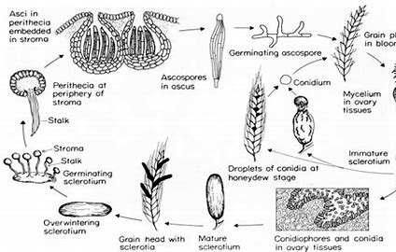

Slide 12
(iii) Secondary Infection:
These are the conidia produced during primary infection which represent the secondary inoculum (source of secondary infection) for the current season. The conidia are contained within the honey dew-like exudate. The latter are taken away by insects which, when they sit on other plants, spread the conidia on them. The conidia germinate there and cause secondary infection. In this way the secondary infection is insect-borne.
After sometimes, the hyphal masses filling in the ovaries as a result of primary as well as secondary infections harden giving rise to sclerotia. The latter are the structures which perennate and work as the source of primary infection during next growing season.
Predisposing Factors:
High humidity in and around the field at the time of infection is considered the most suitable condition for the severity of the disease. It is because the disease spreads very rapidly through secondary inoculum (conidia) during such environmental condition.

Slide 13
Management of Ergot Disease:
(i) Long crop rotation programme essentially helps avoid the disease incidence as this makes the pathogen inocula present in soil wait the proper host for a long length of time. In the mean-time many of the soil-borne inocula (mainly the sclerotia) become unviable.
(ii) The most commonly used method to control this disease is using clean seeds. For this, the seeds are soaked in 20-30% salt solution. The sclerotia come on to the surface of the salt solution and float. Floating sclerotia can be collected by hand and destroyed.
(iii) Repeated ploughing may reduce the viability of deep buried sclerotia in soil.
(iv) Resistant varieties should preferably be grown.
(v) Growth of a fungus, namely, Fusarium roseum on Claviceps fusiformis (= microcephala) as a mycoparasite has been commonly seen in the ‘teria’ area of Uttar Pradesh. The former can be used as highly potential biological control agent against the latter and the incidence of the disease can be effectively reduced employing this method.

Slide 15
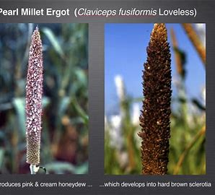
THANK YOU….

