Slide 1
food Chain and Food Web and ecological pyramids

Slide 2
food chain - definition with the help of solar energy, producers produce food. food is energy. this energy gets transferred through producers to primary, secondary and tertiary consumers to decomposers and finally returns to the environment. this completes the energy cycle. this sequential transfer of energy in the form of food is called the food chain.

Slide 3
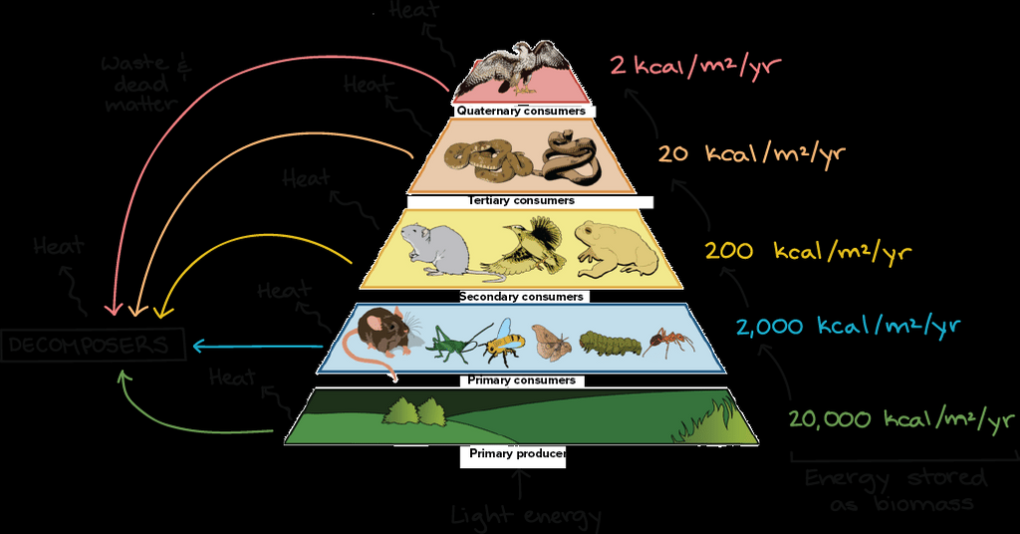
he food chain is the sequence of organisms in which each organism eats the lower member and itself is eaten by a higher member.
The food chain starts with the producer or plants that convert solar energy into the usable form of energy (food) by the process of photosynthesis which is then eaten by consumers.
A food chain is a sequence of populations or organisms of an ecosystem through which the food and its contained energy passes with each member becoming the food of a later member of the sequence.

Slide 4
Food chain is a linear sequence of organisms which starts from producer organisms and ends with decomposer species.
Food web is a connection of multiple food chains.
Food chain follows a single path whereas food web follows multiple paths.
From the food chain, we get to know how organisms are connected with each other. Food chain and food web form an integral part of this ecosystem.

Slide 5
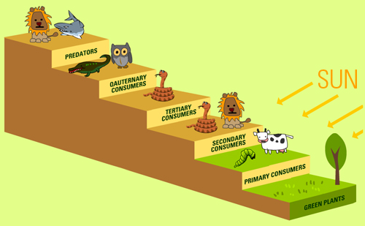
food Chain
In scientific terms, a food chain is a chronological pathway or an order that shows the flow of energy from one organism to the other. In a community which has producers, consumers, and decomposers, the energy flows in a specific pathway. Energy is not created or destroyed. But it flows from one level to the other, through different organisms.
A food chain shows a single pathway from the producers to the consumers and how the energy flows in this pathway. In the animal kingdom, food travels around different levels. To understand a food chain better, let us take a look at the terrestrial ecosystem.

Slide 6
Food chain in a Terrestrial Ecosystem
The sun is the source of energy, which is the initial energy source. This is used by the producers or plants to create their own food, through photosynthesis and grow. Next in this chain is another organism, which is the consumer that eats this food, taking up that energy.
The primary consumers are the organisms that consume the primary producers. In a terrestrial ecosystem, it could be a herbivore like a cow or a goat or it could even be a man. When a goat is consumed by man, he becomes the secondary consumer.

Slide 7
As the energy goes one level up, the food chain also moves up. Each level in the food chain is called a trophic level. The different trophic levels are Primary producers, primary consumers, secondary consumers, tertiary consumers and quaternary consumers.
Example of food chain
Grass (Producer) —–Goat (Primary Consumer) —– Man (Secondary consumer)
When dead organic matter becomes the starting of a food chain, then it is called the detritus food chain (DFC). The decomposers, which are the fungi and bacteria, feed on the organic matter to meet the energy requirements. The digestive enzymes secreted by the decomposers help in the breakdown of the organic matter into inorganic materials

Slide 8
food web is a pattern of several interconnecting food chains. In this process, numbers of the food chain are involved where an organism can derive energy from numbers of other organisms.
Food Web
Many interconnected food chains make up a food web
. When you look at the larger picture, a food web shows a realistic representation of the energy flow through different organisms in an ecosystem.
Sometimes, a single organism gets eaten by many predators or it eats many other organisms. This is when a food chain doesn’t represent the energy flow in a proper manner because there are many trophic levels that interconnect. This is where a food web comes into place. It shows the interactions between different organisms in an ecosystem.
The following diagram shows the energy flow between various organisms through a food web.

Slide 9
food web is a natural network of food chains. it interconnects at various trophic levels to form a number of feeding connections amongst different organisms of a community

Slide 10
What is Ecological Pyramid?
An ecological pyramid is a graphical representation of the relationship between the different living organisms at different trophic levels. It was given by G.Evylen Hutchinson and Raymond Lindeman.
It can be observed that these pyramids are in the shape of actual pyramids with the base being the broadest, which is covered by the lowest trophic level, i.e., producers. The next level is occupied by the next trophic level, i.e., the primary consumers and so on.
All the calculations for construction of these types of ecological pyramids must take into account all the organisms in a particular trophic level because a sample space of a few numbers or a few species will end up giving a huge level of errors.
The three types of ecological pyramids include:
Pyramid of Number
Pyramid of Biomass
Pyramid of Energy

Slide 11
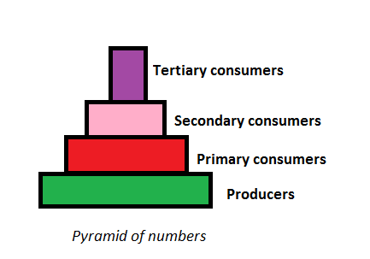
Types of Ecological Pyramid
Three types of ecological pyramid exist.
They are as follows:
Pyramid of Numbers
n this type of ecological pyramid, the number of organisms in each trophic level is considered as a level in the pyramid. The pyramid of numbers is usually upright except for some situations like that of the detritus food chain, where many organisms feed on one dead plant or anima

Slide 12
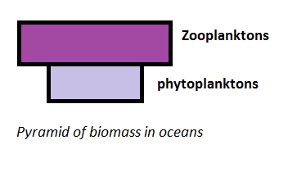
Pyramid of Biomass
pyramid of biomass in oceans
In this particular type of ecological pyramid, each level takes into account the amount of biomass produced by each trophic level. The pyramid of biomass is also upright except for that observed in oceans where large numbers of zooplanktons depend on a relatively smaller number of phytoplanktons.

Slide 13
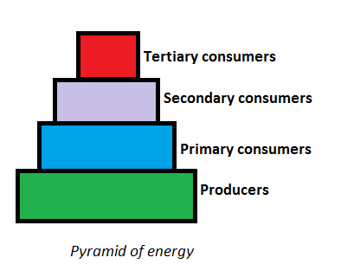
Pyramid of Energy
Pyramid of energy is the only type of ecological pyramid, which is always upright as the energy flow in a food chain is always unidirectional. Also, with every increasing trophic level, some energy is lost into the environmen

Slide 14
Importance of Ecological Pyramid
The importance of ecological pyramid can be explained in the following points:
They show the feeding of different organisms in different ecosystems.
It shows the efficiency of energy transfer.
The condition of the ecosystem can be monitored, and any further damage can be prevented.
Limitations of the Ecological Pyramid
More than one species may occupy multiple trophic levels as in case of the food web. Thus, this system does not take into account food webs.
The saprophytes are not considered in any of the pyramids even though they form an important part of the various ecosystem.
These pyramids are applicable only to simple food chains, which usually do not occur naturally.
These pyramids do not deliver any concept in relation to variations in season and climate.
They do not consider the possibility of the existence of the same species at different levels.

